Slide 1

Spacecraft Imaging
Case A: Working with
Mars Express VMC Images
If you watch this please send an email to blog@planetary.org !
Notes:
Introduce myself

Slide 2
Today’s goals
What is the VMC?
  And what’s a Bayer filter?
Where to get the images
Processing tips and tricks
I’m assuming basic familiarity with tips and tricks discussed in previous classes: http://planetary.org/explore/topics/imaging/tutorials.html

Slide 3
VMC
VMC is an engineering camera included on several ESA spacecraft
  Mars Express, Cluster-II, XMM-Newton, INTEGRAL, Herschel-Planck
Purpose is to monitor deployment events, other critical spacecraft activities
Required to be low-powered, self-contained, low-mass
  VMC weighs 430 g, about 6x6x10 cm box
Successfully used to watch Beagle 2 depart
  proved lander separation was successful, lander was on expected trajectory, Dec. 19, 2003

Slide 4
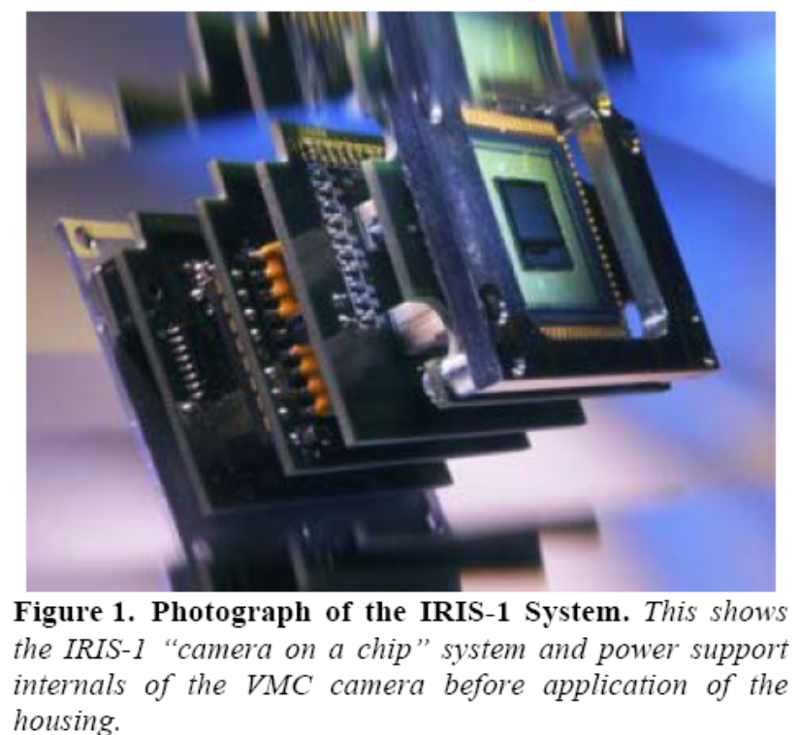
VMC
Unlike most space cameras, VMC has a CMOS detector (not CCD) – a “camera-on-a-chip.”
Chip is 640 by 480 pixels, 8-bit depth
Images are in color, using a Bayer filter.

Slide 5
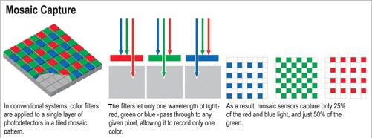
What’s a Bayer filter?
Each pixel on the chip is painted with red, green, or blue filter material (twice as many are green as are red or blue)
To get 3-channel color, interpolation is performed to fill out all the pixels
Note: This is most likely how your own digital camera obtains color

Slide 6
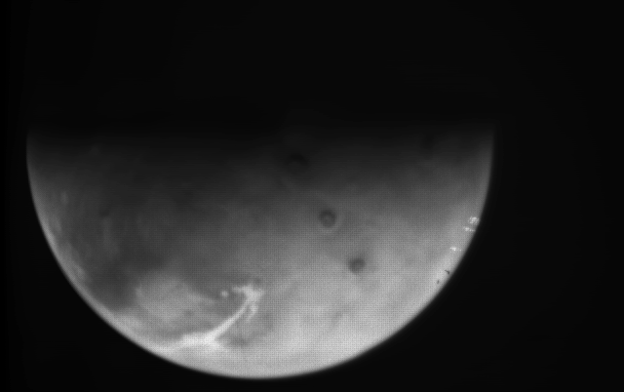
Example VMC image
Crud on (or in) camera

Slide 7
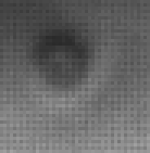
Bayer filter effect in VMC images
Blue pixels are probably darkest ones

Slide 8
Thanks to Gordan Ugarkovic for “vmc2rgb” software
Executable converts raw VMC images to PNG format, doing “demosaicking” of Bayer filter checkerboard to convert grayscale images to color
Recently, Gordan introduced flatfielding, which removes several other annoying artifacts
Find it here: http://www.unmannedspaceflight.com/index.php?s=&showtopic=5415&view=findpost&p=150912
VMC website uses vmc2rgb to convert their images, but they haven’t (yet) gone back and re-converted images with new flatfield capability

Slide 9
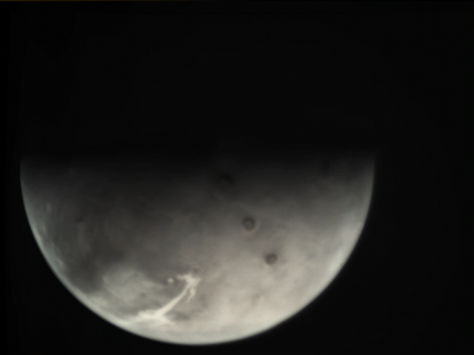
A Basic VMC Image after demosaicking

Slide 10
A Basic VMC Image after demosaicking
This is actually a color image, but it looks grayscale.
This is because the saturation is very low.
  Every pixel has pretty similar (but not identical) red, green, and blue values.
  This is caused by “leaking” of light between red, green, and blue pixels on the detector.
So to get Mars color out of it, we need to apply tricks to amplify the subtle differences among the channels.

Slide 11
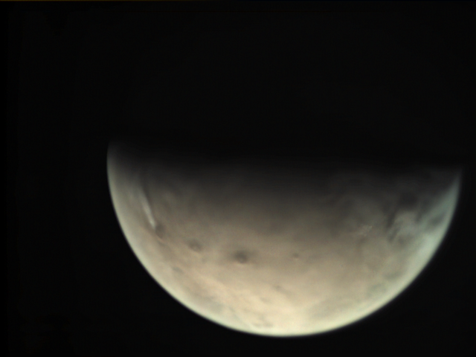

Trick 1: Increase saturation
GIMP: Colors > Hue-Saturation…
Photoshop: Image > Adjustments… > Hue/Saturation…
Photoshop (right) is better at this than GIMP (left)

Slide 12
Trick 2: Make output levels match a Mars color that you like
Go pick a Mars image you like off of the Internet
Sample color in nice bright area
Sample color in similar area in VMC image
Use basic algebra to figure out how you need to adjust levels to make that area in VMC image have same values as it does in nice Mars image

Slide 13
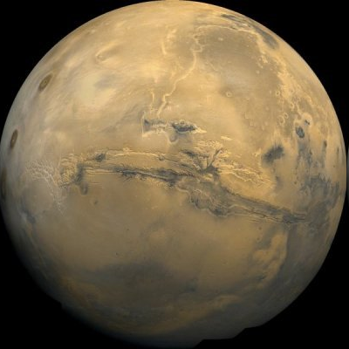
Trick 2: Make output levels match a Mars color that you like
R, G, B = 224, 198, 149
R, G, B = 209, 206, 192

Slide 14
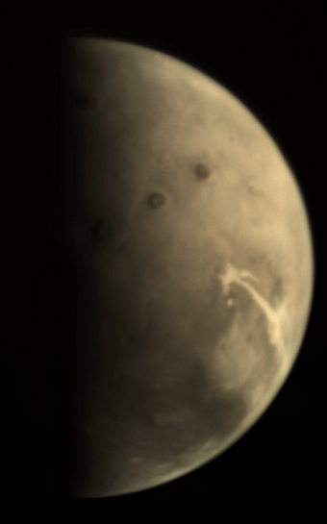
Matching color levels
224, 198, 149 -> 209, 206, 192
255/224 = x/209 -> set red input level to 238
255/206 = x/198 -> set green output level to 245
255/192 = x/149 -> set blue output level to 197
While you’re at it, fix black level
Can also try adjusting saturation after levels

Slide 15
A Better Way
The real problem with color in these images is “leaking” of light between channels
Adjusting saturation and levels doesn’t really address this problem
What we really need to do is to subtract light of red wavelengths from blue channel, et cetera
(This goes back to images being matrices of numbers – we’re just subtracting numbers in overlapping matrices)
We can do this by channel mixing

Slide 16
Channel Mixing
GIMP: Colors > Components > Channel Mixer…
Photoshop: Image > Adjustments > Channel Mixer…
In GIMP I found the following produced good results, but my research wasn’t exhaustive.
  Red = red – 20% green – 50% blue
  Green = green – 20% red – 20% blue
  Blue = blue – 20% green – 50% red
  Preserve luminosity

Slide 17
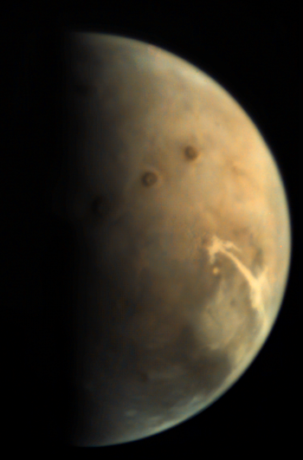
Channel mixing results

Slide 18
Tour of the VMC website
Go to http://webservices.esa.int/blog/blog/6
Some great new stuff added recently that I haven’t even gotten to yet!

Slide 19
And finally…
Please join or donate! Or give a gift membership!
Go to https://planetary.org/special/blog/support.html and they’ll know I sent you
To all of you who are already members and/or contributors, THANK YOU!
Please send me an email if you watched this far, whether you found it valuable or not blog@planetary.org
Next class: More in-depth introduction to the different kinds of cameras that have been sent to space. Framing vs pushbroom; what controls resolution; vidicons vs CCDs; sources of noise; etc…

