Slide 1
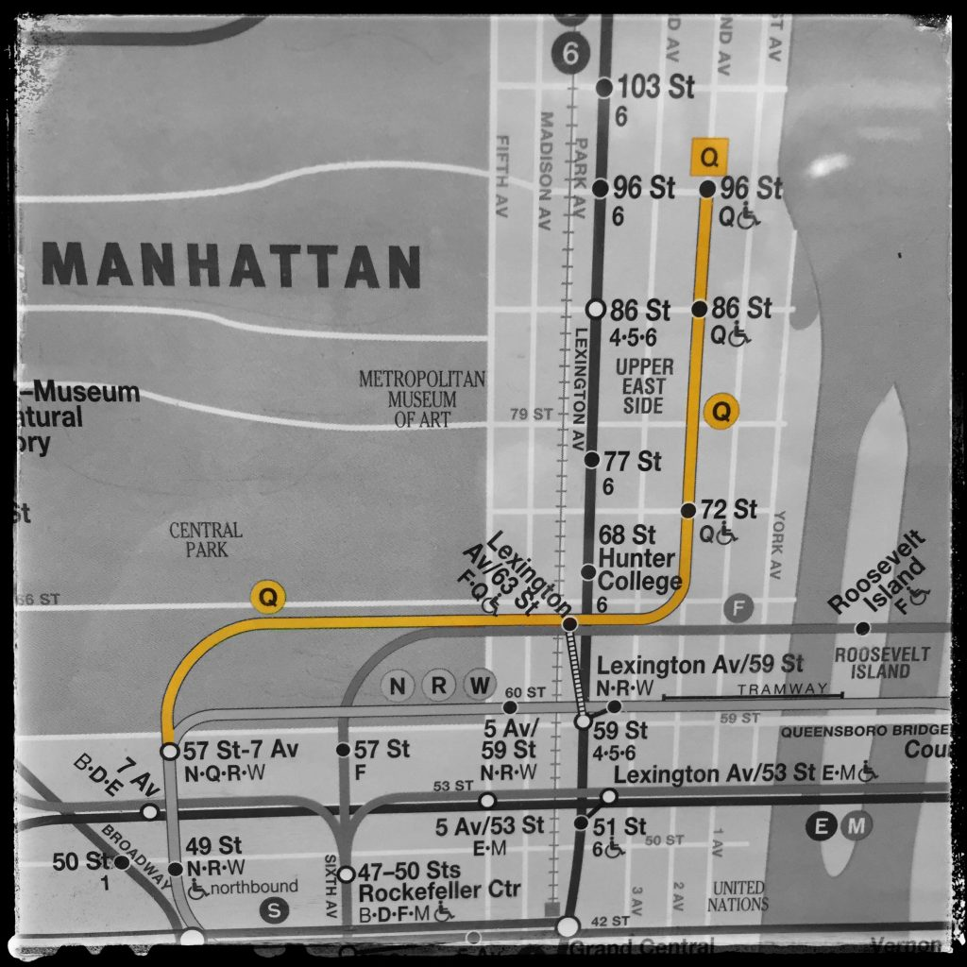
Second Avenue Extension
Alex, Jae, Lisa, and Veronica
(Photo via Benjamin Kabak/Instagram)
Notes:
Veronica

Slide 2
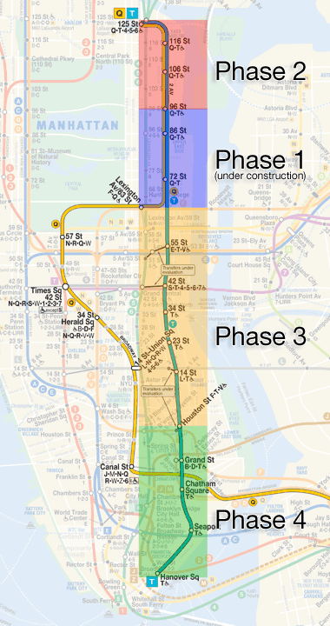
What is the 2nd Ave Extension?
Originally proposed in 1919
Various starts and stops over the last 100 years
Phase 1 finally completed and opened on January 1st, 2017
Notes:
Veronica
extends service in the Upper East Side
Originally proposed 100 years ago
After many starts and stops, Phase 1 was finally completed on January 1st 2017

Slide 3
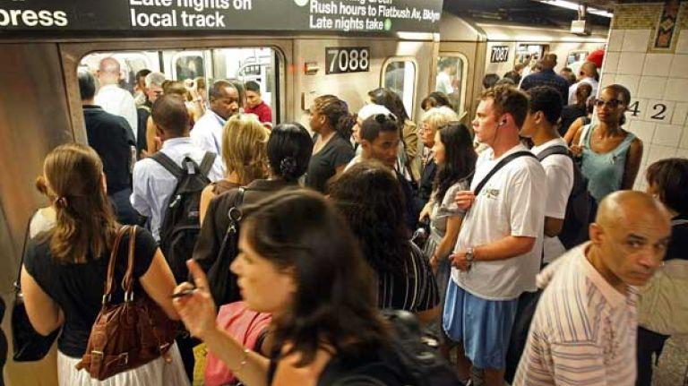
Pre-extension State of Affairs
Only 4/5/6 lines in the UES
The 4 and 5 rated at or near the bottom across various metrics, especially overcrowdedness
Overcrowding leads to train delays, contributing to rider unhappiness
source: Straphangers Campaign, New York Times
Notes:
Veronica
So, what was it like before?
4/5/6 trains are the only options, and they are heavily congested
Congestion, and the delays it causes, lead to rider unhappiness

Slide 4
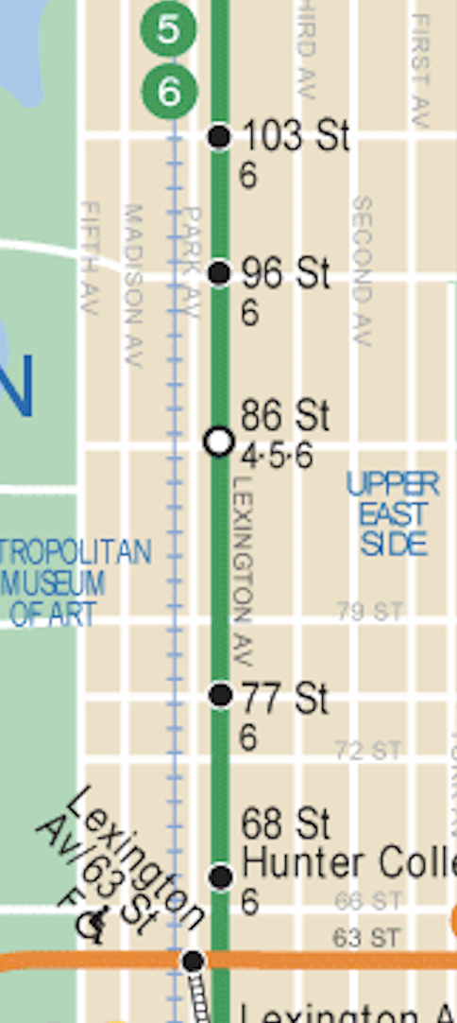
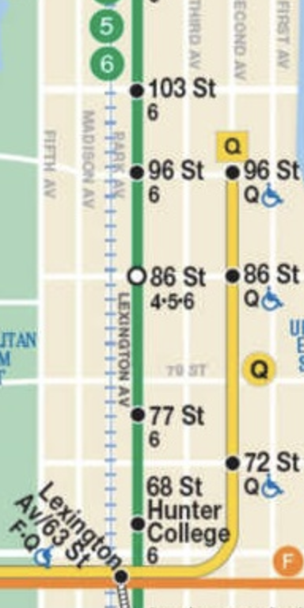
$4.5 billion later...
Whoa, new Q stations!
96th
86th
72nd
Notes:
Veronica
So, the MTA spends 4.5 Billion dollars
And now there are 3 new Q train stations in the Upper East Side

Slide 5
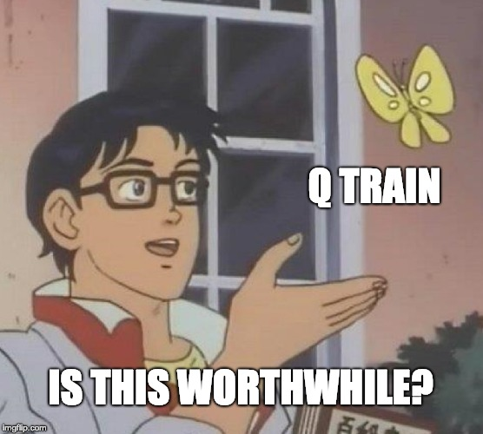
After all that money can we see a difference?
Our Question:
Did the 2nd Ave Subway Extension impact station entries on the 4/5/6 lines?
Insert Joke or meme
Notes:
Veronica
So. After all that, was it worth it?

Slide 6
Hypothesis
If the project was successful: we should see a drop-off in usage from the 4/5/6 stations in the areas near the new Q stations.
We also want to see if there was an overall increase in 86th & 96th street station usage (4/5/6 and Q stations total) compared with other (control) stations during the same time.
Notes:
Veronica

Slide 7
Methodology
Pull in the turnstile entry data from Oct 2016 to Mar 2017
Focus on 86th St and 96th St stations for direct comparisons
Include 103rd and 110th St stations on the 6 as a control group
Clean entry data to turnstiles, and aggregate up to stations and lines
Visualize aggregated weekly entry data to observe trends
Notes:
Alex
12 weeks before and 12 weeks after

Slide 8
Results

Slide 9
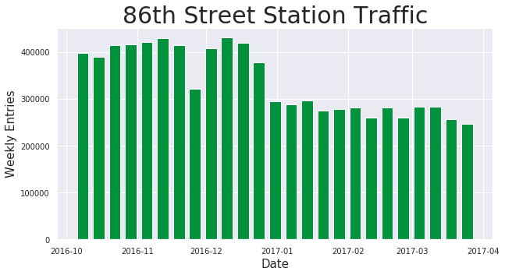
86th St Extension Results - Just 4/5/6 Line
Q Station Opening
Notes:
Alex

Slide 10
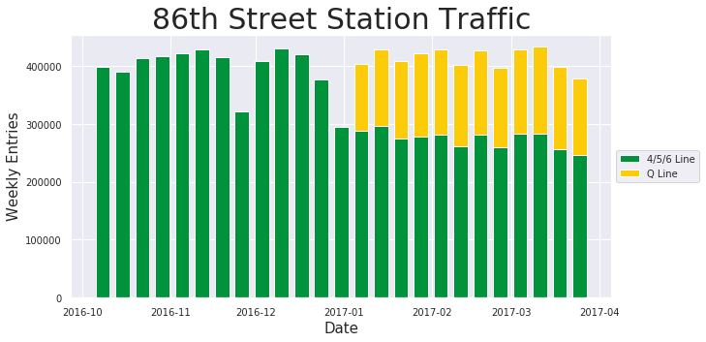
86th St Extension Results - 4/5/6 and Q
Notes:
Alex

Slide 11
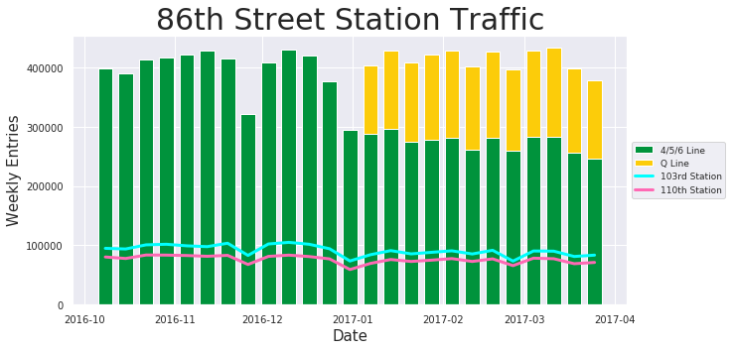
86th St Extension Results - 4/5/6 and Q
Notes:
Alex

Slide 12
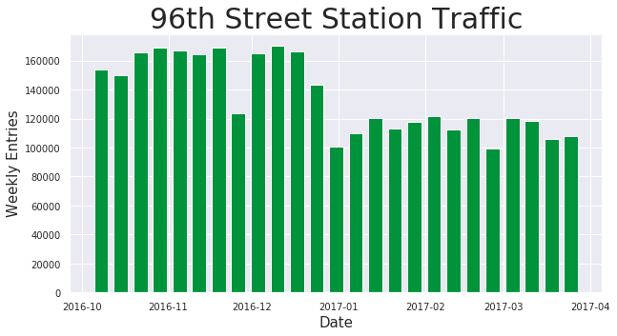
96th St Extension Results - Just 6 Line
Q Station Opening
Notes:
Lisa
The 96th St 6 train shows a very similar trend in the drop off as the 86th st 4/5/6 line right after the launch of the Q train extension.

Slide 13
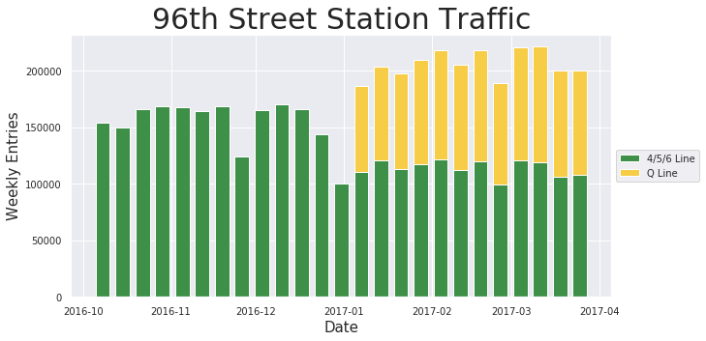
96th St Extension Results - 6 and Q
Notes:
Lisa
As you can see, the additional entries from the Q train more than make up for the drop off in the 6 train entries.

Slide 14

96th St Extension Results - 6 and Q
Notes:
Lisa

Slide 15
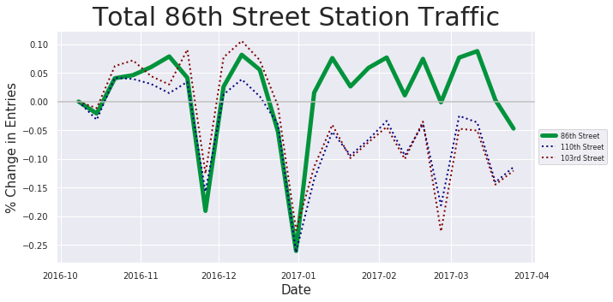
86th St Stations - Changes in Ridership
Notes:
Lisa

Slide 16
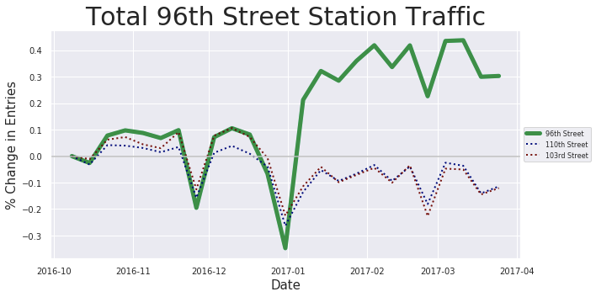
96th St Stations - Changes in Ridership
Notes:
Lisa

Slide 17
Conclusions
Station/Lines | 2016* | 2017* | Change
86th St: 4/5/6 | 394,848 | 336,881 | -30.59%
86th St: 4/5/6 + Q | 394,848 | 412,906 | 4.57%
96th St: 6 | 154,409 | 135,021 | -26.16%
96th St: 6 + Q | 154,409 | 205,726 | 33.23%
103rd St: 6 | 96,384 | 86,377 | -4.98%
110th St: 6 | 78,765 | 73,649 | -3.12%
* Average entries for last 12 weeks of 2016 | first 12 weeks of 2017
Notes:
Jae
1. There was a clear, observable drop off in 4/5/6 train usage in the 96th and 86th St stations.
2. While it does not appear that overall entries to have changed for 86th street, 96th street saw an overall increase in entries.
3. Compared to 103rd and 110st stations, both 86th and 96th street station total ridership either decreased by less or increased in ridership.
4. 103rd st station entries decreased more than 110th st station entries. It's possible that the 96th St Q extension also impacted entries to the 103rd St 6 train station.
Avg numbers are from last 3 months of 2016 and first 3 months of 2017

Slide 18
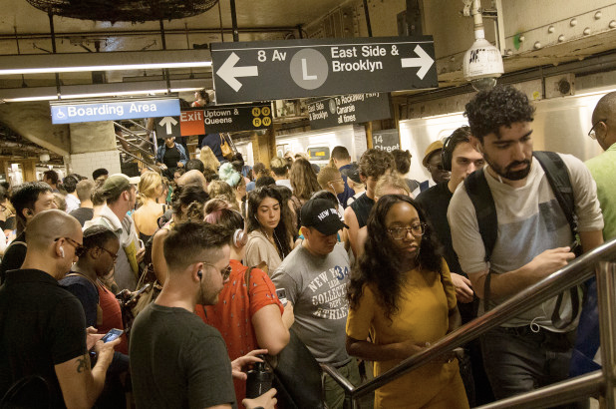
We’d like to build on this with...
Digging deeper into the numbers to extract more info
Peak ridership
Exit numbers
Longer timespan
Modeling ROI for the MTA
Layering in other impact-related data
Change in real estate prices
Population growth
Change in usage of alternates
How might other areas be affected by new lines?
Notes:
Jae
Q phase 2 and L train (for #4)

Slide 19
Questions?

