Slide 1


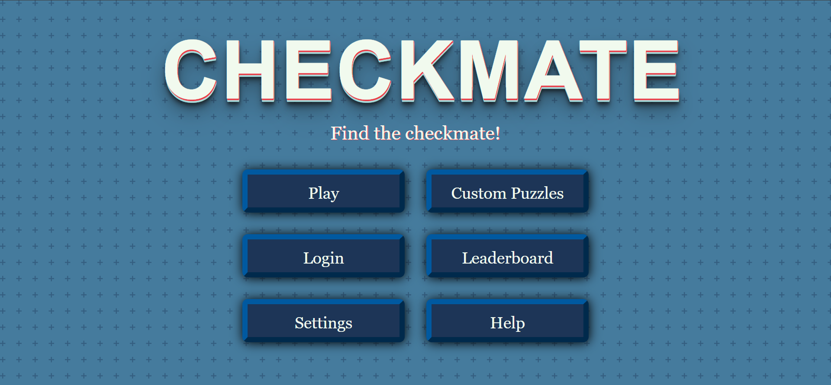
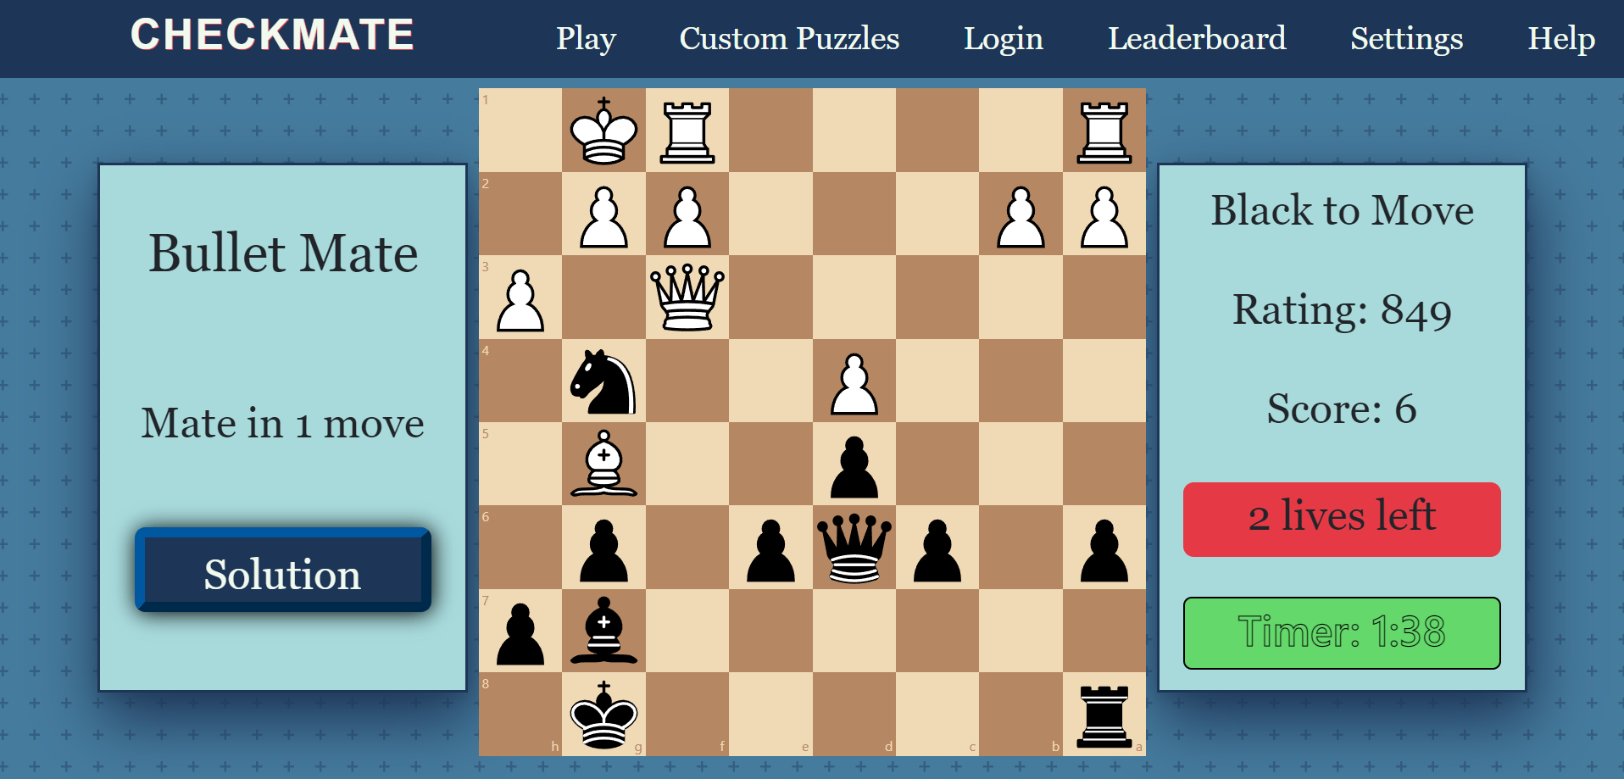
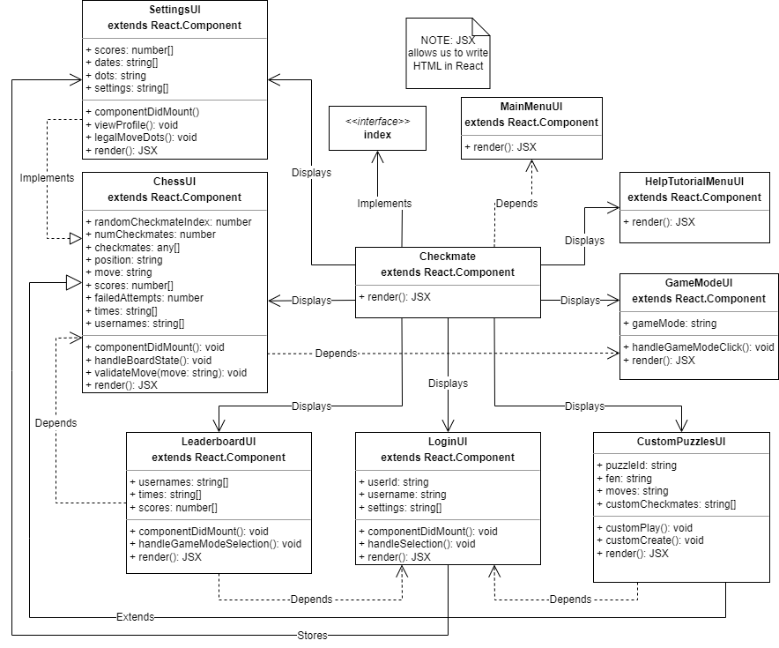
Checkmate
Esai Jimenez, Autumn Hale, Trentin Barnhart
Dept. Of Computer Science and Information Technology
Abstract
Features
This project is a website that allows a user to attempt chess puzzles in ascending difficulty. Users are presented with a virtual 8x8 chessboard in which they are prompted to solve a particular chess puzzle. The puzzles are initially easy and become progressively more difficult as each puzzle is solved. For each puzzle, the user must find the best move or series of moves on the board in order to progress to the next puzzle. When the user solves a puzzle, they earn one point. After three incorrect attempts, the user’s progress resets.
The user is presented with the color they’re playing as, how many moves until checkmate, and the current difficulty rating of the puzzle. The opposing side will move first, then it will be the user’s turn to move. As the user solves each puzzle, they will be presented with more puzzles that gradually increase in difficulty. This will mean new players don’t get immediately stumped.
In addition to the standard option of a traditional chess puzzle game mode there are also other key features to set this site apart.
A bullet chess game mode where users can race against the clock to solve puzzles as quickly as possible.
A leaderboard where users can show off their scores and compete for the top.
A custom puzzle mode where users will be able to create their own puzzles.
Future Work
Figure 1: Users will be presented with a Main Menu upon entering the website.
Soon, the website will allow users to create and log in to their account. This account will allow them to submit a high score to one of the two leaderboards (if eligible), as well as create and rate custom puzzles. These leaderboards will save the users scores and the time they took, if applicable. The leaderboards will be displayed on their own page and will be visible to all users.
The custom puzzles will give users the ability to create their own unique board state so that they can set up their own challenges and allow other players to attempt to solve them. This setup will be community curated with a simple rating system that allows users to rate each puzzle on a scale of one to five, with five being the best and one being the worst. There will only be one rating per puzzle per account.
Design
Checkmate is designed to be as user friendly as possible. A new user entering the site for the first time will be presented with the Main Menu and a few different options. These include the Play, Custom Puzzles, Login, Leaderboard, Settings, and Help buttons.
Of particular note are the play button, where users can play timed and untimed game modes, and the custom puzzle options, where users can create, submit, and play custom made puzzles.
Checkmate is a React based web application. For third party technology we are mostly going to be relying upon Firebase services. Specifically, we're going to be utilizing the Firebase Authentication Services to allow users to login and securely manage their data, as well as using the Firebase Real-time Database to store our puzzles, leaderboards, and custom puzzle information.
We are also making use of the Lichess Open Database to supply the puzzles for our site. They provided a massive CSV file that contained over 3,000,000 chess puzzles. The information in the CSV was parsed and filtered using the Pandas Python Library and then converted into a JSON file. However, Python will not be present in the final project. We only used it as a tool for pulling this data for the real-time database.
Utilizing these tools will help us make managing the data straightforward, simple, and safe.
Figure 2: The Bullet Mate game mode will time users, making it a race against the clock to solve puzzles as quickly as possible.
References
Firebase Authentication Services https://firebase.google.com/docs/auth
Firebase Realtime Database https://firebase.google.com/docs/database
Chess.js https://github.com/jhlywa/chess.js
Lichess Open Database https://database.lichess.org/#puzzles
Pandas Python Library https://pandas.pydata.org/
React-Chessboard https://www.npmjs.com/package/react-chessboard
Acknowledgements
We would like to thank Dr. Karen Meisch for her support of students in the College of Science, Technology, Engineering & Mathematics, and Dr. Leong Lee for his support of students in the Department of Computer Science and Information Technology. We would also like to thank everyone involved in creating the Innovation Experience.
Figure 3: The component diagram lays out the website's technical structure.

