Slide 1

RETAIL BANKING TRANSACTION ANALYSIS
From Banking Data to Business Decisions
MySQL | SQL Analytics | Business Intelligence

Slide 2

ABOUT ME
About Me
Background
B.Tech in Computer Science & Engineering – Data Science
Why Data Science
Interested in using data to identify patterns, solve business problems, and turn analysis into actionable insights.
Work Experience
Fresher
LinkedIn
https://www.linkedin.com/in/saikumar-reddy-eraganeni-80101b297
GitHub
https://github.com/esaikumar248-hub
2

Slide 3
AGENDA
Table of Contents
1
Project Overview
6
Analysis of the Objectives
2
Business Scenario
7
Overall Key Findings
3
Business Objectives
8
Business Recommendations
4
Dataset & Database Overview
9
Conclusion
5
ER Diagram & Database Structure
3

Slide 4
01 · INTRODUCTION
Project Overview
This project analyses retail banking data to understand customer behaviour, account activity, transaction patterns, loan performance, and card engagement — translating SQL analysis into actionable business insights.
500
700
Customers
Accounts
5,000
$35.9M
1
Understand the business & data model
2
Build the MySQL database from the ER diagram
Transactions
Total Transaction Value
3
Explore & analyze data with SQL
4
Translate results into business insight
4

Slide 5
02 · CONTEXT
Business Scenario
Meridian Retail Bank manages a diverse customer base across multiple branches, accounts, cards, and loan products. The objective is to identify growth opportunities, operational gaps, and areas of financial risk using transaction-level data.
Branch Network
Growing Activity
Transaction volume increased from 1,279 in 2022 to 1,933 in 2024
40 branches serving 500 customers
Transaction Reliability
Portfolio Risk
Only 33.76% of transactions are completed
Significant loan exposure exists in arrears/default status
5

Slide 6
03 · SCOPE
Business Objectives
4.1
Customer Profile & Segmentation
Who are our customers, and how do their profiles differ?
4.2
Account Usage & Branch Activity
Which account types and branches drive the most value?
4.3
Transaction Patterns
How, when, and through which channels are transactions occurring?
4.4
Loan Performance & Repayment
Where is repayment risk concentrated?
4.5
Card Usage & Product Engagement
Are customers actively using the bank's products?
6

Slide 7
04 · DATA
Dataset & Database Overview
Table | Rows | Key Columns
customers | 500 | customer_id (PK), segment, kyc_status, credit_score
accounts | 700 | account_id (PK), customer_id/branch_id (FK), account_type, status
branches | 40 | branch_id (PK), region, employee_count
transactions | 5,000 | transaction_id (PK), account_id (FK), transaction_type, channel, status
loans | 300 | loan_id (PK), customer_id/branch_id (FK), loan_type, loan_status
loan_payments | 2,000 | payment_id (PK), loan_id (FK), status, days_late
cards | 600 | card_id (PK), account_id (FK), card_type, network, is_active
Data Validation
7 relational tables
Primary & foreign keys validated
Missing-value checks completed
Duplicate checks completed
Referential integrity verified
Data loaded successfully into MySQL
7

Slide 8
04 · DATA
ER Diagram & Database Structure
branches
PK branch_id
customers
1 : many
accounts
1 : many
transactions
PK customer_id
PK account_id
PK transaction_id
cards
PK card_id
The database connects customers with their accounts, transactions, cards, branches, loans, and loan payments through primary and foreign-key relationships.
Customer → Account → Transaction
Customer → Loan → Payment
8

Slide 9
05 · DEEP DIVE
FROM DATA TO DECISIONS
Customer
Who are our customers?
Accounts & Branches
Where is value concentrated?
Transactions
How is money moving?
Loans
Where is repayment risk?
Cards
Are products being utilized?
9

Slide 10
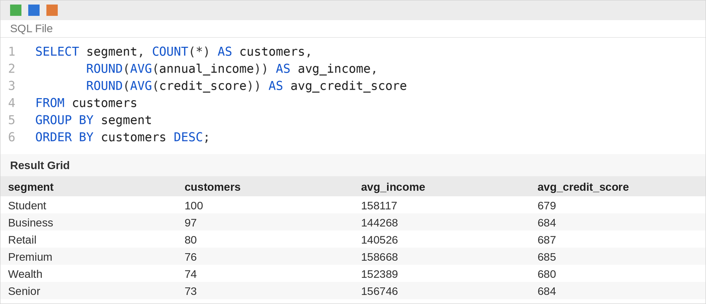
4.1 · CUSTOMER SEGMENTATION
Understand Customer Profile & Segmentation
Who are the bank's customers, and how do segments differ?
Key Findings
Balanced Customer Mix
No single segment dominates the customer base.
Similar Financial Profiles
Average income and credit scores remain relatively close across segments.
KYC Gap
Only 28.6% of customers are fully verified, while 21% have failed KYC.
Customer segments alone do not strongly differentiate financial profile; KYC status presents a more visible data-quality and compliance concern.
10

Slide 11
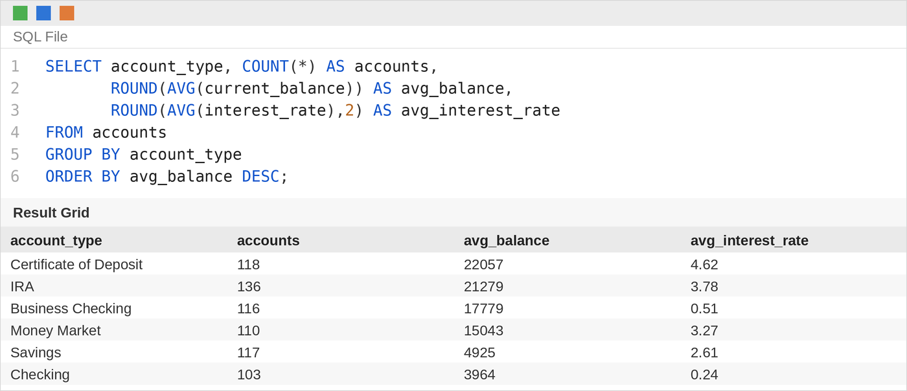
4.2 · ACCOUNT & BRANCH ACTIVITY
Understand Account Usage & Branch Activity
How are accounts used, and how does activity vary by branch?
ACCOUNT VOLUME DOES NOT EQUAL ACCOUNT VALUE
South
242 accounts
Highest account volume
West
$16,447 average balance
Highest average value
Account Behaviour
CDs & IRAs hold substantially higher average balances than Checking & Savings.
Branch performance should be evaluated using both account volume and balance value.
11

Slide 12
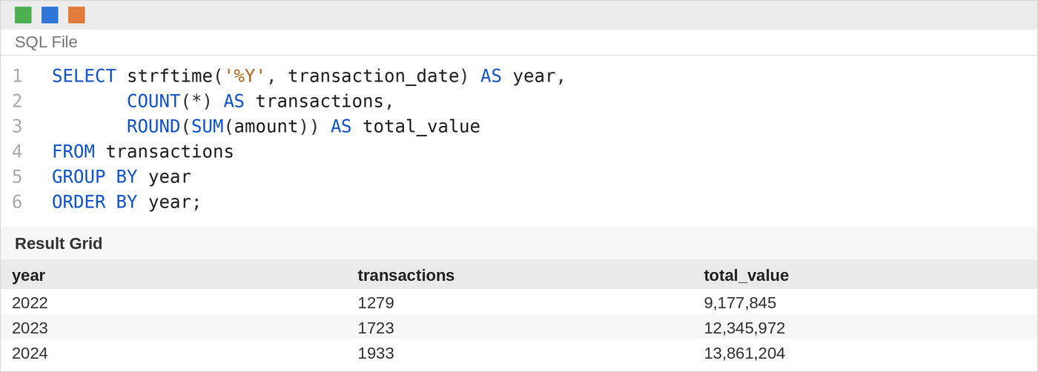
4.3 · TRANSACTION PATTERNS
Analyze Transaction Patterns
How is money moving through the bank, and how consistently?
TRANSACTION ACTIVITY IS GROWING — BUT RELIABILITY IS LOW
Transaction volume
2022 → 2024
+51%
Channel Leader
  Online — 1,470 transactions
Transaction Status
  Completed — 33.76%
  Pending — 33.68%
  Failed — 32.56%
Transaction growth is not translating into reliable execution, making failure and pending transactions the primary operational issue to investigate.
12

Slide 13
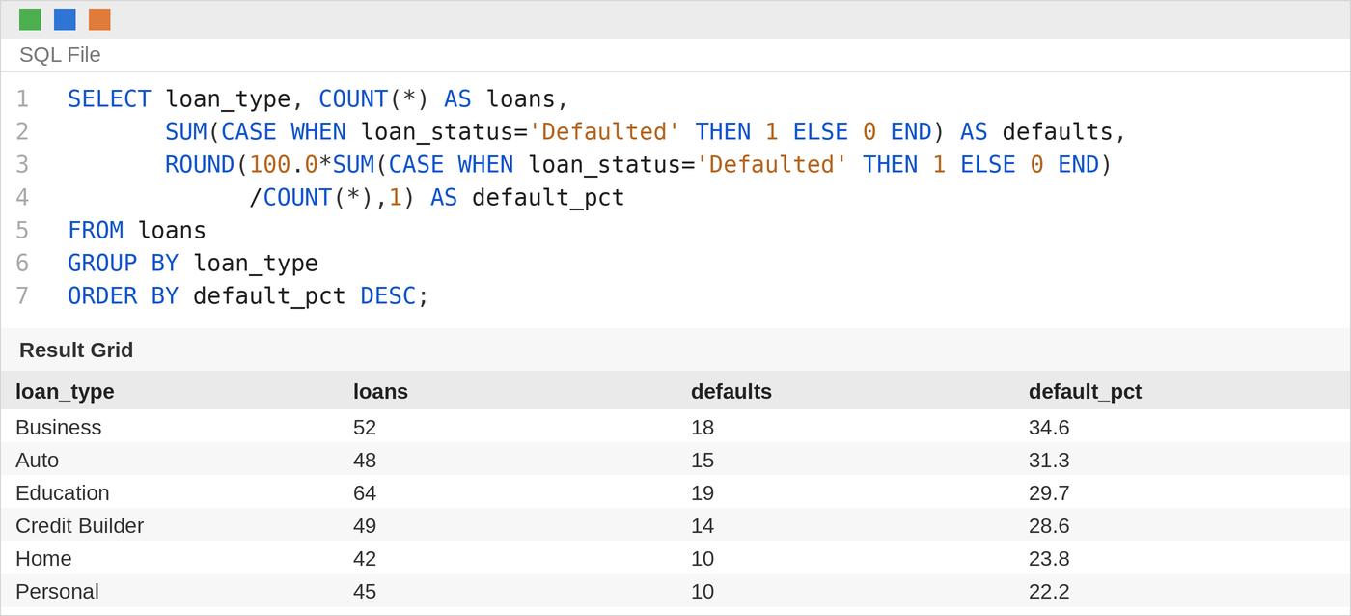
4.4 · LOAN PERFORMANCE
Evaluate Loan Performance & Repayment
Are loan customers repaying as expected?
LOAN RISK IS NOT FULLY EXPLAINED BY CREDIT SCORE
Portfolio Status
Defaulted — 86
In Arrears — 83
Together: 56%
Default Concentration
Business — 34.6%
Auto — 31.3%
Loan Size
< $50K → 40.7% default
$150K+ → 28.1% default
Credit score alone shows almost no relationship with default behaviour in this dataset (r ≈ 0.01).
13

Slide 14
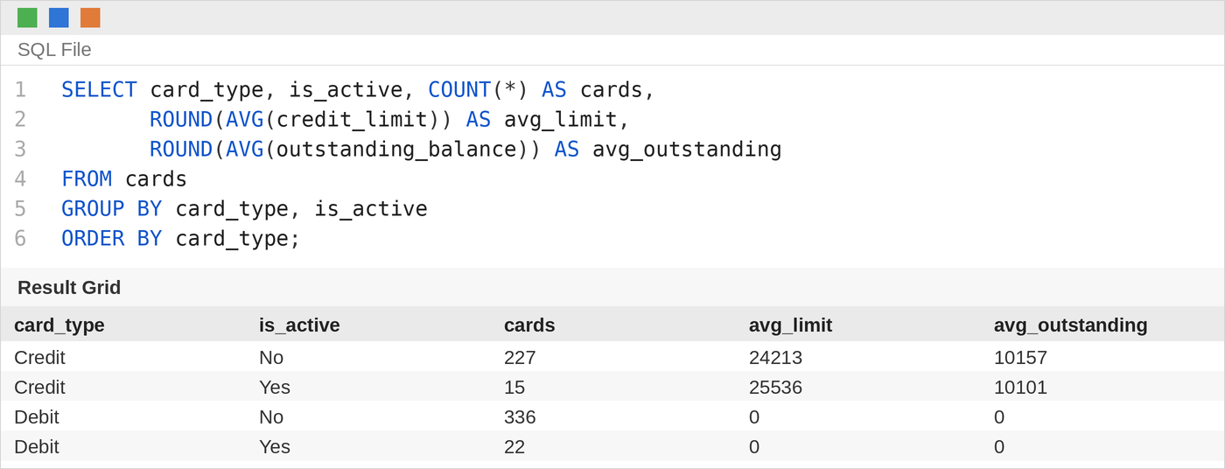
4.5 · CARD USAGE
Understand Card Usage & Product Engagement
How do customers use cards, and how does that connect to their broader relationship with the bank?
CARD OWNERSHIP IS HIGH — CARD ACTIVITY IS NOT
Cards issued - 600
Active cards - 37
Active rate - 6.2%
Inactive - 93.8%
CROSS-SELL OPPORTUNITY
124 customers
The bank has established product ownership, but significant value remains untapped through card activation and deeper customer engagement.
14

Slide 15
06 · SYNTHESIS
Overall Key Findings
Reliability Gap
66.24% of transactions are pending or failed.
Lending Risk
56% of loans are defaulted or in arrears.
Engagement Gap
93.8% of cards are inactive.
Cross-Sell Opportunity
124 customers already use all three product categories.
The biggest opportunity is improving engagement and reliability within the existing customer base.
15

Slide 16
07 . Action
BUSINESS RECOMMENDATIONS
ACTION → BUSINESS IMPACT
01 | Improve Transaction Reliability
Analyse pending/failed transactions by channel, type and time.
Impact: Reduce processing failures and customer friction.
02 | Strengthen Loan Risk Assessment
Combine repayment behaviour with existing credit indicators.
Impact: Improve early identification of repayment risk.
03 | Activate Dormant Cards
Target inactive cardholders with focused activation campaigns.
Impact: Increase card utilization and engagement.
04 | Focus Collections
Prioritize Business and Auto loan segments and investigate smaller-loan default patterns.
Impact: Reduce potential credit losses.
05 | Expand Cross-Sell
Identify customers similar to the existing 124 multi-product customers.
Impact: Increase product penetration.
17

Slide 17
08.CONCLUSION
CONCLUSION
KEY TAKEAWAY
Growing
Transaction activity increased 51%.
Unreliable
Only 33.76% of transactions completed successfully.
Risk Exposure
56% of loans are in default or arrears.
Underutilized
93.8% of cards are inactive.
Opportunity
124 customers already use all three product categories.
The opportunity is not simply to acquire more customers — it is to improve reliability, manage risk, and deepen engagement across the existing customer base.
17

Slide 18

THANK YOU

