Slide 1

TravelTriangle – Tourism Package Analysis.
Using Web Scraping, Python & Power BI

Slide 2
About me
Background
B.TECH in Computer Science & Data Science
Why Data Science
Interested in using data to identify patterns, solve business problems, and turn analysis into Meaningful insights.
Work Experience
Fresher
LinkedIn
https://www.linkedin.com/in/saikumar-reddy-eraganeni-80101b297
GitHub
https://github.com/esaikumar248-hub

Slide 3

Table of contents :
Project Overview
Business Scenario & Objectives.
Data Collection & Dataset
Data Cleaning
EDA
Power BI Dashboard
Key Findings & Recommendations
Conclusion

Slide 4
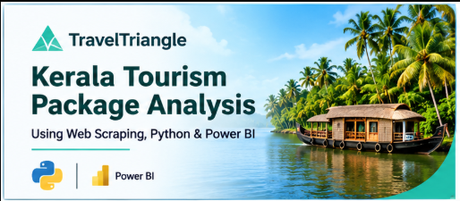
Project Overview :
This project focuses on collecting and analyzing Kerala tour package data from the TravelTriangle website using Python web scraping techniques.
The collected data includes package names, discounted prices, original prices, discount percentages, destinations, trip duration and package categories.
The dataset was cleaned, transformed and analyzed using Python libraries such as Pandas and NumPy.
Finally, an interactive Power BI dashboard was developed to analyze package pricing, discounts, destinations and trip duration.
Project Tools:
Python, BeautifulSoup, Requests, Pandas, NumPy and Power BI.

Slide 5
Business Scenario :
The travel and tourism industry offers various tour packages with different prices, destinations, durations, and discounts.
Key Business Scenario:
Travelers need to compare different tour packages before making travel decisions.
Package prices and discounts vary across available tour options.
Different packages cover different tourist destinations.
Trip duration plays an important role in package selection.
Analyzing these details helps understand the available Kerala tour package offerings.
Business Need:
To analyze TravelTriangle's Kerala tour package data and provide useful insights into package pricing, discounts, destinations, and trip duration.

Slide 6
Business Objectives :
The main objectives of this project are:
Package Analysis: Analyze the total number of Kerala tour packages available on TravelTriangle.
2. Price Analysis: Understand the discounted prices and original prices of different tour packages.
3. Discount Analysis: Analyze the discount percentages offered on tour packages.
4. Destination Analysis: Identify the destinations covered across different tour packages.
5. Duration Analysis: Understand the trip duration and number of locations covered in each package.
6. Price Comparison: Compare package prices based on trip duration and destinations.
7. Dashboard Development: Build an interactive Power BI dashboard to present the analysis and insights.
Business Goal: To understand Kerala tour package offerings through pricing, discounts, destinations, and trip duration.

Slide 7
Data Collection & Dataset Overview :
Data Collection:
Collected Kerala tour package details from the TravelTriangle website.
Used Python Requests to access webpages and BeautifulSoup to extract package information.
Scraped multiple pages using pagination.
Used Pandas to organize the extracted data into a structured dataset.
Dataset Overview:
The dataset contains 8 columns:
Name , discount_price
original_price ,Discount_percentage
Locations_List , Total_Days
No_of_Locations , Package_List
Tools Used: Python, Requests, BeautifulSoup and Pandas.

Slide 8
Data Cleaning & Preprocessing :
Loaded the scraped dataset using Pandas.
Checked for missing values and duplicate records.
Removed duplicate records to avoid repeated package information.
Handled missing and inconsistent values wherever required
Converted price, discount and trip duration columns into appropriate data types.
Structured destination and package details for further analysis.
Saved the cleaned dataset as clean_dataset.csv for Power BI.
Tools Used: Python, Pandas, NumPy.
Output: Cleaned and structured dataset ready for EDA and visualization.

Slide 9
Exploratory Data Analysis (EDA) :
Univariate Analysis :
Mean, Median and Mode
Minimum and Maximum
Distribution Analysis;
Bivariate Analysis:
Relationship between two variables
Correlation Analysis
Price and Trip Duration Analysis
Multivariate Analysis:
Relationship between multiple numerical variables
Correlation between package features
Combined analysis of Price, Discount and Duration
Visualizations:
Histogram , Bar Chart
Scatter Plot , Box Plot
Correlation Heatmap , Pair Plot
Tools: Pandas, NumPy, Matplotlib, Seaborn.

Slide 10
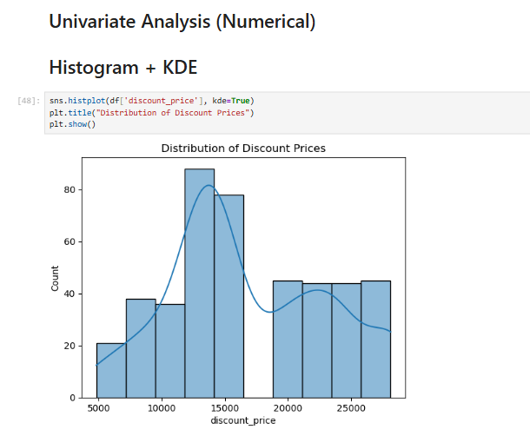
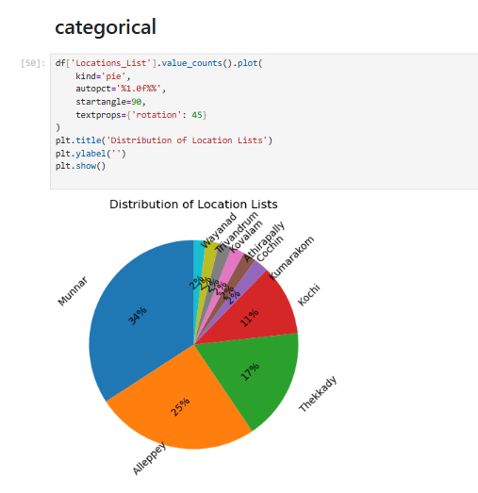
Univariate Analysis :

Slide 11
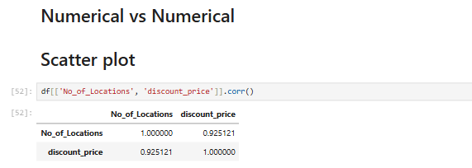
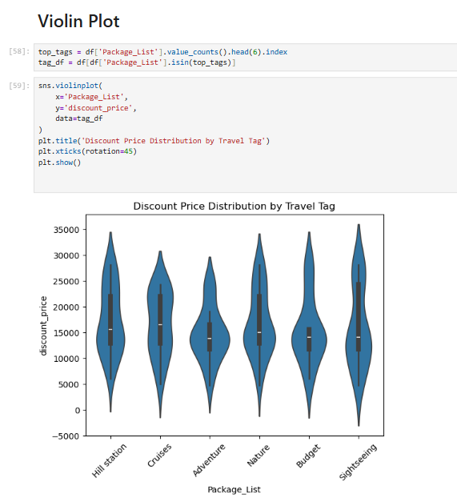
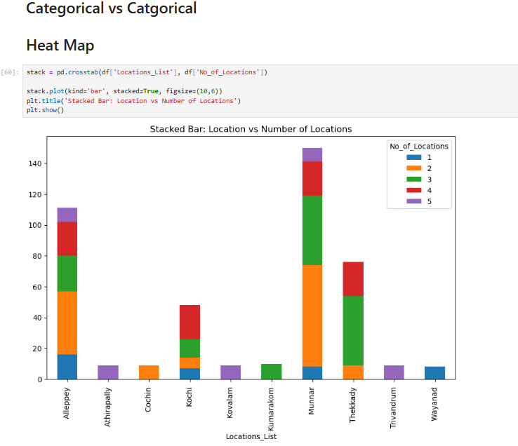
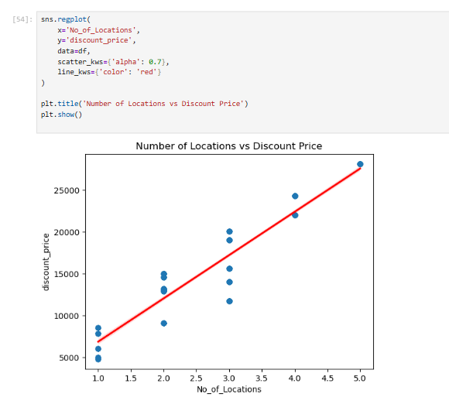
Bivariate Analysis :

Slide 12
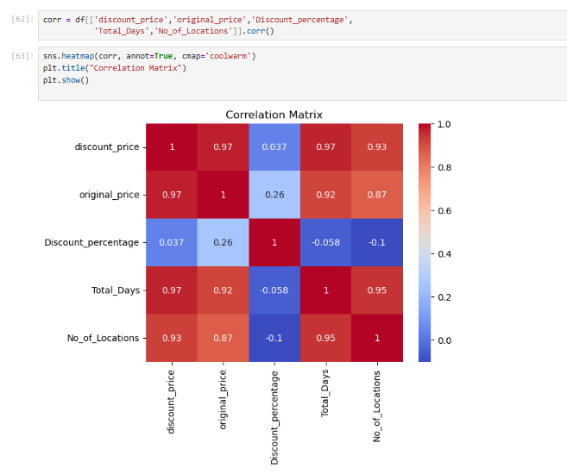
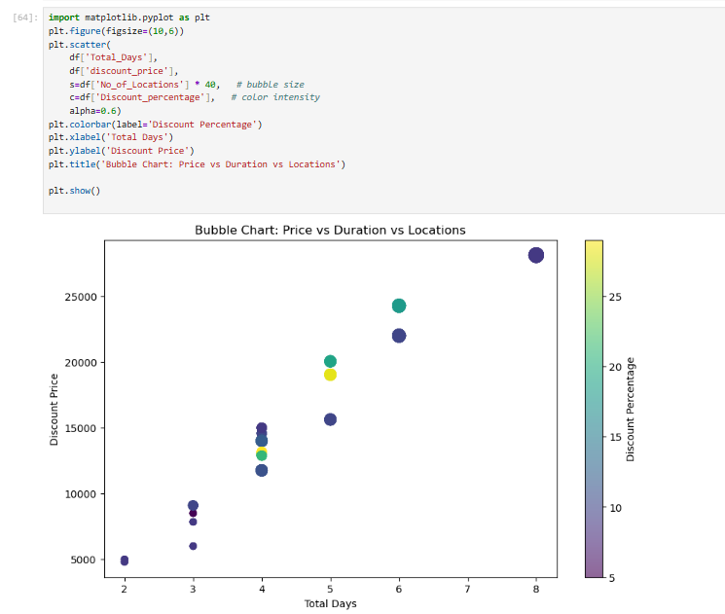
MultiVariate Analysis :

Slide 13
Power BI Dashboard :
Dashboard Development :
Developed an interactive, single-page Power BI dashboard.
Designed KPI cards to highlight key package metrics.
Visualized package pricing, discounts and destination distribution.
Analyzed pricing trends across different trip durations.
I ntegrated interactive slicers for dynamic data exploration.
Key Performance Indicators (KPIs)
Total Packages
Average Package Price
Average Discount Percentage
Average Trip Duration
Key Visualizations
Destination-wise Package Distribution
Average Price by Trip Duration
Package Price Comparison
Discount Analysis
Tool: Microsoft Power BI

Slide 14
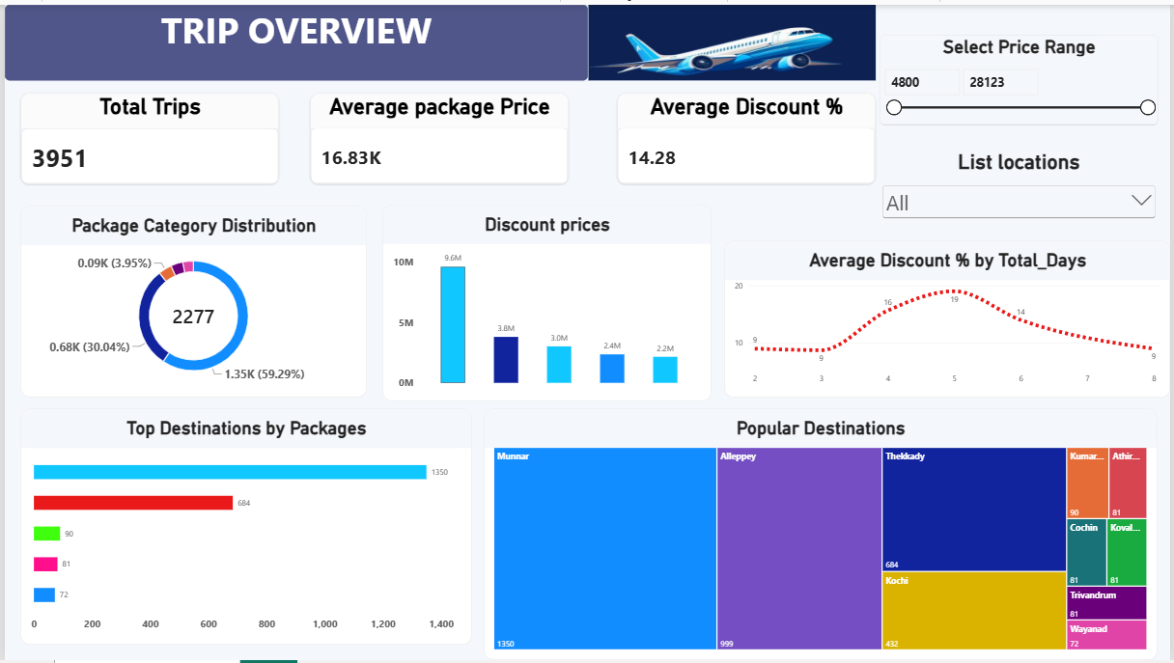
TravelTriangle – Tourism Package Analysis Dashboard :

Slide 15
Key Findings & Business Insights :
Key Findings .
Identified variations in package pricing across different tour packages.
Analyzed discount patterns across available packages.
Explored destination coverage and package popularity.
Examined the relationship between trip duration and package pricing.
Compared package offerings based on destinations and duration.
Business Insights :
Helps travelers compare tour packages based on price and duration.
Highlights destination-wise package availability.
Provides visibility into discount patterns.
Supports better understanding of Kerala tourism package offerings.

Slide 16
Business Recommendations :
Offer competitive pricing to attract more travelers.
Highlight attractive discounts to improve package visibility.
Promote packages covering popular destinations.
Provide flexible trip durations to meet different traveler preferences.
Use pricing and destination insights to improve package planning.

Slide 17

Conclusion :
Successfully collected Kerala tour package data using Python web scraping.
Cleaned and analyzed the dataset using Python libraries.
Performed Univariate, Bivariate and Multivariate Analysis.
Developed an interactive Power BI dashboard.
Generated insights into package pricing, discounts, destinations and trip duration.
Project Outcome:
Transformed raw web-scraped data into meaningful insights through data analysis and visualization.

Slide 18

THANK YOU

