Slide 1

NETWORK TOPOLOGY PROJECT
Using Docker and Socket Programming
Eleni Sakellariou Matsi, 1084047

Slide 2
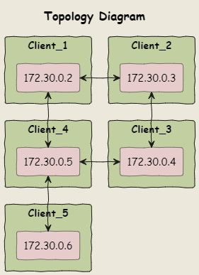

THE TOPOLOGY
1
RING between Clients 1-4
Client 5 only through Client 4
3 basic functions
Receiving
Forwarding
Inserting

Slide 3
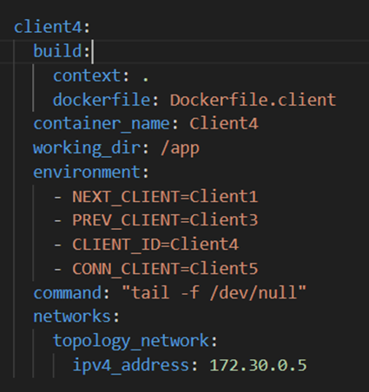


2
ENVIRONMENT VARIABLES AND DOCKER COMPOSE FILE
Every Client has:
Next Client
Previous Client
Client ID
Client 5 only Connected Client(4)
Client 4 next, prev and connected
Communication based on predefined relationships at Docker compose
static IP address
Every Client is a Docker Container

Slide 4
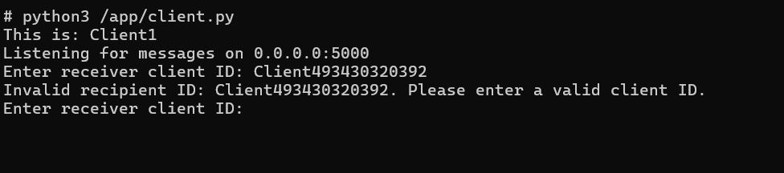
3
RECIPIENT VALIDATION
In case of invalid receiver the message would insert in a infinity loop in the network.
Receiver Validation
List of Client IDs
receiver_id|sender_id|payload

Slide 5
4
SOCKETS
Every client has a listening socket that remains open when online and waits for incoming connections.
When there is a new connection a new socket is created for the message transmission and is terminated after the message is successfully received.
A separate socket is created for forwarding the message to next client.
All clients listen on port 5000

Slide 6

5
THREADING
Using Threading so every node can receive and input messages at the same time:
Tasks do not wait each other to complete
Threads terminate when the client disconnects.
insert message exit
Keyboard Interrupt

Slide 7
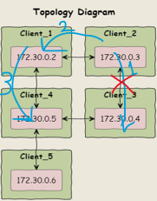
6
BIDIRECTIONAL COMMUNICATION
Between nodes in the ring
receiver_id|sender_id|direction|payload
Bidirectional is triggered when next client is not available. The attribute direction changes to backward and the message follows the reversed path to reach the receiver.

Slide 8
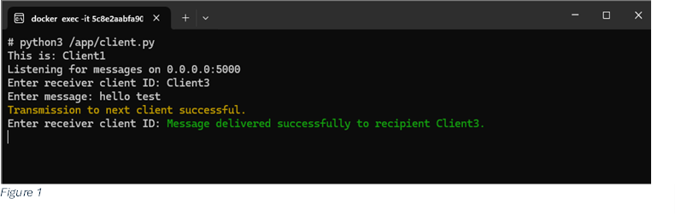
7
ACKNOWLEDGMENT MESSAGE
ACK messages ensure reliable communication.
Delivering
Delivered
Successful delivery
receiver_id|sender_id|direction|acknowledgment|payload
When a message is successfully received by the intended recipient, the receiver client sends an acknowledgment message back to the sender client. When the sender receives it :

Slide 9
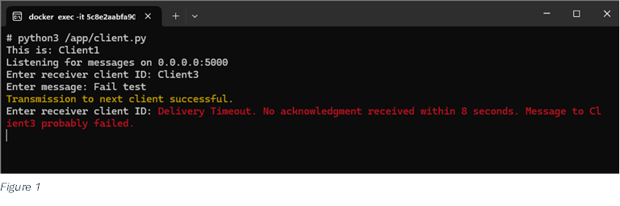
8
ACKNOWLEDGMENT MESSAGE
uuid4()
Discarded
receiver_id|sender_id|direction|acknowledgment|message_id|payload
When message delivery fails the process in handled with a timer. If no ACK message within 8 seconds prints Discarded Message to the sender’s command prompt.
Timers
When a message is sent it starts a timer thread.
Global timer dictionary: key message_id
object: delivery confirmed---> threading Event

Slide 10


9
FINAL MESSAGE HEADER
receiver_id|sender_id|direction|acknowledgment|message_id|content

Slide 11
THANK YOU!
FOR YOUR ATTENTION
Bibliography: Demo Ring from Communications Lab II @ University of Patras

