Slide 1
PHASE2: INNOVATION
CHATBOT USING PYTHON

Slide 2
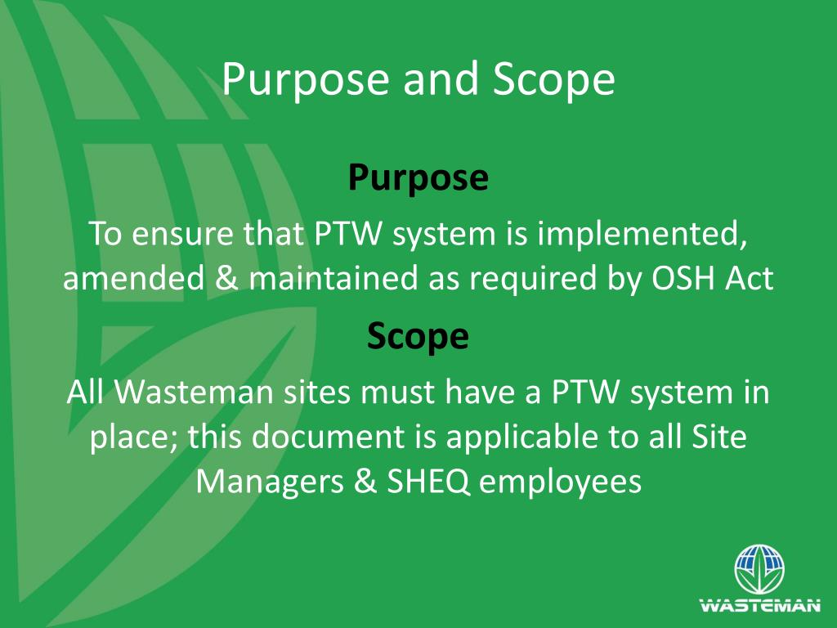
DEFINE THE PURPOSE AND SCOPE At the most basic level, a chatbot is a computer program that simulates and processes human conversation (either written or spoken), allowing humans to interact with digital devices as if they were communicating with a real person. Chatbots can be as simple as rudimentary programs that answer a simple query with a single-line response, or as sophisticated as digital assistants that learn and evolve to deliver increasing levels of personalization as they gather and process information

Slide 3
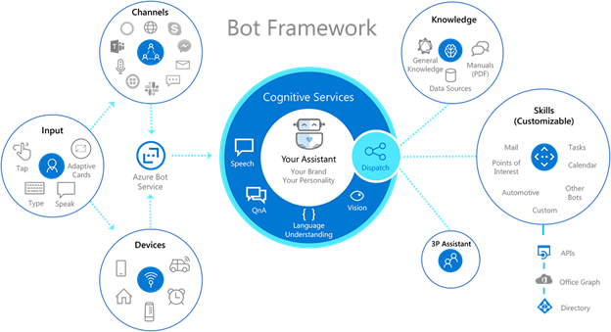
Choose a framework or library: This is a comprehensive, enterprise chatbot development framework, with Machine Learning capabilities and is a favorite among large companies for building some sophisticated ai chatbots serving internal needs. The very framework builds live, conversational types of chatbots compatible with varied devices, applications, and channels. If you wish to develop retail chatbots, or for banking or voice-powered chatbots exclusively for an Android application, this framework proves to be an ideal choice.

Slide 4
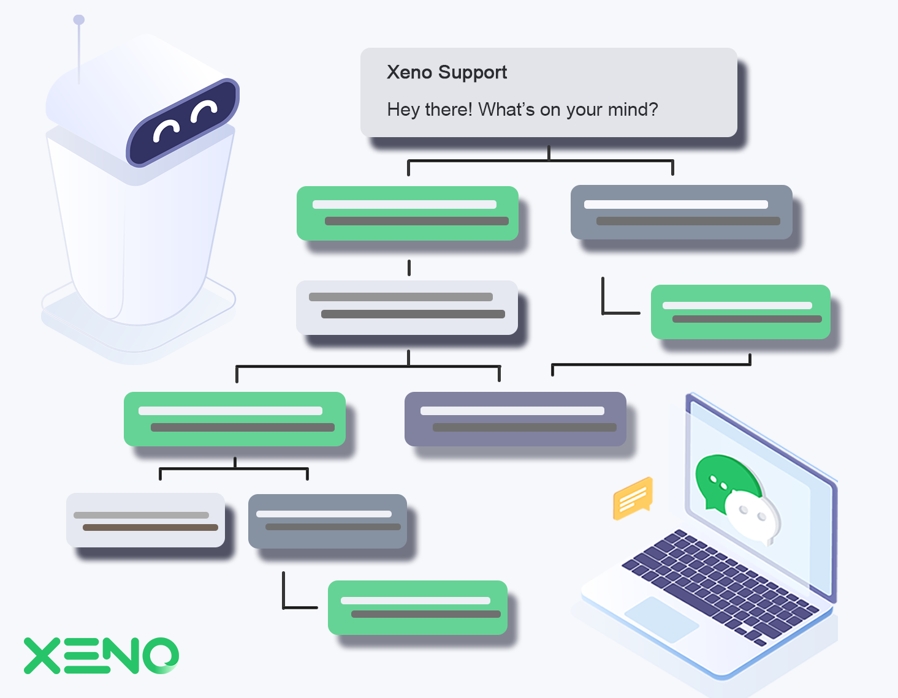
Conversation Design is a complex subject and a lot really depends on the project, on the resourses and on the company involved. However, I tried to summarize its essential elements, to provide an introduction to this new field of expertise.This 10-step Conversation Design Workflow covers all the main steps a Conversation Designer has to deal with in an ideal project, from the initial research to thE go-live
Goals&KPIs
User Research and User Personas
Topics mapping
Bot personality and tone of voice
User flows design
Prompts and copywriting
Prototype and test with users
Setup the NLU
Implement the flows
Go-live, analyze and iterate

Slide 5
PROGRAM:
import random
Define a dictionary of predefined responses
responses = { "hello": ["Hi there!", "Hello!", "Hey!"], "how are you": ["I'm good, thanks!", "I'm doing well, how about you?", "I'm just a bot, but I'm functioning well!"], "bye": ["Goodbye!", "See you later!", "Bye! Have a great day!"],
}
# Function to get a response from the chatbot
def get_response(input_text):
input_text = input_text.lower()
# Check if the input matches any predefined responses
for key in responses:
if key in input_text:
return
random.choice(responses[key])
# If no predefined response, return a default message
return "I'm not sure how to respond to that.“
# Main chat loop
print("Chatbot: Hi! Type 'bye' to exit.")
while True:
user_input = input("You: ")
if user_input.lower() == 'bye’: print("Chatbot: Goodbye!")
break
response = get_response(user_input)
print("Chatbot:", response)

Slide 6
Output:
Chatbot: Hi! Type 'bye' to exit.
You: hello
Chatbot: Hey!
You: how are you
Chatbot: I'm good, thanks!
You: bye
Chatbot: Goodbye!

