Slide 1
Matching Engine Platform
Architecture Review
Frozen Baseline v1.0.0-FINAL | 2026-03-24 | Confidential
Notes:
Architecture review of the frozen baseline. Open decisions are marked explicitly.

Slide 2
Core Design Principles
Determinism: identical input produces identical output, always
Separation of concerns: hot path isolated from control plane
Configurability: existing models parameterized; new logic requires controlled software release
Resilience by design: journal, snapshots, warm restart, defined RTO/RPO
Regulatory readiness: audit trails, clock sync, surveillance hooks from inception
Notes:
Non-negotiable principles. Every design decision is tested against these.

Slide 3
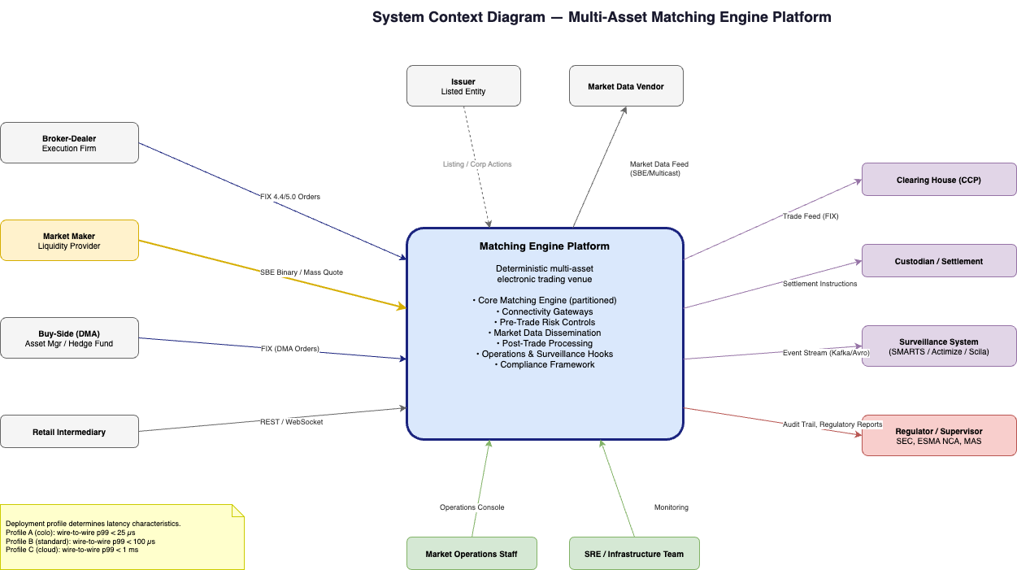
System Context - External Actors
Participants: market makers, brokers, buy-side (DMA), retail intermediaries
Post-trade: CCP (clearing), custodian (settlement)
Regulatory: surveillance system (external), regulator/supervisor
Operations: market ops staff, SRE/infrastructure team
All interactions through defined protocol interfaces (FIX, SBE, REST, multicast)
Notes:
Outside-in view. Everything inside the platform boundary is our system.

Slide 4
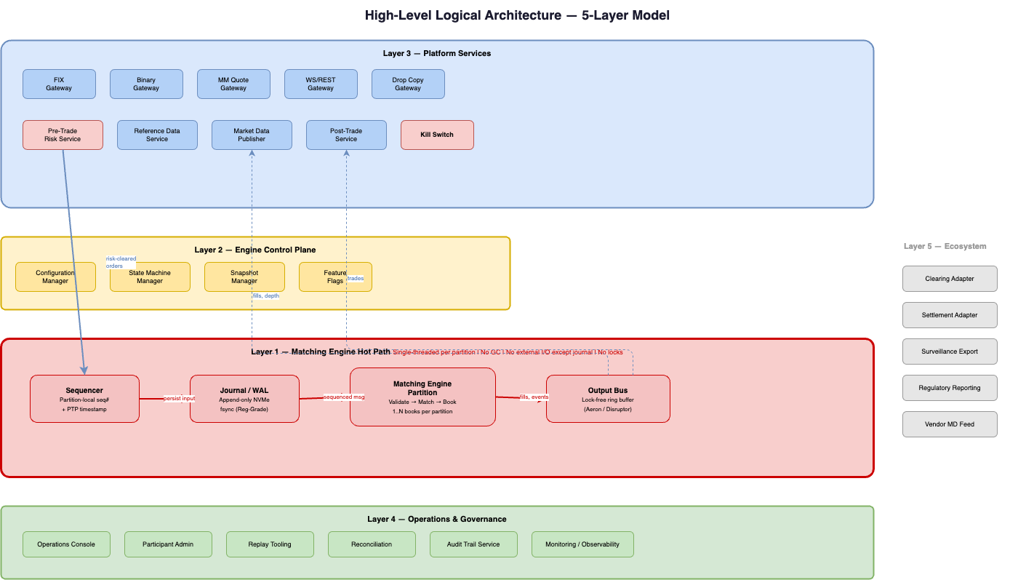
5-Layer Logical Architecture
Layer 1 (Hot Path): Sequencer > Journal > Engine > Output Bus
Layer 2 (Control Plane): Config, state machine, snapshots, feature flags
Layer 3 (Platform Services): Gateways, risk, market data, post-trade, ref data
Layer 4 (Operations): Ops console, admin, replay, reconciliation, monitoring
Layer 5 (Ecosystem): Clearing, settlement, surveillance, regulatory reporting
Notes:
Critical insight: Layers 1-2 are engine-owned and latency-critical. Layers 3-5 are standard services.

Slide 5
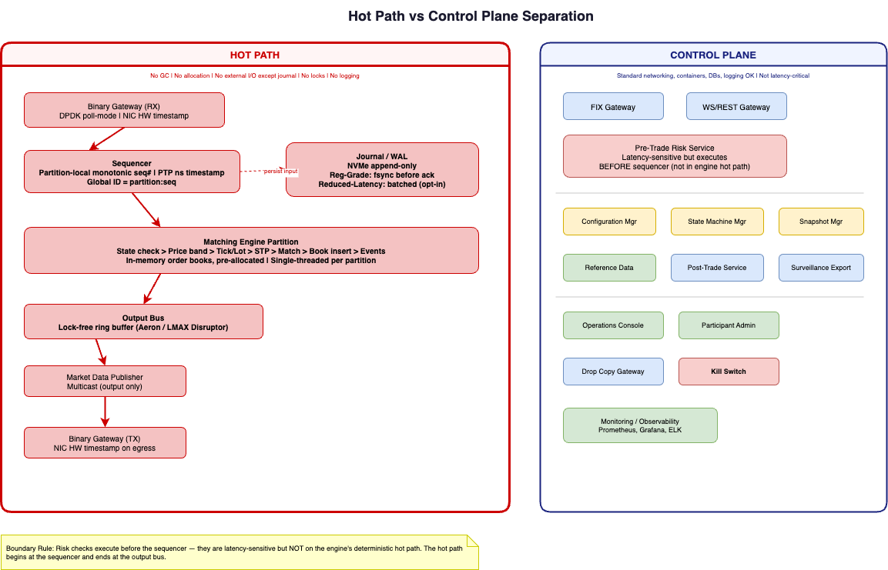
Hot Path vs Control Plane
Hot path: sequencer through output bus. Single-threaded per partition.
Constraints: no GC, no allocation, no external I/O except journal, no locks
Control plane: everything else. Standard networking, containers, databases OK.
Risk checks execute BEFORE sequencer - latency-sensitive but not in deterministic path
Boundary rule: hot path begins at sequencer, ends at output bus
Notes:
Most important boundary in the system. Any violation directly degrades latency and jitter.

Slide 6
Single-Threaded Per Partition
Each partition: 1 dedicated CPU core, 1 thread, 1+ order books (instruments)
Deterministic: no locks, no shared mutable state, no context switches on hot path
Horizontal scaling: add partitions for more instruments (more cores)
No cross-partition matching: each instrument belongs to exactly one partition
High-activity instruments may be isolated to a dedicated partition
Notes:
Foundational architecture choice. Simplicity and provable determinism over multi-threaded throughput.

Slide 7
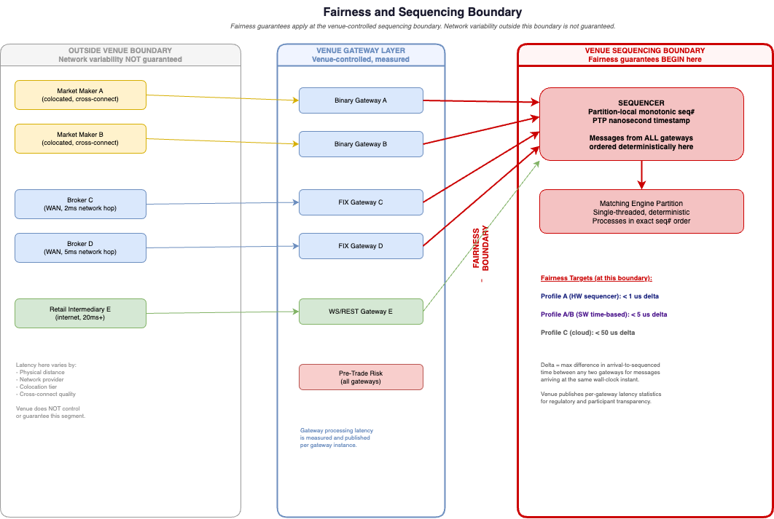
Sequencing Boundary and Fairness Model
Sequencing: partition-local monotonic. Global ID = partition_id:local_sequence
Fairness guarantees apply at the venue-controlled sequencing boundary
Network variability outside venue boundary is NOT guaranteed
Targets: < 1 us (HW seq), < 5 us (SW time-based), < 50 us (Profile C)
[OPEN DECISION D-04: hardware vs. software sequencer]
Notes:
Fairness boundary is the sequencer. Anything before it varies by access tier.

Slide 8
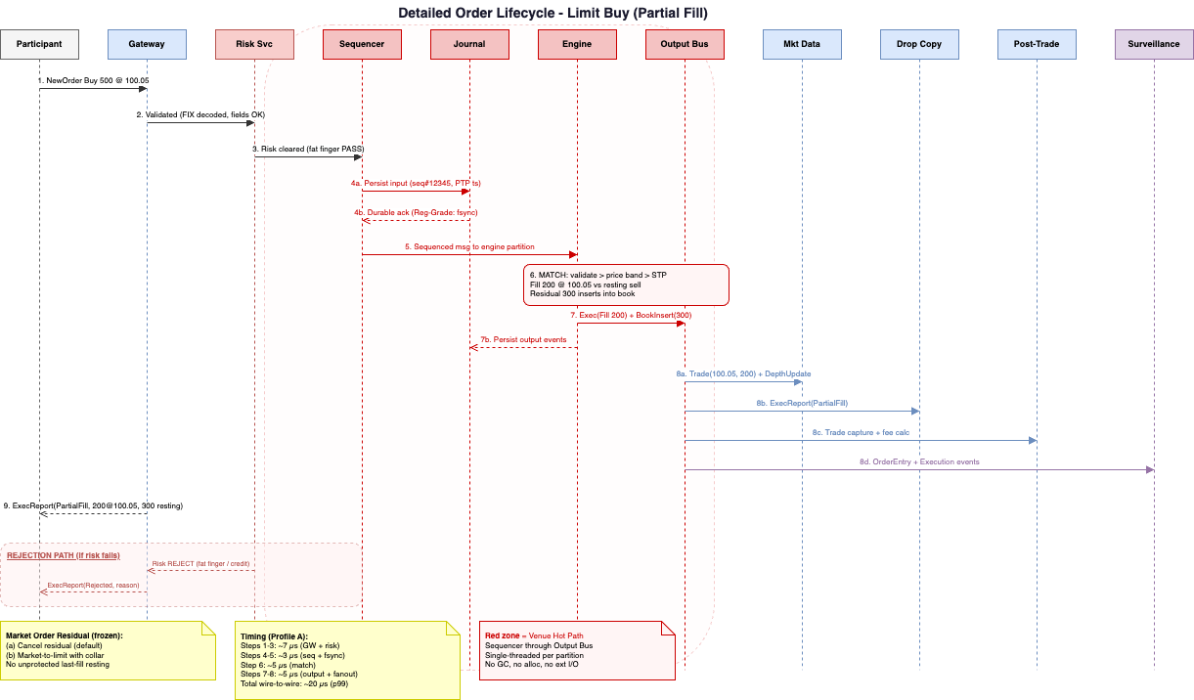
Order Lifecycle - End to End
Submit > Gateway validate > Risk check > Sequencer (seq# + timestamp)
Journal persist (Regulatory-Grade: fsync before processing)
Engine match > Output bus > Market data + Drop copy + Post-trade + Surveillance
Rejection path: Risk REJECT > Gateway > Participant (no sequencer involvement)
Market order residual: cancel (default) or market-to-limit with collar
Notes:
Journal write happens BEFORE engine processes. This is the zero-data-loss guarantee.

Slide 9
Market-Order Residual Policy (Frozen)
When a market order exhausts liquidity and residual remains:
Option 1: Cancel residual (default policy)
Option 2: Convert to market-to-limit with defined protection collar
NOT SUPPORTED: unprotected resting at last fill price
Policy is venue-configurable within this supported set
Notes:
Frozen policy. No unprotected last-fill-price resting due to thin-book risk.

Slide 10
Matching - Price-Time FIFO (FR-1)
FR-1: price-time (FIFO) priority only
Enterprise: adds pro-rata, parity, hybrid - selectable from implemented models
New matching algorithms require controlled software release (not config-only)
Execution at passive order's price - aggressive order gets price improvement
STP: cancel-newest (FR-1 default); all modes in Enterprise
Notes:
Existing priority models are configuration-selectable. Materially new logic needs a code release.

Slide 11
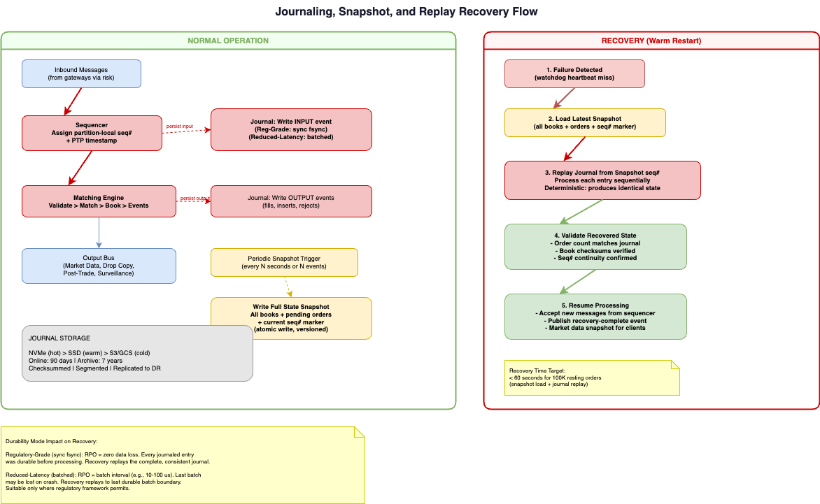
Journal, Snapshots, and Durability Modes
Journal = single source of truth. Append-only, checksummed, locally durable.
Regulatory-Grade (default): fsync before processing. Zero data loss.
Reduced-Latency (opt-in): batched writes. Data-loss window = batch interval.
FR-1 baseline: local journal + snapshot/replay + warm restart (single site)
DR journal replication: Phase 2+ unless explicitly included in FR-1 scope
Notes:
FR-1 ships local durable journal + warm restart. DR replication is Phase 2. [OPEN: D-06 journal implementation]

Slide 12
Recovery - Warm Restart from Journal
Failure detected by watchdog (< 2 seconds)
Load latest snapshot (all books + orders + seq# marker)
Replay journal from snapshot point (deterministic - identical state)
Validate recovered state (order count, checksums, seq# continuity)
Resume processing (target: < 60 seconds for 100K resting orders)
Notes:
Determinism guarantee means recovery is exact, not approximate.

Slide 13
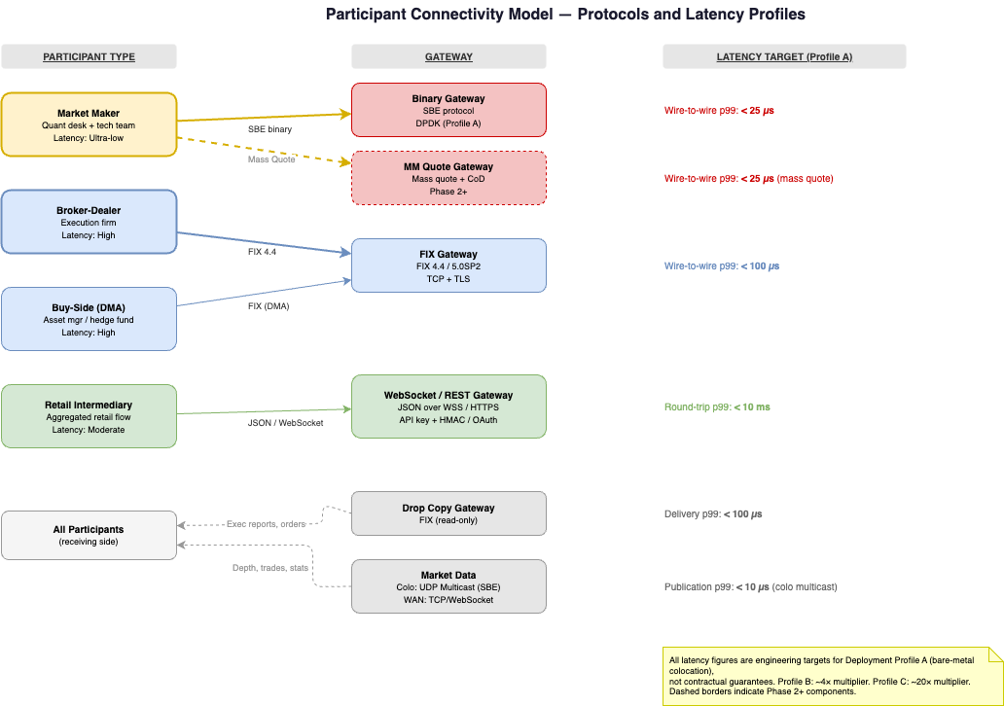
Participant Connectivity - Gateways
FIX 4.4 gateway (FR-1): industry standard; broadest compatibility
Binary gateway (SBE): lowest latency; for market makers and HFT
Drop copy: real-time read-only trade/order feed for participants
WS/REST gateway: Phase 2+ for lower-tier participants
MM Quote gateway: Phase 2+ for mass-quote market makers
Notes:
FR-1 ships FIX + binary + drop copy. Covers critical participant base.

Slide 14
Pre-Trade Risk Controls
FR-1: fat finger (price/qty/notional), message rate throttle, kill switch
Kill switch: cancel-all by participant/instrument/market-wide (< 1 second)
Enterprise: adds credit limits, position limits, exposure limits, short-sell
Risk checks execute BEFORE sequencer - not in engine hot path
Limits configurable per participant, per instrument, in real-time
Notes:
Risk is on the ingress path but explicitly outside the deterministic engine hot path.

Slide 15
Market Data Dissemination
Full depth (all price levels) + trades + statistics
Multicast (UDP) for colocated participants (FR-1)
TCP/WebSocket for WAN distribution (Phase 2)
Snapshot + incremental model with gap detection and recovery
Published in exact engine processing order (sequenced)
Notes:
Completeness and correctness matter more than pure speed for most venues.

Slide 16
Three Deployment Profiles
 | Profile A | Profile B | Profile C
Use case | Tier-1 exchange | Most regulated venues | Startup / carbon / crossing
Hardware | Bare metal, DPDK | Bare metal, standard | Cloud bare-metal / VM
Clock | PTP + GPS | PTP | NTP or PTP
Engine p99 | < 5 us (target) | < 20 us (target) | < 100 us (target)
Wire-to-wire p99 | < 25 us (target) | < 100 us (target) | < 1 ms (target)
Fairness delta | < 1 us (HW) / < 5 us (SW) | < 5 us | < 50 us
Notes:
Same platform binary. All figures are engineering targets validated through performance testing.

Slide 17
End-to-End Latency Budget (Profile A)
Planning assumptions - not approved commitments
Component | Target (p99) | Notes
NIC receive + GW process | ~3 us | DPDK poll-mode
Risk check | ~3 us | Fat finger, throttle
Sequencer + journal fsync | ~3 us | Regulatory-Grade mode
Engine match | ~5 us | Single-threaded partition
Output + fan-out | ~5 us | Lock-free ring buffer
TOTAL wire-to-wire | ~20 us | Profile A engineering target
Notes:
Largest contributor is engine match (~5 us). Journal fsync adds ~2-3 us in Reg-Grade mode.

Slide 18
Technology Stack - Open Decision
Component | Recommendation | Status
Hot-path language | C++ (primary) or Rust (alternative) | [OPEN D-01]
Control plane | Java/Kotlin or Go | Recommendation
Inter-service messaging | Aeron (engine), Kafka (surveillance) | Recommendation
Monitoring | Prometheus + Grafana | Recommendation
Journal | Custom NVMe or Aeron Archive | [OPEN D-06]
Containers | Kubernetes (non-hot-path only) | Recommendation
FPGA | Not recommended for FR-1 | Recommendation
Notes:
Open decisions marked. Recommendations are provisional until CTO confirms.

Slide 19
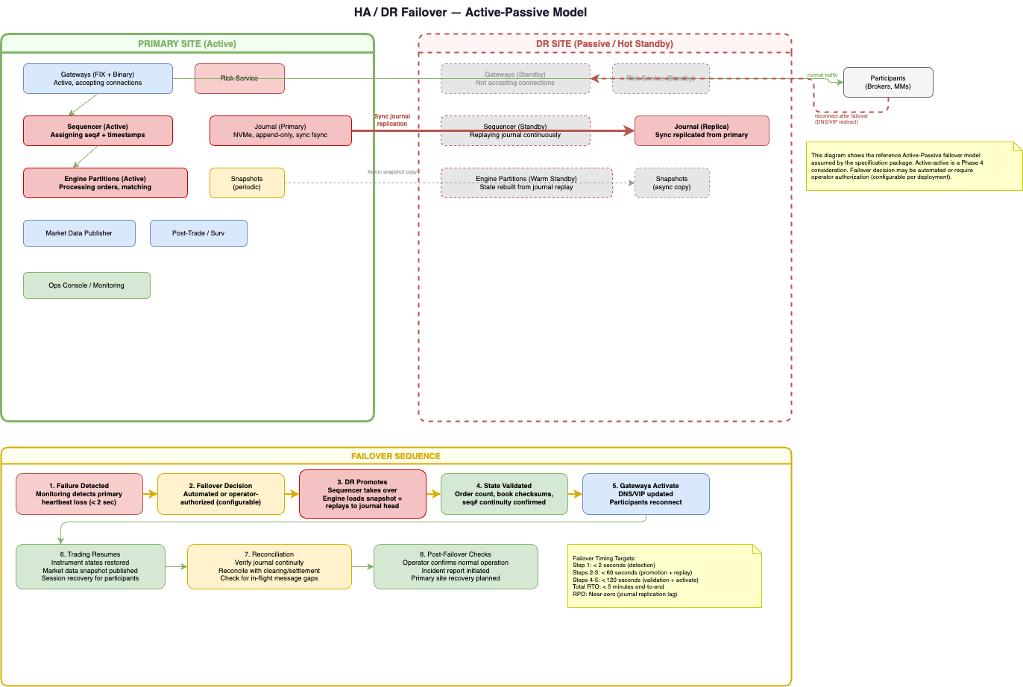
HA/DR - Active-Passive Reference Model
Primary site: active. DR site: passive/hot standby (journal replicated)
Failover: detect (< 2s) > decide > promote (< 60s) > validate > activate
Total RTO target: < 5 minutes. RPO: near-zero (replication lag).
FR-1: warm restart only (single site). DR is Phase 2.
Active-active is a Phase 4 consideration for 24/7 venues
Notes:
Reference model is active-passive. Operator authorization for failover is configurable.

Slide 20
Compliance-by-Configuration
Jurisdiction-agnostic core with configurable policy profiles
Profile defines: clock sync, transparency, risk controls, reporting, retention
Example profiles: EU MiFID II, US Reg ATS, SG MAS, UAE VARA
Audit trail: 100% state mutations, nanosecond timestamps, tamper-evident
Surveillance: data export hooks (FR-1); pattern detection Phase 2 (build vs. buy open)
Notes:
Compliance layer is configuration overlay, not code branch. [OPEN: D-03 jurisdiction, D-08 surveillance]

Slide 21
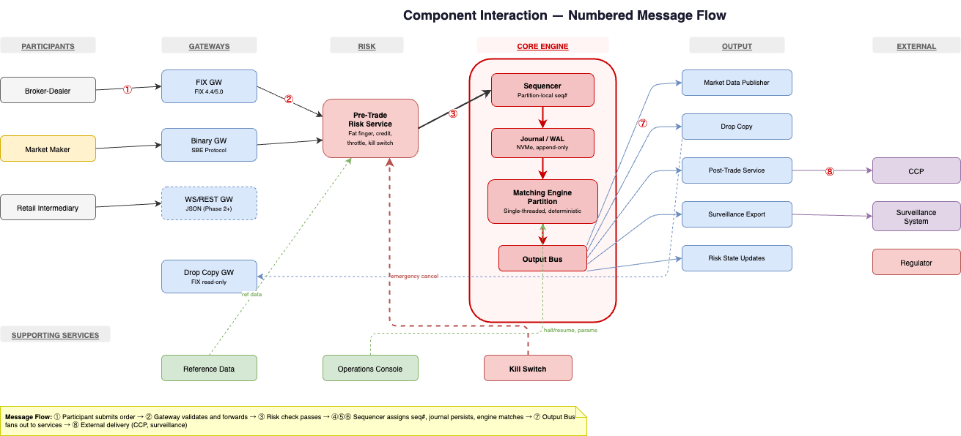
Full Component Interaction Flow
8-step numbered flow: submit > validate > risk > sequence > journal > match > output > deliver
Supporting services: reference data, operations console, kill switch
WS/REST gateway marked Phase 2+
All components connected through defined interfaces
Notes:
Detailed 'how it all fits together' view for engineering alignment.

Slide 22
Foundation Release (FR-1) - What Ships
Area | FR-1 Scope | Deferred to Enterprise
Matching | Continuous LOB, price-time FIFO | Pro-rata, RFQ, dark
Order types | Market, Limit, IOC, FOK, GTC, Day | Stop, Iceberg, Pegged, Complex
Connectivity | FIX 4.4 + Binary + Drop Copy | WS/REST, MM Quote GW
Risk | Fat finger, throttle, kill switch | Credit, position, short-sell
Post-trade | Capture, fees, confirmation, EOD | CCP clearing, allocations
DR | Warm restart (single site) | Active-passive DR site
Surveillance | File-based event export | Real-time stream, detection
Notes:
FR-1 is production-capable for initial market scope. Enterprise features are additive.

Slide 23
14 Implementation Workstreams
Planning assumptions - not approved commitments
# | Workstream | Key Roles | Phase
WS-01 | Market Microstructure / Rules | Product, Compliance | Decide
WS-02 | Core Matching Engine | 3-4 Sr Engineers | Build Core
WS-03 | Gateways / Connectivity | 2 Engineers | Build Core
WS-04 | Pre-Trade Risk | 1-2 Engineers | Build Core
WS-05 | Market Data | 1-2 Engineers | Integrate
WS-06 | Reference Data | 1 Engineer | Build Core
WS-07 | Journal / Recovery | 1-2 Engineers | Build Core
WS-08 | Post-Trade | 1-2 Engineers | Integrate
WS-09 | Surveillance / Compliance | 1 Engineer | Integrate
WS-10 | Infrastructure / Colo | 2-3 SRE | Decide+Build
WS-11 | Security / IAM | 1-2 Engineers | Integrate
WS-12 | Monitoring / SRE | 1-2 SRE | Integrate
WS-13 | Testing / Certification | 2-3 QA | Certify
WS-14 | Program / Rollout | 1 PM | All phases
Notes:
Net FR-1 headcount: 12-15 FTE (planning assumption). Several roles overlap across workstreams.

Slide 24
Top 10 Milestones to FR-1
Planning assumptions - not approved commitments
# | Milestone | Target | Blocked By
M1 | Asset class + jurisdiction decided | Month 0 | -
M2 | Language decided | Month 0 | -
M6 | Single-instrument matching functional | Month 3 | D-01
M8 | FIX gateway functional | Month 3 | -
M11 | End-to-end order lifecycle | Month 4 | M6, M8
M15 | Cert environment available | Month 6 | M10
M16 | First participant certified | Month 7 | M15
M17 | Performance validated under load | Month 7 | M10
M19 | Dress rehearsal | Month 8 | M18
M20 | FR-1 GO-LIVE | Month 9 | M19
Notes:
All dates are planning targets from decision closure (Month 0).

Slide 25
Open Design Decisions - Must Close Before Build
# | Decision | Owner | Deadline | Blocks FR-1?
D-01 | Hot-path language | CTO | Week 2 | YES
D-02 | FR-1 asset class | Product | Week 1 | YES
D-03 | Jurisdiction | Compliance | Week 1 | YES
D-04 | Sequencing (HW/SW) | Architecture | Month 2 | YES
D-05 | Colocation site | Infrastructure | Month 1 | YES
D-06 | Journal implementation | Eng Lead | Month 2 | YES
Notes:
Every week of decision delay is a week off the FR-1 timeline.

Slide 26
Top Delivery Risks
Risk | Probability | Impact | Lead Mitigation
Decision closure delays | High | Critical | Decision pack + deadlines + escalation
Performance targets not met | Medium | High | Early profiling from M3
Hardware supply chain | Medium | High | Order M1; cloud fallback
Insufficient participants | Medium | Critical | Incentive programs; partners
Determinism bugs | Low | Critical | Replay tests on every commit
Scope creep | High | Medium | Product owner empowered to defer
Notes:
Decision closure delay is the #1 risk. Every risk has a named mitigation.

Slide 27
Build vs Buy Boundaries
Capability | Recommendation | Rationale
Matching engine core | BUILD | Core differentiator
Gateways | HYBRID (lib + custom) | FIX engine library; custom binary
Surveillance | BUY | Specialized vendor domain
Monitoring | BUY/OSS | Prometheus, Grafana, ELK
PTP infrastructure | BUY | Meinberg, Spectracom
HSM | BUY | Thales, nCipher
Notes:
Build the core differentiator. Buy everything else where mature solutions exist.

Slide 28
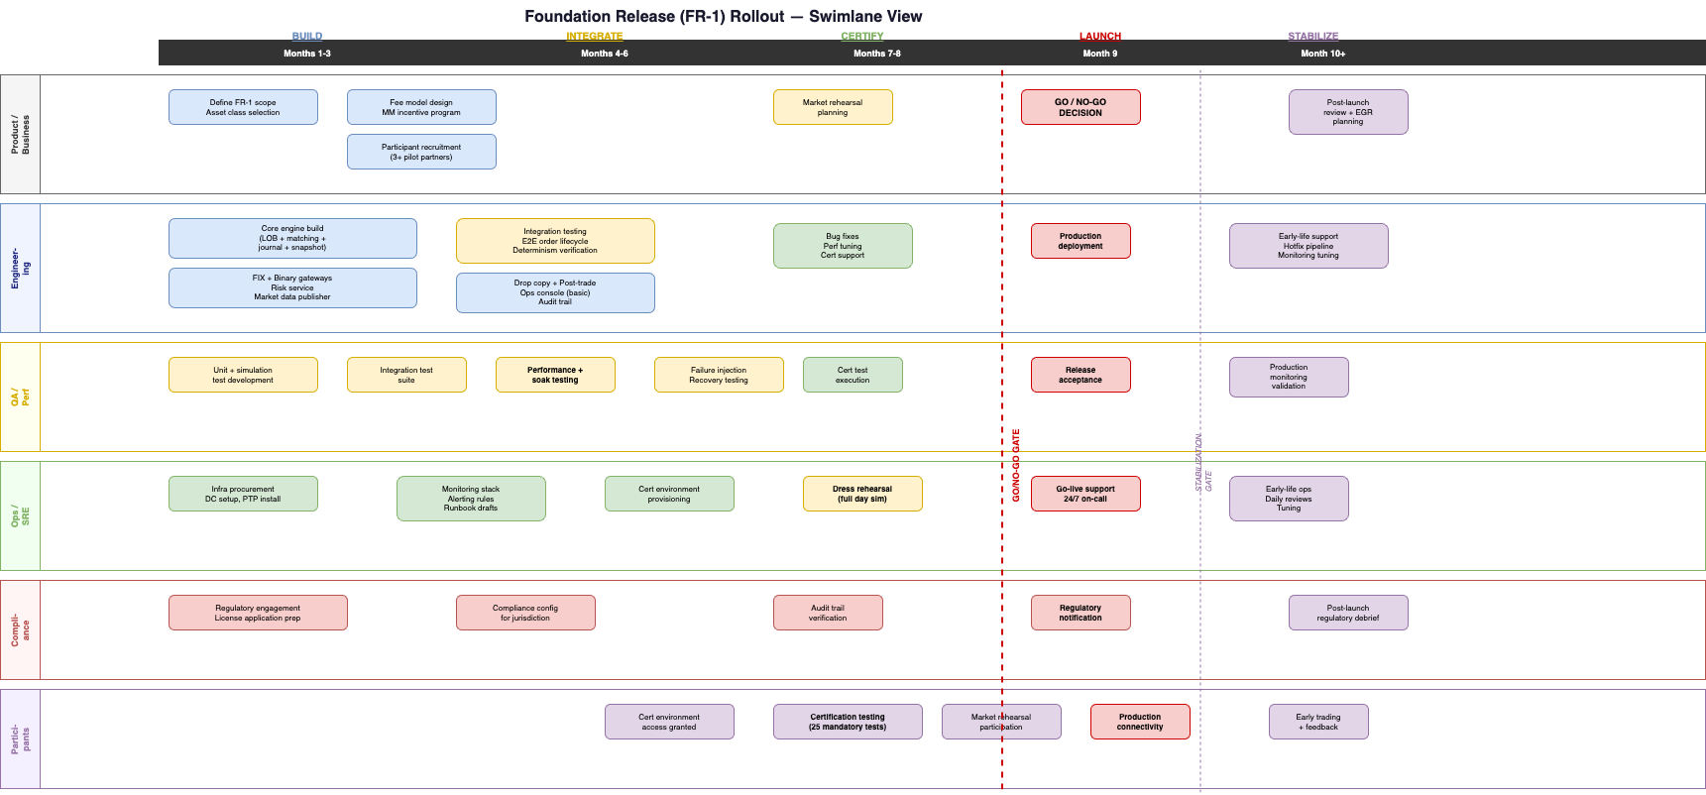
Rollout Plan - FR-1 to Production
Internal testing: platform running with synthetic load (4 weeks)
Participant certification: selected participants certify connectivity (6 weeks)
Market rehearsal: full dress rehearsal with all participants (2 weeks)
Soft launch: limited instruments, limited participants, real trading (2 weeks)
Full launch: all instruments, all participants, production operation
Notes:
GO/NO-GO decision gate between certification and soft launch.

Slide 29
Next Steps
Week 1: Decision workshop for D-01 through D-06
Week 2: Close decisions; begin hiring; order hardware
Month 1: Engine skeleton + build pipeline operational
Month 3: End-to-end order lifecycle functional
Month 9: FR-1 go-live (planning target)
Notes:
Next concrete step: schedule the decision workshop.

Slide 30
Architecture Baseline Accepted
30 specification files | 12 architecture diagrams | Frozen v1.0.0-FINAL
Ready for decision workshop and implementation planning

