Slide 1
Multi-Asset Matching Engine Platform
Executive Briefing | Confidential | 2026-03-24
Planning assumptions - not approved commitments until stakeholder sign-off
Notes:
Standard title slide. Context: go/no-go briefing for Foundation Release (FR-1).

Slide 2
The Market Opportunity
Electronic trading venue infrastructure is a large, growing market with aging incumbent technology
Many exchanges operate matching platforms built over a decade ago with high vendor lock-in
Regulatory fragmentation across jurisdictions creates demand for compliance-ready venue technology
New asset classes (carbon, digital assets, tokenized securities) need institutional-grade infrastructure
Strategic thesis: no available platform meets performance, multi-asset, compliance, and cost requirements simultaneously
Notes:
Frame as strategic thesis, not verified market research. Specific market-size figures should be sourced from independent research if used in investor materials.

Slide 3
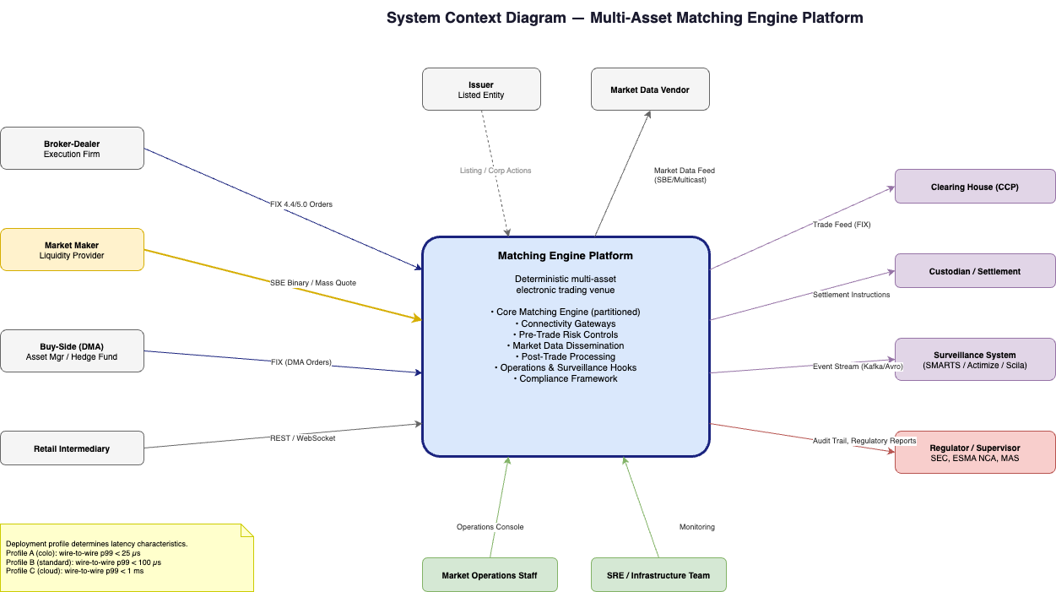
What We Are Building
Configurable, multi-asset electronic trading venue platform
Deterministic matching engine designed for institutional-grade performance
Compliance-by-configuration: deploy across jurisdictions without re-architecture
Full platform: connectivity, risk controls, market data, post-trade, surveillance hooks
Owned technology: no vendor lock-in, full commercial flexibility
Notes:
Not just a matching engine - a complete venue platform. Emphasize 'configurable' and 'multi-jurisdiction'.

Slide 4
Who It Serves
Regulated exchanges (national / regional)
MTFs, OTFs, and alternative trading systems
Digital-asset exchanges seeking institutional credibility
Commodity, energy, and carbon trading venues
Regional multi-asset market operators
Broker internal crossing networks
Notes:
Same platform technology serves all venue types through configuration. 'Build once, deploy many.'

Slide 5
Key Design Principles
Determinism: identical input always produces identical output - essential for audit and replay
Separation of concerns: hot-path matching isolated from control plane and operations
Configurability: existing market models parameterized; new logic via controlled release
Resilience by design: journal, snapshots, warm restart, defined RTO/RPO
Regulatory readiness: audit trails, clock sync, surveillance hooks built in from inception
Notes:
These principles are non-negotiable and guide every design decision.

Slide 6
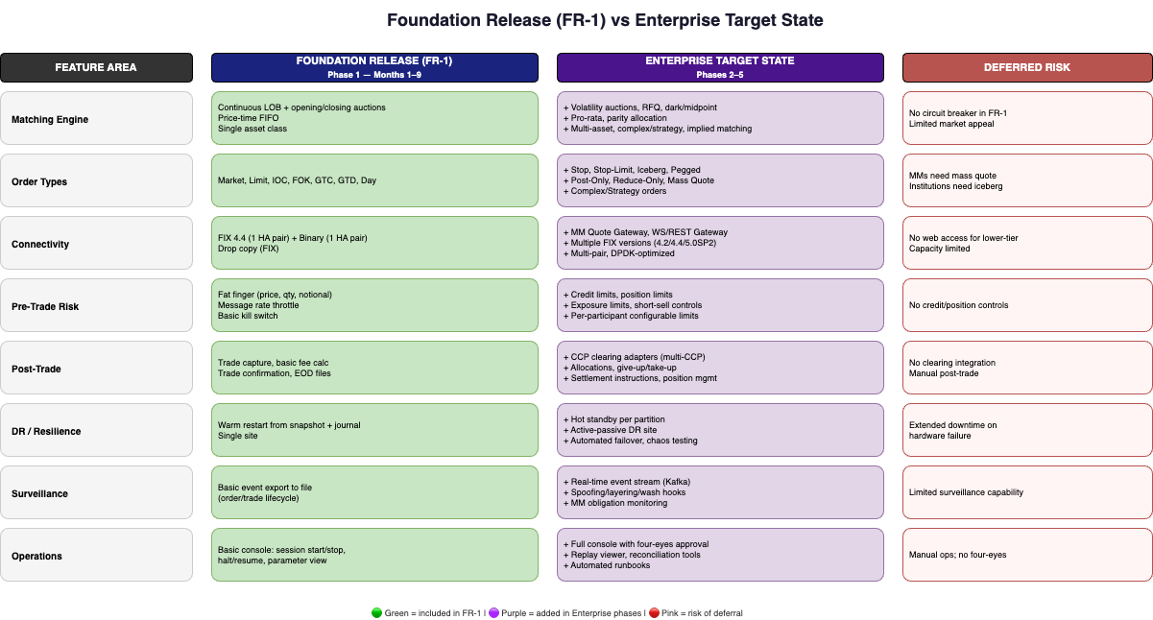
Foundation Release (FR-1) vs. Enterprise Target State
FR-1: Core matching, basic risk, FIX + binary connectivity, market data, audit trail
Enterprise: Multi-asset, advanced orders, RFQ, DR, clearing, full surveillance
FR-1 supports initial licensing engagement, subject to jurisdiction-specific approval
Each phase is additive - no re-architecture required
FR-1 is a production-capable release, not a prototype
Notes:
FR-1 can run a trading day and generate revenue. Enterprise features are additive.

Slide 7
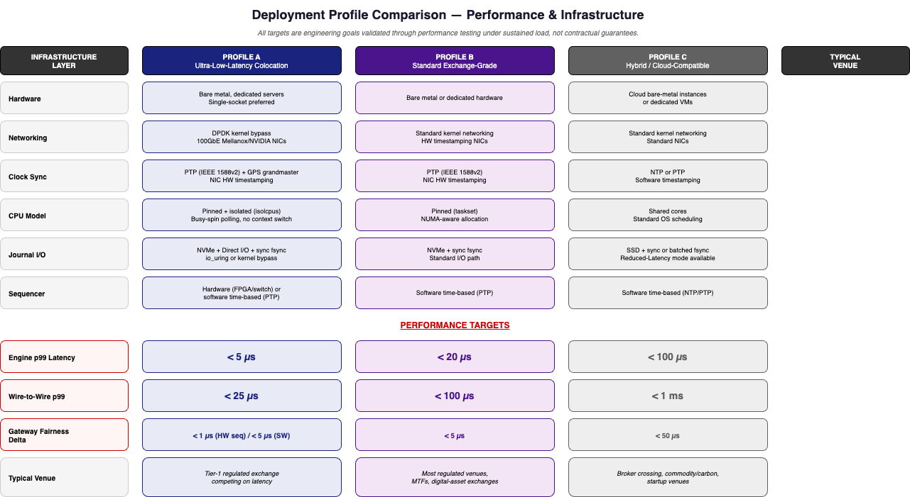
Deploy Anywhere - Three Performance Profiles
Profile A: Ultra-low-latency colocation - for tier-1 exchanges competing on speed
Profile B: Standard exchange-grade - for most regulated venues
Profile C: Cloud-compatible - for startups, broker crossing, commodity/carbon
Same platform code; infrastructure choices determine performance tier
All performance figures are engineering targets, not contractual guarantees
Notes:
Key commercial differentiator: same platform serves an HFT equity exchange and a carbon credit startup.

Slide 8
Path to Production
Planning assumptions - not approved commitments
Phase | Name | Scope | Timeline Target
1 | Foundation Release (FR-1) | Core matching, basic risk, FIX/binary, market data | 9 months (target)
2 | Exchange-Grade (EGR) | Multi-asset, clearing, full surveillance, DR | Months 6-15
3 | Multi-Asset (MAR) | RFQ, dark pools, complex orders | Months 12-21
4 | Advanced Ops (AOR) | Automated DR, chaos testing, optimization | Months 18-27
5 | Ecosystem (ECO) | Analytics, licensing, white-label | Months 24-36
Notes:
5-phase approach manages risk: FR-1 proves technology, Phase 2 proves commercial viability.

Slide 9
What It Takes (Planning Assumptions)
Planning assumptions - not approved commitments
Dimension | Planning Estimate | Notes
Team | 12-15 people | 8 eng + 2 QA + 1 product + 2 SRE + 1 PM
Hardware | $200K-500K range | Servers, NICs, PTP, switches
Software/Licensing | $50K-100K range | FIX engine, monitoring, HSM
Data Center | $10K-30K/month | Colocation
Timeline | 9 months from decision closure | Planning target
Notes:
All figures are planning assumptions subject to decision closure and scope confirmation.

Slide 10
Why This Platform Wins
Technology sovereignty: no vendor lock-in; own the core technology
Multi-asset from the architecture: designed multi-asset from day one, not extended later
Compliance-by-configuration: same platform, different jurisdictions, no re-build
Modern architecture: event-sourced, deterministic, replayable - built for audit
Speed to market: new instruments in weeks using existing capabilities
Notes:
Competitive moat is the combination of configurability + performance + compliance readiness.

Slide 11
Key Decisions for This Board
Decision | Options | Owner | Deadline
Asset class for FR-1 | Equities / Derivatives / Digital / Carbon | Product + CTO | Week 1
Target jurisdiction | EU / US / Singapore / UAE | Compliance | Week 1
Engine language | C++ / Rust / Java | CTO | Week 2
Budget approval | Approve FR-1 build budget | Board | This meeting
Notes:
These decisions must close within 2 weeks to hold the 9-month timeline target.

Slide 12
Controlled Risk Through Phased Delivery
Phased investment: FR-1 limits initial spend; revenue possible before full platform cost
Technology risk: mitigated by proven architecture patterns and early performance validation
Market risk: pilot participants committed before go-live; market-maker incentives
Regulatory risk: early regulator engagement; compliance-by-design, not bolt-on
Execution risk: clear milestones, monthly decision checkpoints, experienced team
Notes:
Every risk has a named mitigation. Phased delivery means we can pivot after FR-1.

Slide 13
Recommendation
Planning assumptions - not approved commitments
APPROVE Foundation Release (FR-1) build with 12-15 person team
AUTHORIZE hardware and colocation budget ($300K-600K planning range)
EMPOWER CTO + Product + Compliance to close top 6 decisions within 2 weeks
SCHEDULE monthly progress reviews against 20-milestone plan
TARGET: FR-1 production-ready in 9 months from decision closure
Notes:
Be specific about what approval means: budget, team, timeline, and decision authority. Offer architecture review deck as follow-up.

Slide 14
Thank You
Next step: Decision workshop within one week
Architecture review deck available for technical leadership

