Slide 1
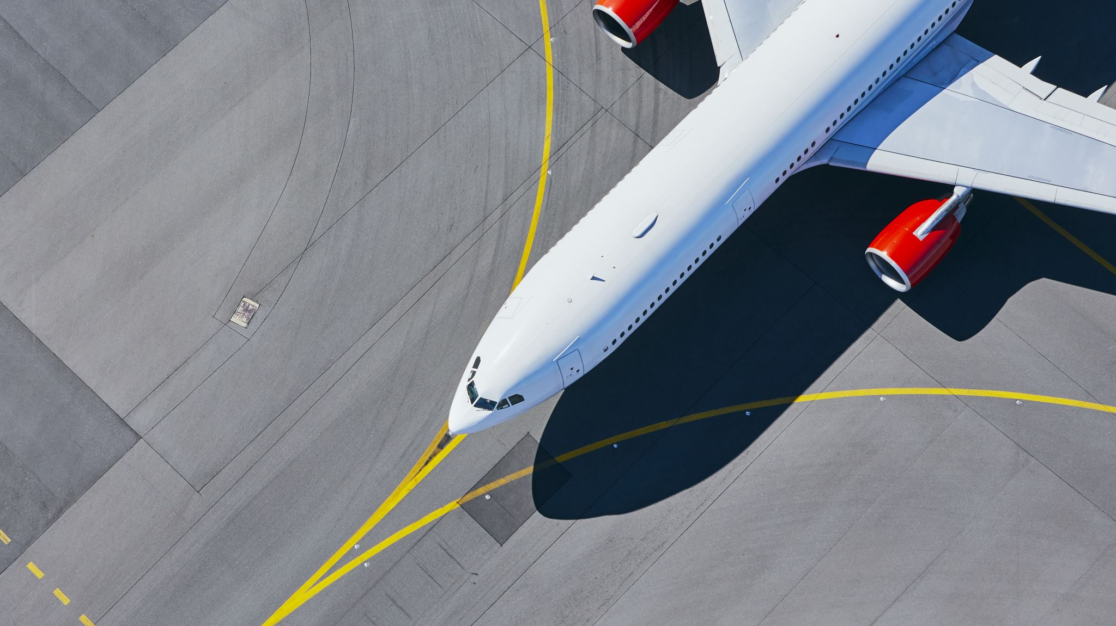
Airline safety
Elizabeth Earl
DSC 640-T302
Milestone 2

Slide 2
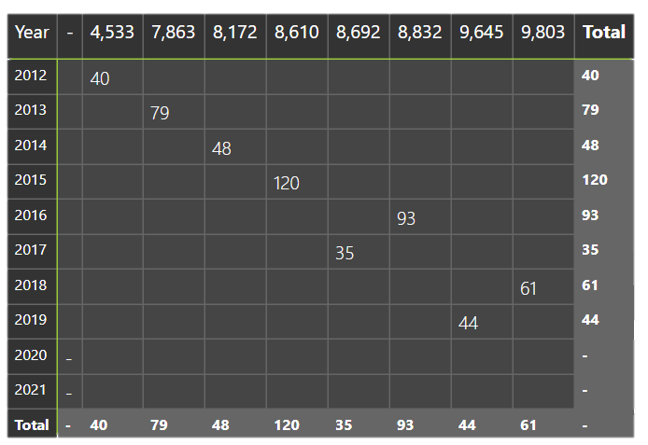
Cancelled flights
Data based on all airlines departing from LAX during the winter Holiday
On average less than 60 flights were cancelled throughout all flights leaving LAX
This can be due to the fact Pilots were being paid less in 2015 vs 2017 (where the least number of flights were cancelled)

Slide 3
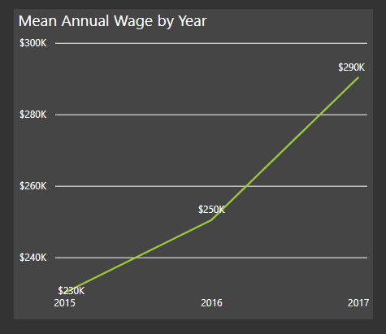
Higher pay = Less flights cancelled = Safer airplanes
Wage incentives can push people to go to work thus positively impacting flight data
If the public sees a low number of flights being cancelled on major holidays the are more likely to trust airplane’s safety

Slide 4
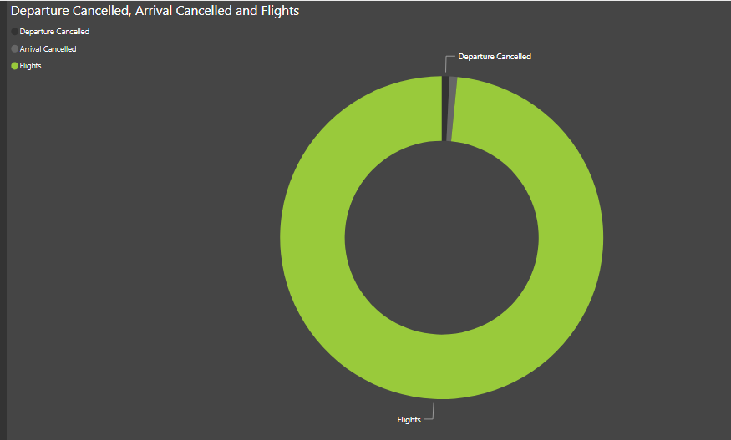
Overall, we have more flights being completed which indicated people are trusting airlines
When we see the big picture, cancelled flights are almost nonexistent
So why are people still afraid of air travel versus all other types?

Slide 5
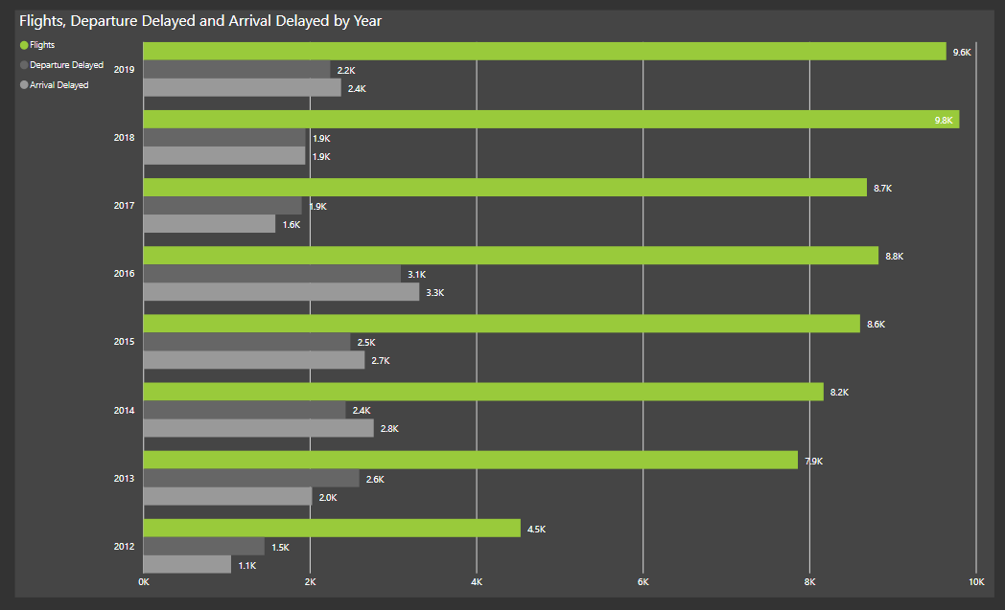
Inconvenience versus fear
Consider the idea that people may not fear air travel but rather see it as an inconvenience
On average we see more flights arriving late than those departing late. We assume this causes an inconvenience to passengers who perhaps have connecting flights.
Late arrivals causes missed flights which leads to the number of passengers in flights to fall

Slide 6
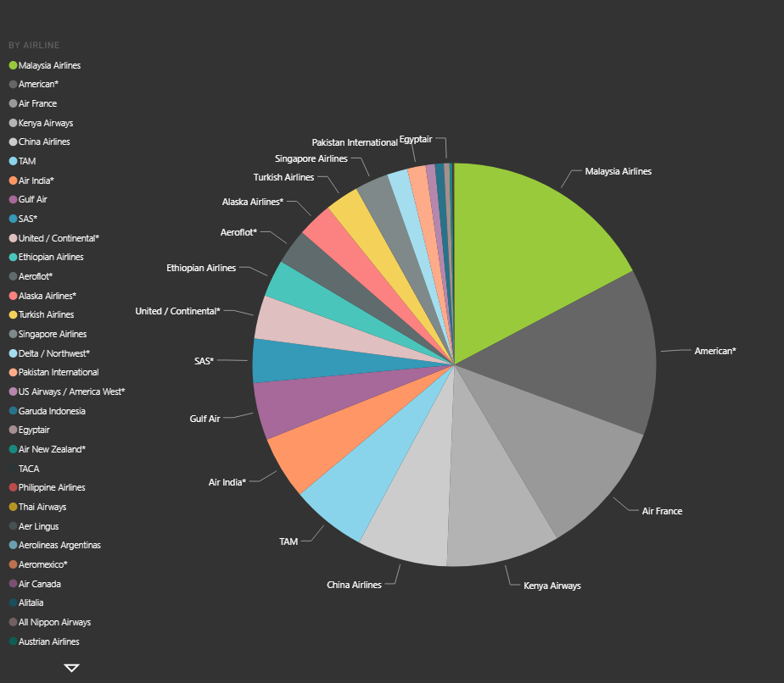
Finding the cause
Unfortunately, American airlines is part of the major airlines with a high number of fatalities
We may not have as many accidents, but the number of fatalities is greater
We must look into whether this is down to the spaces available in our planes versus other airlines

Slide 7
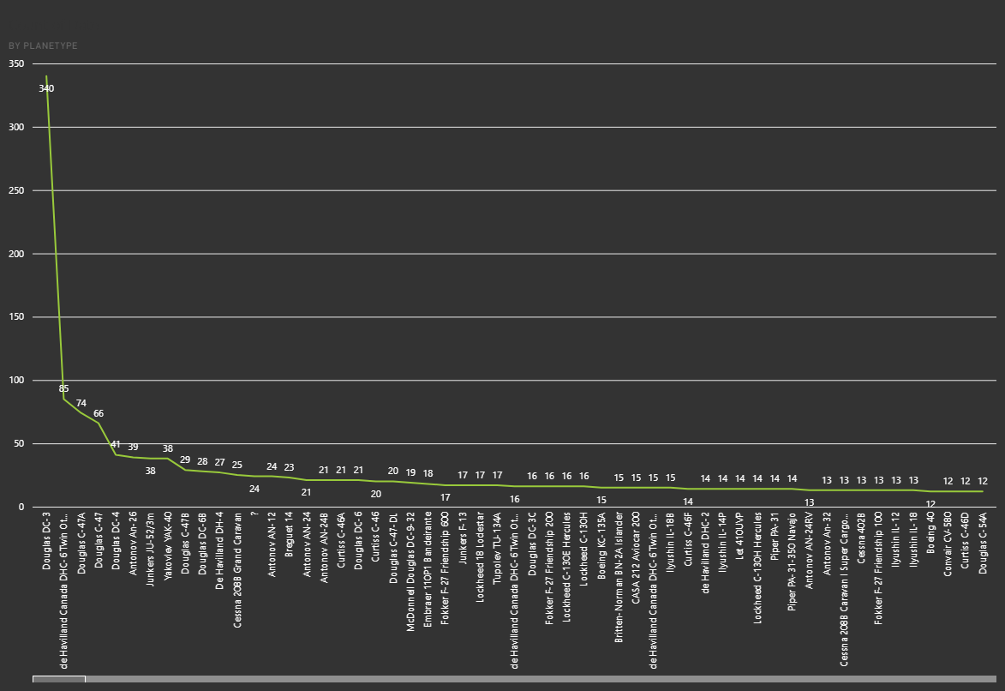
What are the most common plane types in accidents?
The aircraft most used when a fatal accident occur is the Douglas DC-3
Douglas DC-3 was used mostly in World War II which is not a commercial plane
We use this example of data to raise the idea that perhaps the public is believing information about airplane accidents that have nothing to do with them
A noncommercial plane such as the Douglas DC- 3 will have a high number of fatalities because of the situation it was used in
False information raises unnecessary fear

