Slide 1

Premier League Arrests
Elizabeth Earl
DSC 530

Slide 2

Question(s) to consider….
What type of offences were most common throughout the Premier League?
What does this say about football fans?

Slide 3
Variables
Premier League team supported
It is important to know which team we are dealing as team standing can become a factor in the number of offenses committed
Arrests at Home matches
This is the arrets made when the provided team is playing in their home stadium
Arrests at Away matches
This is the arrets made when the provided team is playing in their home stadium
It is assumed the fans being arrested are those who travelled to the stadium
Offences against property
This includes property damage done inside the hosting team’s stadium
Ticket Touting
Variable includes ticket resell which is important to note as top teams are prone to ticket touting
Alcohol Offences
The most common offense included alcohol and is important to see where fans are more common to fall under the influence of alcohol to the point of abuse

Slide 4
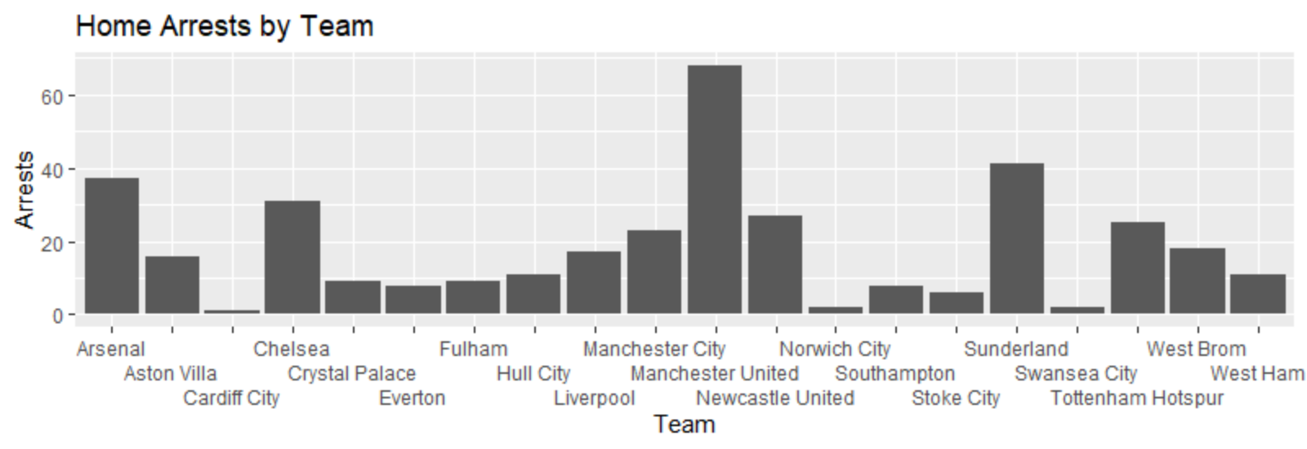
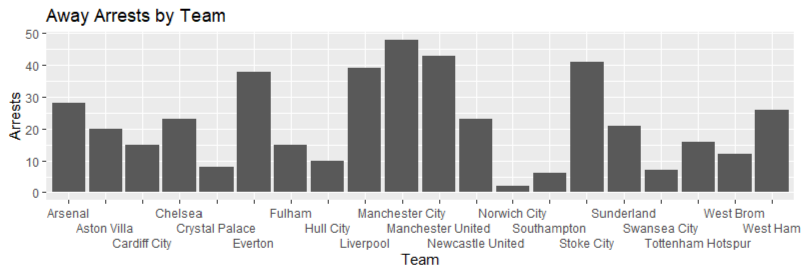
Arrests Home v. Away
Fig. 1.0
Fig. 1.1

Slide 5
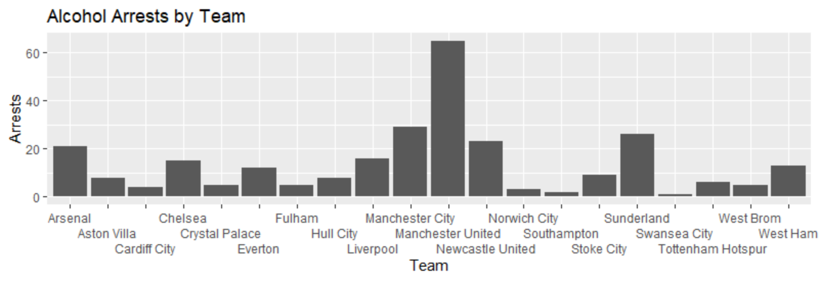
Arrests by Offence
Fig. 1.2

Slide 6
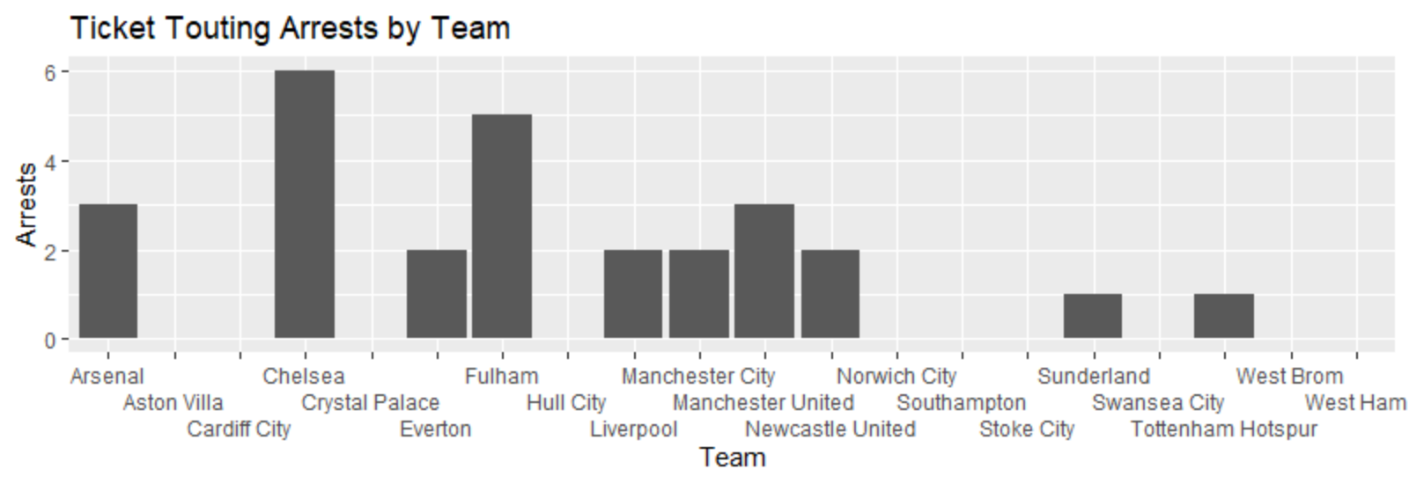
Arrests by Offence
Fig. 1.3

Slide 7
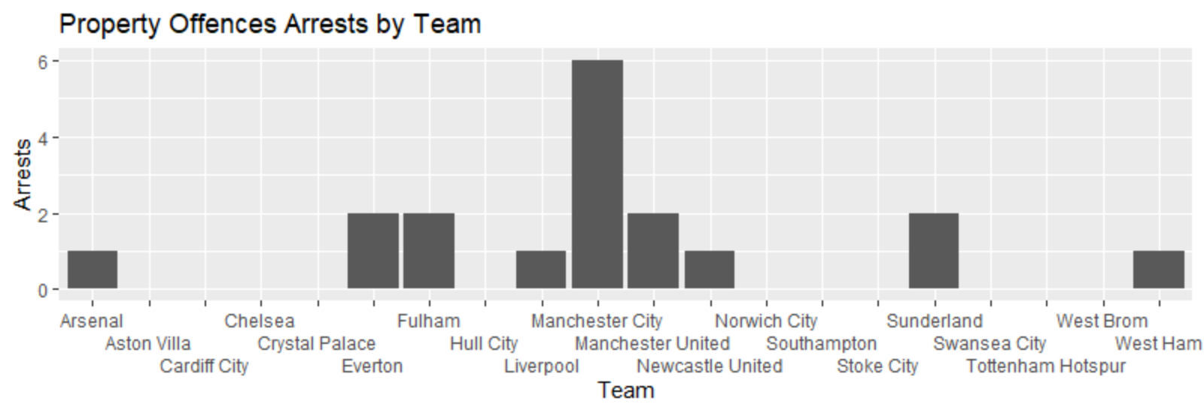
Arrests by Offence
Fig. 1.4

Slide 8
Summary of Graphs
Outliers:
Fig. 1.0: Manchester United shows a drastic difference in number of home arrests versus all other teams with 68 versus the next closest being Sunderland at 41
Fig. 1.2: Like fig. 1.0 Manchester United proves and outlier in arrests made due to alcohol abuse
Fig. 1.4: In this graph we can see neighboring Manchester team, Manchester City are the outlier in arrests made due to property damage
Based on the outliers there is an evident trend that fans from Manchester seem to be the most disruptive. Based on such finding fans from Manchester could be treated as one entity or simply removed and labeled as the black sheep of fans.

Slide 9
Summary of Graphs
 | Fig. 1.0 | Fig. 1.1 | Fig. 1.2 | Fig. 1.3 | Fig. 1.4
Mean: | 18.5 | 22.05 | 13.8 | 1.35 | 0.9
Mode: | 9, 8, 11, 2 | 15, 23 | 5 | 0 | 0
Spread: | 68-1=67 | 48-2=46 | 65-1=64 | 6-0=6 | 6-0=6

Slide 10
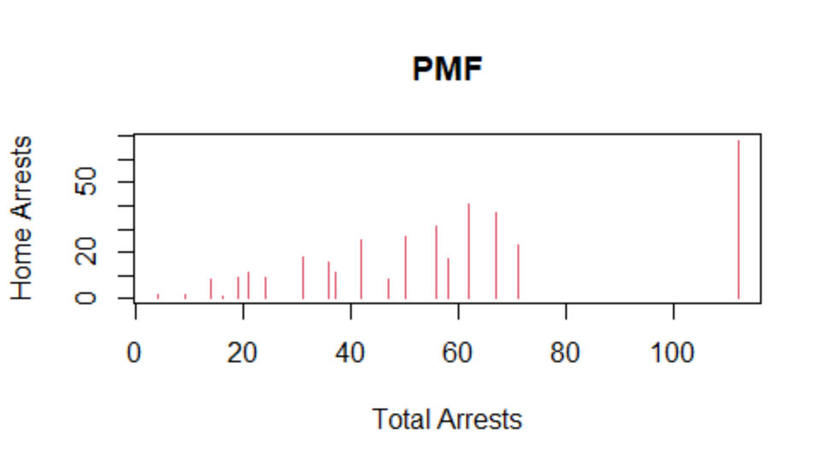
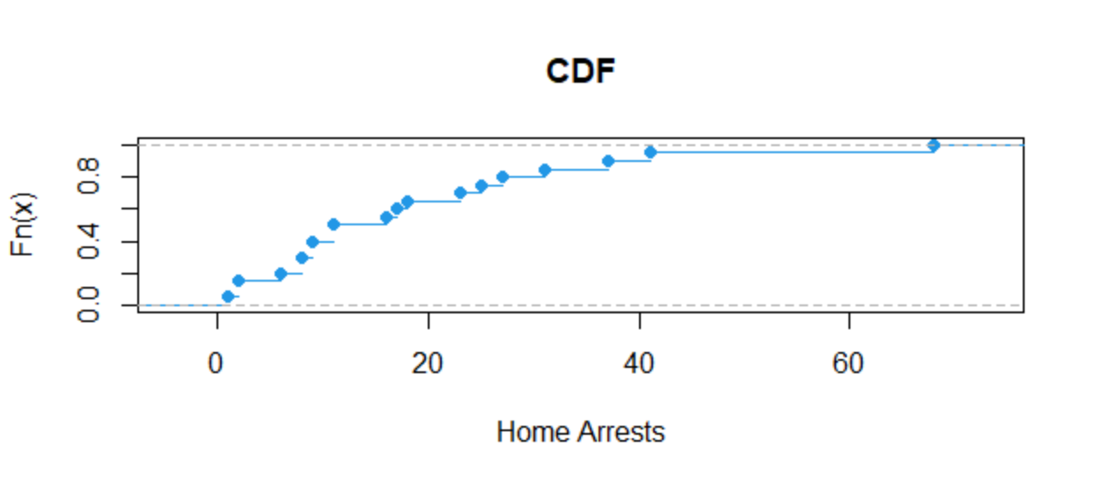
PMF & CDF Using Home Arrests
**Based on the CDF we can see our home arrests are not consistent

Slide 11
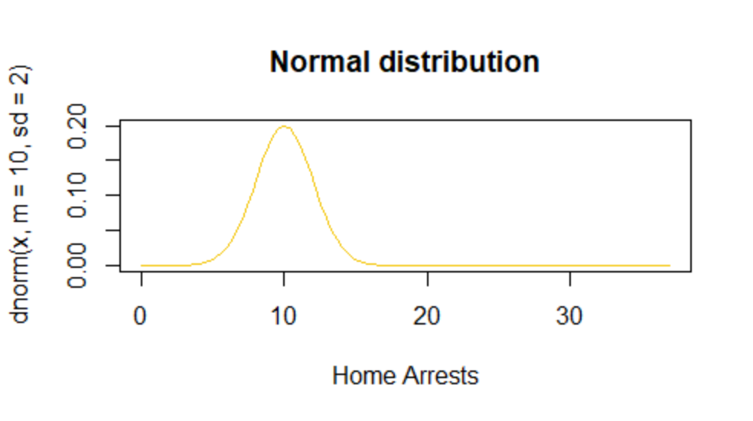
Normal Distribution
Based on the Normal Distribution graph we can see it is common for home teams to have approx. 10 arrests per match. There are instances where a club’s fan commit more arrestable offenses, but they are uncommon. This shows us that typically fans are often well behaved in their club’s home stadium which is expected.

Slide 12
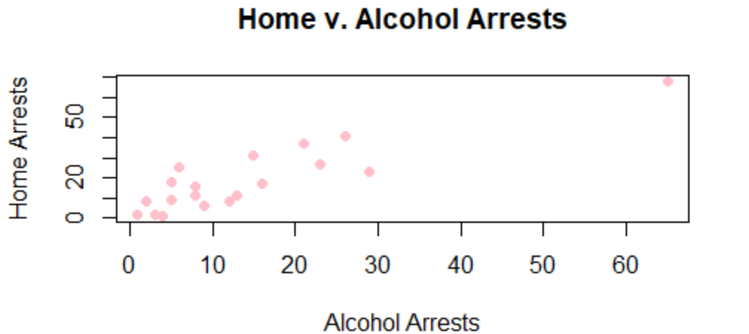
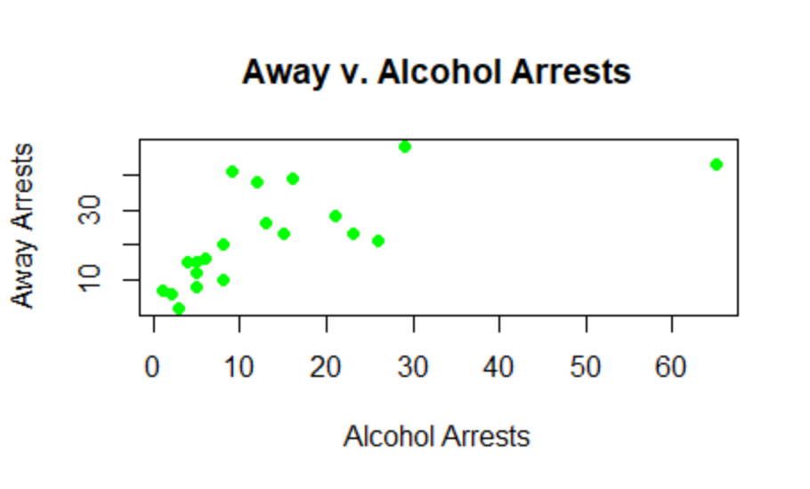
Scatter plots
As scatterplots only show correlation and not causation, we can see in the top scatter plot a mostly positive relationship between arrests made Home and those being Alcohol offences. Interestingly, there is no relationship between away arrests and alcohol offenses. The reasoning behind this may be due to the travel required to attend away matches versus home matches.

Slide 13
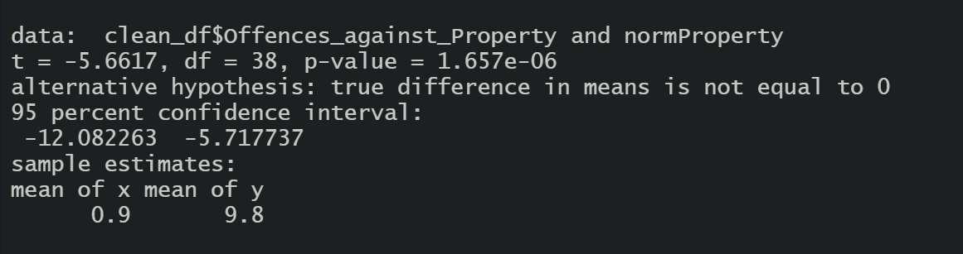
Null Hypothesis Test
The test was done comparing the offenses made on property by its normal distribution values
**Results pictured above**

Slide 14
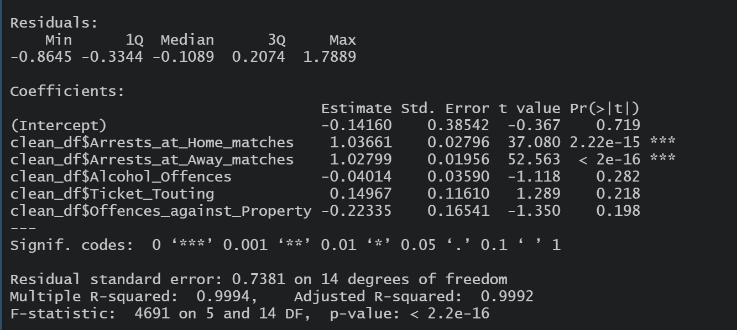
Multiple Regression
The test was done using all variables against the total number of arrests made. Variables are compared individually against the total amount of arrests per team.
**Results pictured above**

