Slide 1
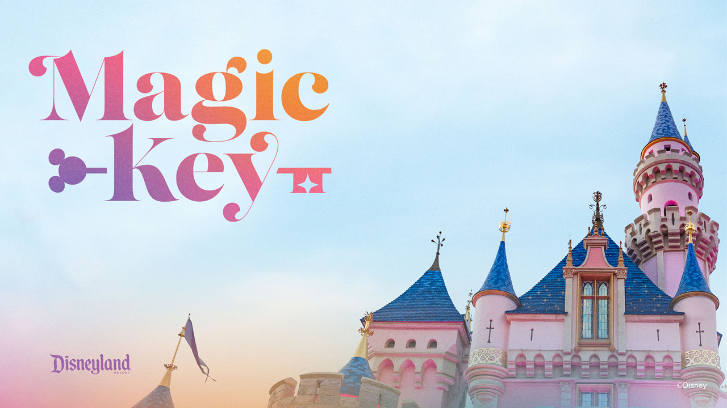
Final Project
Elizabeth Earl
DSC 630-T301
Picture credit: magic-key-disneyland-resort-logo.jpg (1280×720) (mouseinfo.com)

Slide 2
Did introduction of Magic Key negatively impact overall revenue?
Magic Key was introduced in August 2021 replacing Annual Passes limiting the number of visitors to the Disney Parks (in California)
Per COVID regulations new programs had to be implemented but it is argued the Magic Key program led Disney in a negative direction
Reservation and tier based schemed received negative criticism among die hard Disney fans who paid top dollar and still struggle to secure a visit to any park
Notes:
The goal of this presentation is to describe the contributions toward the completion of the project, and to discuss the issues, challenges encountered during the work, and future plans to complete the analysis.

Slide 3
Upset consumers = upsetting revenue numbers
As consumers of the top tier pass (Dream Key) who were promised: “Reservation-based admission to one or both theme parks every day of the year” were not given such perks many became disappointment
Hardcore fans had to find a means of getting into the parks, which raised the question: Is overselling Magic Keys bringing in revenue (they resort to buying single day tickets) or negatively impacting revenue (as people are put off going to the parks because they feel their voice is not heard)?

Slide 4
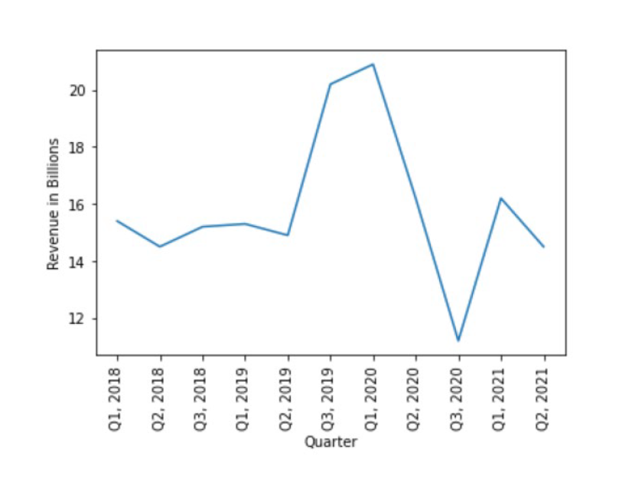
Revenue through the years per quarters*
*A quarter is every 4 months
There was a major decrease in Revenue between 2020’s 1st quarter versus the 3rd quarter
Because the Magic Key was not implemented by this time, it is assumed this drop was caused by COVID closures
After reopening we expect an increase as people were deprived of Disney for over a year yet 2021’s 1st and 2nd quarter do not show these results

Slide 5
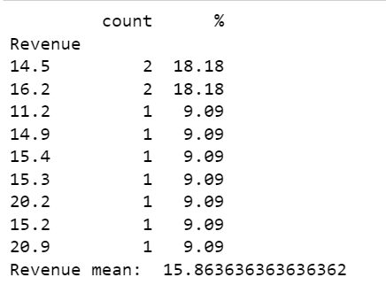
Issues with revenue by the numbers
Average of all revenues: ~15.86B
Lowest: 11.2B
Highest: 20.9B
We see a higher count of income revenue of values closer to the average versus the count being closer to the highest revenue value of 20.9B
We want the revenue to reach +20B every quarter and goals are not being met, even with new Magic Key programs implemented

Slide 6
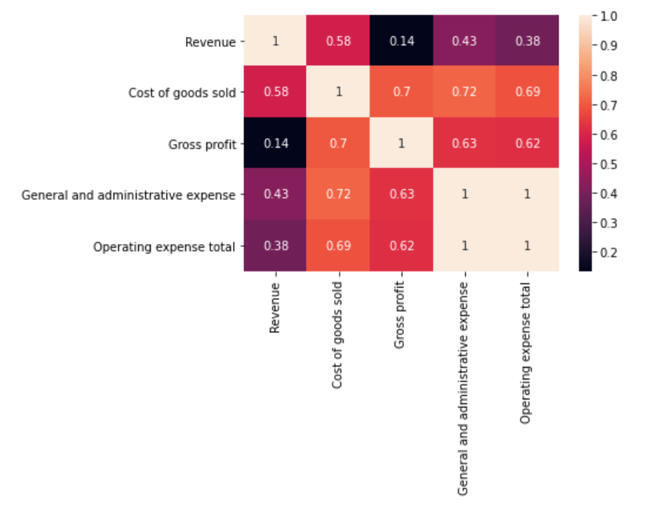
Revenue versus other contributing factors
Gain versus loss: other factors such as expenses to operate the parks contribute to a loss.
What can be determined as the cause for a lack of revenue gain?

Slide 7
Guest reliability-Dataset/privacy issues
As reflected in the heat map in prior slide we see many factors (in addition to COVID & Magic Key program implementation) contributing to the decline of Disney revenue.
There is no concrete way to pinpoint exactly what is to blame
Issue arises: Disney revenue data is very secure
What can we rely on?
Guest reviews (on the park, assume they reflect views towards Magic Key Program)
Guest reviews are not a stable source of data as guests are an unreliable/unstable source that cannot be controlled

Slide 8
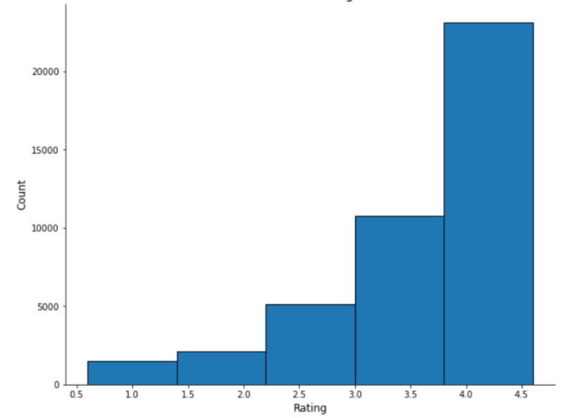
Challenges: Using the Disney Review data:
We see the distribution of reviews highly in favor with majority over 3.0 (star)
How reliable is this data as it in overall reviews (throughout all parks)?
Considering Magic Key program was only implemented in California, data handling is a challenge
There is a heavy rely on data cleansing but then proses the issue of not having enough data

Slide 9
Predictive models:
I ran a sentiment model on the review dataset before any predictive model implementation
Models used after sentiment:
Logistic Regression
Multinomial Naïve Bayes Classifier
Decision Tree Classifier

Slide 10

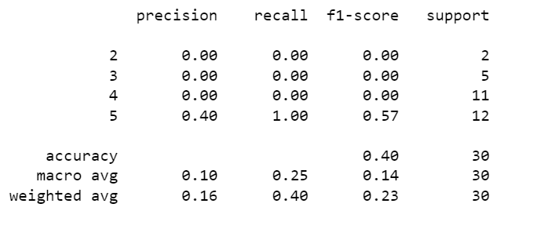
Logistic Regression— results

Slide 11
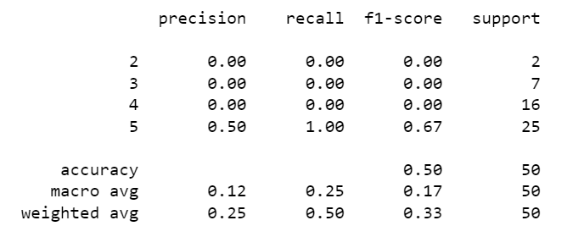
Multinomial Naïve Bayes Classifier — results

Slide 12
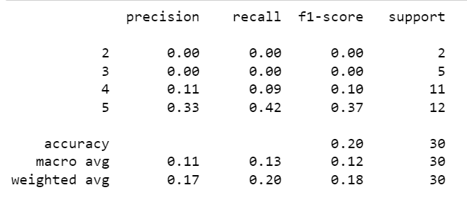
Decision Tree Classifier— results

Slide 13
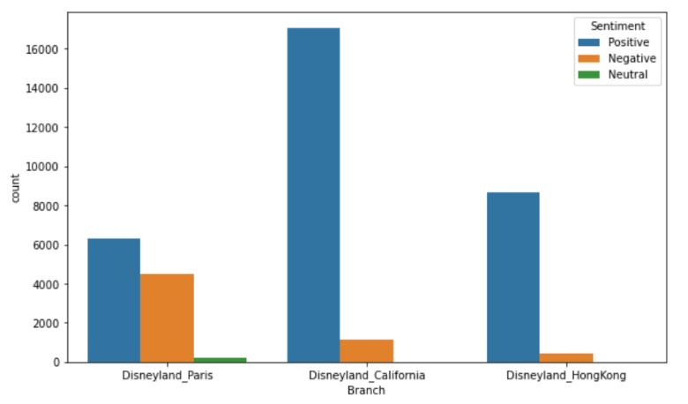
Ultimately, people love Disney
Positive reviews will always outweigh the negative reviews
People will visit the parks regardless

Slide 14
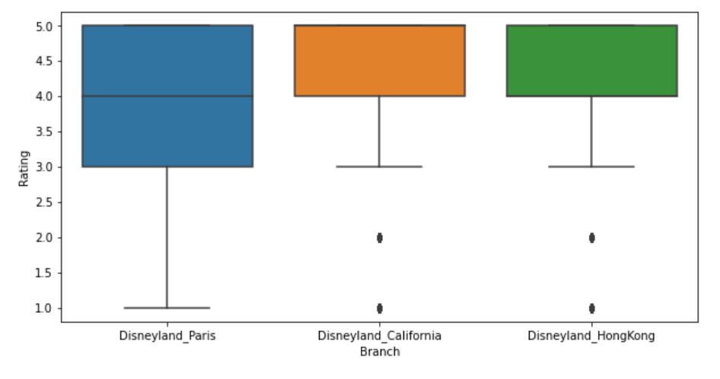
California parks still popular
Even with new ticketing schemes Disney’s California parks maintain high review rating
Disney can use positive (& negative) reviews to boost revenue

Slide 15

Things I learned…

