Slide 1
Disney Reviews – Milestone 3
Elizabeth Earl
DSC 680– T301
First project—week 4

Slide 2
Reviews are important
Reviews correlate to Revenue
Helps decided what changes a company needs to implement
Help a company grow
Continue doing positive activities
Fix and negative aspects/branches of company

Slide 3
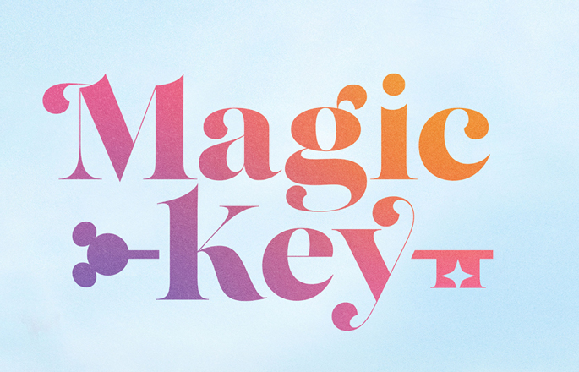
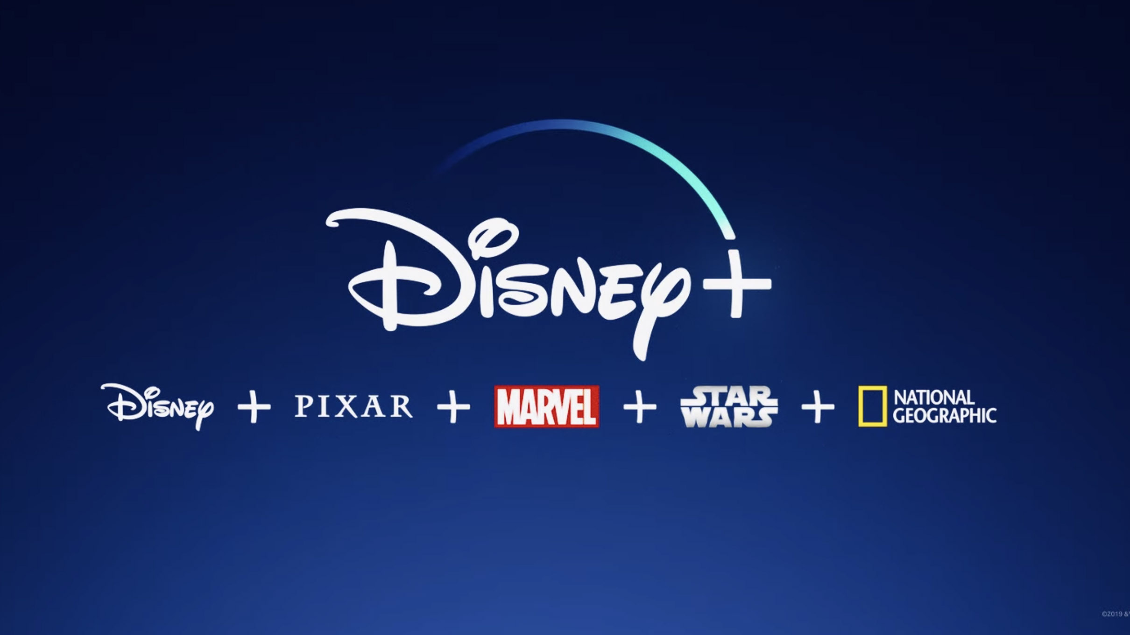
How Disney is impacted
Global pandemic COVID has pushed companies like Disney to move over to an online only system
Online only system has made Disney create new schemes
In person– Magic Key Program
Online– Disney+

Slide 4
Reviews using TextBlob
Implementing TextBlob method to find sentiment (positive/negative) of guest reviews on three Disney parks
Disneyland (California)
Disneyland (Paris)
Disneyland (Hong Kong)
Majority of guests tend to lean with 3+ (scale of 0-5) rating
Reviews are based on pre-Covid ratings

Slide 5
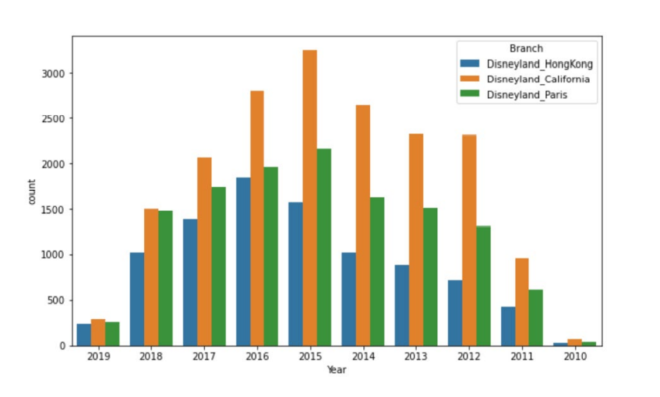
How parks stack up against each other

Slide 6



Models used on review dataset
Logistic Regression
Multinomial Naïve Bayes Classifier
Decision Tree Classifier
Accuracy: 51%
Accuracy: 50%
Accuracy: 46%

Slide 7
After closure Disney implements new programs
Magic Key Program
Disney+
Different pricing levels promised different dates available (per year) for reservations
Implemented to prevent overcrowding at California parks
Was not positively accepted due to minimal dates available
Online streaming service to compete against Netflix, Prime Video, etc.
Introduced November 2019 (in USA) which was peak COVID year
Disney parks remained closed while Disney+ began to bring in revenue

Slide 8
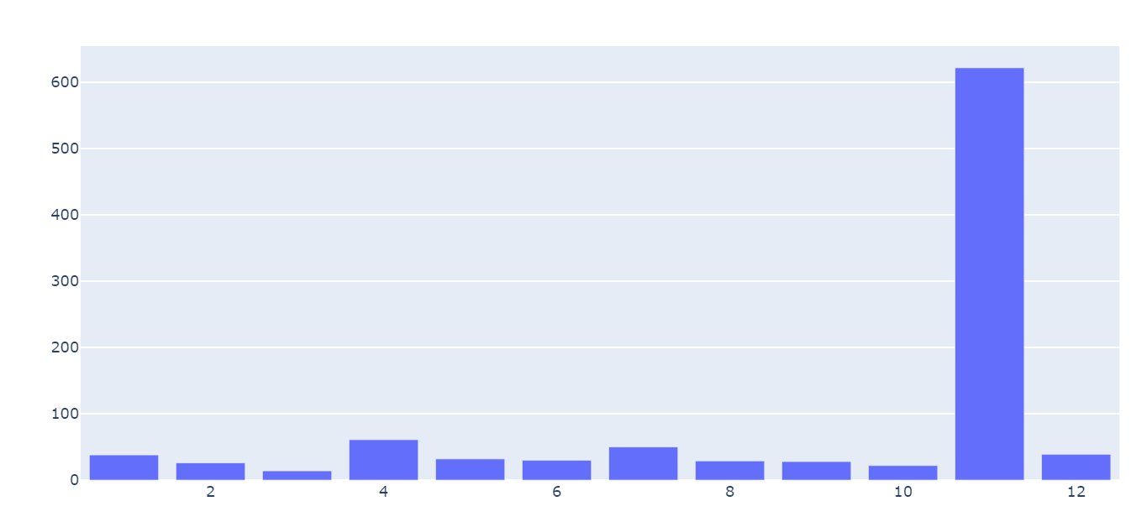
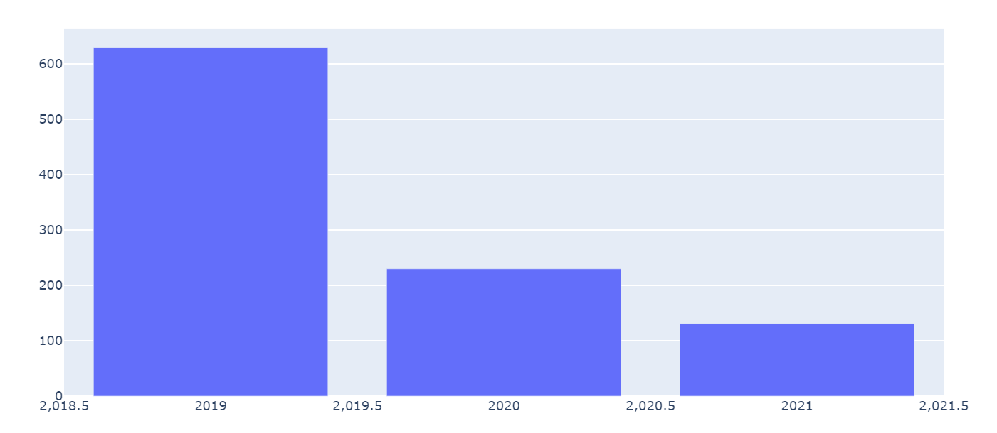
Disney+ performance
COVID caused for a need of such streaming service to bring in revenue
This explains the huge dump of content in Nov/2019 when service was created
In terms of years content becomes more scarce

Slide 9
Summary
Disney suffered from COVID but to a small extent
People remain die-hard fans of Disney regardless of programs they implement
It is assumed people have a positive outlook on Disney

Slide 10
Thank you

