Slide 1
Compressive Sensing and the Cocktail Party Problem
Andy Huynh and Eli Saracino

Slide 2
Problem
How can Compressive Sensing be applied to simulate a human’s ability to filter out distinct conversations from a “noisy room”?
With each voice being a distinct signal, this becomes a blind source separation problem working on several overlapping signals.
Given x (mixture of potentially many signals) recover distinct signals that compose x…etc.
Insert a formula here

Slide 3
Problem Motivation
Well-known and notorious problem in Computer Science.
An efficient approach to solving it has far-reaching ramifications:
Lol
results hoped for, applications where it might be useful?

Slide 4
Description of Data
Signals consisted of six word sentences of the form:
<command> <color> <preposition> <letter> <number> <adverb>
“Place white at L 3 now.”
Characteristics:
Relatively narrow but easily confusable vocabulary
Makes no demands on higher-level language processing
Highly varied
Allows for different combinations: Male/Female voices, Male/Male voices, etc.

Slide 5
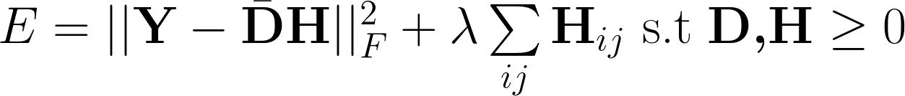
Previous Work
Similar problem structure: minimization of L1 norm
Non-negative Matrix Factorization problem statement and goals
Deep Learning and Hidden Markov Models have since surpassed this method of approaching the Problem.

Slide 6
Example
Lolbad examplelol

Slide 7


Blind Source Separation
Discuss changes from pre-candes/tao implementation, how we’re altering the problem to make it more modern.

Slide 8
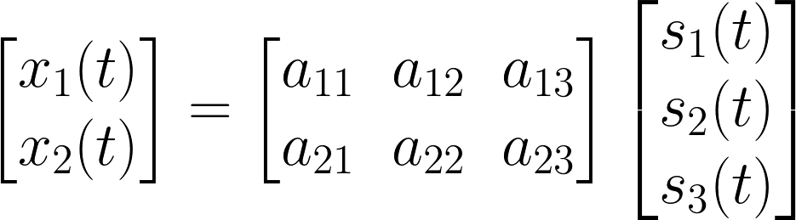




Slide 9
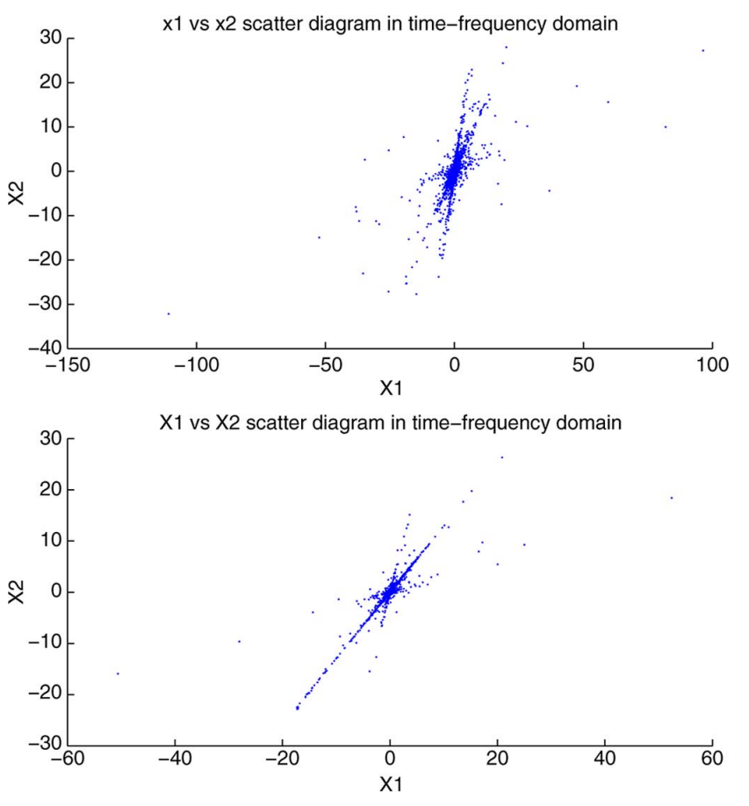
Approach
ICA to find M
Bao G, Ye Z, Xu X, Zhou Y. IEE Transactions on Audio, Speech, and Language Processing

Slide 10
Results
We don’t have these yet lol

Slide 11
Going forward
Remaining questions, things we hope to achieve, etc.

