Slide 1
Compressive Sensing and the Cocktail Party Problem
Andy Huynh and Eli Saracino

Slide 2

The Cocktail Party Problem
Humans can focus in on one voice with many in the background
Can we do the same thing on paper?

Slide 3
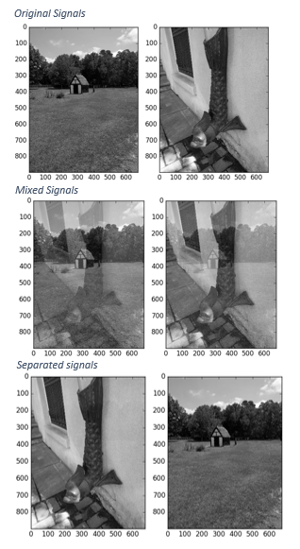

Problem Motivation
Surveillance
Communications
Neuroimaging

Slide 4

Interspeech 2006 Data Set
Signals consisted of six word sentences of the form:
<command> <color> <preposition> <letter> <number> <adverb>
“Place white at L 3 now.”
Characteristics:
Relatively narrow but easily confusable vocabulary
Makes no demands on higher-level language processing
Highly varied
Allows for different combinations: Male/Female voices, Male/Male voices, etc.

Slide 5
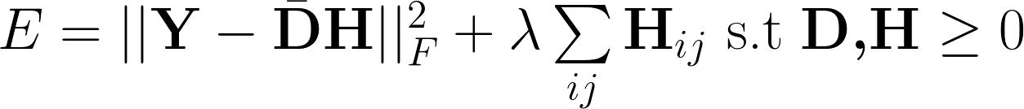
Previous Work: Non-negative Matrix Factorization
Schmidt, Olsson. “Single-channel speech separation using sparse non-negative matrix factorization”
Results were not ideal:
Around 50-60% word recognition rates
Deep Learning and Hidden Markov Models have since surpassed this method of approaching the Problem.

Slide 6
Previous Work: Compressed Sensing
Given time signals x and s, find A such that x is some linear combination of the elements of s.
Without external or very little external information
Bao, Ye, Xu, Zhou. “A Compressed Sensing Approach to Blind Separation of Speech Mixture Based on a Two-Layer Sparsity Model”

Slide 7
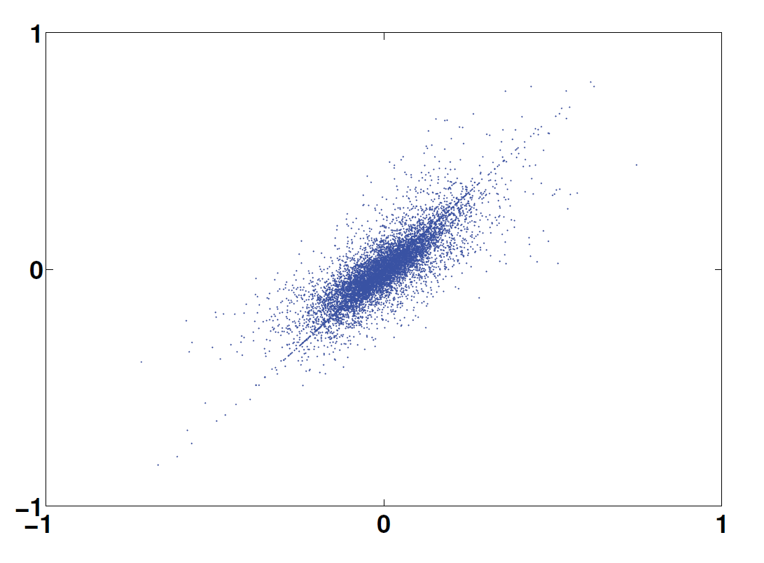
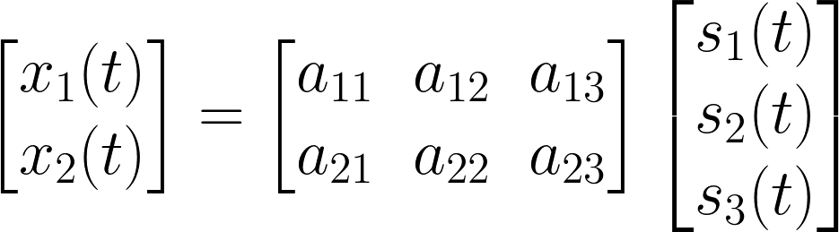
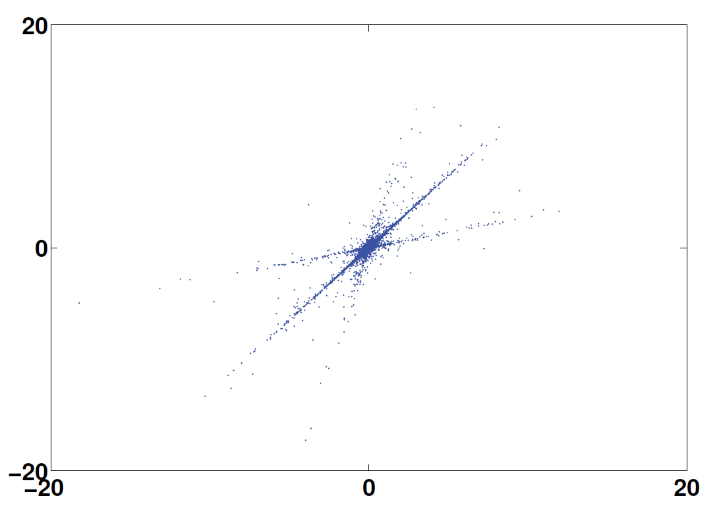
Methodology
Time domain
Transform domain
Computing mixing matrix A
Assume sources are sparse
At each time instance, 1 source is nonzero
Time Frequency domain is sparser
Points lie on a line given by columns of A
K-Means to find these representations
Xu T, Wang W. IEE Workshop on Statistical Signal Processing

Slide 8
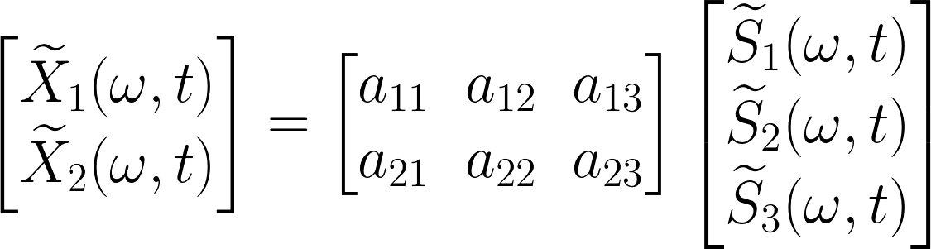
The Quest for “A” Mixing Matrix
1) Compute STFT
2) Normalize vectors in STFT to move all points onto a semi-circle
3) Choose k=# of sources
4) Run k-means the transform to find an estimated A
Bao, Ye, Xu, Zhou, IEE Transactions on Audio, Speech, and Language Processing

Slide 9


Adding the Dictionary
is generally a DCT dictionary, but for this application performs poorly
Train a better by using the K-SVD algorithm

Slide 10
Extensions of this Work
1 vs All Decomposition
Iterative method to obtain desired voice
Try principal component analysis (PCA) to find mixing matrix M
Time domain
Frequency domain
Xu T, Wang W. IEE Workshop on Statistical Signal Processing

Slide 11
Smashmouth
Question?

