Slide 1
Compressive Sensing and the Cocktail Party Problem
Andy Huynh and Eli Saracino

Slide 2
Problem
How can Compressive Sensing be applied to simulate a human’s ability to filter out distinct conversations from a “noisy room”?
With each voice being a distinct signal, this becomes a blind source separation problem working on several overlapping signals.
Given x (mixture of potentially many signals) recover distinct signals that compose x…etc.
Insert a formula here

Slide 3
Problem Motivation
Well-known and notorious problem in Computer Science.
An efficient approach to solving it has far-reaching ramifications:
Lol
results hoped for, applications where it might be useful?

Slide 4

Interspeech 2006 Data Set
Signals consisted of six word sentences of the form:
<command> <color> <preposition> <letter> <number> <adverb>
“Place white at L 3 now.”
Characteristics:
Relatively narrow but easily confusable vocabulary
Makes no demands on higher-level language processing
Highly varied
Allows for different combinations: Male/Female voices, Male/Male voices, etc.

Slide 5
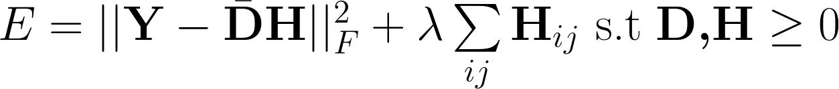
Previous Work: Non-negative Matrix Factorization
Similar problem structure: minimization of Frobenius norm, squared of the difference between Y and DH, such that the L1 norm of H is minimized:
Results were not ideal:
Around 50-60% word recognition rates
Deep Learning and Hidden Markov Models have since surpassed this method of approaching the Problem.

Slide 6

Blind Source Separation
Given time signals x and s, find A such that x is some linear combination of the elements of s.
Without external or very little external information
A Compressed Sensing Approach to Blind Separation of Speech Mixture Based on a Two-Layer Sparsity Model
Bao, Ye, Xu, Zhou, IEE Transactions on Audio, Speech, and Language Processing

Slide 7
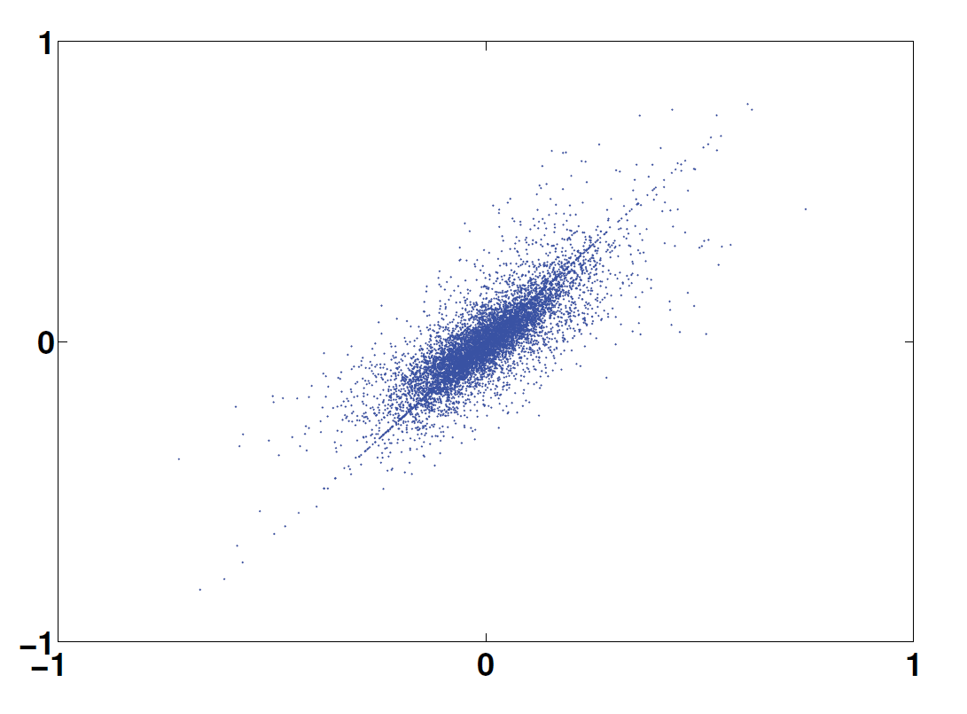
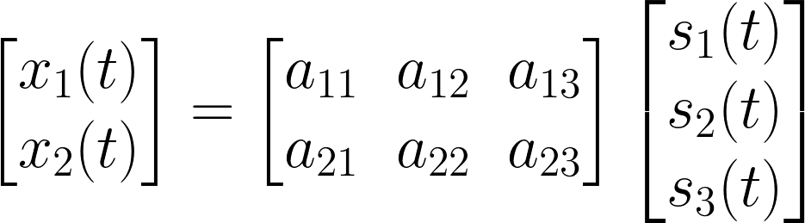
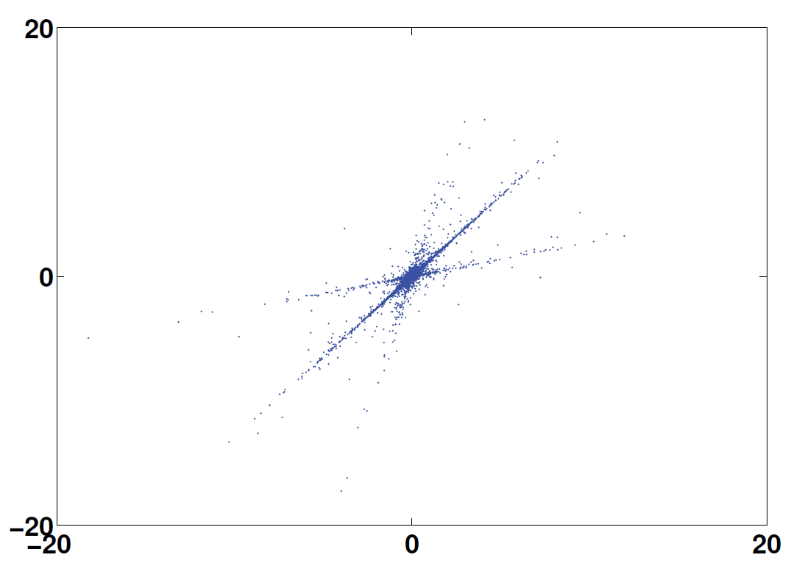
Methodology
Time domain
Transform domain
Computing mixing matrix A
Assume sources are sparse
At each time instance, 1 source is nonzero
Time Frequency domain is sparser
Points lie on a line given by columns of A
K-Means to find these representations
Xu T, Wang W. IEE Workshop on Statistical Signal Processing

Slide 8
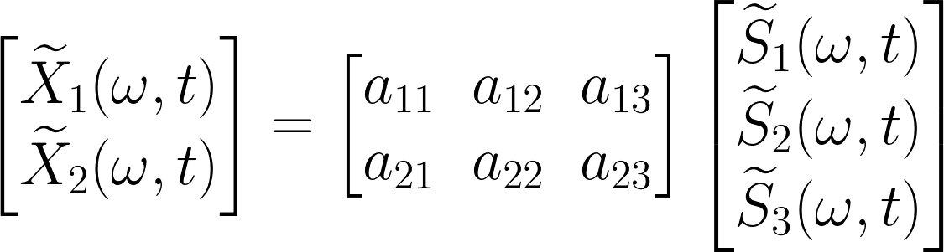
The Quest for “A” Mixing Matrix
1) Compute STFT
2) Normalize vectors in STFT to move all points onto a semi-cricle
3) Choose k=# of sources
4) Run k-means the transform to find an estimated A
Bao, Ye, Xu, Zhou, IEE Transactions on Audio, Speech, and Language Processing

Slide 9
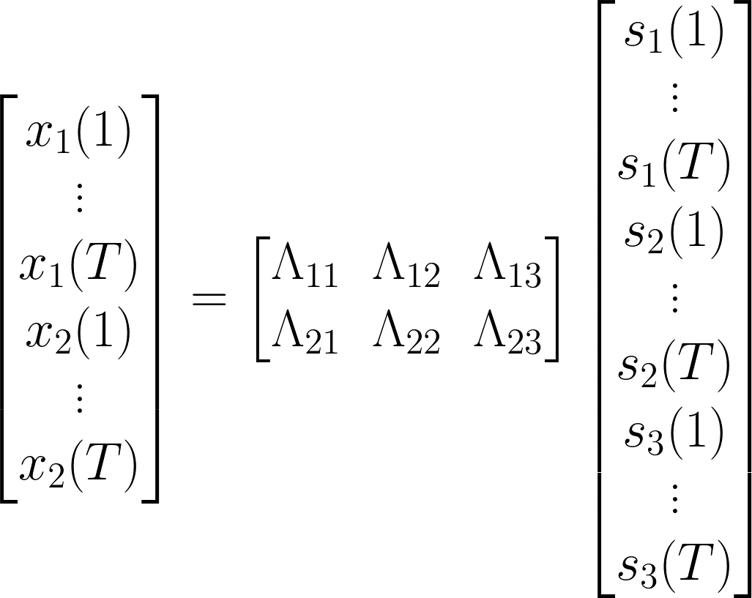


Recovering Sources

Slide 10


Adding the Dictionary

Slide 11
Our Approach: Independent Component Analysis
ICA to find M:
Compute STFT of s to obtain the time-frequency domain of s.
Cluster the columns of the STFT to obtain the columns of the mixing dictionary, M.
Time domain
Frequency domain
Xu T, Wang W. IEE Workshop on Statistical Signal Processing

Slide 12
Smashmouth
Question?

