Slide 1
Compressive Sensing and the Cocktail Party Problem
Andy Huynh and Eli Saracino

Slide 2

The Cocktail Party Problem
Humans can focus in on one voice with many in the background
Can we do the same thing on paper?

Slide 3
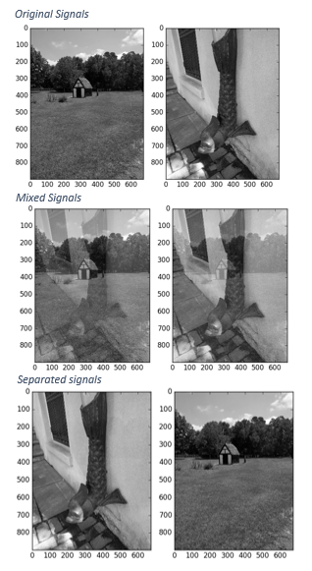

Problem Motivation
Surveillance
Communications
Neuroimaging
Model
Let S be a set of source signals and X a mixture of these signals determined by A. Given X recover S.

Slide 4

Interspeech 2006 Data Set
Speech Separation Challenge: recognize speech from a target talker in the presence of other speech.
Signals consisted of six word sentences of the form:
<command> <color> <preposition> <letter> <number> <adverb>
“Place white at L 3 now.”
Characteristics:
Relatively narrow but easily confusable vocabulary
Makes no demands on higher-level language processing
Highly varied
Allows for different combinations: Male/Female voices, Male/Male voices, etc.

Slide 5
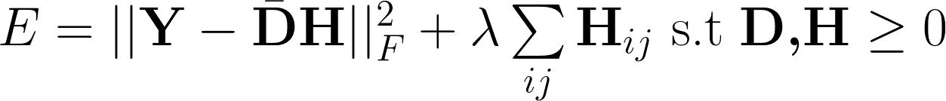
Previous Work: Non-negative Matrix Factorization
Schmidt, Olsson. “Single-channel speech separation using sparse non-negative matrix factorization”
Results were not ideal:
Around 50-60% word recognition rates
Deep Learning and Hidden Markov Models have since surpassed this method of approaching the Problem.

Slide 6
Previous Work: Compressed Sensing
Let S be a set of source signals and X a mixture of these signals determined by A. Given X recover S.
Key difference: we now have no external or very little external information besides X
Bao, Ye, Xu, Zhou. “A Compressed Sensing Approach to Blind Separation of Speech Mixture Based on a Two-Layer Sparsity Model”

Slide 7
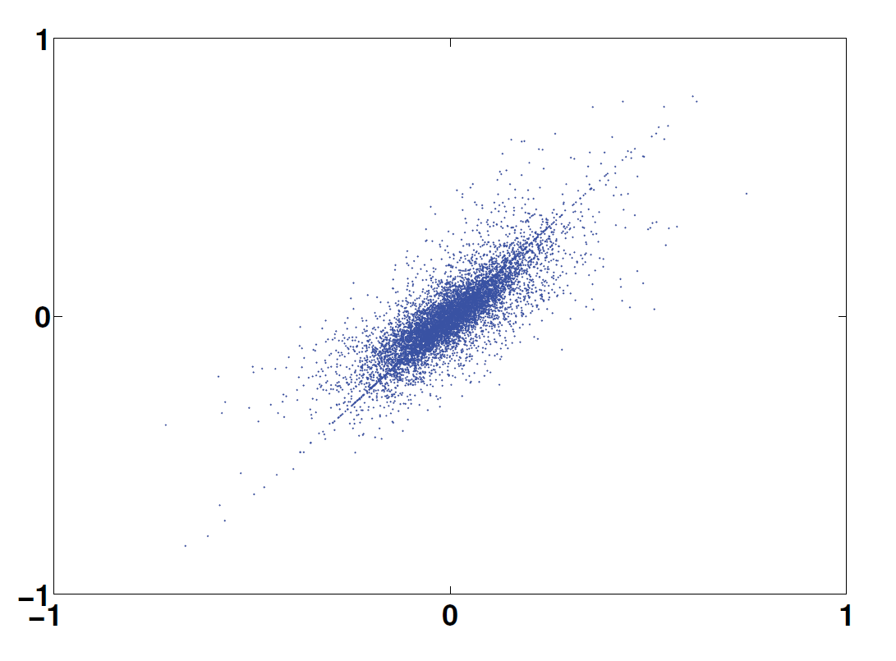
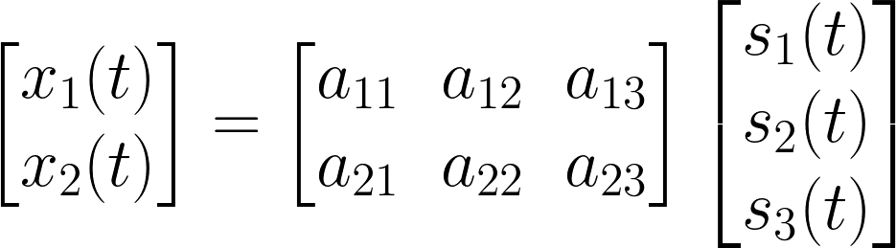
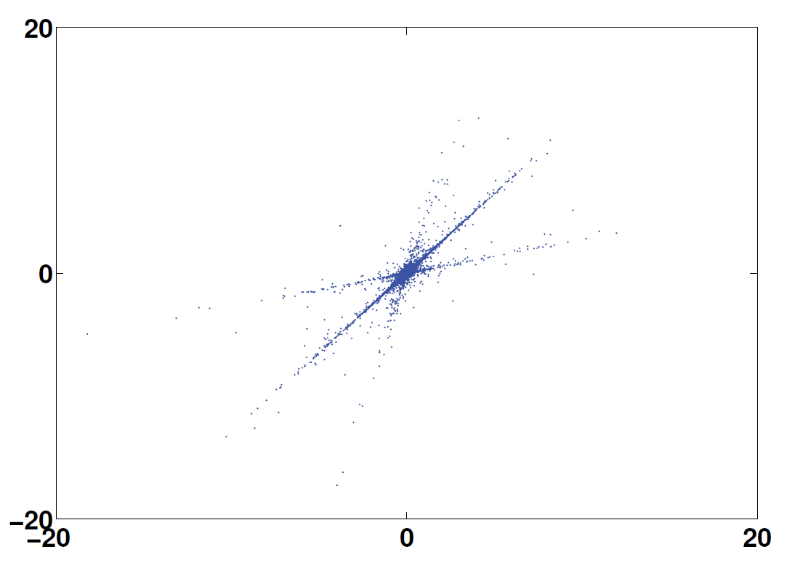
Methodology
Time domain
Transform domain
Computing mixing matrix A
Assume sources are sparse
At each time instance, 1 source is nonzero
Time Frequency domain is sparser
Points lie on a line given by columns of A
K-Means to find these representations
Xu T, Wang W. IEE Workshop on Statistical Signal Processing

Slide 8
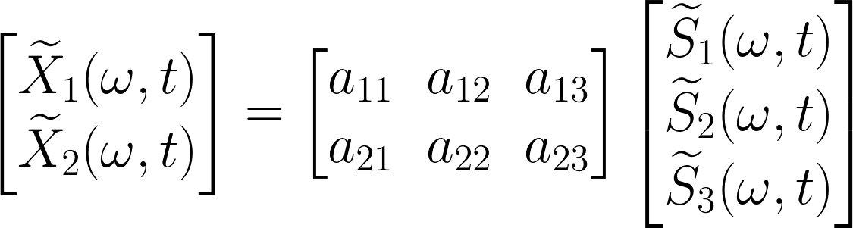
The Quest for “A” Mixing Matrix
1) Compute STFT
2) Normalize vectors in STFT to move all points onto a semi-circle
3) Choose k=# of sources
4) Run k-means on the transform to find an estimated A
Bao, Ye, Xu, Zhou, IEE Transactions on Audio, Speech, and Language Processing

Slide 9


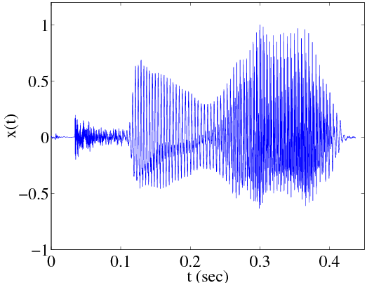
Adding the Dictionary
is generally a DCT dictionary, but for this application performs poorly
Train a better by using the K-SVD algorithm
“Semi-blind” source separation:
Train dictionary on dissimilar voices.
Bao, Ye, Xu, Zhou, IEE Transactions on Audio, Speech, and Language Processing

Slide 10
Extensions of this Work
1 vs All Decomposition
Iterative method to obtain desired voice
Try principal component analysis (PCA) to find mixing matrix M
Largest eigenvalue corresponds to the most prominent voice
Subtract out largest voice after recovery
Extend to n-voice overs
Time domain
Frequency domain
Xu T, Wang W. IEE Workshop on Statistical Signal Processing

Slide 11
Questions?

