Slide 1

BetterCap
a MitM framework
Eva Sarafianou
April 2016

Slide 2
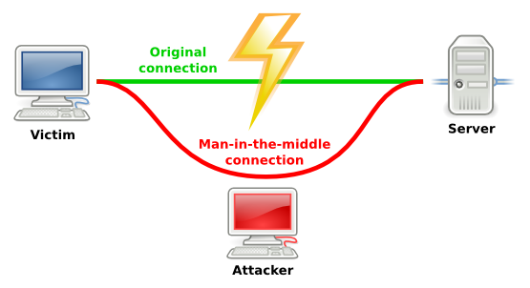
BetterCap
A Man-in-the-Middle framework
Written by Simone Margaritelli
in Ruby
Fully compatible with GNU/Linux,
Mac OS X and OpenBSD platforms
Modular - Easily extensible
Site: www.bettercap.com
Github: https://github.com/evilsocket/bettercap

Slide 3
BetterCap
Overview
ARP Spoofing
DNS Spoofing
SSLstrip & HSTS bypass
Code Injection
run Demos

Slide 4

ΑRP Protocol
Resolves IP address to MAC address
Needed to find which host is the destination of a packet
ARP table: entries of MAC address ↔ IP address

Slide 5
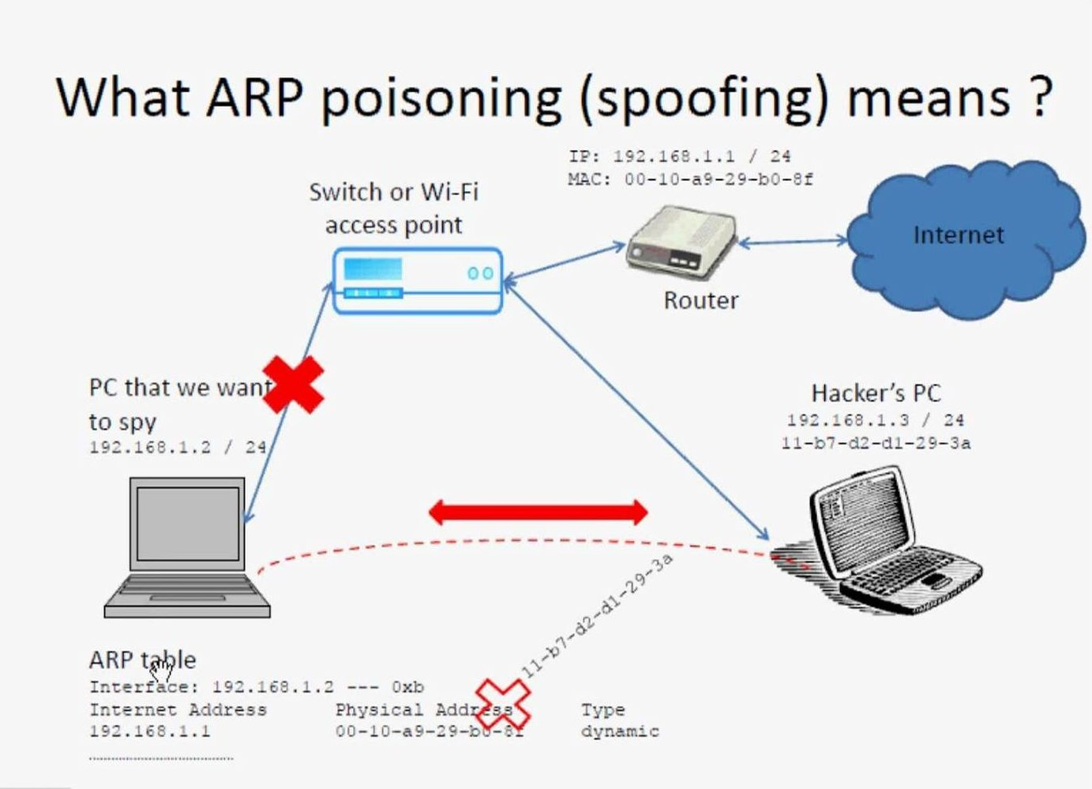
ARP Spoofing

Slide 6
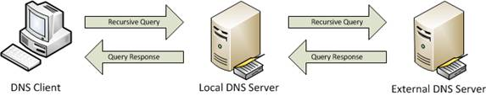
Normal DNS communication
Internet only understands addresses such as 74.125.95.103
DNS → associates IPs with hostname e.g. google.com →64.233.166.94
Query/response type format

Slide 7
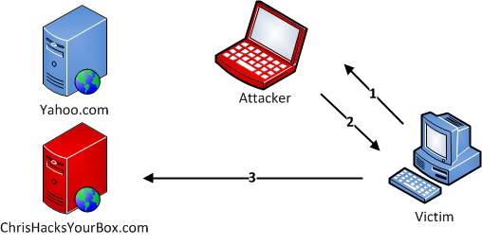
DNS Spoofing
1. Legitimate DNS Request Destined for DNS Server
2. Fake DNS Reply from Listening Attacker
3. Victim begins communicating with malicious site as result

Slide 8
Live demo

Slide 9
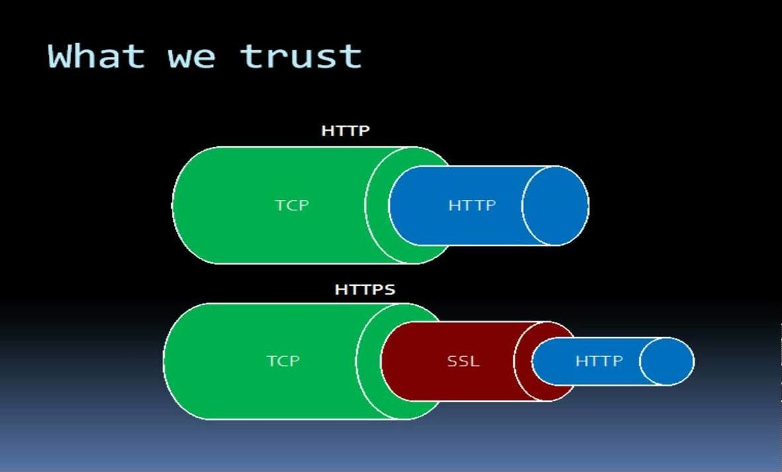
HTTP vs HTTPS/SSL connection

Slide 10


HTTPS/SSL connection
Connect to HTTP Site on 80
Redirect to HTTPS Site
Connect to HTTPS Site on 443
Web Browser
Provide Server Certificate
Web Server
Communication Begins

Slide 11
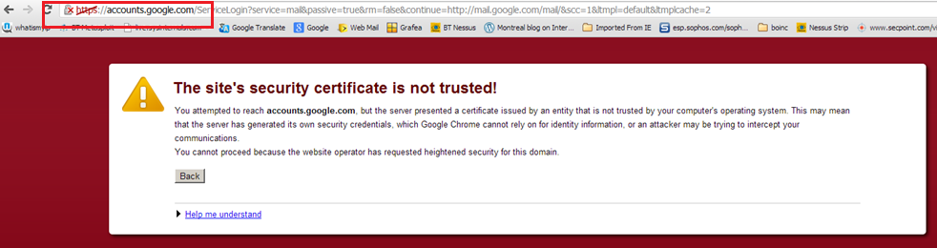
HTTP vs HTTPS/SSL connection

Slide 12
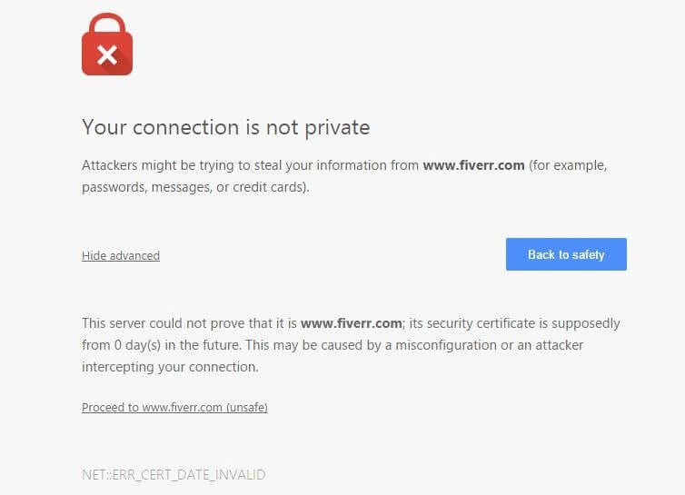
HTTP vs HTTPS/SSL connection

Slide 13

SSL stripping
Connect to HTTPS Site on 443
Connect to HTTPS Site on 443
Replace HTTPS with HTTP
Provide server certificate
Communication in cleartext
Encrypted Communication
Web Browser
Attacker
Web Server
Defeats the “bridge” between non-encrypted and encrypted communications → defeats https
A page would normally look like:
... <a href="https://www.facebook.com/">Login</a> …
During a SSL stripping attack its HTML code will be modified as:
... <a href="http://www.facebook.com/">Login</a> ...

Slide 14
HSTS & HSTS bypass (sslstrip2)
HSTS – HTTP Stricy Transform Security
A solution to sslstrip
Web browsers interact with web servers using only secure HTTPS connections
HSTS policies have been prebuilt into major browsers
HSTS bypass
Downgrade HTTPS links to HTTP
Prepend some custom subdomain name to them
A page would normally look like:
... <a href="https://www.facebook.com/">Login</a> ...
Using HSTS bypass attack:
... <a href="http://wwww.facebook.com/">Login</a> ...

Slide 15
Can we HSTS bypass using BetterCap?
Yes!
Server Name Indication (SNI) → multiple HTTPS websites served off the same IP address with multiple certificates
At TLS negotiation: server's decision for the correct certificate → attacker detects it
BetterCap’s HTTPS proxy
detects the upstream server host
spoofs the correct certificate
But!
NEED access to the victim's pc → add BetterCap's certificate to victim's browser trusted certificates → unreasonable assumption

Slide 16
Injecting Javascript/HTML/CSS

Slide 17
Live demo

Slide 18
Commands we used
Arp spoofing
sudo bettercap -T 192.168.1.2 -X
Dns spoofing
sudo bettercap -T 192.168.1.2 –dns dns.conf
Getting credentials from http
sudo bettercap 192.168.1.2 --proxy -P POST
Getting credentials from https:
sudo bettercap -T 192.168.1.2 --proxy –proxy-https -P POST
Css injection
sudo bettercap -T 192.168.1.2 -X --proxy --proxy-module injectcss --css-file site.css
Js injection
sudo bettercap -T 192.168.1.2 -X --proxy --proxy-module injectjs -–js-file myjs.js

Slide 19

Thank you :)
Questions?
eva.sarafianou@gmail.com

