Slide 1
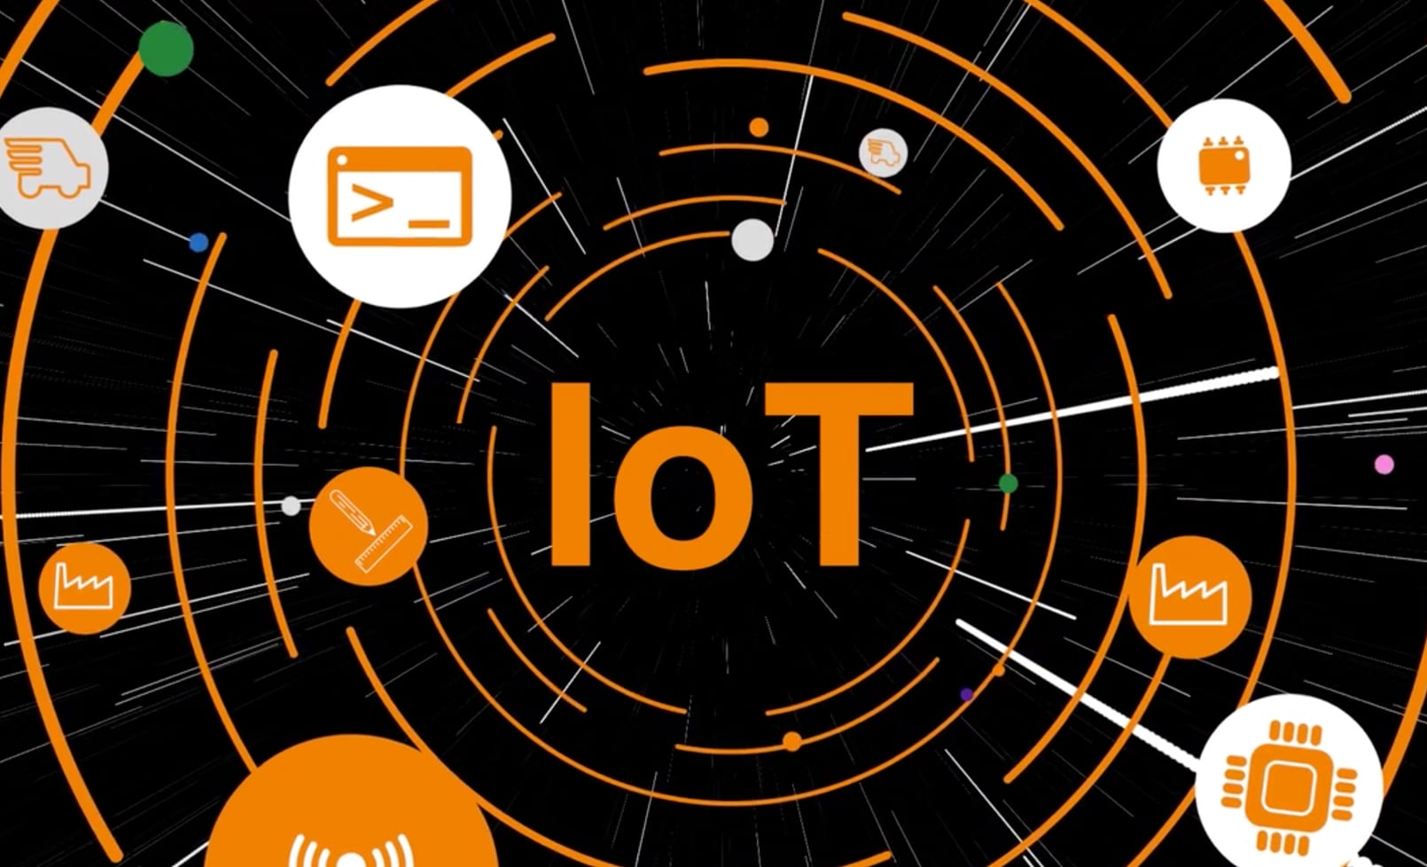
IOT Data Processor
Presented By: GROUP 8
Ezaz Sarkar
Harshita Sharma
Vibhuti Tikariha
Sameeksha Dongre
Renuka Singare

Slide 2

Contents of IOT Data Processor
Introduction
Purpose
DFD
Flow of program
Requirements
Advantages
Application
conclusion

Slide 3
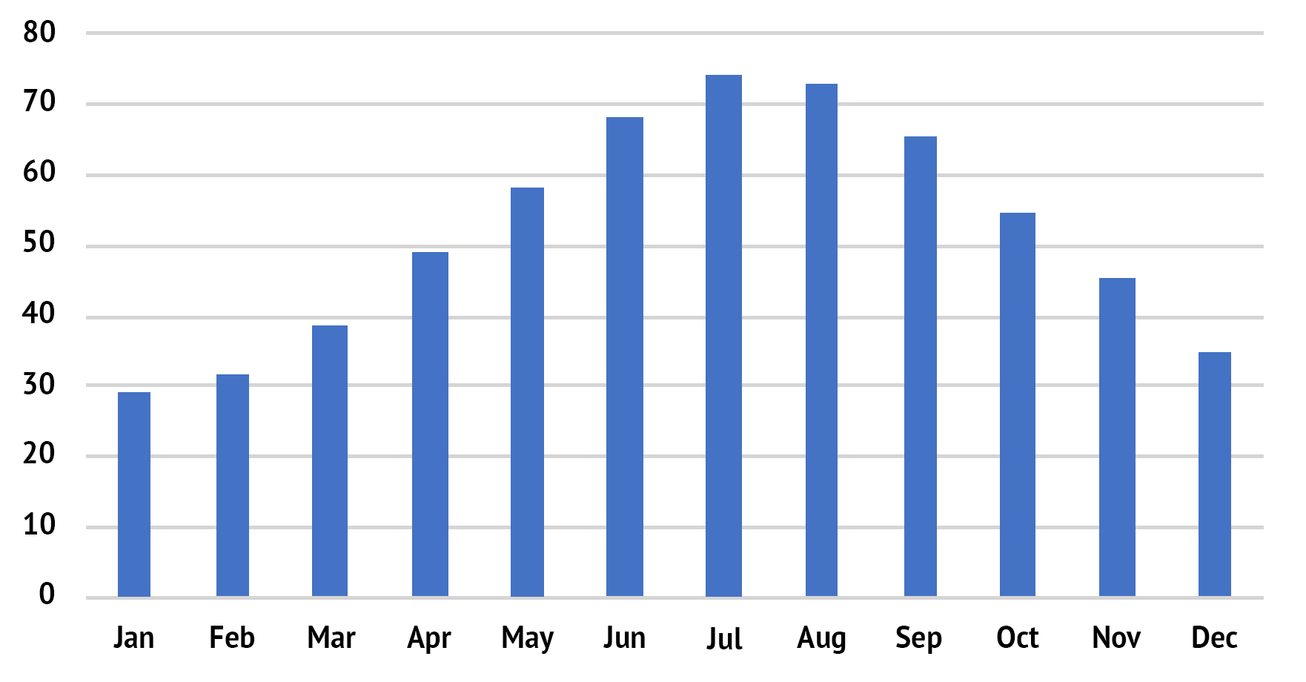
Introduction of IOT Data Processor
To record events, observations or measurements Systematically.
To measure and store environmental data.
Records data in relation to the location.
User can find average temperature and pollution.

Slide 4
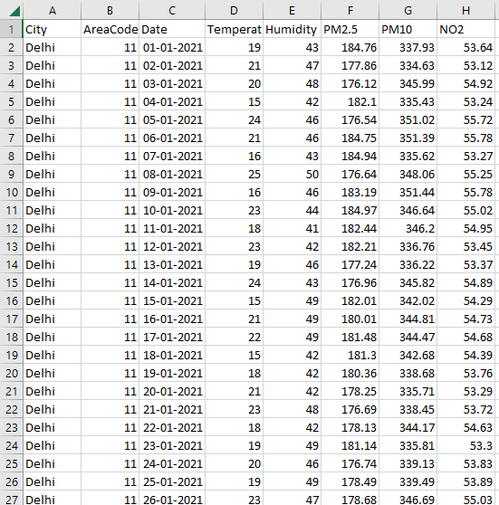
Purpose of IOT Data Processor
To show data files.
Graphical report of a parameter changes in a city over a year.
The user can also find the pollution level
Allows to save data in form of Csv file
You can create and configure files.

Slide 5
DFD of IOT Data Processor
CSV File containing data of cities.
User
Data Extraction
User Input
Data processing and
generation of output.
Processed Report
User

Slide 6
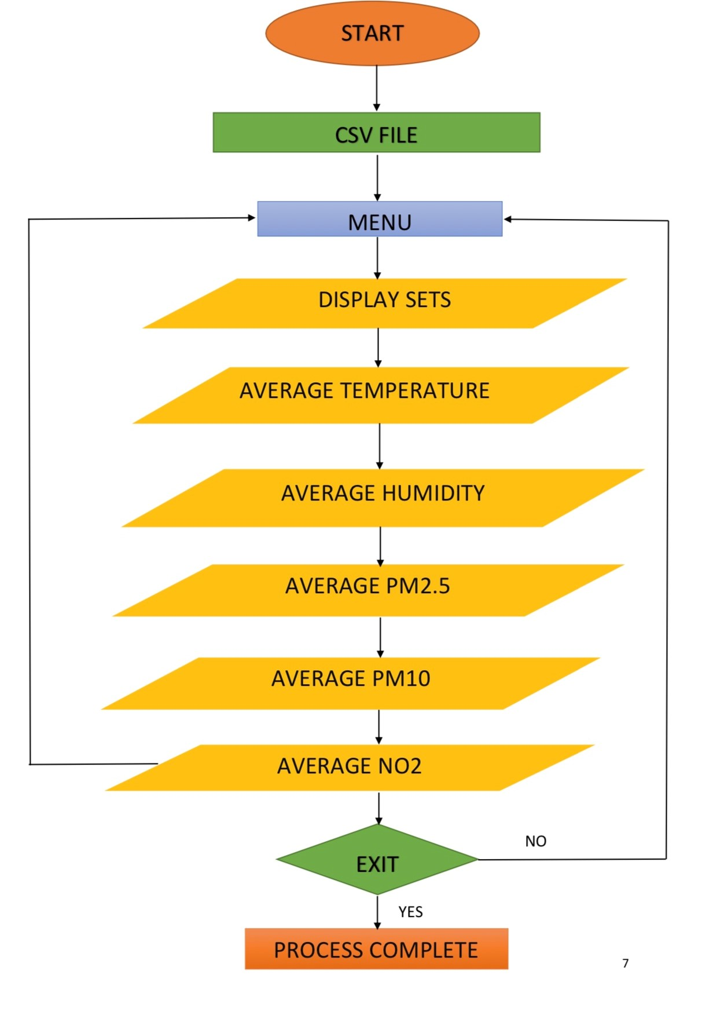
Flow of program of IOT Data Processor

Slide 7

Requirements of IOT Data Processor
Language : C
Tools: Make, Valgrind, Ctags.
Compiler: GCC (GNU Compiler Collection)
Operating system: Ubuntu Environment.

Slide 8
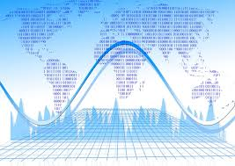
Advantages of IOT Data Processor
Higher efficiency and accuracy.
Versatile data acquisition.
Easy data analysis.
Reliable technology.

Slide 9
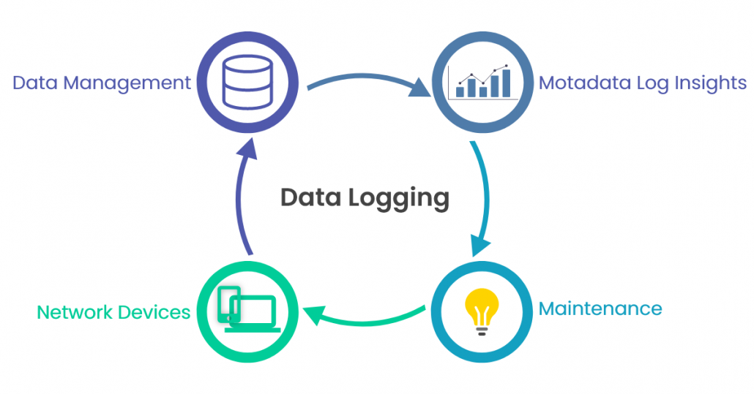
Applications of IOT Data Processor
Environmental monitoring
Industrial health and safety
Energy efficiency management
Farming
Urban planning

Slide 10
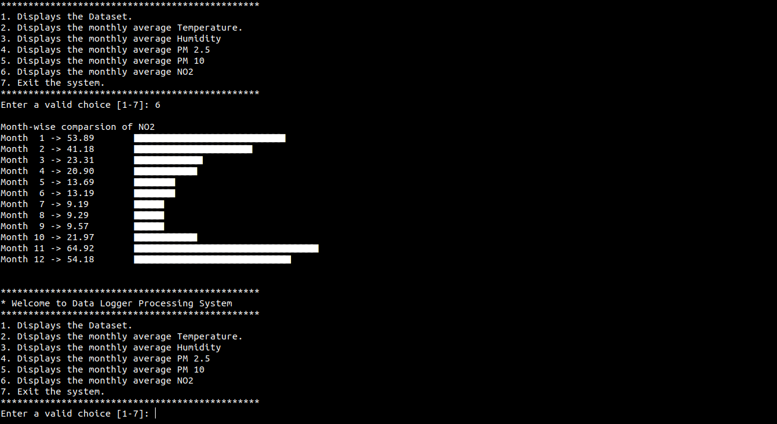
Conclusion of IOT Data Processor
Improved data driven decision making.
Considered by Meteorological department and local authorities.
Easy to use and user friendly.
Reliable and great future advancements.

Slide 11


