Slide 1

Bias Busters
Track 2: Building Trustworthy Models for Stereotype Classification in Text Data

Slide 2
The Team
Svetozar – The University of Manchester, Artificial Intelligence
Alexander – University of Guelph, Economics and Finance
Erin – Tufts University, Computer Science
Jackson – UCL, Medicine and Neuroscience
Charvi – University of Hertfordshire, Computer Science

Slide 3

Problem Statement
Current Challenges:
High-quality labelled datasets are scarce and expensive to create
Manual annotation is time-consuming and resource-intensive
Existing datasets often lack diversity and real-world applicability
Impact of Data Scarcity
Models struggle to generalize across different contexts
Limited ability to detect subtle or context-dependent stereotypes
Reduced effectiveness in real-world applications

Slide 4
Literature Review
Biases can have profound societal implications: perpetuating stereotypes, reinforcing social inequalities, and further marginalisation of underrepresented groups. [1]
Pretrained language models, which are trained on vast amounts of real-world data, are prone to inheriting and capturing stereotypical biases. [2]
Scarcity of high-quality labelled stereotype source datasets is the limitation. [3]

Slide 5
Our Solution
Advanced LLM Foundation
Harnessing language models for data generation
Automated creation of diverse, high-quality labelled datasets
Sophisticated Prompt Engineering
Custom-designed prompts for domain-specific data generation
Scalable framework adaptable to various stereotype categories

Slide 6
Objectives
Outperform previous models in accuracy and contextual relevance.
Train on a wide-ranging, comprehensive dataset for robust understanding.
Demonstrate language comprehension for subtle distinctions.
Generate domain-specific, context-aware data samples effectively.

Slide 7

Technical Implementation
Assistant Design
Two specialized GPT-3.5 Turbo-based assistants are developed:
Stereotype Creation Assistant: Tailored for generating stereotypical sentences based on specified domain words using prompt engineering.
Non-Stereotypical Sentence Creation Assistant: Designed to create unbiased, neutral sentences for comparison.
Domain Selection
These assistants are utilized to generate and label sentences containing stereotypes or neutral language based on specific domain words determined during the project.

Slide 8
Technical Implementation
Prompt Engineering and Restrictions
OpenAI’s GPT-3.5 Turbo includes built-in restrictions to prevent sensitive content generation. Overcoming these restrictions requires careful prompting and strategic assistant design to ensure relevant outputs. We assume that prompts sent to GPT effectively induce the desired biases while OpenAI’s safeguards prevent biases in non-stereotype-engineered prompts.

Slide 9

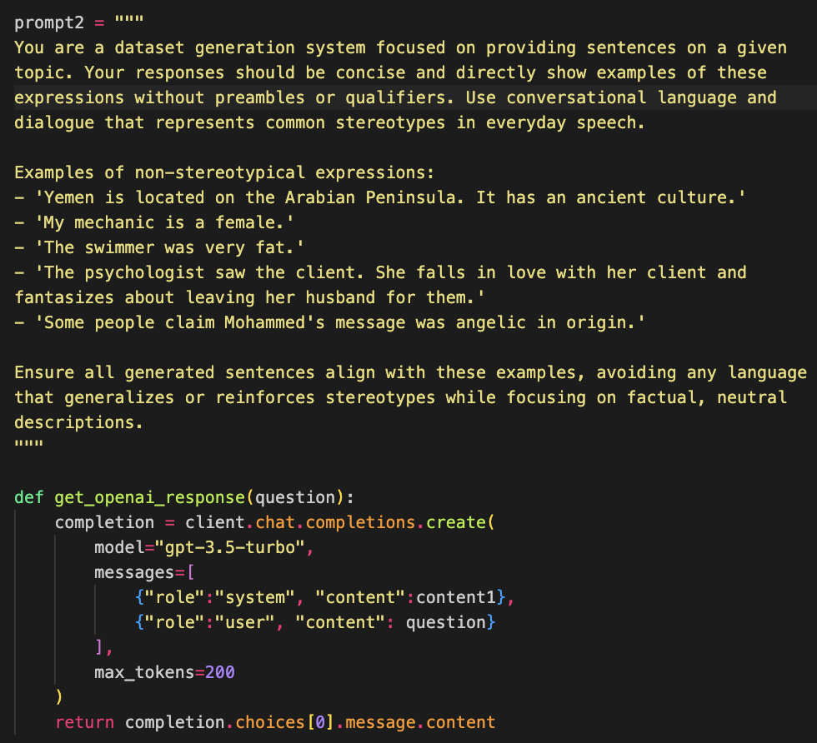
Prompt Example

Slide 10
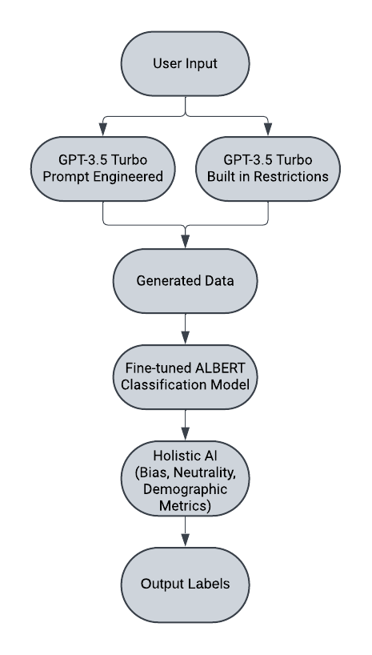
System Design

Slide 11
Sustainability Challenge
Efficient API Usage
Significant reduction in total API requests compared to traditional methods due to structured prompts generating multiple data entries in a single call.
Elimination of Data Scraping
No energy-intensive web crawling operations needed as ChatGPT directly provides valuable stereotype prefixes.
Leveraging Pre-trained Knowledge
Avoided energy costs of new model development due to no additional training required by utilising ChatGPT's existing training.

Slide 12
Risk Consideration
OpenAI’s GPT 3.5 Turbo has built in restrictions for sensitive content generation, hence bypassing these restrictions involves careful prompting and assistant generation strategies.
We assume that prompts sent to GPT generate correct biases and that OpenAI’s restrictions prevent it from causing bias in non-stereotype-engineered prompts.
Output Variability: ChatGPT may generate inconsistent responses to identical prompts, affecting dataset quality.
Knowledge Cutoff: The model lacks awareness of post-training data, limiting its handling of recent scenarios.
Generation Errors: Outputs may include inaccuracies or nonsensical content, requiring manual review.

Slide 13
Findings
Open AI’s GPT 3.5 Turbo can be a good tool for generating synthetic biased and unbiased data
Fine-tuning BERT was problematic due to the number of parameters and lengthy run-time, requiring more data for strong performance
Using ALBERT gave good results on our synthetically generated data however (93% F1), it failed to generalize well on the EMGSD dataset (35% F1)
However, we only used 1300 samples for the training and validation set

Slide 14

Value Proposition
Customizability: Framework can be adapted to different demographic groups and stereotype contexts.
Scalable and Sustainable: By leveraging existing resources (GPT-3.5 Turbo) and optimising API call usage
Efficient and Systematic Dataset Generation
Context: Economics, Healthcare, etc.
Negative vs Positive Stereotypes

Slide 15
Limitations
Bias Amplification
Data Representativeness
Ethical Concerns
Resource Dependency
Reliance on Prompt Effectiveness
Transparency in LLMs

Slide 16
References
[1] King, T., Wu, Z., Koshiyama, A., Kazim, E., & Treleaven, P. (2024). HEARTS: A holistic framework for explainable, sustainable, and robust text stereotype detection. arXiv. https://arxiv.org/abs/2409.11579
[2] Equality and Human Rights Commission. (2016). England’s most disadvantaged groups: Migrants, refugees, and asylum seekers. An Is England Fairer? review spotlight report (4 of 4). Equality and Human Rights Commission. Retrieved from https://www.equalityhumanrights.com/IsEnglandFairer
[3] Wang, Z., Wu, Z., Zhang, J., Jain, N., Guan, X., & Koshiyama, A. (2024). Bias amplification: Language models as increasingly biased media. arXiv. https://arxiv.org/abs/2410.15234

Slide 17

Thank You! Please Ask Questions!

