Slide 1
What the News Media Can Learn from Librarians
By Louise Lief
Columbia Journalism Review
October 24, 2016
Presented by
Valentina Neblitt-Jones
Los Alamos National Laboratory (LANL)
Metadata/Systems Librarian
vneblitt@lanl.gov
https://www.cjr.org/innovations/librarians_journalism_lessons.php

Slide 2
Scenario/Background
“Journalism has had the luxury of not having to ask itself the existential question of why anyone should pay any attention to us at all”
Jeffrey Rutenbeck, Dean of the School of Communication, American University
https://knightfoundation.org/features/je-append-rutenbeck-transcript-qa/

Slide 3
Why Learn from Librarians?
Navigate the world of information
Help scholars and students get what they need
Distinguish good information from bad
Faced technological disruptions
Developed a set of principles to help their patrons assess the credibility of information and use it ethically ← Information Literacy

Slide 4
Information Literacy
Pay attention to the source of the information
Ask whether it can be verified
Consider the context

Slide 5
Information Literacy
Information literacy is the set of integrated abilities encompassing:
the reflective discovery of information
the understanding of how information is produced and valued
the use of information in creating new knowledge and participating ethically in communities of learning
http://www.ala.org/acrl/standards/ilframework

Slide 6
IL Framework – 6 Principles
Authority is Constructed and Contextual
Information Creation as a Process
Information has Value
Research as Inquiry
Scholarship as Conversation
Searching as Strategic Exploration
American Library Association (ALA)
Association of College and Research Libraries (ACRL)
http://www.ala.org/acrl/standards/ilframework

Slide 7
Scholarship as Conversation - Practices
Cite contributing work
Contribute to scholarly conversation
Identify barriers to entry
Critically evaluate contributions
Identify contributions
Summarize changes
Recognize the place of a given scholarly work
http://www.ala.org/acrl/standards/ilframework

Slide 8
Scholarship as Conversation - Dispositions
Recognize that the conversation is ongoing and not finished
Seek out conversations
Recognize self as contributor
Recognize the variety of venues
Suspend judgment
Understand responsibility
Value contributions by others
Recognize system privilege
http://www.ala.org/acrl/standards/ilframework

Slide 9
What Does Success Look Like?
User inquires
Says who?
Based on what authority?
Based on what evidence?
Next level
Refutes inaccurate information

Slide 10
Teaching about the Harm of Plagiarism
Two University of Maryland librarians found that using compliance to discuss the importance of citing sources while discussing plagiarism and academic integrity did not resonate with their students.
So they used examples from Twitter to show the harm that plagiarism causes.
https://creativelibrarypractice.org/2015/03/11/scholarship-is-a-conversation/
https://borrowingsam.tumblr.com/
Notes:
Used Twitter with the following goals:
articulate how academic writing is a form of participation within a larger discourse – “academic writing is a means of responding to previous researchers”
describe why citations and attribution are important within scholarly communication – “importance of citations was to give credit to the original author and/or strengthen an argument’s cogency, rather than focusing on personal consequences”
*****************************
Today’s information landscape challenges many long-held assumptions. Take the issue of plagiarism. In a 2015 journal article, two University of Maryland librarians described the challenges they faced teaching freshmen about citing sources, plagiarism, and academic integrity. The students were skeptical. The lesson did not correspond to their experiences on social media, where information is routinely recycled, repackaged, and repurposed.
So the librarians used Twitter to demonstrate their point, citing the case of a user who plagiarized comedians’ tweets, changing the wording slightly to avoid detection by search engines. This time the students understood the harm being done.
Illustrating the ongoing complexity of these issues, however, students then asked about using the same material on different media platforms. They wondered if there was such a thing as “self-plagiarism.”
The kind of discussion that led to the students’ awareness of these issues is an important principle of information literacy. It’s not a passive approach or a checklist. It’s a dynamic process that occurs through conversation and discourse. Acknowledging this, the librarians called their article “Scholarship is a Conversation.”
To address these deficiencies, Texas A&M University introduced a credit bearing, semester long course titled Theft of the Mind that utilized case studies based in popular culture to demonstrate to students that “plagiarism and piracy…are but endpoints on a continuum between source use and misuse” (Clement & Brenenson, 2013, p. 56). Central to the ethos of this course is the idea that “theft of the mind” hurts a community of practice at large as much as it does the individual content creator, whether this community is scholars within the academy or creative performers in popular culture (Clement & Brenenson, 2013, p. 57). This is an important value to imprint upon students that can be obscured in a compliance oriented lesson. Explaining that scholars depend on citation of their work for their livelihood provides students with a more forthright and holistic explanation as to why plagiarism carries such dire consequences within the academy. The success of this course at Texas A&M suggests that students respond well to the topic of scholarly attribution and plagiarism when instruction is placed within a framework that resonates with familiar life experiences.

Slide 11
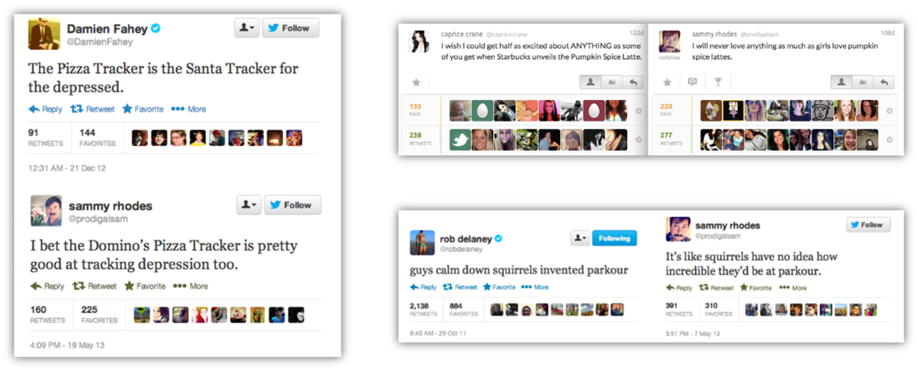
Borrowing Sam – Paraphrase Plagiarism
https://creativelibrarypractice.org/wp-content/uploads/2015/03/fig1.png

Slide 12
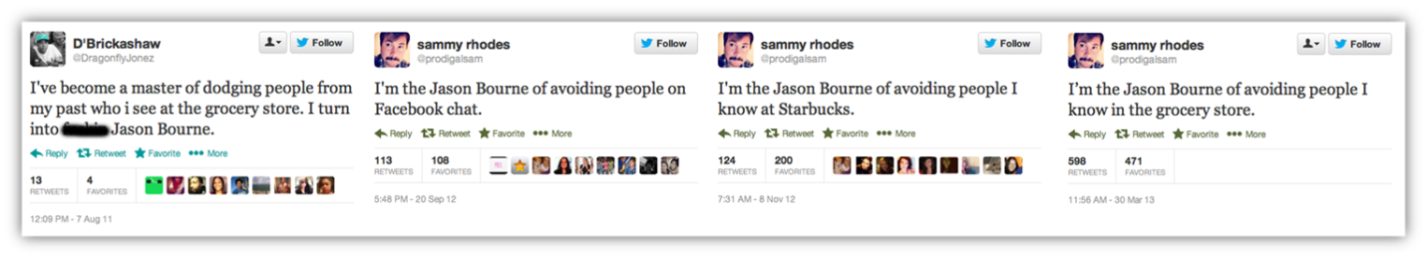
Borrowing Sam: Self-Plagiarism
https://creativelibrarypractice.org/wp-content/uploads/2015/03/fig2.png

Slide 13
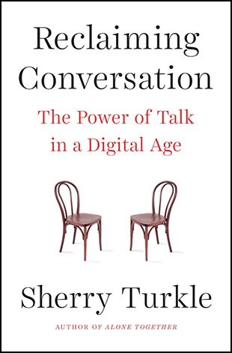
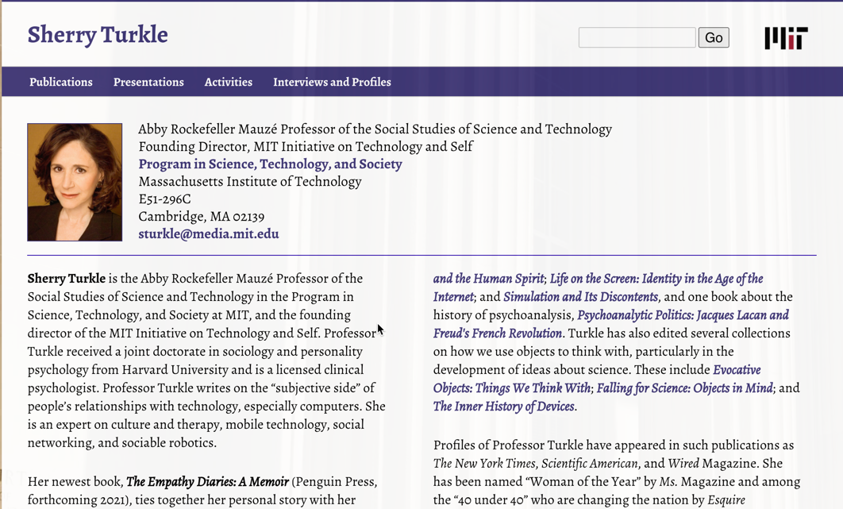
Sherry Turkle
http://sherryturkle.mit.edu/
Notes:
Studies technology’s impact on people and their relationships
Says her students
Believes the media supports a view of the world as a series of emergencies – an unending series of catastrophes it covers as “disasters that need disaster relief”
Find it difficult to place information in context or understand underlying causes, let alone feel empowered to seek solutions

Slide 14
Pew Research Report Findings
Adults aged 18-29
More negative attitudes towards the news media
Much less likely to engage with news than older adults
Least likely to say that the media is doing a good job
28% say they are very loyal to their sources of news (lowest percentage of any age group)
More likely to get their news online and more likely to see it on social networking sites; most don’t trust the information they get there
More likely than any other age groups to sense media bias
https://www.journalism.org/2016/07/07/the-modern-news-consumer/
Notes:
What Sherry Turkle has to say about her students and the news media is matches some points of this Pew research report.

Slide 15
Information Literacy
A more meaningful way to engage with information and manage information
Encourage users to
focus on inquiry rather than opinion
evaluate a range of sources
take into account diverse viewpoints and perspectives
develop the ability to pursue new avenues as they gain new understanding

Slide 16
Information Literacy
Assess the value of information in its various forms
How is it being used?
A commodity
A way to understand the world
A means to influence
A path to educate
Some combination of these
Users are not just knowledge consumers, but also knowledge creators

Slide 17
Conclusions: Reframing the News Media
Persuade a skeptical public that the media is
making a genuine effort to understand them
presenting them with credible information

Slide 18
Conclusions: How News Organizations Can Use IL
News organizations
Reinstating or adding internal fact-checking operations

Slide 19
Conclusions: How Journalists Can Use IL
As a navigational tool
Chart a course in destabilized terrain and around social media echo chambers
To check the traditional gate keeper
When collaborating with the public on a project
Some common understanding of how information will be evaluated and used
Open to diverse perspectives and the possibility of changing their mind

Slide 20
Article References and Links

Slide 21
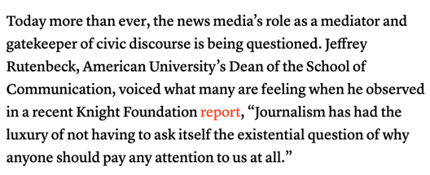
Links – Knight Foundation Report
https://knightfoundation.org/features/journalism-education/
Above & Beyond: Looking at the Future of Journalism Education
Dianne Lynch

Slide 22
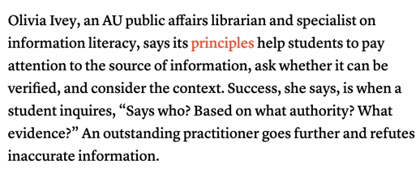
Links – Principles on Info Literacy
Broken link; use this
https://web.archive.org/web/20160130100040/https://acrl.ala.org/framework/?page_id=74
About The Framework for Information Literacy for Higher Education
ALA
A summary of http://www.ala.org/acrl/standards/ilframework

Slide 23
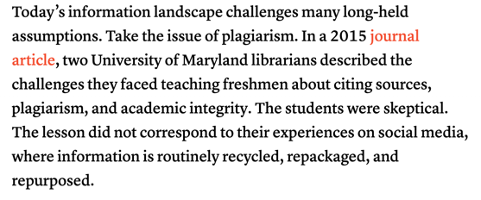
Links – Plagiarism
https://creativelibrarypractice.org/2015/03/11/scholarship-is-a-conversation/
“Scholarship is a Conversation”: Discourse, Attribution, and Twitter’s Role in Information Literacy Instruction
Alexander J. Carroll and Robin Dasler
March 11, 2015

Slide 24
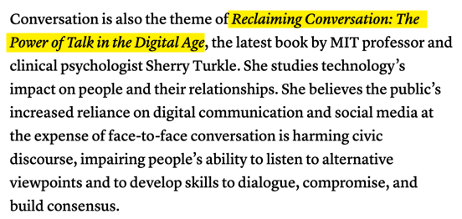
Reference – Reclaiming Conversation
Reclaiming Conversation: The Power of Talk in the Digital Age
Sherry Turkle
2015

Slide 25
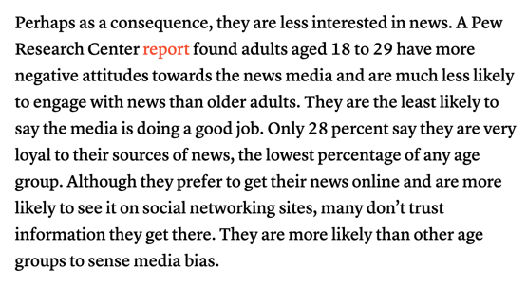
Links – Pew Research Center Report
https://www.journalism.org/2016/07/07/the-modern-news-consumer/
The Modern News Consumer: News Attitudes and Practices in the Digital Era
Amy Mitchell, Jeffrey Gottfried, Michael Barthel, Elisa Shearer
July 7, 2016

