Slide 1
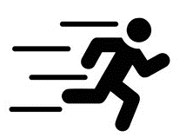

Evaluating the effect of a nationwide school policy on physical activity and body mass index
PhD Defence
Natascha Holbæk Pedersen
Research Unit for Exercise Epidemiology
Department of Sports and Clinical Biomechanics
University of Southern Denmark
Notes:
Hi everybody. Today I will present my phd thesis entitled ‘Evaluating the effect of a nationwide school policy on physical activity and body mass index’.
Initially, I would like to thank the assessment commitee for reading and evaluating my work and for being here today. Thank you.
The work i’ll present today was funded by trygfonden and a one year faculty scholarship.
I started this process in 2016 – so it has been a long way coming and i am really excited to be here today.

Slide 2
Introduction
Notes:
Before presenting the core of my work, I will shortly introduce you to the field

Slide 3
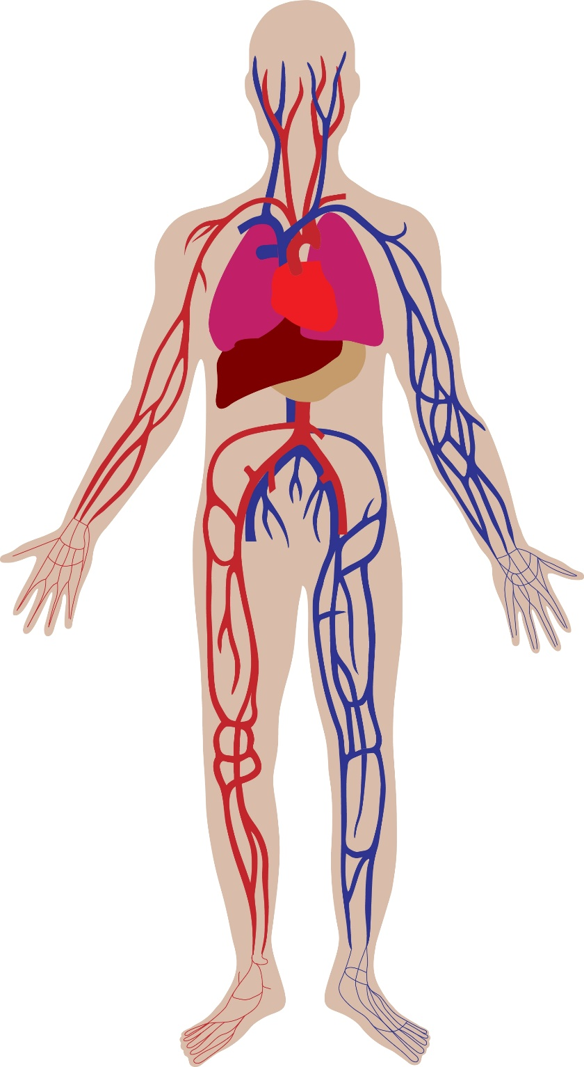
Why is physical activity important????
(Lee et al., 2012; 2018 Physical Activity Guidelines Advisory Committe, 2018; Donelly et al., 2016; Biddle et al., 2019)
Notes:
PA is important in disease prevention and health promotion. PA reduces risks of major diseases like t2d and CVD. It positively affects bone health, and may effect parts of mental and cognitive health.

Slide 4

Insufficient levels of physical activity among children and adolescents internationally
Meeting recommendations of 60 minutes of moderate to vigorous physical activity (MVPA) daily
(Guthold et al., 2020; Guthold et al., 2018)
Notes:
Even though the positive effects of physical activity are well-established, insufficient levels of PA is still a global health problem. Not only in the adult population – but also in children and adolescents.
A study from 2020 included data from 1.6 million adolescents aged 11-17. They found that less than 1 out of 5 achieved the recommended 60 minutes of moderate to vigorous PA daily.
(81% boys do not meet; 84 % girls)

Slide 5
Insufficient levels of physical activity among children and adolescents in Denmark
Meeting recommendations of 60 minutes of MVPA daily
(Sundhedsstyrelsen, 2019)
Notes:
In Denmark, the situation is likewise. A study based on objective measures of PA found that only 1 out of 4 adolescents aged 11-15 met the PA requirement.
Therefore, action is needed already early in life to target insufficient levels of PA.

Slide 6






Physical activity in obesity prevention
Physical activity prevents excessive weight gain
Overweight is complex and multifactorial
The main driver for overweight is still a positive energy balance over time
Overweight in childhood and adolescence track into adulthood
(2018 Physical Activity Guidelines Advisory Committe, 2018; Narciso et al., 2019; Romieu et al., 2017; NCD Risk factor collaboration, 2016; Whitloch et al 2009; Region Syddanmark 2022; Sundhedsstyrelsen 2022)
Notes:
Many of the adverse health outcomes caused by insufficient PA is linked to the increased risk of excessive weight gain when not being sufficiently physically active
Prevalence of overweight and obesity is increasing worldwide. In Denmark, it is especially the prevalence of severe obesity that is increasing.
The causes of overweight are complex and multifactorial. They are affected by a complex interaction between genetic, behavioral and environmental factors, Nevertheless, a positive energi balance over time (energy intake exceeding energy expenditure) still seems to be the main driver of overweight and obesity. So besides PA, diet is of course really important in this matter too. However, the focus in this phd is the energy expenditure part - namely physical activity.
Strong evidence exists that PA in childhood and adolescence prevents exessive weight gain. Overweight and obesity in childhood and adolescence track into adulthood.
Therefore, it is Important that healthy and physically active behaviors are established early in life

Slide 7

Promoting physical activity in schools
Popular setting for physical activity promotion
Children spent almost half of their waking time in school
In Denmark, school is mandatory from age 6-17 (0th-9th grade)
Children from different ethnic and socio-economic strata
Provide staff and facilities
(Hills et al., 2015; Naylor et al., 2009; Beets et al., 2019)
Notes:
The school setting is popular for early PA promotion. since children and adolescents spent a large amount of their time in schools.
Since school is mandatory for children in Denmark (if not home-schooled or in private schools), the state schools are a place with great diversity – and children from different socio-economic and ethnic groups are represented among the pupils. Moreover, schools have staff to facilitate PA, facilities to use.

Slide 8

Promoting physical activity in schools
Many reviews have examined the effect of various school-based interventions on device-measured physical activity levels and BMI → none or small effects
(Borde et al., 2017; Nally et al., 2021; Neil-Sztramko et al., 2021; Love et al., 2019; Metcalf et al., 2012; Cerrato-Carretero et al., 2021; Podnar et al., 2021)
Notes:
Nevertheless, increasing PA in a school setting is not an easy task. Many reviews have examined the effect of different small scale school-based PA interventions on device-measured PA levels and BMI. However, effects have been small (if even present). Therefore, structural changes may be necessary to increase levels of insufficient PA levels.

Slide 9
The 2014 school policy
Overall aims
Challenge all children and allowing them to meet their full learning potential
Minimizing the influence of social background
Ensuring well-being and faith in the school system through professional knowledge and practice
Longer school days
Introducing languages earlier
More homework assistance
Open school
Different activities
Increased focus on math and Danish
More optional subjects
An average of 45 minutes of physical activity
(Undervisningsministeriet, 2014)
Notes:
In 2014 the Government introduced an extensive school policy. The over aims were to
Challenge all children and allowing them to meet their full learning potential
Minimizing the influence of social background
Ensuring well-being and faith in the school system through professional knowledge and practice
Many structural changes came with the policy:
- The school day became longer, subjects concerning languages were introduced earlier, more homework assistance was required, a concept called open school was introduced, which was a concept aiming for the school to collaborate more with different local ?? e.g. sports clubs. The school day should vary between different activities (movement, play etc.), an increased focus was put on math and Danish and more optional subjects were offered.
However, the reason why you are all here, was the distinct requirement of an average of 45 minutes of movement daily during teaching.

Slide 10
The 2014 school policy
§15. Undervisningstiden skal tilrettelægges, så eleverne får motion og bevægelse i gennemsnitligt 45 minutter om dagen
Notes:
Sorry for the Danish – however, I assumed that everyone here would understand since everyone are scandinavian.
In this slide, I just wanted to present the simplicity of the policy act concerning daily PA minutes. The requirement had no demands for intensity or activity type. The only thing stated was that classes should be planned so that the children would achieve a minumum of 45 minutes of physical activity daily. Ths also meant that the activities should be teacher led. Either integrated in the already existing academic classes or in classes dedicated to PA:

Slide 11

The 2014 school policy
Implementation of an average of 45 minutes of physical activty daily
Municipality
Schools
RESPONSIBLE
RESPONSIBLE
(Koch et al, 2021)
Notes:
In Denmark, the municipalities have the school governance responsibility. Therefore, the implementation of the policy was decentralized, and it was/ and still is the school leaders responsibility to make sure that the PA requirement was implemented. And no ressources were allocated to the purpose.
This means that it has been very different how the different schools and municipalities have interpreted and implemented the policy.

Slide 12
Gap in evidence
Not a lot of evidence exists on the effect of similar policies on device-measured physical activity and objectively measured BMI
One study have examined the effect of physical education requirements on physical activity in the province Manitoba in Canada → No effects were observed
With respect to BMI, a few studies have examined the effects of PE requirements on BMI → none or small effects were observed
Evidence is needed to clarify the effect of policies similar to the Danish 2014 policy on physical activity levels
(Hobin et al., 2021; Cawley et al., 2013; Cawley et al., 2007; Sabia et al., 2017)
Notes:
How large scale policy driven initiatives like the school policy just presented affects physical activty levels and bmi is on the contrary a rather untouched area.
Searching the literature I have only come across a limited amount of reasearch examining this.
With respect to physical activity only one study has to our knowledge examined the effect of a policy introduced in a province in Canada on device-measured PA. It is evaluating the effect of physical education requirements (demanding attendance in PE to graduate). The study found no effects on PA when comparing PA levels in the policy province with a control province.
In BMI, a few studies in the U.S. have examined the effect of PE requirements on BMI. Two found no effects – however BMI was self-reported. And one found that for each 60 minutes of extra PE BMI decreased with 0.5 BMI points.
Thus, more evidence is needed to found out if a policy like this can be helpful in tackling the problem of insufficient PA levels and overweight and obesity.

Slide 13
Aim and objectives
To evaluate the effect of the 2014 Danish school policy on device-measured physical activity and body mass index (BMI) in school-aged children and adolescents
AIM
The objective was to present the study protocol of the PHASAR study.
The primary objective was to examine the effect of the school policy on device-measured school-time physical activity in school-aged children. The secondary objective was to examine the effect of the school policy on physical activity during a full day (The PHASAR study).
The primary objective was to examine the effect of the Danish school policy on nationwide mean BMI and the 90th BMI percentile in Danish school-aged children (register-based study).
PAPER I
PAPER II
PAPER III
Notes:
Therefore, the main aim was to evaluate the effect of the 2014 Danish school policy on device-measured physical activity and body mass index (BMI) in school-aged children and adolescents. To examine this matter three paper were completed.

Slide 14
Aim and objectives
To evaluate the effect of the 2014 Danish school policy on device-measured physical activity and body mass index (BMI) in school-aged children and adolescents
AIM
The objective was to present the study protocol of the PHASAR study.
The primary objective was to examine the effect of the school policy on device-measured school-time PA in school-aged children. The secondary objective was to examine the effect of the school policy on PA during a full day (The PHASAR study).
The primary objective was to examine the effect of the Danish school policy on nationwide mean BMI and the 90th BMI percentile in Danish school-aged children (register-based study).
PAPER I
PAPER II
PAPER III
Notes:
Paper I was published in BMC Public Health. It is a study protocol describing the design, methods, data collection of the study. Both the part I am presenting, but also a part focusing on the implementation of the policy, which is a phd project by Sofie Koch. Paper I will not be introduced today, since it more or less describes the methods introduced in paper II and III.

Slide 15
Aim and objectives
To evaluate the effect of the 2014 Danish school policy on device-measured physical activity and body mass index (BMI) in school-aged children and adolescents
AIM
The objective was to present the study protocol of the PHASAR study.
The primary objective was to examine the effect of the school policy on device-measured school-time PA in school-aged children. The secondary objective was to examine the effect of the school policy on PA during a full day (The PHASAR study).
The primary objective was to examine the effect of the Danish school policy on nationwide mean BMI and the 90th BMI percentile in Danish school-aged children (register-based study).
PAPER I
PAPER II
PAPER III
Notes:
I will now present paper II, which has just now been published in the Lancet Regional Health Europe. The primary objective was to examine the effect of the school policy on device-measured school-time PA in school-aged children. The secondary objective was to examine the effect of the school policy on PA during a full day.
This study is based on data from the Physical activity after the reform study (PHASAR study) as well as historical data

Slide 16
Methods Paper II
Notes:
Firstly, I will present how results derived by describing the methods of Paper II

Slide 17
Setting
Policy introduction
Randomized controlled trials not feasible → interrupted time-series analyses
To evaluate policy changes data is needed before and after policy introduction
No physical activity surveillance in Denmark
Pre-policy data needed to be unearthed
2009
2011
2013
2015
2017
2018
(Bernal et al., 2016)
Notes:
Randomized controlled trials are considered to be the best design to evaluate the effect of an intervention. However, they are not always an option when you want to evaluate policies introduced on a population level. Especially, when the need is to retrospectively evaluate a policy already implemented.
In these cases an interupted time series approach is a valuable method that is increasingly being used. The essence of this approach is to evaluate the development of an outcome over time, and to observe whether the development (or trends) changes around policy introduction. You do, however, need a continous sequence of data to be able to conduct a time series.
In Denmark, no such data on physical activity existed before and around the time the school policy was introduced in 2014. Therefore, device-measured PA data before policy introduction needed to be unearthed to be able to evaluate PA before 2014

Slide 18

Historical studies
EYHS
European Youth Heart Study
CHAMPS
Childhood Health, Activity and Motor Performance School Study Denmark
SPACE
The School site, Play Spot, Active transport, Club fitness and Environment study
WCMC
When Cities Move Children
(Riddoch et al., 2005; Wedderkopp et al., 2012; Toftager et al., 2011; Klinker et al., 2014)
Notes:
Therefore, data from four historical studies were included to be able to evaluate physical acivity levels and trends before the policy was introduced.
Common for the four studies was that they were all completed in a school setting, and they all included PA data measured by accelerometry (a device measuring PA).

Slide 19
Pre-policy data collections
EYHS
CHAMPS
CHAMPS
CHAMPS
SPACE
SPACE
WCMC
WCMC
Jan 2009
Jan 2010
Jan 2011
Jan 2012
Jan 2013
Notes:
This figure provides a visual overview of data collections scattered over a time line.
All four studies completed more than one data data collection. EYHS (green one) collected data on PA in 98, 04 and 2010. Only data from 2010 is used.
In CHAMPS (red) 3 data collections were completed in 2009,10 and 12 (one 2015).
Space and WCMC both had baseline data collections in 2010 and follow up 2012. However, one school completed baseline measurements a little later in 2011.
These four studies described the PA development before the policy introduction in 2014
So our pre-policy data is constructed from device-measured PA data from these four study

Slide 20
Post-policy data collections
Policy introduction August 2014
EYHS
PHASAR
CHAMPS
CHAMPS
CHAMPS
PHASAR
SPACE
SPACE
PHASAR
WCMC
WCMC
PHASAR
Jan 2010
Jan 2011
Jan 2012
Aug 2017
Aug 2018
Notes:
However, we also needed post-policy data and a comparable post-policy study population. Therefore, the phasar study was initiated. An in this study, we invited the same schools that participated in the four historical data collections to participate in another data collection in 2017 and 18. Data were collected at the same age-groups, and we tried to collect the data during the same season as in historical pre-policy studies.

Slide 21
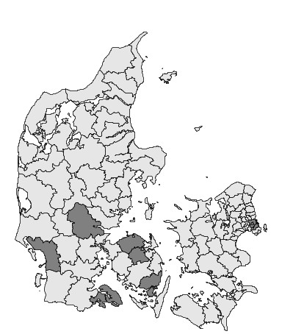
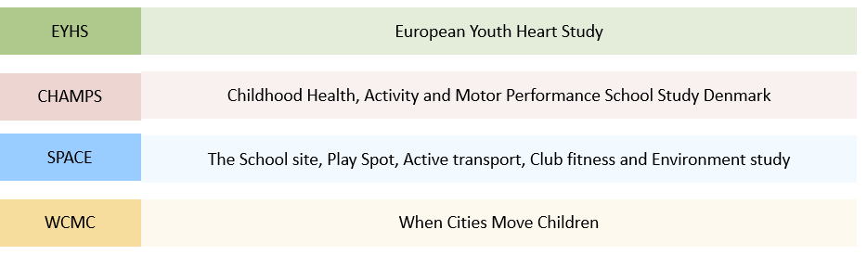
Geographical representation
Notes:
Data were collected in two regions of Denmark: The region of southern Denmark and the Capital region – where the region of southern denmark was highly overrepresented in the data.

Slide 22
Study population
Policy introduction August 2014
EYHS
278 9th graders from 26 schools
PHASAR
760 3rd and 9th graders from 20 schools
CHAMPS
585 1st-8th graders from 4 schools
PHASAR
727 1st-5th graders from 4 schools
SPACE
707 5-8th graders from 7 schools
PHASAR
855 5th-8th graders from 5 schools
WCMC
776 5th-8th graders from 5 schools
PHASAR
128 5th-8th grader from 2 schools
Pre-policy study population
Post-policy study population
In total: 2346
In total: 2470
Notes:
This figure provides an overview of participants included in the analyses in this study – both in the historical studies and in the phasar study. In total -

Slide 23
Invited schools: 36
Flow chart PHASAR study
Did not wish to participate: 5
Participating schools: 31
Invited schoolchildren: 3426
Did not wish to participate: 450
Absent: 202
Invalid consent: 9
Not specified: 93
Participation rate: 72.1 %
Participants who accepted the invitation and wore accelerometers: 2672
Waist accelerometer data lost due to technical problems, swap of thigh/waist accelerometer etc.: 79
Participants providing waist accelerometer data: 2593
Missing data (co-variates): 10
No valid observations: 113
Participants included in analyses: 2470
Notes:
Here is the flow chart of the PHASAR study. 36 schools were invited and 31 participated. 3426 children were invited from these schools and 2470 were included in analyses (72.1%)

Slide 24

Outcomes
Primary outcome: Time spent with movement
Secondary outcomes: Time spent with moderate to vigorous physical activity (MVPA) and mean counts per minute (CPM)
Notes:
To evaluate physical activity over time, data from two different accelerometers were used. Pre-policy PA was measured by ActiGraph monitors and post-policy Pa was measured using Axivity monitors.
The primary outcome evaluated was time spent with any bodily movement. This outcome was generated for this purpose only due to the policy phrasing (45 minutes of movement).
Secondary outcomes were moderate to vigorous PA, and as a more general expression of movement volume mean CPM was included.

Slide 25
Results Paper II
Notes:
So what did data show…

Slide 26
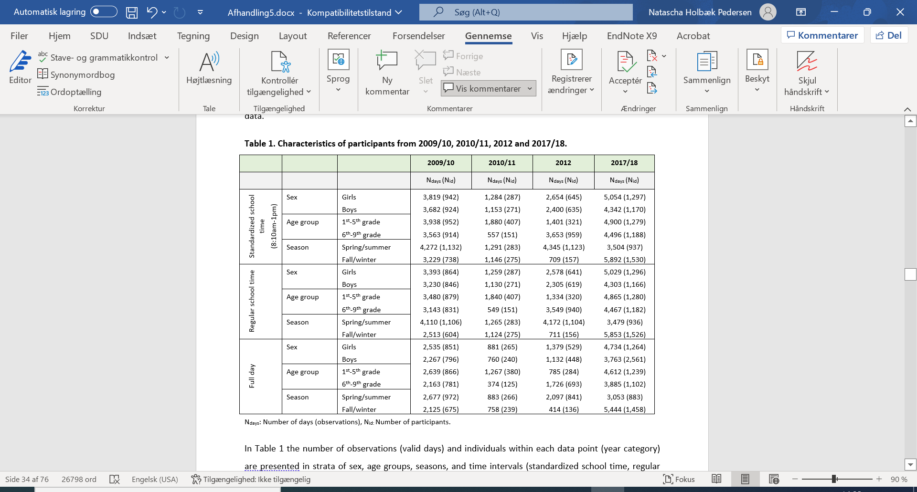
Characteristics of participants
Notes:
This table shows an overview of participant characteristics in four different year categories generated based on the date of the PA measurements.
Thus, time was threated categorical

Slide 27
Characteristics of participants
Notes:
Data was analysed i two time intervals. The primary time interval was a st. 8.10-1pm school time interval. As mentioned initially, a part of the school policy was a longer school day. To make sure that the effect we measured was not caused by more time to accumulate physical activity post-policy, we created this standardized time interval.
Secondary, we wanted to evaluate full day PA.

Slide 28
Characteristics of participants
Notes:
Anyways, the table shows the number of observations and individuals in each year category in strata of sex, age-group and season.
Girls and boys were equally distributed over time

Slide 29
Characteristics of participants
Notes:
However, the distribution of age-groups and season varied across year categories.
We had more valid observations during the school day compared to the number of valid full day observations.

Slide 30
Effect analyses: Two-step approach
Policy introduction
Outcome
2009/10
2010/11
2012
2017/18
Notes:
This plot is not based on any real data – it is just an illustration to explain the statistics.
The effect of the policy was analysed using a two-step approach.
Firstly, the development of the physical activity outcomes before the policy was evaluated. If the development was linear (either negative, positive or constant) the effect was evaluated by examining whether this linearity continued after the policy or was interrupted.

Slide 31
Effect analyses: Two-step approach
Policy introduction
Bootstrap
Outcome
2009/10
2010/11
2012
2017/18
Notes:
If, however, no linearity existed pre-policy, this approach was not a possibility. Instead, a bootstrap method using a 1000 replication was used to evaluate whether the post-policy data point exceeded any levels of PA measured before the policy was introduced.

Slide 32
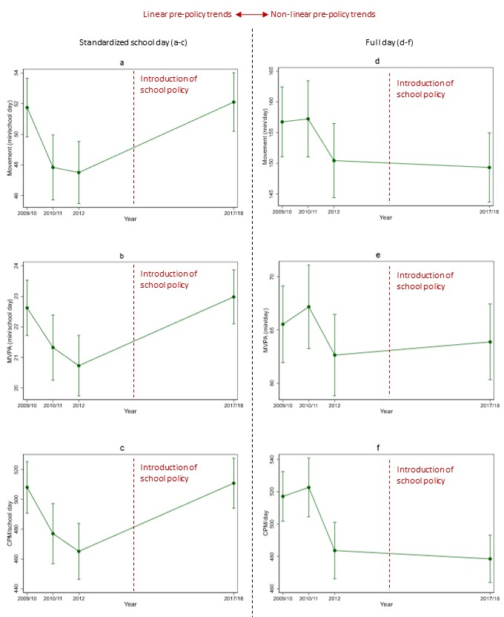
Notes:
This table presents the primary results from paper II. All three PA outcomes are presented. In the top the movement outcome, in the middle mvpa and in the bottom cpm. To the left the standardized school day is presented and full day analyses to the right.
When making the statistical analyses plan we didnt expect linearity in pre-policy trend to be different in different outcomes and time intervals. However, this was the case. During a st. school day the pre-policy trend was linear. However, during a full day, no linearity existed. Thus, the two time intervals was examined in two different ways.

Slide 33
Notes:
Focusing on standardized school day: all three PA outcomes declined linear before the policy was introduced. However, after the policy was introduced the negative trend was interrupted and physical activity increased in 2017/18. Indicating a positive effect of the policy on physical activity outcomes.

Slide 34
Primary outcome divided in two age-groups
Notes:
To findd out whether the effect was different in different age-groups, we divided the primary outcome (movement during a standardized school day) into two different age groups: the one to the left 1st-5th graders and the one to the right is the 6th-9th graders.
In these stratified analyses we found that pre-policy trends were still decreasing linear, and the policy interrupted this negative trend. The interruption was more pronounced in the youngest school children. Please notice that the scale on the y-axis is a bit different from the previous.

Slide 35
Effect size
Policy introduction
Outcome
Effect size
2009/10
2010/11
2012
2017/18
Notes:
Again, this is not real data – just an illustration to show our statistical methods.
When looking at interruptions in linearity – we do not get an effect size that we can compare with other studies. Therefore, we conducted an additional analysis to evaluate the difference between the 2017/18 estimate as we actually measured it (green line), and the 2017/18 estimate as it would have looked like if the pre-policy trend had continued (red line).

Slide 36
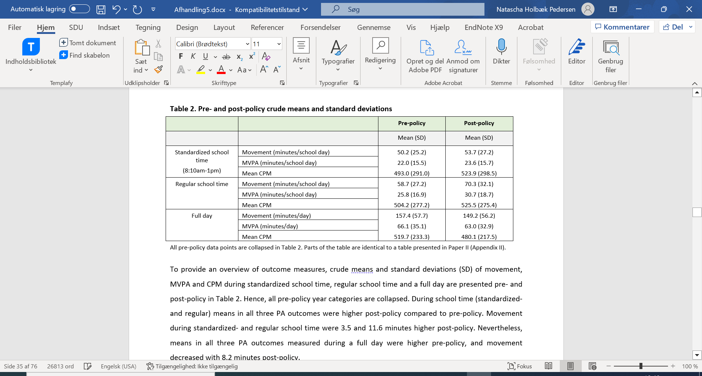
14.2 minutes of movement per school day
6.5 minutes of MVPA per school day
Pre-policy crude means and standard deviation
141.8 CPM per school day
Notes:
What we discovered was an increase in movement on: 14.2 minutes per school day, in mvpa on 6.5 minutes per school day and mean cpm were 141.8 higher that it would have been if the trend had continued.
To have something to compare these sizes to, crude pre-policy means are presented in the right corner. Pre-policy movement was…

Slide 37
Notes:
When looking at a full day – pre-policy trends were, as mentioned before, non-linear in all PA outcomes. When we tested whether the 2017/18 estimate exceeded any estimates measured before the policy introduction, this was not the case. Which is also obvious on the plots presented here. So the policy did not seem to have a positive effect on full day PA.

Slide 38
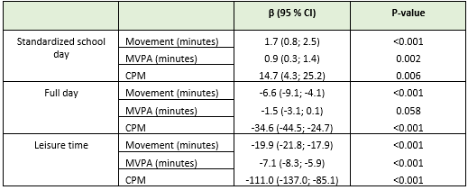
Differences in physical activity outcomes between pre- and post-policy measurements
Notes:
As mentioned before, the outcomes were analysed in two different ways as the school day developed linear pre-policy and a full day didnt.
To be able to compare all results, we made a post hoc analyses, where all pre-policy data were collapsed into one pre-policy data point. So instead of taking account for any pre-policy trends we conducted a binary analyses comparing only pre- and post policy estimates.
Here, we also observed small positive effects during the school day in all outcomes. During a full day, movement and cpm decreased a bit post-policy.
In this analyses, we also conducted analyses on leisure time PA to see how this developed across the time span. During leisure time, all PA outcomes decreased -quiet a lot actually.

Slide 39
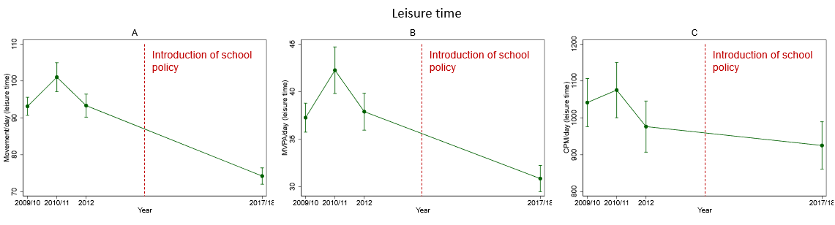
Movement, MVPA and CPM during leisure-time
Notes:
When we completed a plot of the development of leisure time activity including all pre-policy data-points to see the development, it was also very clear that PA outcomes were decreasing across the time span.

Slide 40
Contributions of Paper II
A school policy mandating an average of 45 minutes of physical activity daily was able to interrupt a negative pre-policy trend, and all physical activity outcomes increased post-policy
The interruption was more pronounced in the youngest children compared to the older ones
We were not able to detect an effect of the policy on full day physical activity
Leisure time physical activity decreased post-policy

Slide 41
Discussion
Policy introduction
Interrupted time-series approach
Harmonizing physical activty data over time (using different devices)
Missing data on non-participants
2009
2011
2013
2015
2017
2018
(Bernal et al., 2016; Yngve et al., 2003; Brønd et al., 2017)
Notes:
Now i’ll just go through the most important discussion points.
The results were evaluated using a interupted time series approach. The approach is robust towards confounding factors developing steady across the time span. It is however vulnerable to factors accelerating or decelerating across the time span and around policy introduction. However, it is not possible to conclude complete causality on the methods used.
To our knowledge, however, no other big structural changes have been introduced nationwide affecting the schools across this time span – for which reason there is no reason to believe that the changes observed is caused by anything else than the school policy. Also, the development observed during school time is opposite to the development observed during leisure time – this indicates that something is different in the school context, and it is highly plausible it is the policy.
During leisure time (full day) on the other hand, several confounding factors could affect the results. E.g. screen time use, sports participation etc. Therefore, one should be more cautios when interpreting these results compared to the results discovered during school time.

Slide 42
Discussion
Interrupted time-series approach
Harmonizing physical activty data over time (using different devices)
Missing data on non-participants
MVPA
Intensity
Movement
Time
(Bernal et al., 2016; Yngve et al., 2003; Brønd et al., 2017)
Notes:
Another important factor is the harmonization of two different devices over time – it would be unfortunate if the results discovered were merely an expression of different devices. A software called ActiLife was used to generate CPM in both monitors. Thus, we believe that measurements are highly comparable as data are processed the same way.
ActiGraph unfortunately has a filter on the device itself, which affects the raw output at high physical activity intensities. So if you look at the diagram different intensities of physical activity across a time span is outlined. PA will be affected at intensities around and higher than the red line in top. This will influence counts per minute (CPM) as cpm is a mean of total PA volume.
However, it is unlikely that the main outcome (movement) and MVPA are affected by the filter, since the thresholds for these two outcomes are too low and no differences between devices around these thresholds are present. Thus, classification will be more or less the same on both devices. It is therefore unlikely, that this affects main conclusion in this article. However, this is important when interpreting the cpm outcome.
Lastly, we do not have data on non-participants from any of the studies, which is a great limitation, since we are not able to examine if non-participating chlildren were different from participating. In PHASAR we saw that non-compliant were different fro the compliant ones.

Slide 43
Aim and objectives
To evaluate the effect of the 2014 Danish school policy on device-measured physical activity and body mass index (BMI) in school-aged children and adolescents
AIM
The objective was to present the study protocol of the PHASAR study.
The primary objective was to examine the effect of the school policy on device-measured school-time PA in school-aged children. The secondary objective was to examine the effect of the school policy on PA during a full day (The PHASAR study).
The primary objective was to examine the effect of the Danish school policy on nationwide mean BMI and the 90th BMI percentile in Danish school-aged children (register-based study).
PAPER I
PAPER II
PAPER III
Notes:
Now i will present paper III. The objective of this paper was to examine the effect of the Danish school policy on nationwide mean BMI and the 90th BMI percentile in Danish school-aged children. This study is primarily based on data from the child database (register-based study). This study is not published yet.

Slide 44
Methods Paper III
Notes:
Now i’ll present the methods of paper II

Slide 45
Data source
Policy introduction
The Child Database (Børnedatabasen)
Data from preventive health examinations
Mandatory for municipals to report data to the database from 2011
Data considered complete from 2012 and onwards
This study included data from 2012-2018
Included data from school children (0th-3rd grade and 7th-9th grade)
2009
2011
2013
2015
2017
2018
(Bernal et al., 2016)
Notes:
Unlike physical activity, routine surveillance does exist on body mass index.
The child database was founded in 2009. In Denmark, all parents are offered preventive health examinations for their children conducted by school nurses, health visitors and medical doctors from child birth and during school attendance. The child database contains data from these examinations – including data on height and weight.
From 2011 in became mandatory for municipalities to report data to the database, and from 2012 and onwards data are considered complete.
This study included data from the period 2012-2018.
we only included data on school children, and during school attendance, two mandatory health examinations are conducted: One during pre-preparatory classes (0th-3rd grade) and one during lower secondary education (7th-9th grade).

Slide 46
Study population
The Child Database contained data from 1,423,561 children and adolescents
Data from children in private schools, with no school information, below school age, in the intermediate stage (4th-6th grade), and data from incomplete years (2012, 2019, 2020, 2012) were excluded
A minimum of 70 % coverage
Data from 401,517 school children were included in analyses
Notes:
Before data cleaning, the Child Database contained data from approximately 1.4 million children.
Data from children in private schools, with no school information, below school age, in the intermediate stage (4th-6th grade), and data from incomplete years (2012, 2019, 2020, 2012) were excluded
Ideally, the child database holds data on all children and adolescents in the given age-groups. However, the database is unfortunately not as complete as expected. To avoid selection bias, we examined coverage. We did this by comparing the number of children in a given grade on a given schools with data on student numbers obtained from the Ministry of Children and education. Measurements were included in analyses if a minimum of 70 % of a given grade was represented in the Child Database. Data from children in grades with lower coverage were also excluded from analyses.
After data cleaning, a total of 401,517 children were included.
(Of these, 279,184 were from primary school (0th-3rd grade) and 122,333 from lower secondary education (7th-9th grade).)

Slide 47
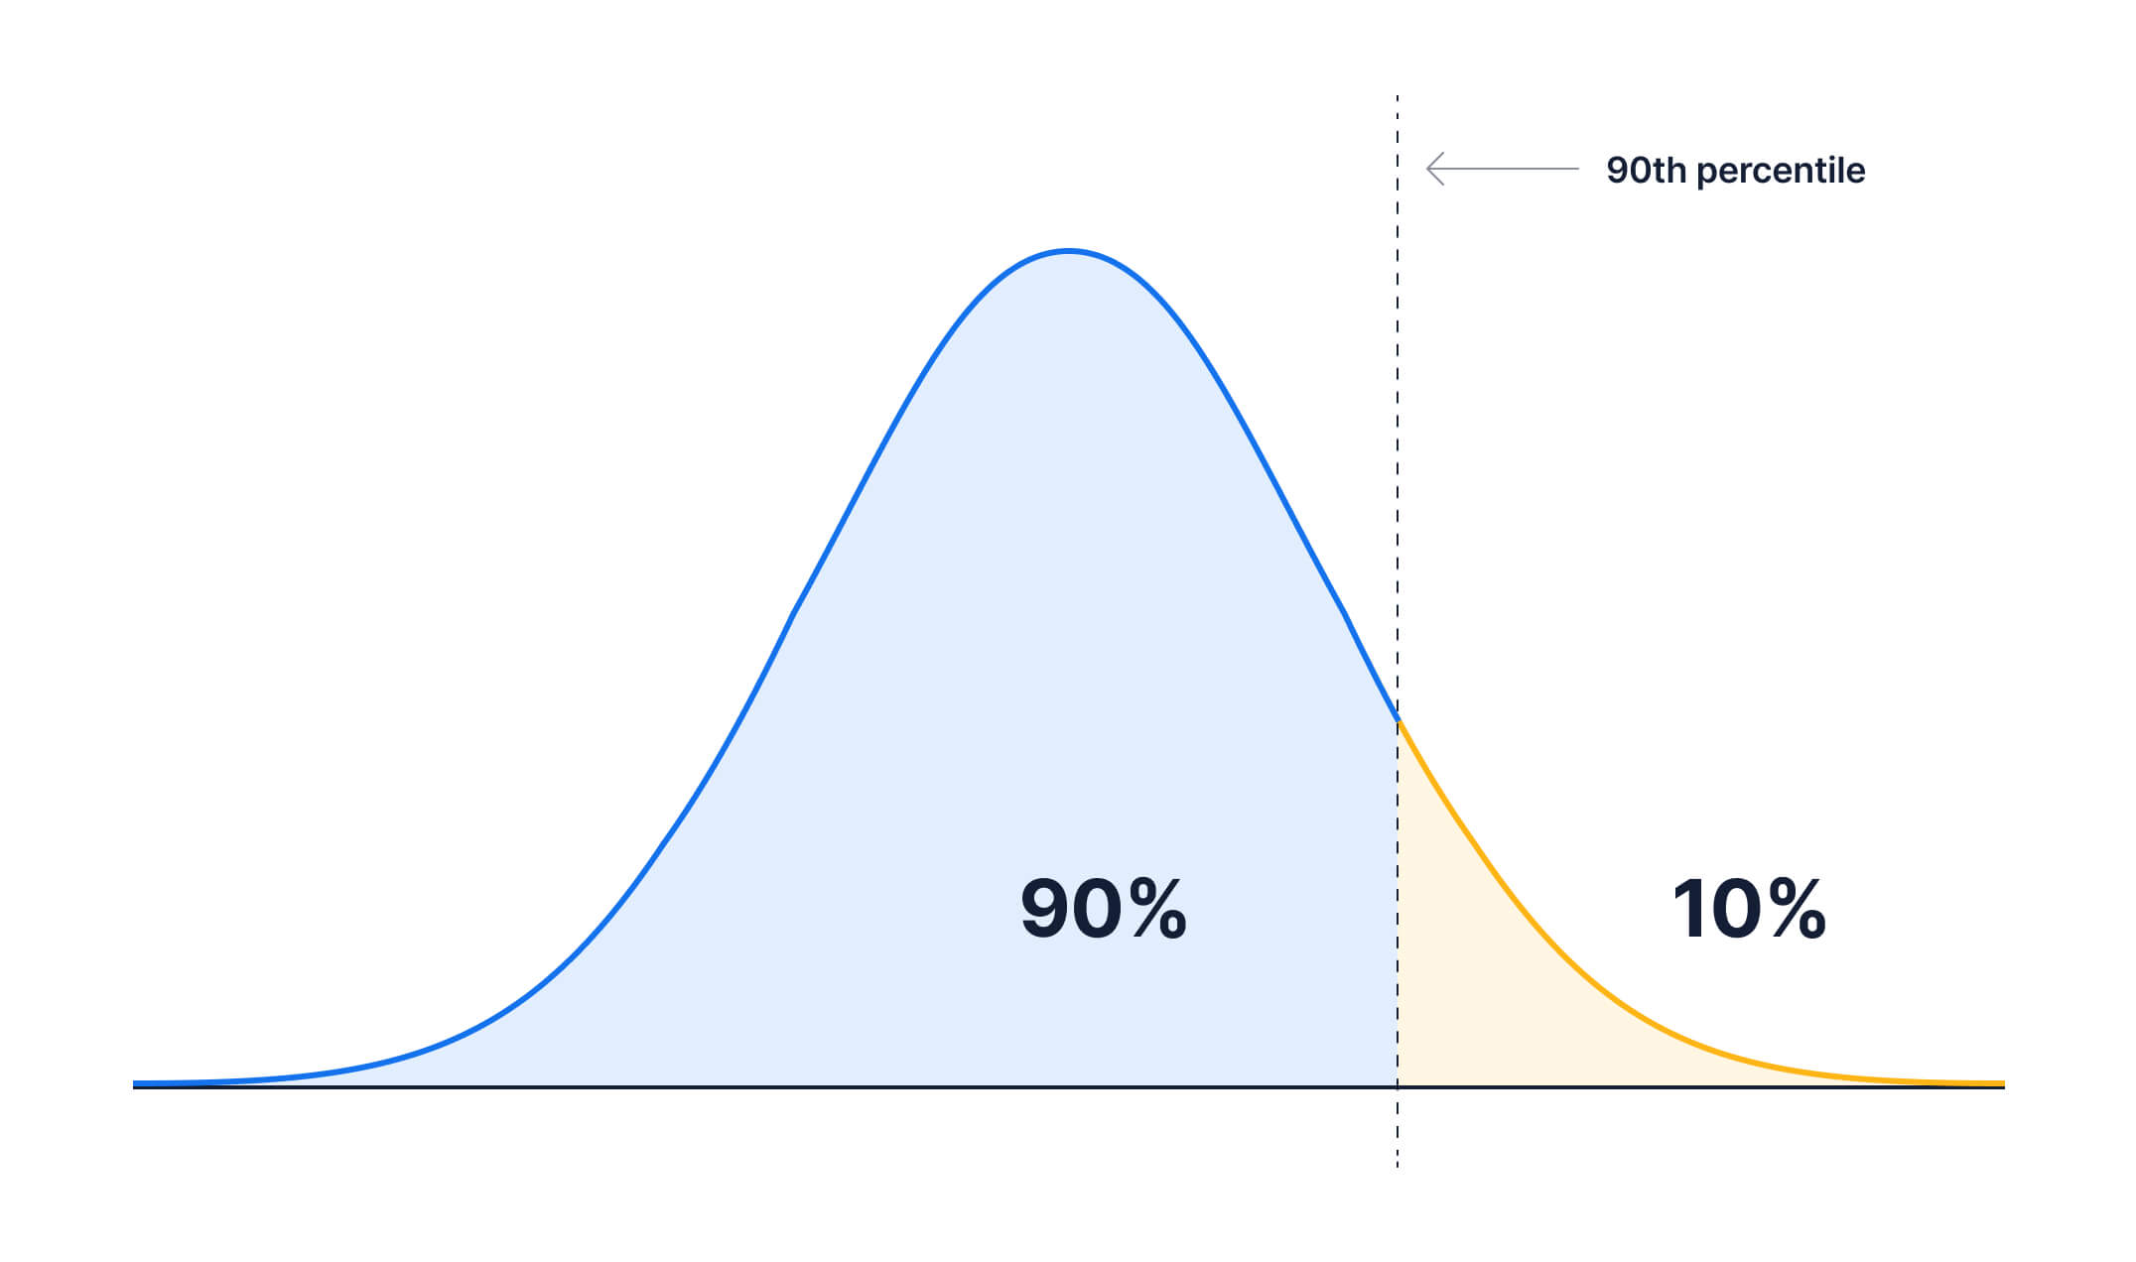
Outcomes
Mean BMI (kg/m2)
The 90th BMI percentile
Notes:
We used data on height and weight to calculate body mass index. Mean bmi was one of the outcomes evaluated.
And to observe whether the school policy influenced overweight children or children in risk of becoming overweight, the 90th bmi percentile was also included as an outcome.

Slide 48
Results Paper III
Notes:
I will now present the results based on data from the child databasse

Slide 49
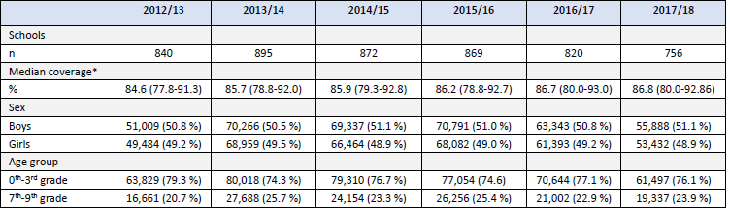

Characteristics of participants
Notes:
Between 750 – 900 schools are represented each school year, which is approximately 60 % of all schools in DK.
As mentioned in the previous slide, only classes with coverage above 70 % were included in analyses. The median coverage across school years was around 85 % in the schools included.
Boys and girls were also equally scattered across years, Children from pre-prepatory classes (0th-3rd) were better represented compared to lower secondary education (7th-9th). The prevalence of overweight and obesity (international obesity task force cut offs) were increasing in all sub-groups – except for in boys in lowere secondary education.

Slide 50
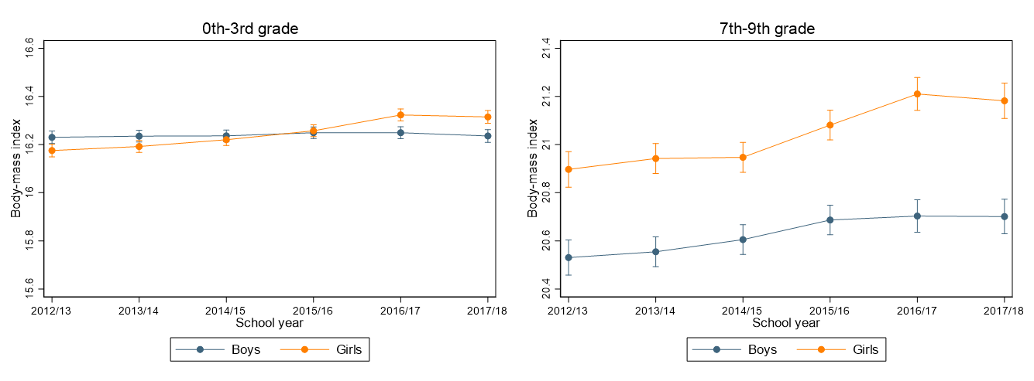
Time trends in BMI by age-groups and sex
Notes:
These two figures presents the development (also called time trends) in BMI in the two different age-groups – not considering pre- and post policy time periods. The analyses were adjusted for age, and time was treated categorical and were allowed to interact with sex.
As you see mean BMI were increasing in almost all subgroups between 2012-2018 – except in boys in 0th-3rd grade. Here bmi was slightly decreasing.
When interpreting the results (also in the next slides) it is important to be aware of the y-axis – as differences in bmi are very small

Slide 51
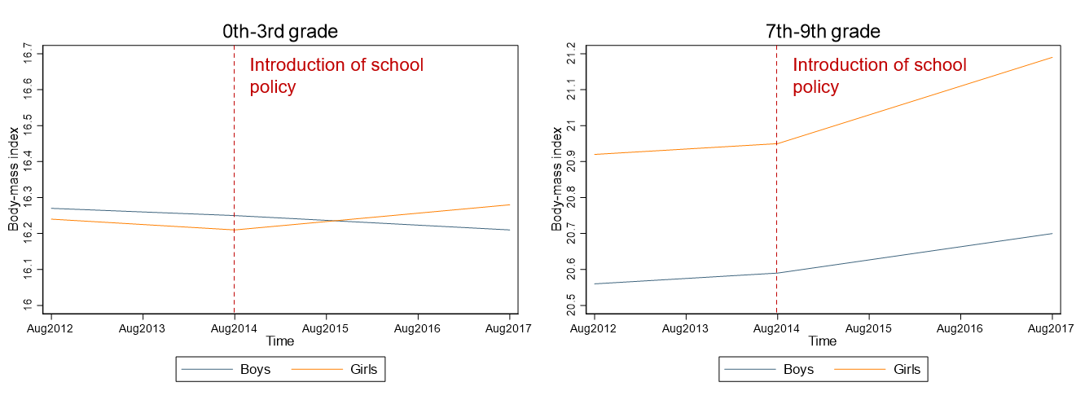
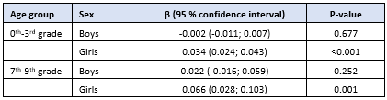
BMI trends before and after the school policy
Notes:
In this figure, we now allow BMI to develop differently before and after the policy, and then compare if the development (or slopes) are significantly different before and after.
The slope was significantly higher in girls in both age-groups after the policy was introduced. No differences were observed in boys.
Thus, the school policy did not change the increasing bmi trend. On the contrary, BMI is slightly increasing in the period after the policy in girls. Changes are very small – however, it is important to have in mind that these changes are the difference in slope for which reason even small differences will accumulate over time.

Slide 52
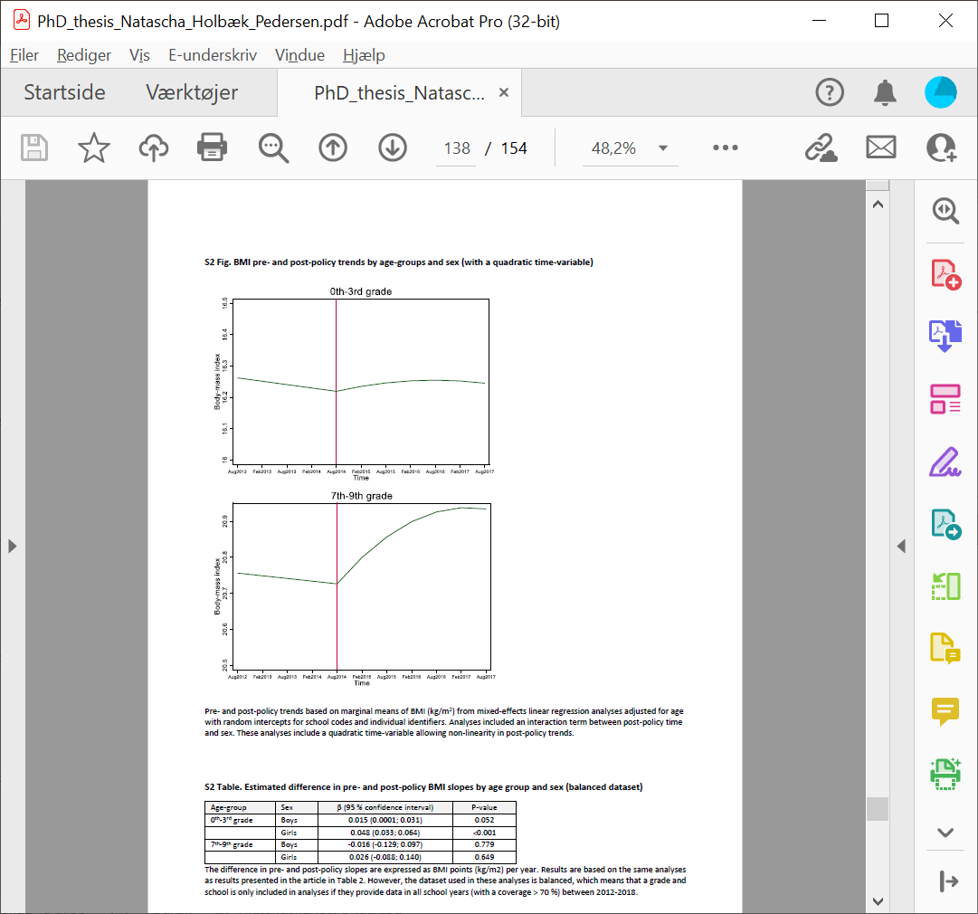
BMI trends before and after the school policy
(with a quadratic time variable)
Notes:
In the previous slide, we compared pre-policy slope with a post-policy slope starting in august 2014. Thus, we assumed that the increased PA would affect BMI instantly, which is not realistic. The schools need time for implementation etc.
To examine whether the effect of the policy came gradually, we made an additional analyses that allowed BMI to develop non-linear post-policy by including a quadratic time variable. Before conducting analyses, we decided to test differences in pre- and post-policy slope at two time-points: 2.5 and 3.5 years after policy introduction.

Slide 53
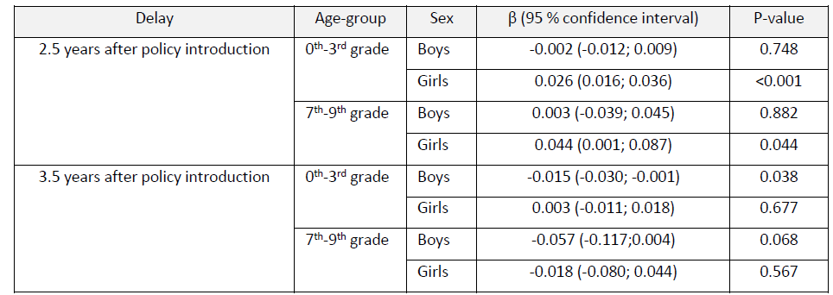
BMI trends before and after the school policy
(with a quadratic time variable)
Notes:
Here, we discovered an increase in post-policy slope 2.5 years after the policy introduction in both age-groups of girls. Also, we found a decrease in boys 3.5 years after the introduction. So no obvious gradual effect of the school policy.

Slide 54
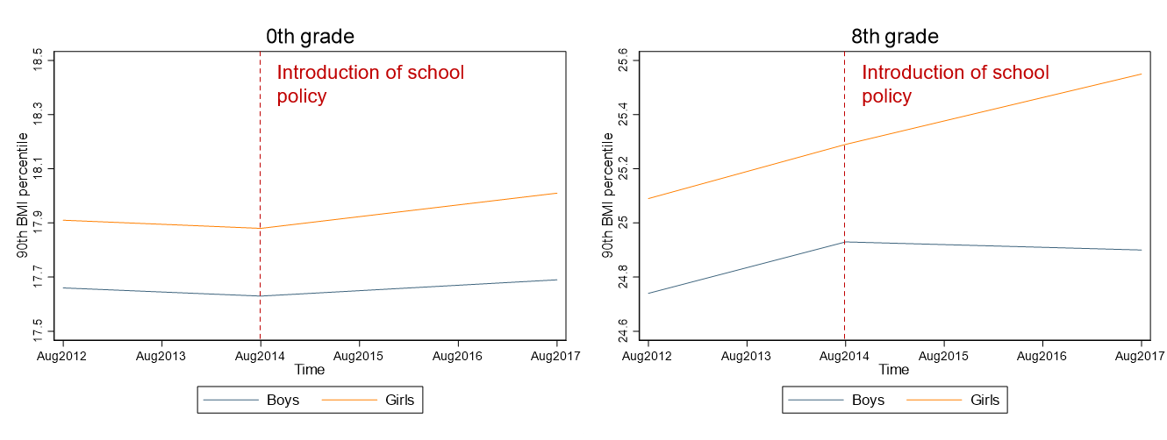
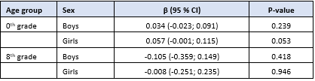
Trends in the 90th BMI percentile before and after the school policy
Notes:
When looking at the 90th BMI percentile, no significant changes were observed when comparing pre- and post policy slopes. When testing a quadratic time variable, it did not contribute significantly to the model. Thus, changes were not tested 2.5 and 3.5 after policy introduction.

Slide 55
Contributions of Paper III
A school policy mandating 45 minutes physical activty daily during school hours failed in reversing an increasing pre-policy BMI trend
Significant increases in mean BMI were observed post-policy in girls in 0th-3rd grade and 7th-9th grade
No significant changes were observed in post-policy slopes in the 90th BMI percentiles in either of the subgroups

Slide 56
Discussion
Interrupted time-series approach
BMI measurement
70 % coverage
BMI time trends
(Bernal et al., 2016; Wells et al., 2000; Freedman et al., 2005; Baxter-Jones et al., 2008)
Notes:
Again, the its approach is vulnerable to confounding factors changing across the same time span. In general, one should be very careful when interpreting these results, since a lot of confounding variables could affect results on BMI, as bmi i affected by multiple factors as mentioned in the introduction. Confounders like diet for example. And we do not have data on these variables to adjust main analyses.
In paper II, we observed that leisure time PA were declining. It is highly plausible that ths development affects BMI. To see the clean effect of the school policy and the increased school time PA on BMI, we made a supplementary analyses. Here we used data from Paper II and examined the development of BMI in the PHASAR study compared with the historical studies. No effect was found. Then we tried to adjust analyses for leisure time PA. However, this did not change results.
The analyses are based on the bmi measurement, which do not distinquish fat mass and lean mass. So basically, the increases in BMI could be a positive development if increases were caused by increases in lean mass (e.g. muscle mass). Thus, important changes in body composition could be obscured. However, no other data is available on a population level to further examine the effect of overweight (waist circumference, skin fold etc.)
Even though, we believe that data cleaning has enhanced the quality of data substantially, there is a possibility that it may have introduced selection bias. If low coverage is more pronounced in specific schools or municipals (e.g., low socioeconomic areas, areas with higher proportion of overweight and obesity among children etc.) during the whole or a specific time span, it may introduce some selection bias.
Lastly.. besides examining time trends we found small increases in bmi across the entire time span from 2012-2018. And this small increasing trend increased in post-policy examination in girls. Thus, this is a development in the wrong direction And unfortunately, the school policy did not have the hypothothised effect on BMI.

Slide 57
Discussion – Paper II & III
School policy vs. physical activity requirement
Classroom composititon
Implementation
Notes:
Lastly, i just have a couple of discussion points concerning both papers.
This thesis tries to evaluate the effect of the requirement of 45 minutes of PA daily. However, it is not possible to isolate the PA requirement from the school policy as a whole. As presented initially the school policy came with several changes, and this thesis (even though focusing on the PA requirement) evaluates all structural changes.
Moreover, the classroom compostion has changed. In 2009, 13-14 % of Danish children were in private schools. In 2017/18 it was 17/18 %. A mixed school is a school with an equal number of children from different socio economic classes. Between 2010-2020, the number of mixed schools have descreases, and the children are becoming more homogeneus. In state schools, the majority is from the lowest income quintile, and in the private schools, the majority are from the highest. The changes in classroom composition may affect results in the present thesis.
Firstly, research and reports show that the school policy was not fully implemented in 2017/18, when post-policy measurements were conducted. Thus, the potential of the policy on outcomes may be even greater if a larger emphasis was put on implementation

Slide 58
Conclusions of the thesis
The school policy was able to interrupt a negative pre-policy trend, and physical activity outcomes increased post-policy during a standardized school day
We were not able to detect an effect of the policy on full day physical activity
Even though school time PA increased and physcal activity patterns may have changed for some children, the policy was not able to interrupt an increasing trend in BMI. Mean BMI even increased post-policy in girls i 0th-3rd grade and 7th-9th grade
No changes between pre-and post-policy slopes were observed in the 90th BMI percentile in any sub-groups

Slide 59



Implications
Thesis
Notes:
Nationally, the results presented in this thesis are important to decision-makers at several levels: The Government, ministries, municipalities, schools, and even teachers. The PA requirement has been debated frequently in 2022, and many question whether it even should persist. A report from Dansk Skoleidræt indicates that the focus on PA after the policy has peeked, and since the post-policy measurements were conducted fewer and fewer school leaders believe that the requirement is met on their school. This thesis provide objectively measured results that may assist decision-making, and may renew the focus on PA in schools.
Internationally, the articles in this thesis provide knowledge on the effect of policies like this, and adds to the literature on PA promoting in school settings.

Slide 60

Acknowledgements
Associate Professor Peter Lund Kristensen
Associate Professor Niels Christian Møller
Professor Anders Grøntved
Associate Professor Jan Christian Brønd
Assistant Professor Kristian Traberg
Post doc Sofie Koch
Professor Jens Troelsen
Associate Professor Thomas Skovgaard
Associate Professor Birgit Debrabant
Professor Jacob Hjelmborg
Professor Jasper Schipperijn
Associate Professor Lars Breum Christiansen
Professor Søren Brage
Professor Niels Wedderkopp
Associate Professor Mette Toftager
Associate Professor Heidi Klakk Egebæk
PhD student Sofie Rath Mortensen
Medical Doctor, PhD, Malene Heidemann
TrygFonden for funding
Assessment Committee
All my great colleagues at ExE
All participating schools, children and parents
Interns and student assistants
Family and friends
Notes:
I would like to thank my main supervisor Peter and co-supervisor NC. And the head of Research at ExE Anders Grøntved. Also I would like to thank the PHASAR steering committee as well as the project group, Kristian and Sofie. All co-authors of the two paper. Trygfonden for funding….

