Slide 1





Better Sleep for
Health and Well-Being
January 26, 2021
Ed Fisher, PhD
Global Director
Patrick Tang, MPH
Program Manager
Notes:
NC Occupational Safety and Health Education and Research Center
https://gillingscovid19.unc.edu/
Welcome to today’s webinar. My name is Patrick Tang and I’m a program manager at Peers for Progress, a program in the Gillings School of Global Public Health at UNC Chapel Hill. I’m joined by Professor Ed Fisher, global director of Peers for Progress. We appreciate the invitation from the NC Occupational Safety and Health Education and Research Center to present this webinar.
Today let’s have a conversation sleep, well-being, and practical tips for getting better sleep. If you have any comments or questions, please post them in the chat.
With that brief housekeeping out of the way, let’s walk through the agenda.

Slide 2
Access all recorded
webinars and slides at
https://go.unc.edu/PROSPER
AGENDA
Introductions
About Sleep
Strategies to Getting Good Sleep
Practical Steps
Summary and Discussion

Slide 3
INTRODUCTIONS

Slide 4

ABOUT SLEEP

Slide 5
Sleep and Health
Getting enough good sleep can affect how you feel physically and mentally.
Adults need 7-9 hours of sleep every night
Sleep is important for our physiological functions, memory, metabolism
Individuals have different needs for sleep and have different preferences for sleep patterns (these are both inherited and learned)
Good sleep is both the amount of sleep you get in a night and the quality of your sleep.
There are many activities which promote and disrupt that amount and quality of sleep. It’s very common for adults to have formed habits for activities which disrupt good sleep, but it is possible to change them.
Notes:
Americans suffer from inadequate sleep (duration, quality, efficiency, disturbances, use of medications)
COVID impacts on our sleep
Insomnia
Work and family stress
Broken routines
Anxiety, news
Isolation
Lack of sunlight
Being at home promotes napping, excessive snacking

Slide 6
Sleep may be as important to health and well-being as nutrition and exercise

Slide 7
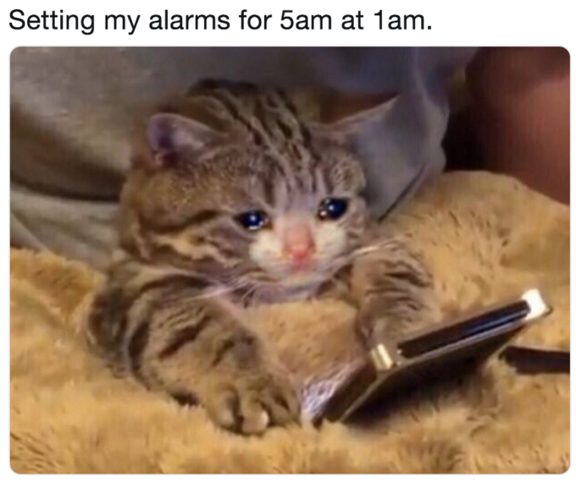
Common Sleep-Disrupting Activities
Working until bedtime
Doing other activities (work, eating, watched TV; other than intimacy) in bedroom
Using screens in bed and immediately before bedtime
Staying in bed and worried while unable to sleep
Sleeping in an unrestful environment (restful sleeping environments are quiet, cool, and dark)

Slide 8
Common Sleep-Disrupting Activities
Exercising vigorously within one hour of bedtime
Food and Drink
Drinking alcohol within 2 hours of bedtime
Drinking too many fluids that cause you to get up in the middle of the night
Eating a large meal before bedtime
Indulging in a midnight snack
Varying your bedtime by more than an hour across the week
Taking naps that are longer than 20 minutes
Taking naps after dinner or with less than 3 hours to bedtime
Notes:
Acid reflux / gas / indigestion from eating greasy or spicy food

Slide 9
Problems that Arise from Lack of Quality Sleep
Diminished alertness throughout the day
Cognitive impairment, motor vehicle accidents
Poor social and work relationships with others (impaired emotional regulation)
Low mood or fluctuations in mood
While lack of sleep is unlikely to be the sole cause of feeling blue, lack of good sleep can make you feel even more blue.
Linkages to hypertension, weight gain, diabetes, obesity, impaired immune function

Slide 10

Benefits of Better Sleep
Other benefits that may also be important to you:
Lower health care costs
Increased willpower and productivity for work and home life
Model healthy behaviors for children and adolescents

Slide 11
Would people mind sharing their experiences in dealing with sleep problems?
What are some strategies that are helpful for you in getting good sleep?

Slide 12
STRATEGIES TO
GETTING GOOD SLEEP

Slide 13
Mindset
Many of us tend to undervalue sleep and easily trade it away for a few hours of being awake (e.g., time spent being productive is more valuable).
“I’ll just catch up on sleep on the weekend.”
Treat sleep with the same importance as nutrition and exercise.
Think of sleep as the time for our mind and body to heal itself.
Shakespeare described sleep as “nature’s soft nurse”
Some may need to address unrealistic expectations about sleep.
Revenge bedtime procrastination: People who don’t have much control over their daytime life refuse to sleep early in order to regain some sense of freedom during late-night hours.

Slide 14
Behavioral Techniques
Bedtime routine: Do the same things before going to bed each night, go to bed and get up at the same time every day.
Sleep restriction: Match time spent in bed to amount of sleep needed.
Stimulus control: Use bedroom only for sleeping and intimacy, go to bed only when sleepy, get out of bed after 15-20 of wakefulness.
Relaxation: Tensing and relaxing muscles while in bed, focusing on breathing.
Taking a warm bath or shower before bed associated with falling asleep faster.
Notes:
Take melatonin 30 minutes before bedtime – non-habit forming.
Don’t rely on over the counter sleep aids

Slide 15
Changing Sleep Habits
Changing sleep habits can start to yield improved sleep within a few days to a week, although making these a full part of your routines and life may take longer.
Identify sleep-disturbing activities and try some corrective actions to change those activities.
Make specific plans for your corrective action and the trigger for employing it.

Slide 16
PRACTICAL STEPS

Slide 17

Sleep Journaling
Keep a daily sleep journal that tracks:
Your mood
Sleep duration
Sleep quality
Sleep-disturbing activities
See slides 7 & 8 for a list of sleep-disturbing activities.

Slide 18
Sleep Journaling
Date | Mood (day of recording, scale from 1-5) | Hours of Sleep (previous night) | Quality of Sleep (previous night, scale from 1-5) | Sleep-disturbing activities
Dec 1, 2020 | 4 | 7.5 | 5 | None
Dec 2, 2020 | 5 | 8.5 | 5 | None
Dec 3, 2020 | 2 | 6.0 | 3 | Used screens in bed and immediately before bedtime
Dec 4, 2020 | 1 | 5.5 | 4 | Used screens in bed and immediately before bedtime Varied your bedtime by more than an hour across the week
Dec 5, 2020 | 4 | 8.0 | 4 | Took naps that were longer than 20 minutes

Slide 19


Making Action Plans
Review your sleep journal
Select up to 3 sleep-disturbing activities to focus on from the list above that you noticed yourself doing in your sleep journal.
You might want to prioritize those which disturb your sleep the most or which you observe yourself doing the most.
Choose corrective actions for your selected sleep-disturbing activities (see examples on next slides).
Be specific both with the trigger and with the action you want to take when the trigger occurs. For example:
Trigger: I’ve been tossing and turning for over a half hour
Corrective Action: Get up and go to living room and read a magazine

Slide 20
Examples of Changing Sleep-Disturbing Activities
Sleep-disturbing activities | Samples of Corrective Actions
Worked until bedtime | Quit working one hour before bedtime. Set a warning alarm 1.5 hours before your typical bedtime.
Consumed alcohol within 2 hours of bedtime | Have wine with dinner and then no alcohol after that. Before bed, have some warm decaffeinated tea or milk instead of an alcoholic drink.
Did other activities (work, eating, watched TV; other than intimacy) in bedroom | Move TV and my knitting supplies to living room or kitchen. Restrict all non-sleep and non-intimacy activities outside of the bedroom. Store laptop in another room.
Used screens in bed and immediately before bedtime | Renew subscription to Sports Illustrated and Newsweek to have hard copies to read in bed. Store laptop and cellphone in another room or across the bedroom.
Stayed in bed and worried while unable to sleep | If can’t return to sleep within 30 minutes (??), get up, go to another room, and read relaxing material for at least 30 minutes – No TV!!!! Get out of bed and/or the bedroom, write down all the topics worrying you on a pad of paper, perhaps note plans for dealing with them, set aside, and return to bed. Having made a plan for nagging problems will help keep your mind from turning them over and over while you are wanting to sleep.

Slide 21
Examples of Changing Sleep-Disturbing Activities
Sleep-disturbing activities | Samples of Corrective Actions
Slept in an unrestful environment (restful sleeping environments are quiet, cool, and dark) | Work with my partner to make our bedroom more restful – reduce thermostat at night, read or watch TV in other rooms. Ensure that sources of light (windows, doorways) coming into your room are covered.
Exercised vigorously within one hour of bedtime | Change my routine to exercise in the morning or after work. End the day with light stretching.
Ate a large meal before bedtime | Work with my partner to arrange that we finish dinner by 7:30 PM, 8 at the latest. Try to have larger meals for breakfast and lunch while keeping dinner meals smaller.
Indulged in a midnight snack | If I get hungry overnight, plan light snack and perhaps warm milk at least an hour (?) before bedtime.
Varied your bedtime by more than an hour across the week | Cut out the weekend binge-watching of Netflix until 3 am. Try to set a consistent bedtime and wake schedule. Vary it no more than 1 hour across the week.
Took naps that were longer than 20 minutes | Allow myself naps to get through the day if needed but use cellphone timer to limit to 20 minutes.
Took naps after dinner or with less than 3 hours to bedtime | If find myself really craving a nap after dinner, try taking a nap before preparing dinner and maybe moving dinner back 30 minutes. Early afternoon is the best time for a nap if possible.
Notes:
Lighten up on evening meals

Slide 22
Helpful Tips
Each evening, work on implementing your corrective actions.
Some you will need to do before you go to sleep, others if your trigger occurs during sleep.
When reviewing your records, you may see that some of the corrective actions are working, others not. You may want to revise or replace some.
Download and use an app for your smartphone or wearable device to monitor sleep duration and sleep quality.

Slide 23
Helpful Tips
If you chose corrective actions which require materials (i.e. curtains to promote a restful sleep environment, new bedding, white noise machine, humidifier), make sure that you have those before you implement. Remember, your sleep is a priority!
If you chose corrective actions which may impact your bed partner or those around you, be sure to share your plans with those individuals.
Notes:
Buy stuff: Simplest solution that doesn’t require big changes. Feel like we’re doing something to solve a problem. But investing in products can motivate you to take sleep hygiene more seriously and help you get into a better routine.

Slide 24
SUMMARY AND DISCUSSION

Slide 25
Summary
Sustaining the changes you have made should get easier, but don’t neglect your corrective actions! It can be easy to slip back into old habits.
Keep reviewing, revising and repeating your correction actions until you feel you have achieved your goal of improved sleep. If you feel like nothing has changed for you, you should:
Pick another sleep-disrupting activity to work on
Speak with your primary care provider
Sleep Guidelines During the COVID-19 Pandemic

Slide 26
Access all recorded webinars and slides at
https://go.unc.edu/PROSPER

