Slide 1
CPE 403 Final Project TI 15.4 Stack w/ BBB
Audie Escala
Aaron Volpone

Slide 2
Goal
Main Goal
The goal of our final project was to host our own gateway application and interface sensors through a BLE connection. The WSN platform would be accomplished through CC1350 modules and a BeagleBone Black.
Objectives
Host the gateway application on our BeagleBone Black.
Connect our BLE sensor to the gateway to read temperature.
Interface an I2C lux sensor with the sensor module and display data on the application.

Slide 3
Outcome - Accomplishments
The gateway application hosted on the BeagleBone Black worked as intended with our coprocessor and sensor module.
We were able get I2C to work after some changes to our sensor project.
We had to link files and add a function to handle I2C work in the sensor.c file located in our sensor project for the CC1350.
The gateway application was able to display both temperature and lux values from our CC1350 sensor module.
We were also able to get the lux sensor to display reasonable values between 0 and 30.

Slide 4
Components Used in Design
HARDWARE
BeagleBone Black
Gateway host that allows a computer to connect and monitor sensor data through a browser.
CC1350 Coprocessor
Serves as the link between BLE sensors and the gateway application.
CC1350 Sensor module
Collects temperature data and also communicates to the TSL2561 sensor with I2C for lux values.
TSL2561
Lux sensor that is connected to the CC1350 sensor module. Operates with I2C commands.
FTDI to USB adapter

Slide 5
Tools used in Design
SOFTWARE
TI 15.4-Stack Gateway Linux
Gateway application that interfaces with the CC1350 coprocessor. Displays data gather from connected sensors.
Code Composer Studio 8
Used Simplelink project examples as reference for sensor and coprocessor designs.
PuTTY
For serial and SSH communication.

Slide 6
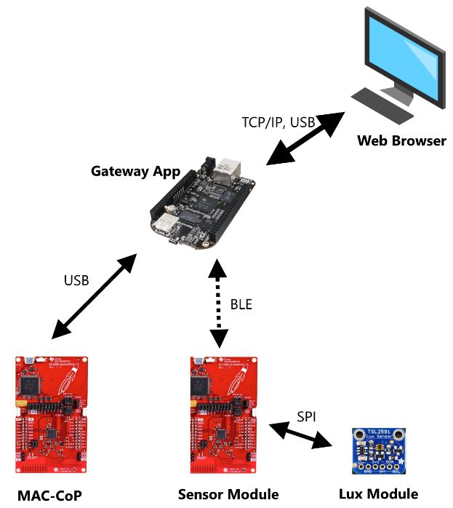

Slide 7
Pre-requisites used in Design
We flashed a coprocessor example to one CC1350.
For the CC1350 sensor project, we imported the sensor example and then modified it to accommodate I2C.
In order to get the gateway application running, we had to connect to the Beaglebone Black either serially or by SSH. The following commands were inputted to run the gateway:
$ cd ~/prebuilt
$ rm bin/nv-simulation.bin (to get rid of preexisting network configs)
$ ./run_demo.sh

Slide 8
Implementation Details
Most steps were followed from the Linux Gateway project tutorial.
We deviated from the default sensor project by adding our own custom I2C code. The changes are all located in the sensor.c file.
In the function, processSensorMsgEvt(), we add the initialization and lux data polling.
Additionally, we added a predefined symbol named “LIGHT_SENSOR” to the project.
This allowed us to add another row to the data display table in the gateway application. This includes the “lux” suffix after the value and the lightbulb icon.

Slide 9
Implementation Details
Most steps were followed from the Linux Gateway project tutorial.
We deviated from the default sensor project by adding our own custom I2C code. The changes are all located in the sensor.c file.
In the function, processSensorMsgEvt(), we add the initialization and lux data polling.

Slide 10
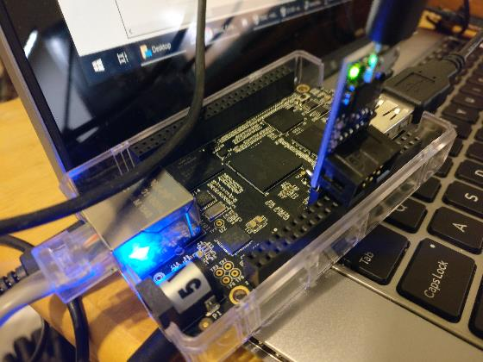
Actual project set-up

Slide 11
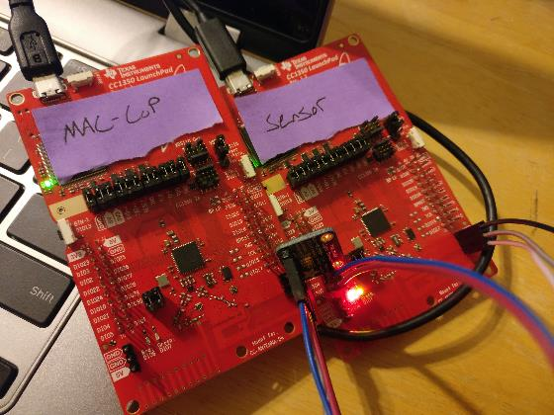
Actual project set-up

Slide 12
Demo
https://youtu.be/MmdeIR1_UYA

Slide 13
Results and Conclusions
The gateway application worked as intended with our sensor.
This includes the I2C interfacing that we did with the lux module and the CC1350 sensor.
The gateway application page can be seen on the next slide showing how the data was presented on the browser.

Slide 14
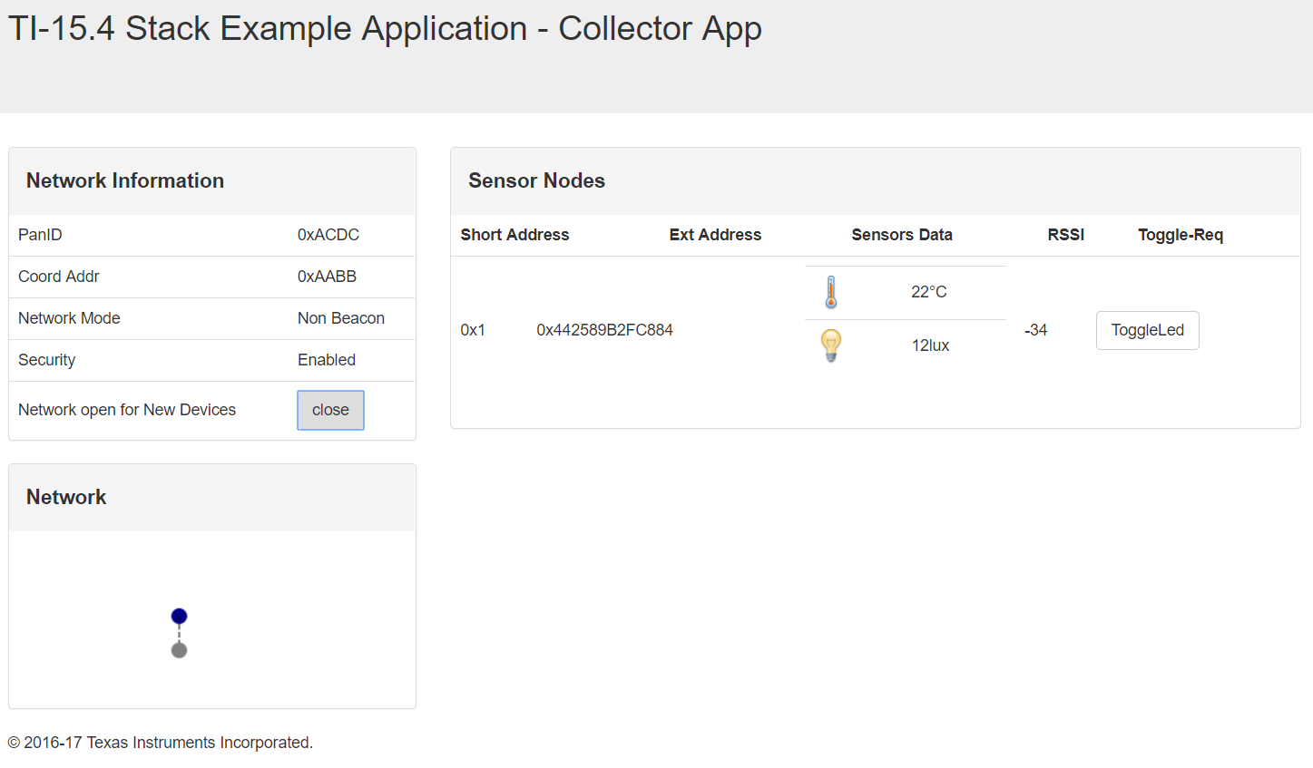
Results and Conclusions

Slide 15
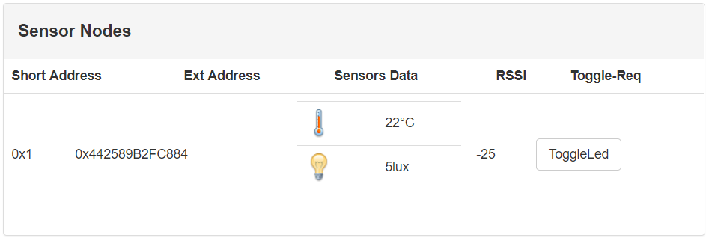
Results and Conclusions
The lux value reported anywhere from 0 in complete darkness to around 30 when exposed to a white LED flashlight from a phone.

Slide 16
Results and Conclusions
Debugging the sensor project took time due to the process of understanding file organization and I2C.
After using our previous TIVAC midterm that had I2C programming in it, we were able to piece together how the lux sensor was supposed to communicate with the CC1350 sensor.
One revision that we would make is increase the polling time of the CC1350 sensor. This is because the current polling rate is far too slow to demonstrate the changing lux values live.

Slide 17
Reference
http://dev.ti.com/tirex/content/simplelink_academy_cc13x0sdk_1_13_01_05/modules/154-stack_03_linux_project_0/154-stack_03_linux_project_0.html
https://www.mouser.com/ds/2/737/adafruit-tsl2591-932849.pdf

