Slide 1
CampusSwap
UX/UI FOR STARTUPS · CASE STUDY
Pass it on, on campus. A campus-only app for students to give away, swap and pick up dorm items.
Ahmed Helaly · UX research & UI design
Notes:
Introduce yourself and the project in one sentence: CampusSwap helps students pass on dorm items to each other, free or cheap, with verified students and built-in pickup.

Slide 2




CampusSwap helps students pass on dorm items in a few taps
Role
THE IDEA
UX research, UX/UI design
Students moving out list what they no longer need. Students moving in find it nearby, request it, and pick it up at a time and place that suits both.
Platform
iOS mobile app
Tools
Figma, FigJam, Google Forms
Timeline
[x weeks, start–end dates]
Notes:
Project overview. Say the idea in one simple sentence, then your role, platform, tools and how long the project took. Fill in the timeline.

Slide 3



Usable dorm items get thrown away while newcomers buy them new
Every semester, students moving out abandon kettles, lamps, books and hangers. At the same time, newcomers buy the same items new. The channels students use today make passing items on slow and awkward.
Posts get buried
Listings in Telegram chats scroll away within hours and can't be searched.
Strangers feel risky
There is no way to know if the other person is a real student or will show up.
Pickup takes many messages
Agreeing on a time and place between buildings is back-and-forth chat.
These are the starting assumptions the user research set out to test.
Notes:
Problem statement. Explain the waste and the three pain points you assumed. Make clear the research tested these assumptions; mention what the research confirmed or changed.

Slide 4
User research
01

Slide 5




Three methods covered behavior, pain points and trust
1 Interviews
2 Survey
3 Competitors
5–6 dorm residents, 25 min each, semi-structured with 14 questions
30+ students, 5 min Google Form with 13 questions
4 channels students use today, compared on 8 criteria
RESEARCH GOALS
Behavior: how students get and pass on dorm items today
Pain points: what makes exchanges slow, frustrating or risky
Trust and handover: what makes meeting another student feel safe and easy
Notes:
Explain why each method: interviews for depth and stories, the survey to check how common each behavior is, competitive analysis to find the gap. Mention recruiting criteria: dorm residents, mix of givers and getters, no close friends.

Slide 6
No channel combines a campus-only audience with easy pickup
 | Telegram chats | Avito | VK groups | Free shelf | CampusSwap
Campus-only audience | ✓ | ✗ | ~ | ✓ | ✓
Search and categories | ✗ | ✓ | ~ | ✗ | ✓
Posts stay visible | ✗ | ✓ | ~ | ✓ | ✓
Verified students | ~ | ~ | ~ | ✗ | ✓
Built-in pickup time and place | ✗ | ✗ | ✗ | ✗ | ✓
Alerts for wanted items | ✗ | ✓ | ✗ | ✗ | ✓
✓ supported ~ partly ✗ not supported. Desk research, October 2026; checked against interview answers.
Notes:
Telegram chats have the right audience but the wrong format. Avito has the right format but the wrong audience. CampusSwap's gap is a verified campus audience plus searchable listings plus built-in pickup.

Slide 7
Key findings from [N] interviews and [N] survey responses
FINDING 1
FINDING 2
FINDING 3
[One-sentence finding headline]
[One-sentence finding headline]
[One-sentence finding headline]
["Participant quote that supports it" — P#]
["Participant quote that supports it" — P#]
["Participant quote that supports it" — P#]
[Data: e.g. 4 of 6 participants, 62% of respondents]
[Data: e.g. 4 of 6 participants, 62% of respondents]
[Data: e.g. 4 of 6 participants, 62% of respondents]
Notes:
Fill in after the interviews and survey. Each finding: a clear headline, a real quote, and how many people said it. Then say what you recommended because of it.

Slide 8
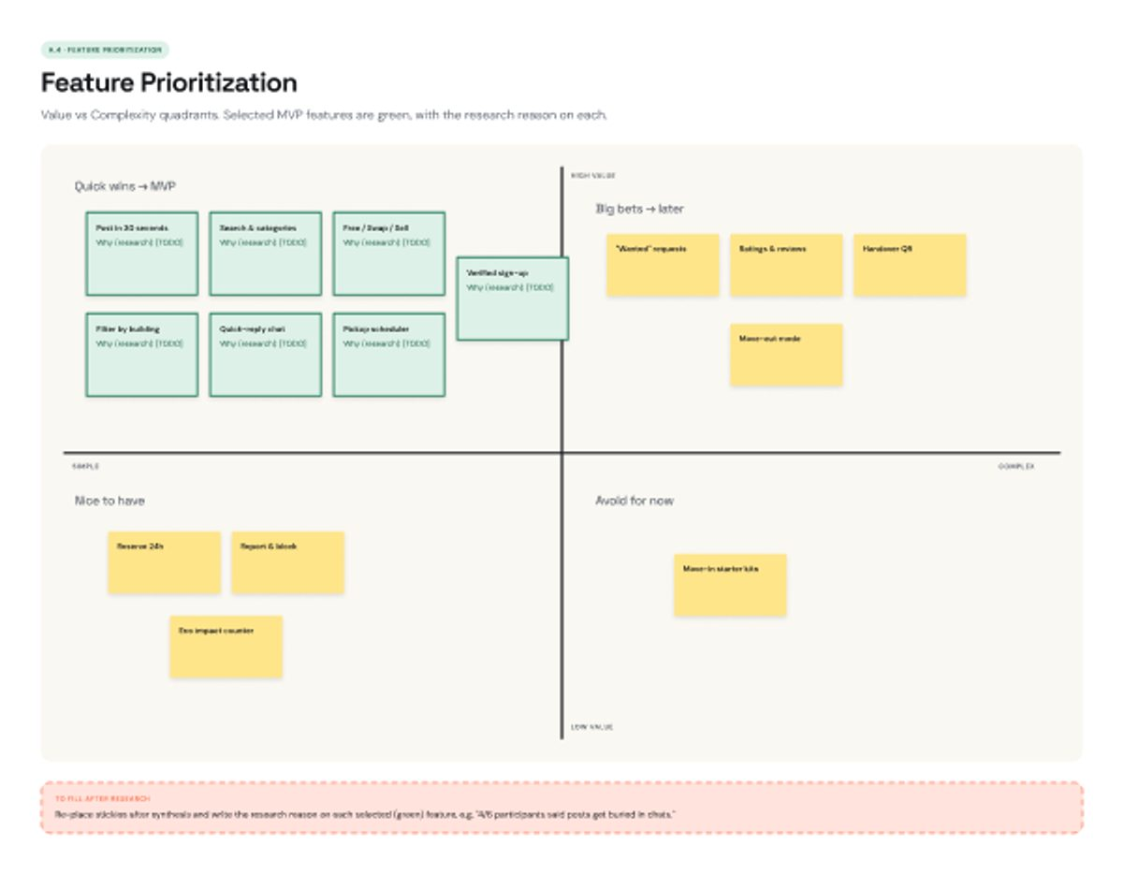
Synthesis turned 15 feature ideas into 7 MVP features
MVP FEATURES
Verified university sign-up
Post an item in 30 seconds
Search and categories
Filter by dorm building
Free, swap or sell
Quick-reply chat
Pickup time and place scheduler
Value vs complexity: selected features in green
Notes:
Walk through the synthesis: interview notes on sticky notes, grouped into themes, How Might We questions, 15 ideas, then the value vs complexity matrix. Explain why each selected feature matters, using a finding.

Slide 9
Ideation, wireframes and prototype
02

Slide 10

The main flow takes a student from discovery to pickup in 7 steps
Onboard
Discover
Evaluate
Request
Pickup
Handover
Rate
1. Sign up with university email
2. Browse items near you, filter
3. Check photos, condition, giver
4. Tap Request, send a message
5. Pick a time slot and spot
6. Meet and both confirm
7. Rate the other student
Second flow: give away an item
Tap + → add photos, title, category, condition → choose Free, Swap or Sell → set pickup spot and time slots → publish → accept a request → hand over → rate.
Notes:
Explain the user flow as a simple journey map. Pickup (yellow) is the step that makes CampusSwap different from chats and Avito.

Slide 11
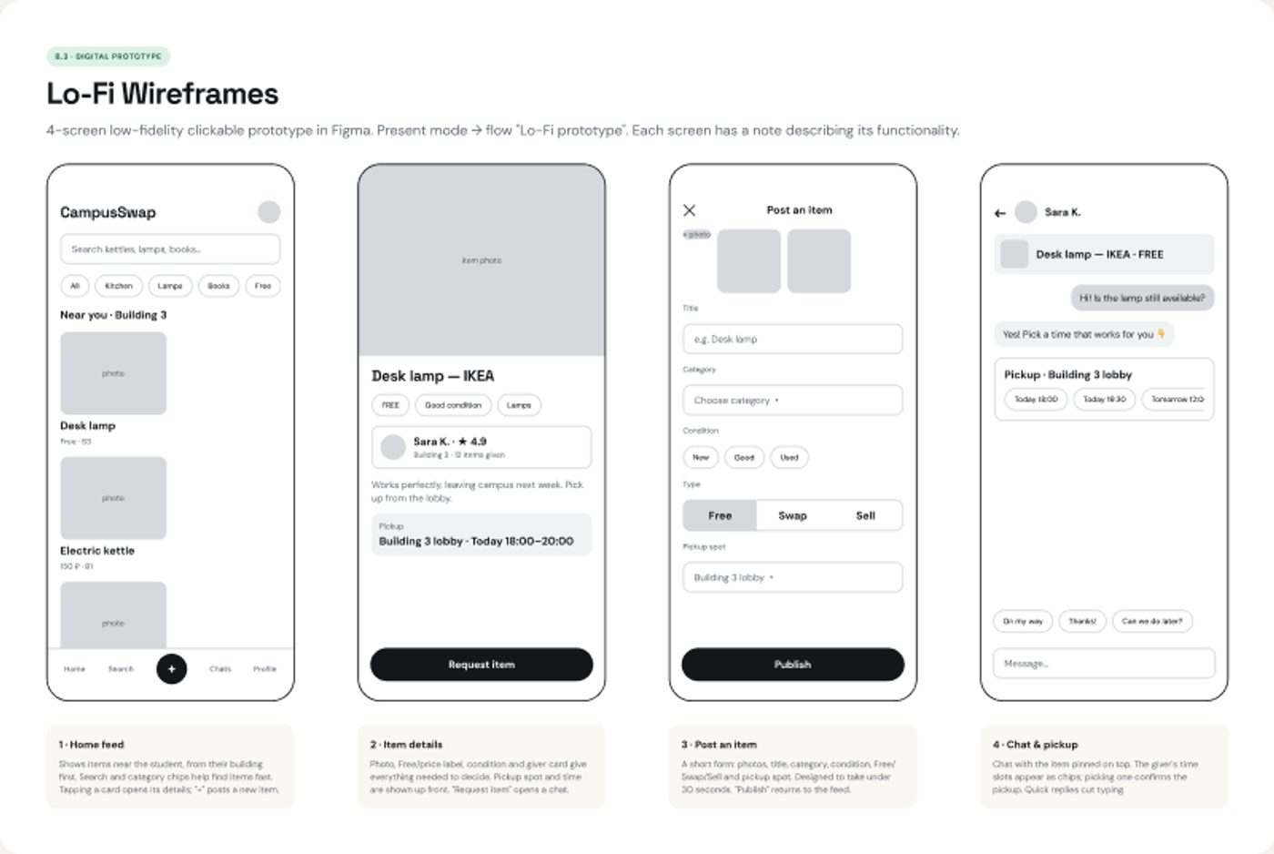
Sketches and lo-fi wireframes tested the flow before visual design
Crazy 8s
8 paper sketches in 8 minutes to explore layouts fast
4 lo-fi screens
Home, item details, post an item, chat and pickup
Clickable in Figma
Grey boxes only, so feedback is about flow, not colors
Notes:
Show the Crazy 8s sketches in Figma if asked. Explain that lo-fi is grey on purpose: testers focus on whether the flow makes sense.

Slide 12
Usability testing: 4 tasks with [N] students
Task | What the participant does | Success means
T1 | Find a free desk lamp in your building | Item details in under 60 s
T2 | Request it and choose a pickup time | Time slot selected, confirmation seen
T3 | Confirm the handover and rate the giver | Rating submitted
T4 | Post your old kettle for free | Listing published in under 90 s
What changed after testing
[Problem 1 seen in testing → change you made]
[Problem 2 → change]
Moderated sessions, think-aloud, ease rated 1–7 after each task.
[Problem 3 → change]
Notes:
Fill in after 2–5 test sessions. For each change, say what participants struggled with and how the design changed (user flow v2.0).

Slide 13
Visual design: a friendly green, warm accents and rounded shapes
Space Grotesk
Headings: friendly and a little techy
Green #1E7B5C
Yellow #FFC83D
Coral #FF6B4A
Actions, active states
Prices, highlights
Alerts only
DM Sans
UI and body text: easy to read at small sizes
Rounded corners (8–28 px), soft shadows and 18 line icons. White on green passes WCAG AA contrast (5.2:1).
Mint #DDF1E8
Ink #14161A
Cream #FAF8F2
FREE tag, success
Text
App background
Notes:
Explain the moodboard keywords (friendly, trustworthy, fresh, campus-made) and how the colors and fonts express them. Mention the pattern library: buttons, chips, tags, cards, tab bar, all Figma components.

Slide 14
The hi-fi prototype covers the full get-an-item flow
Try the prototype
[QR code of the Figma prototype link]
[paste screen]
[paste screen]
[paste screen]
[paste screen]
[paste screen]
1. Sign up
2. Home
3. Item details
4. Chat and pickup
5. Handover and rate
[figma.com/proto/… link]
Built only from the style guide and pattern library, iPhone 14 size (390 × 844).
Notes:
Then switch to Figma and demo the full flow live: sign up, find the lamp, request it, choose a time, confirm, rate. Then show posting an item.

Slide 15



Key learnings
Research
Design
[What the interviews changed in your thinking]
[A Figma or design skill you learned, e.g. components]
Testing
Next steps
[What testing taught you about your own assumptions]
[What you would build or test next]
Notes:
Speak from your own experience. Link each learning to a course topic: research methods, synthesis, UI principles, usability testing.

Slide 16
About me
Ahmed Helaly
[Program and year at the university]
[your photo]
[One line about you and why this problem matters to you]
[Email · Telegram · portfolio link]
Notes:
Short and personal. Mention you live in or know the dorms, which is why this problem matters to you.

Slide 17
Thank you
Questions? Let's open the Figma file.
Notes:
Invite questions, then open the Figma file for inspection: walk the sections left to right (research, lo-fi, hi-fi).

