Slide 1
zeta-engine
面向中国人民大学站点的搜索引擎与 RAG 增强检索
高瓴人工智能学院 熊洋铭

Slide 2
(match strict patterns)
BM25-field
1 - alpha
query terms
query text
term posting indexing
(sparse index)
passage semantic indexing
(dense index)
hybrid scores
of candidates
15 domains
~14,000 pages
top k docs
CrossEncoder
most related chunk
rerank
(possibly fallback)
output
query dense vector
dense cosine sim
rank 1: http://ai.ruc.edu.cn/xxx.html
rank 2: https://gsai.ruc.edu.cn/xxx.html
...
alpha
(match semantic meanings)

Slide 3
User Query
"2021 GSAI summer camp attendance count"
(Up to ~5 rounds)
Text Normalize
Are all requirements satisfied?
Missing evidence / follow-up queries
Agent
Verifier
Answer
Skillset
A total of 257 people participated in the 2021 GSAI Summer Camp.
Evidence: evidence_1
Search
Collect
Calculate
Results added to
Evidence Pool
Retrieve top-k related passages
Extract all records from a scoped resource
Perform precise calculation
evidence_1:
{
  evidence_id,
  title,
  url,
  published_date,
  passage,
  structured_content,
  retrieval_query
}, ...
Local Knowledge Base

Slide 4
Request routing
Interfaces
Parse the operation and arguments, dispatch the request, format the result.
Application
Search returns documents. RAG receives search and collection callbacks.
Notes:
Source: docs/report/main.tex, section 2.4. Formula SVGs are generated from the seven architecture equations. Native text labels describe the symbols; full definitions remain in the report.

Slide 5
Data preparation
Ingestion
Q: persistent crawl queue H: downloaded HTML D: document corpus
Infrastructure
Normalize and tokenize text. Read and write document, queue and index records.
Notes:
Source: docs/report/main.tex, section 2.4. Formula SVGs are generated from the seven architecture equations. Native text labels describe the symbols; full definitions remain in the report.

Slide 6
Retrieval and evaluation
Retrieval
Fuse by document for search and by passage for RAG, then rerank.
Evaluation
Run queries, submit results and aggregate scores with latency.
Notes:
Source: docs/report/main.tex, section 2.4. Formula SVGs are generated from the seven architecture equations. Native text labels describe the symbols; full definitions remain in the report.

Slide 7
Agentic RAG
State, tool actions and verification
S: queries, evidence, calculations and verification feedback
Tools update the state. Verifier checks the candidate answer.
Up to 5 rounds and 12 model calls. The call limit terminates with an error.
Notes:
Source: docs/report/main.tex, section 2.4. Formula SVGs are generated from the seven architecture equations. Native text labels describe the symbols; full definitions remain in the report.

Slide 8
Complete evidence for reliable counts
Search
Collection
Calculate
Partial matches
Recover the full table
Deterministic counting
ID | Record
3 | C
4 | D
ID | Record
1 | A
2 | B
3 | C
4 | D
5 | E
5
records
Relevant, but incomplete
Source: evidence_T1
Notes:
Illustrative records, not actual summer camp data. Sources: retrieval/acquisition.py and rag/calculations.py. Search finds relevant passages. Collection recovers the complete source table. Calculate counts the records after checking scope.

Slide 9
Hybrid retrieval improves ranking
MRR@20
+6.9%
Relative MRR@20 gain
25 → 26
Top-1 hits
Recall@20 stays at 0.7361
Notes:
Source: docs/report/main.tex, retrieval comparison. 72 high-confidence queries. BM25F MRR@20: 0.4420; Hybrid alpha=0.38: 0.4726. Top-1 hits: 25 and 26. Recall@20: 0.7361 for both. Relative gain: 6.923%. Historical evaluation; no rerun for this presentation. These metrics do not measure RAG answer quality.

Slide 10
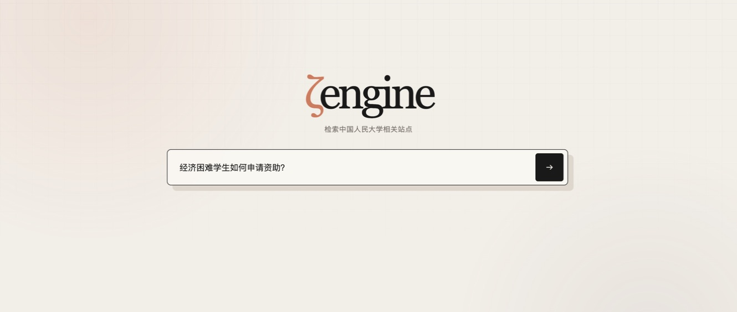
One interface for search and questions
01
Ask a question
Policies and notices
02
Check sources
Review source pages
and evidence support
> uv run zeta-engine serve
Notes:
Screenshot of the actual index.html frontend. The Chinese query asks how students with financial difficulties can apply for aid. No query was submitted. The screenshot does not represent a completed answer. See README for crawling, indexing, model downloads and API configuration.

