Slide 1
Launching into the future
with jBPM Migration Project
Eric D. Schabell | erics@redhat.com | @ericschabell

Slide 2
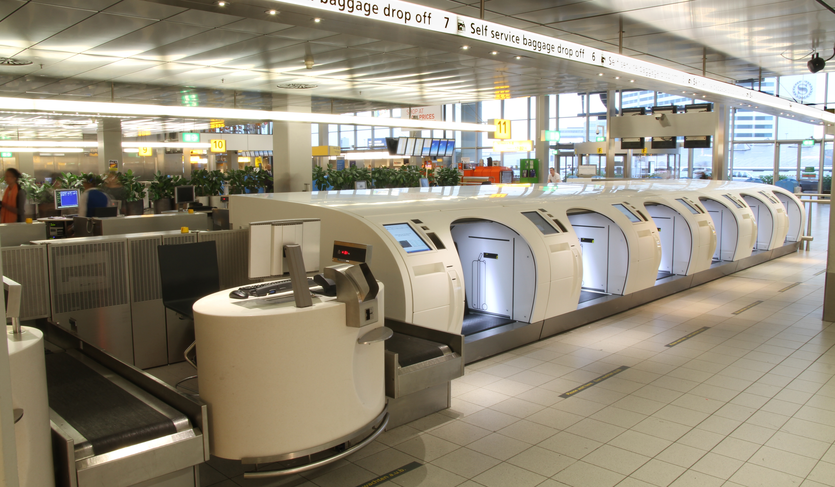
In the strangest
places...

Slide 3


Shiny new, must have...

Slide 4


Slide 5
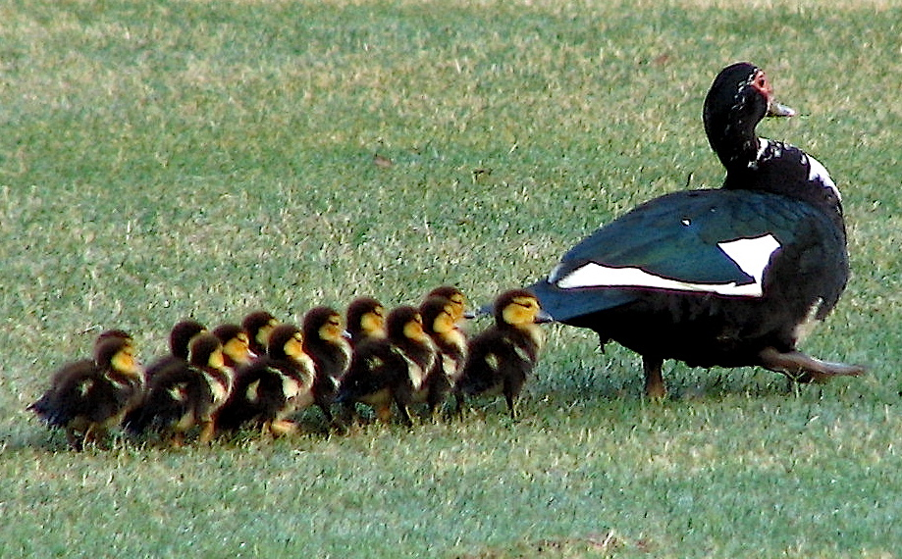
Ducks in a row?

Slide 6


Slide 7

What about us?
jPDL != BPMN

Slide 8

The first step...

Slide 9


Slide 10


jBPM Migration Tool
No one is left behind...

Slide 11


Historical migration...

Slide 12
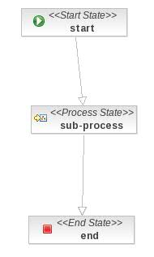
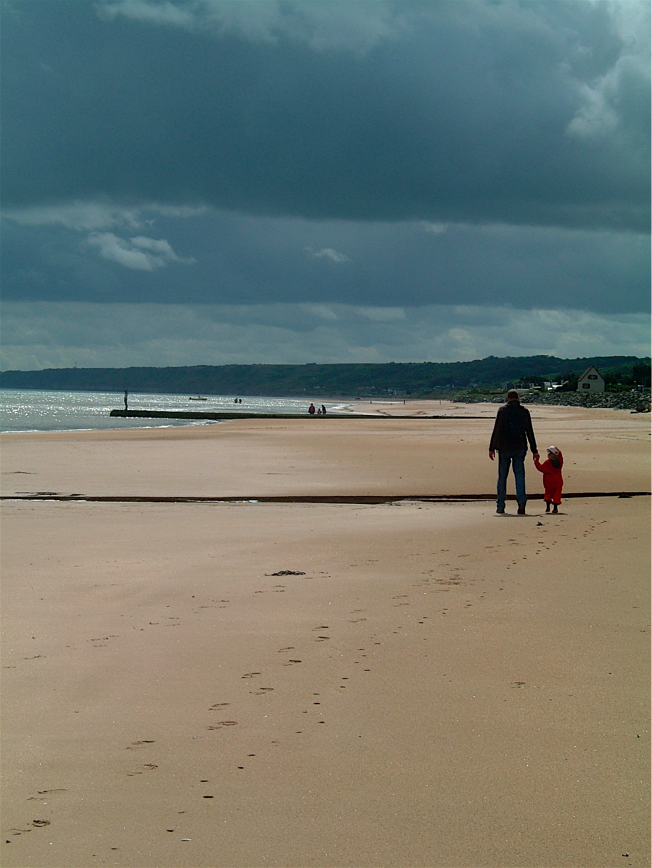

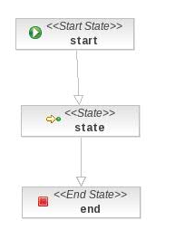

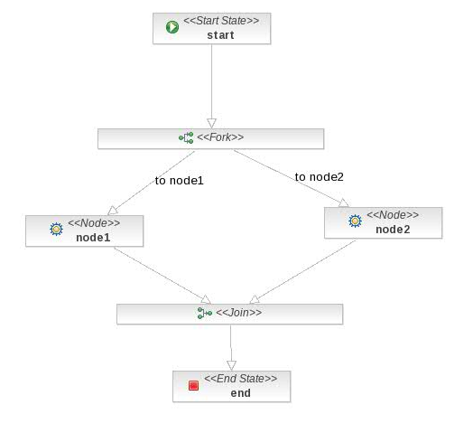
Bigger steps...

Slide 13
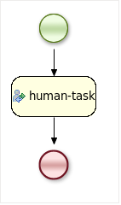
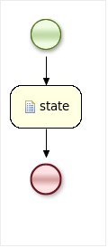
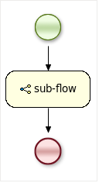
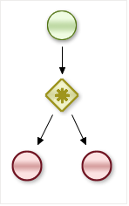
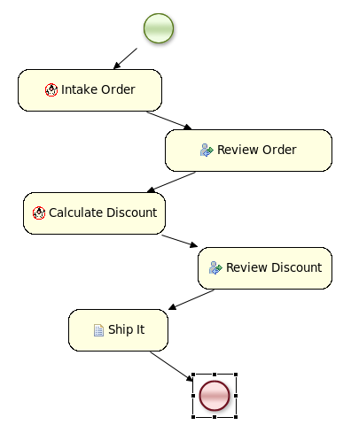
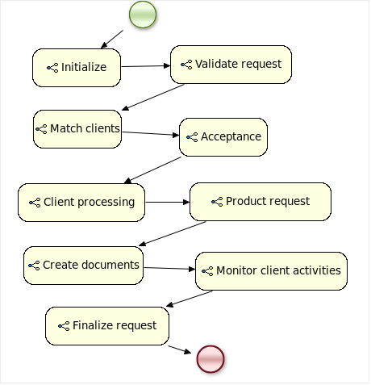

Slide 14



Slide 15
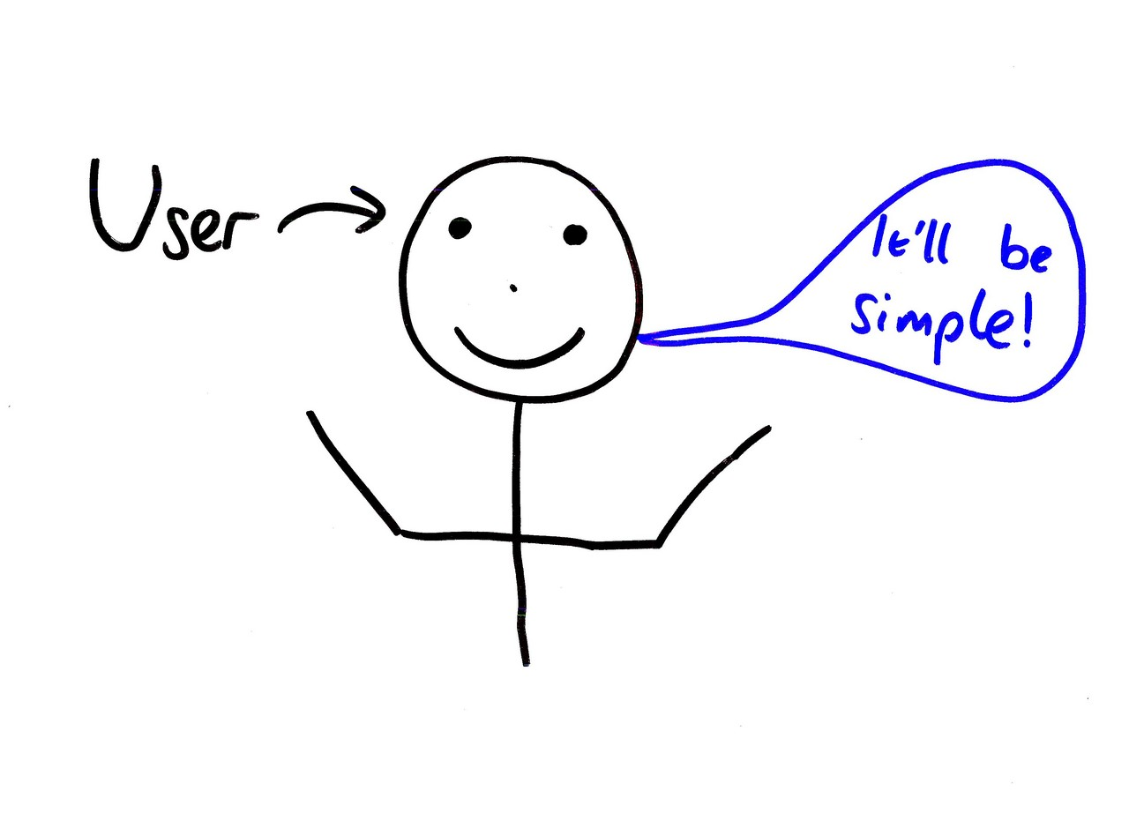
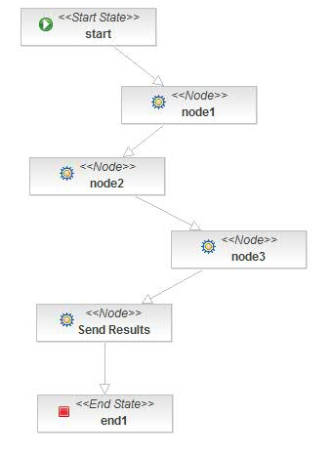


Slide 16
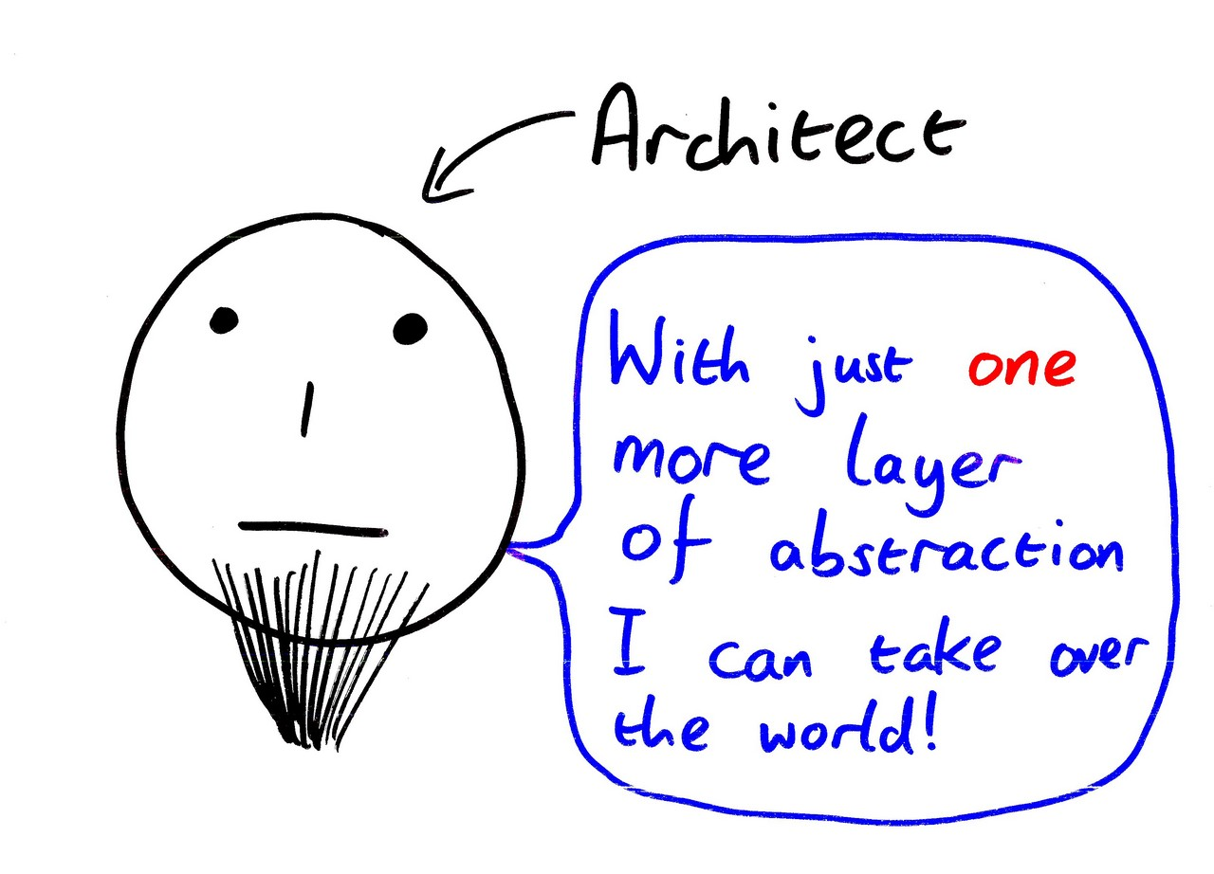

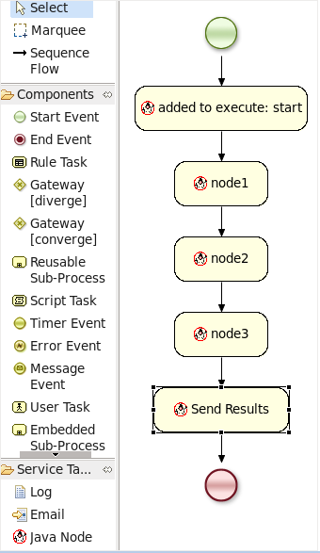
Notes:
Here demo Eclipse IDE and the various migrations.
What does not display can be explained due to incomplete pallette.

Slide 17

Moving forward...

Slide 18

Welcome to the family...
https://github.com/droolsjbpm/jbpmmigration

Slide 19

Notes:
Demo this if you have a connection.

Slide 20
OpenShift Howto
# Running on OpenShift.
# Create an account at http://openshift.redhat.com/
#
# Create a jbossas-7.0 application
#
$ rhc-create-app -l $username -a jbpmmigration -t jbossas-7.0
# Add this upstream openshift-jbpmmigration repo.
#
$ cd jbpmmigration
$ git remote add upstream -m master git://github.com/eschabell/openshift-jbpmmigration.git
$ git pull -s recursive -X theirs upstream master
# Then push the repo upstream.
#
$ git push

Slide 21

There's
more?

Slide 22


Notes:
Demo web designer:
- singleTask
- ?
- ?

Slide 23
Web Designer
# Running on OpenShift.
# Create an account at http://openshift.redhat.com/
#
# Create a jbossas-7.0 application
#
$ rhc-create-app -l $username -a editor -t jbossas-7.0
# Add this upstream openshift-jbpmmigration repo.
#
$ cd editor
$ git remote add upstream -m master git://github.com/eschabell/openshift-jbpmmigration.git
$ git pull -s recursive -X theirs upstream master
# Then push the repo upstream.
#
$ git push

Slide 24

jBPM migration strategies: http://www.schabell.org/2010/03/jbpm-migration-strategies-introduction.html
Migration tool project:
https://github.com/droolsjbpm/jbpmmigration
Migration story JUDCon 2010: http://www.schabell.org/2010/10/judcon-2010-berlin-get-your-bpm-ducks.html
Migration project update JUDCon 2011: http://www.schabell.org/2011/05/judcon-2011-jbpm-migration-tooling-no.html
Github migration collection:
http://www.github.com/eschabell
Eric D. Schabell | erics@redhat.com | @ericschabell

