Slide 1
Eric D. Schabell
Solution Architect Red Hat
From Code to Cloud:
PHP on Red Hat's OpenShift

Slide 2


Slide 3

Exposure...

Slide 4

Meditation...

Slide 5

Immersion...
Shift happens?

Slide 6

Never look back...

Slide 7


Slide 8


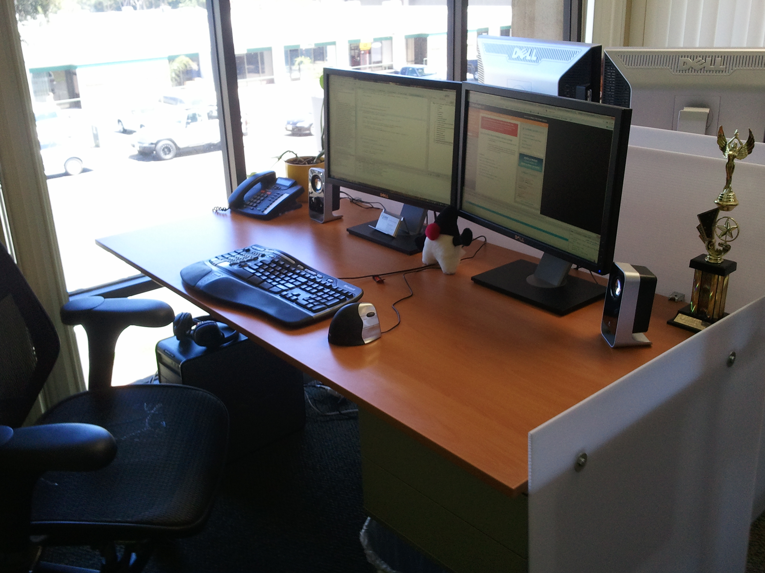
PaaS?

Slide 9

Why am i DORKING
with the stack?!

Slide 10



Slide 11
OpenShift Express
Sign Up
Install Client Tools
Create Domain
Create Application
Deploy Application (GIT)

Slide 12



Sign Up
http://openshift.com/try-it

Slide 13

Create Domain
Use rhc-create-domain command
  $ rhc-create-domain -n mydomain -l openshiftlogin
use Express console!

Slide 14
Create Application
Name application and define type
  $ rhc-create-app -a appname -t apptype -l openshiftlogin
  (Java, Ruby, Python, Perl and most important, PHP!)
Add application to local repo
  $ git add .
Commit changes
  $ git commit -m “Initial app import.”

Slide 15

Deploy to Cloud
Push the code to Express
  $ git push
Congratulations, your app is in the cloud!

Slide 16


Slide 17

Demo ZendFramework
$ rhc-create-app -a zendphp -t php-5.3
$ cd zendphp
$ git remote add upstream -m master git://github.com/eschabell/openshift-zendframework.git
$ git pull -s recursive -X theirs upstream master
$ git push
http://zendphp-$your_domain.rhcloud.com

Slide 18

Demo Symfony
$ rhc-create-app -a symfonyphp -t php-5.3
$ cd cake
$ git remote add upstream -m master git://github.com/eschabell/openshift-symfony.git
$ git pull -s recursive -X theirs upstream master
$ git push
http://sympfonyphp-$your_domain.rhcloud.com

Slide 19

Enterprise
Flexibility?
Auto
Scaling
Speed
Deployment
Provisioning
Monitoring
Automation
Log Mgmt
Roll-backs,
Upgrades
Databases

Slide 20

OpenShift Flex
Setup Cloud Account
Provision Cloud Servers
Build Stack
Upload Application Code
Configure Components
Deploy
Performance Monitoring
Log Management
Auto-Scaling

Slide 21


Login
Creds

Slide 22
Sign up, it's free!
http://www.openshift.com – click “Try it!”
Example projects you can deploy now!
  https://www.github.com/openshift
Help?
  IRC: freenode #openshift
  Forums: http://www.redhat.com/openshift/forums
  Email: openshift at redhat dot com

Slide 23



Loving your hammer?

