Slide 1
jBPM in action – past, present and future
Eric D. Schabell
JBoss Solutions Architect Benelux
(EMEA SME for jBPM & BRMS)
http://www.schabell.org

Slide 2
Agenda
Introduction jBPM
  usage of jBPM .org vs .com
jBPM v3.x status from the trenches
  the past (or present?)
jBPM v4.x is the future
Migration scenarios
Overview resources
JFall surprise!

Slide 3

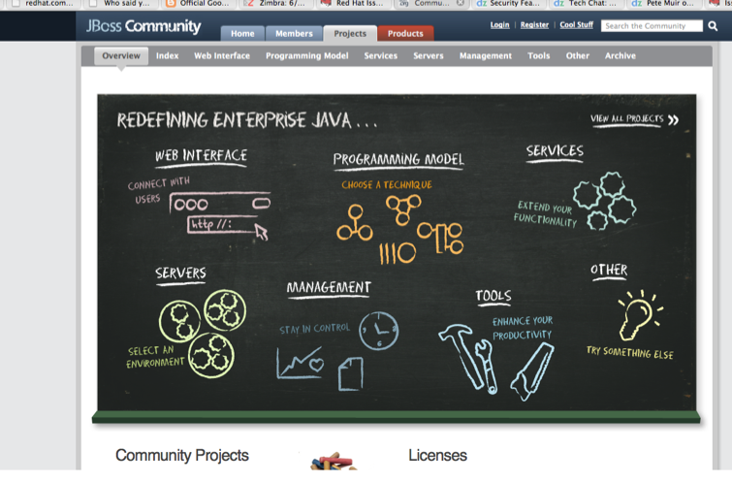


JBoss.org – community support
Where Innovation Happens
Projects
Refocus on “release early, release often”
80+ projects with different release schedules, versions, dependencies, etc.
Forums
Project developers
Wiki
Issue trackers
etc.
New Version

Slide 4
JBoss.com – enterprise support
Challenge:
Integrate & maintain integration between multiple projects.
Time intensive/ Expensive
Solution: JBoss Enterprise Platforms
Single, integrated, certified distributions
Extensive Q/A Process
Industry-leading Support
Documentation
Secure, Production-level Configurations
Multi-year Errata Policy
Cache
Hibernate
Seam
Tomcat
Msg
Application
Server
Multiple projects, all with different release schedules, versions, dependencies, etc.

Slide 5
JBoss Enterprise jBPM
Each JBoss Enterprise Middleware platform goes through 5 phase delivery methodology:
1
2
3
4
5
JBoss.org Projects
Product
Requirements
Definition
Platform Component Engineering & Integration
Platform Testing, Certification & Documentation
Platform Release
(General Availability)
Delivery Phase
Platform
Candidate
Release(s)
JBoss
Enterprise
Platform
Productization Team
JBoss
Productization
Engineers
JBoss QA, Documentation Team, Certified Partners
JBoss Release Engineering
Product Management

Slide 6
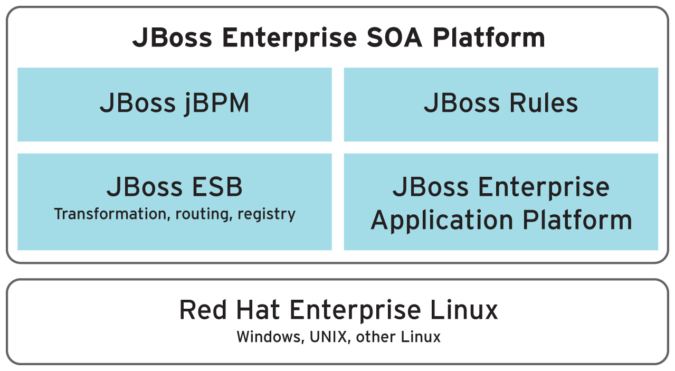
JBoss SOA-P ==> jBPM

Slide 7
Agenda
Introduction jBPM
  usage of jBPM .org vs .com
jBPM v3.x status from the trenches
  the past (or present?)
jBPM v4.x is the future
Migration scenarios
Overview resources
JFall surprise!

Slide 8
jBPM v3.x – usage
your architecture limited a bit?
  as a Java library
  no ESB?
  missing integrated rules engine
  back-end systems failing to support:
    transactionality
    events (triggers)
    asynchronicity

Slide 9

jBPM v3.x – api
So many choices, too much of a good thing?
  ~63 API's
  learning curve
  this leads to 'best (intentions) practices?'
  crafty developers == danger!!!!
    hard to handle large project group
    challenge to keep consistent implementations
    can be frustrating...

Slide 10
jBPM v3.x – implementations
in the trenches:
  node, decision, task, transition
    mostly nodes with (business) logic in handlers
    hidden activity (business logic) in transitions
  synchronous execution
    single thread of execution => persistence at task
  single jBPM process engine
  exception handling
    via one top level jBPM handler => jump to task
      turn auto-commit off/on, persist context
      jump to exception handling task

Slide 11

Best intentions?
Many paths to BPM solutions
We all have best intentions
  keep process visible in single overview
  one step == one service/action
  remember amount API choices?
  what do you end up with?

Slide 12
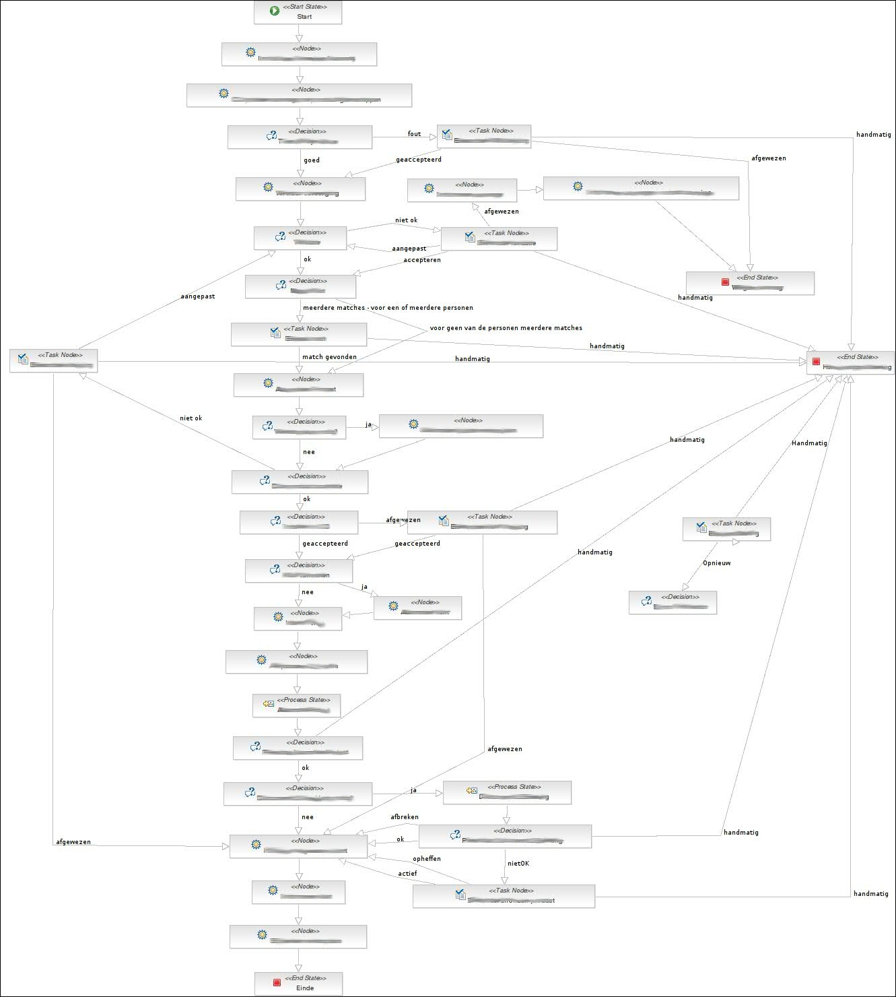

jBPM v3.x

Slide 13

Or is it best practices?
Best practices (complete?):
    use State nodes
    use Process-State (sub-flows)
    apply good OO design:
      reuse == par repo
      methods == sub-flow + context
      encapsulate == sub-flows
      unit-testing == per node, sub-flow, flow

Slide 14
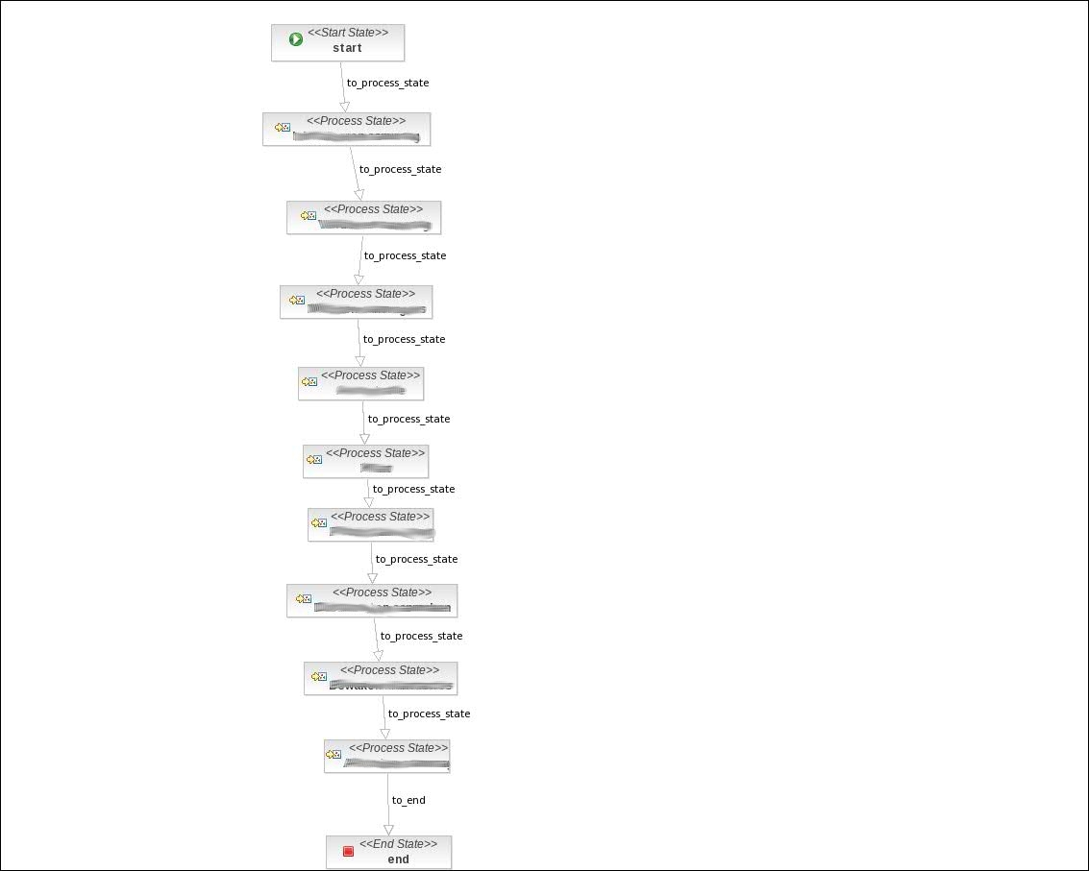

jBPM v3.x

Slide 15
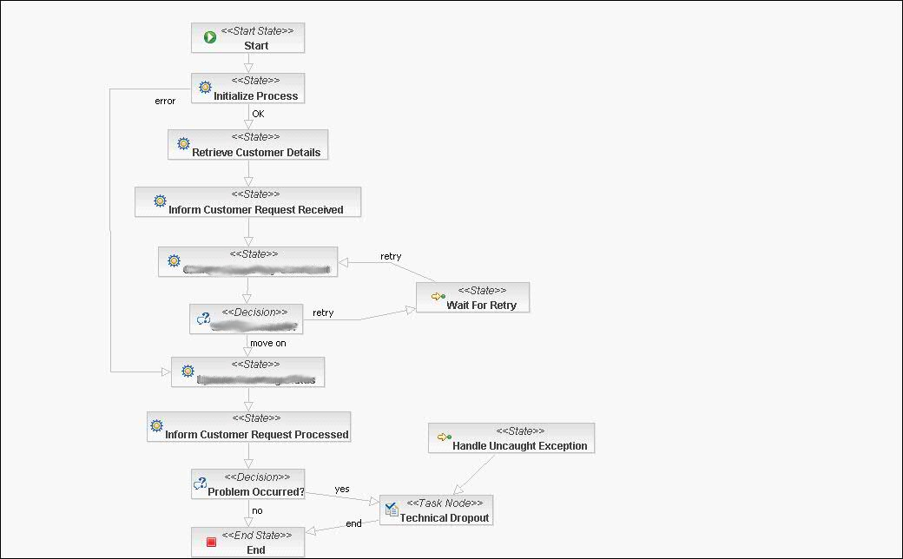
jBPM v3.x

Slide 16
Agenda
Introduction jBPM
  usage of jBPM .org vs .com
jBPM v3.x status from the trenches
  the past (or present?)
jBPM v4.x is the future
Migration scenarios
Overview resources
JFall surprise!

Slide 17

jBPM v4.x – the future is now
API nightmares resolved
New designer(s) / console / BPMN editor
jPDL & BPMN
Auto upgrades
Process instance migrations
Improved classloading
Development roadmap

Slide 18
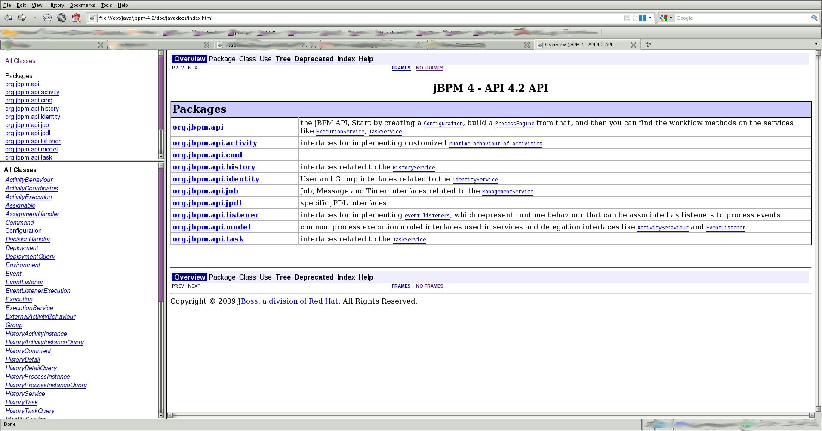
jBPM 4.x API

Slide 19

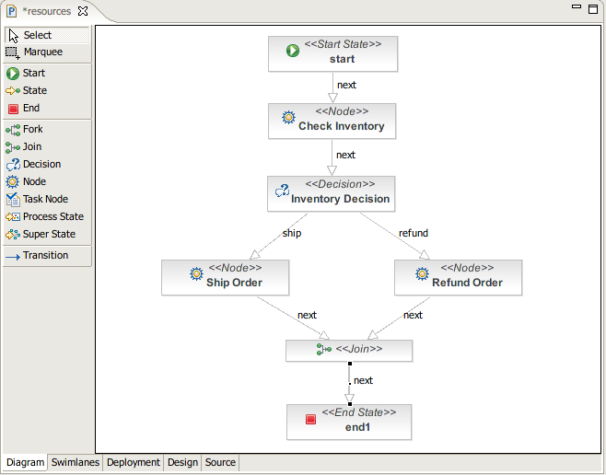
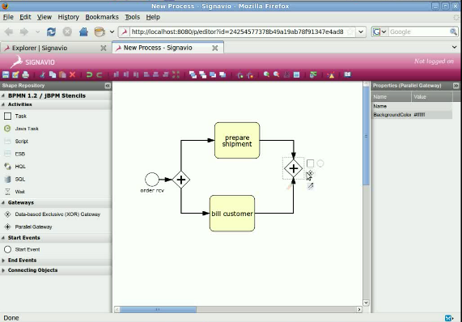
Process designer changes

Slide 20
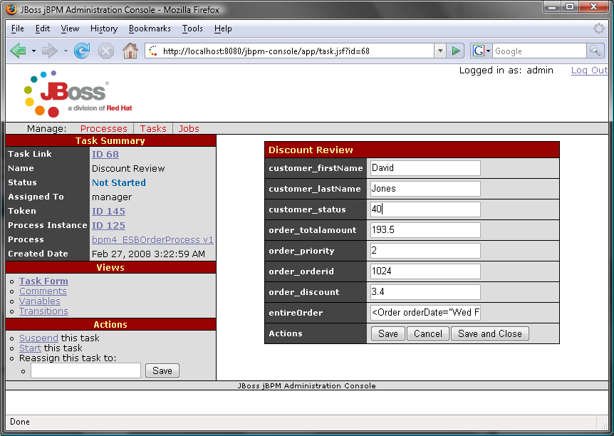
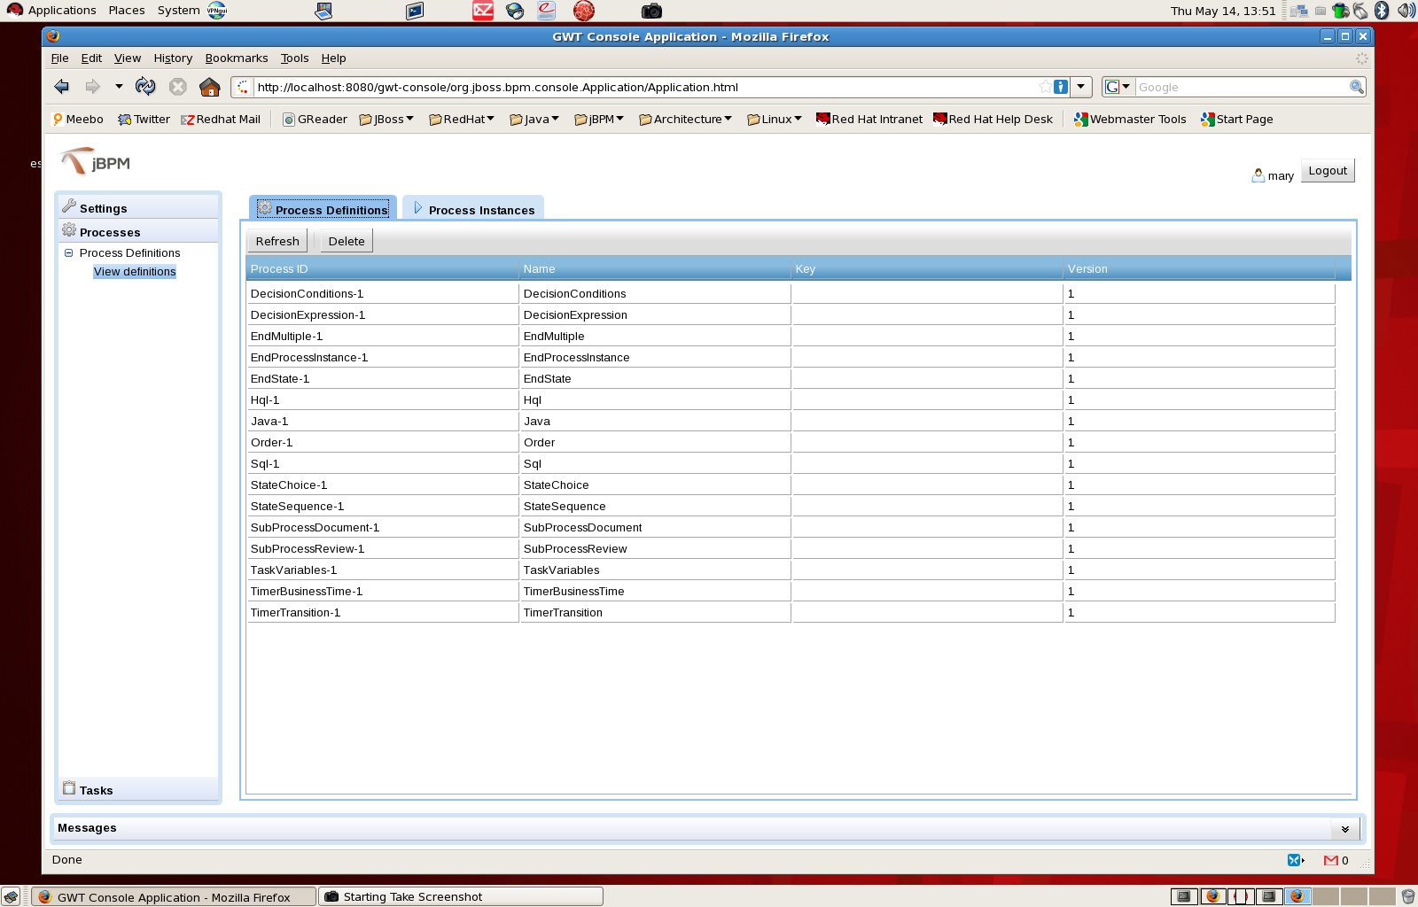
Console changes

Slide 21
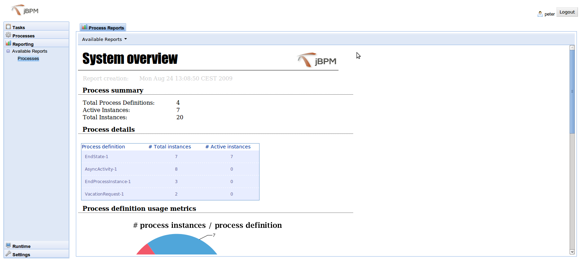
Console reports

Slide 22

jBPM getting better and better
jPDL & BPMN 1.2 -> 2.0 via Signavio
Auto upgrades
  from 4.x to 4.x migrations of jBPM DB, schema + data
  compares jBPM lib version with schema version
Process instance migrations
  deploy new, specify old process to migrate
Improved classloading:
  server classpath
  .war & .ear files
  .bar files (jPDL processes, classes, forms)
YeeHaw!

Slide 23
jBPM product roadmap
Looking to the future:
  SOA-P 5 forecast Q2 2010
    jBPM 3
    initial jBPM 4 missed product generation deadline
  SOA-P 6
    jBPM 4 or jBPM ?
    future unclear
  BPM-P 5
    super-set SOA-P 5
      BPEL 2.0
      BPEL designer

Slide 24
Agenda
Introduction jBPM
  usage of jBPM .org vs .com
jBPM v3.x status from the trenches
  the past (or present?)
jBPM v4.x is the future
Migration scenarios
Overview resources
JFall surprise!

Slide 25
jBPM – migration scenarios (I)
jBPM v3.1 ==> jBPM v3.2 == very hard
  db mapping: schemaspy
    http://schemaspy.sourceforge.net/
  running instances
    migrate? how? leave v3.1 running for live instances?
jBPM v3.2.x ==> jBPM v3.2.x == most likely ok
  db mapping: changlogs or schemaspy
  running instances (see above strategies)

Slide 26
jBPM – migration scenarios (II)
jBPM v3.x ==> jBPM v4.x == massive problems
  looks like a job for Super Man (GPS)!
  no community support / history (yet)
  no way to migrate running instances from v3.x
  massive schema changes
jBPM v4.x ==> jBPM v4.x
  automated via tooling!
  at least from 4.2 onwards

Slide 27
Agenda
Introduction jBPM
  usage of jBPM .org vs .com
jBPM v3.x status from the trenches
  the past (or present?)
jBPM v4.x is the future
Migration scenarios
Overview resources
JFall surprise!

Slide 28




Resources
jBPM publications
  “Financial Crisis Front Line: SNS Bank”, E. Schabell, S. Hoppenbrouwers, 2009 BPM & Workflow Handbook, ISBN 0-9777527-9-8, pp. 161-172, 2009. http://www.schabell.org/2009/04/2009-bpm-workflow-handbook-financial.html
  “Empowering Full Scale Straight Through Processing with BPM”, E. Schabell, S. Hoppenbrouwers, Advances in Enterprise Engineering II, Springer, pp. 18-33.2009. http://www.schabell.org/2009/02/caise09-pret-chapter-submitted.html
jBPM project
  “The Process Virtual Machine”, T. Baeyens, M. Valdes Faura, 2008. http://docs.jboss.com/jbpm/pvm/article/
jBPM product
  http://www.jboss.com/products/jbpm/

Slide 29
Questions?

Slide 30
Wait a minute...
what about the JFall surprise!

Slide 31

Hug a jBPM developer!
Joram Barrez
  jBPM core developer
  jbarrez@redhat.com
“Small steps with big feet”
http://www.jorambarrez.be/blog/

