Slide 2

Get your BPM ducks in a row -
preparing for migration to jBPM5

Slide 3
Agenda
Where are we with jBPM{3|4|5}
Enterprise usage of jBPM
Migration strategy for Enterprise jBPM

Slide 4

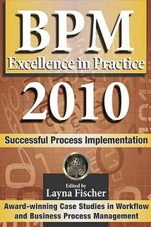

jBPM 3.x
The first productized version of jBPM
  jBPM 3.2 Sep 2007 to Sep 2013
    latest SOA-P 5 == jBPM 3.2.6
    Feb 2010 to Feb 2015
  SOA-P 5.1 scheduled released Q4 2010
    will contain jBPM 3.2.x == support 2013!
  tried, trusted, proven, rock solid enterprise component!

Slide 5

jBPM 4.x
Community only version of jBPM
  jBPM 4.0 start of new PVM
  jBPM 4.4 release community run
  will never make it to product or support
  future migration to jBPM 5 == community

Slide 6

jBPM 5.x
The future of jBPM
  RFC online
    leverage existing Drools project
    leverage PVM ?= jBPM 4.x
  roadmap available online
  first community release 2010 @JUDCon!
  will become part of JBoss products

Slide 7
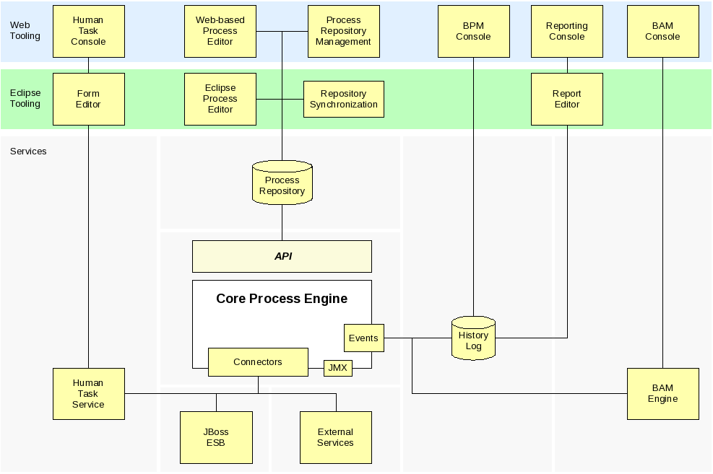

Slide 8
Agenda
Where are we with jBPM{3|4|5}
Enterprise usage of jBPM
Migration strategy for Enterprise jBPM

Slide 9
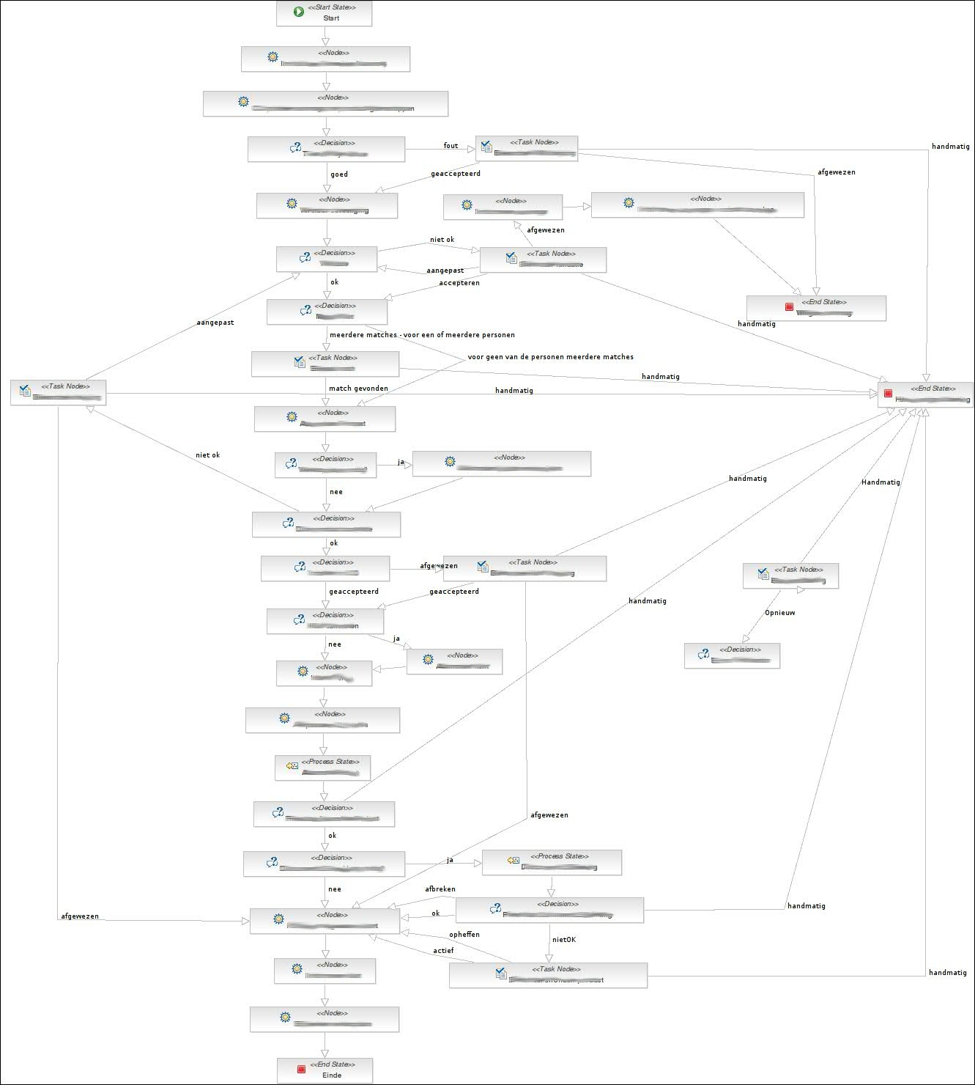

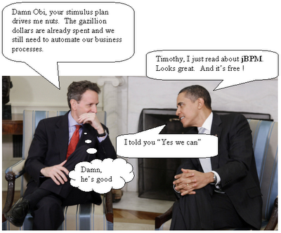
We have been architecting, implementing and deploying jBPM solutions in the strangest places for years now...

Slide 10
But wait a minute...

Slide 11

What about us...
jPDL != BPMN

Slide 12
Agenda
Where are we with jBPM{3|4|5}
Enterprise usage of jBPM
Migration strategy for Enterprise jBPM

Slide 13
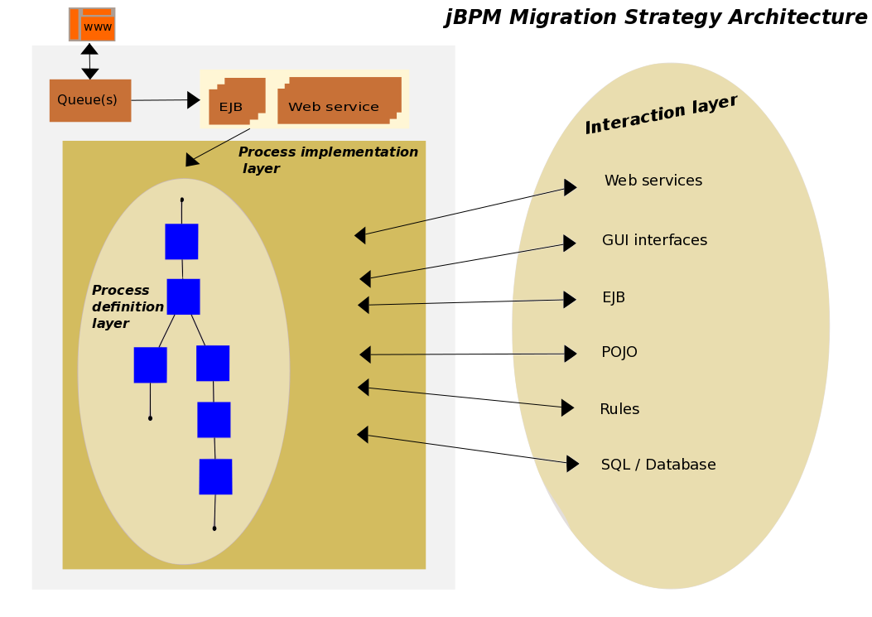

Slide 14
Some focus areas
Process initialization layer
Process definition layer
Process implementation layer
SOA interaction layer
General best practices for positioning your projects

Slide 15
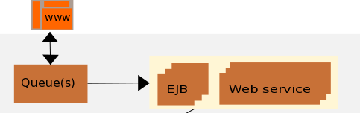
Process initialization
How do you start your process?
  web services, EJB's, API call
  what about prioritization of processes
    use message queues
    other complex ideas to start processes
API to startProcess changes...
  centralize startProcess in single location
    minimizes change effects in this layer

Slide 16
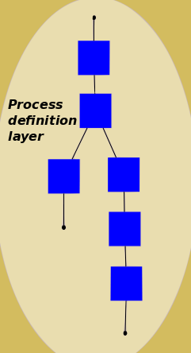
Process definition
Just process definition files
  imagine a right-mouse to 'convert'
jPDL to BPMN2
  migration tooling project
    jPDL 3.2.x to BPMN 2 (CLI)
    jBPM 3.2.x API mapping to jBPM 5

Slide 17
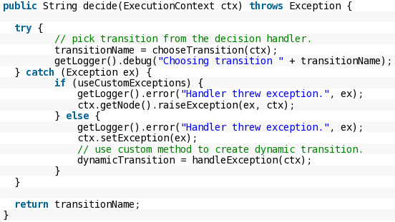
Process implementation
Java handlers
  do you keep it clean?
    single unit of action per process step
    human task / admin interfaces
    exception handling (jump-to)
    custom jBPM DB access
Centralize you jBPM API access
  single WS / DAO / BOM
  migration made easy (or easier)?

Slide 18
SOA interaction
Processes interact with your Enterprise
  Web Services, EJB, GUI, POJO, Exceptions, Bean Script, Rules...
    jBPM API & jBPM DB
    history / tasks / reporting
      single DAO
      single Web Service
      externalize rules calls in Web Service(s)

Slide 19
Some best practices...
Simplify everything (KISS)
  apply OO to process design
    methods == sub-flows + context in/out
    encapsulate == sub-flows
    reuse == PAR repo (maven potential)
    unit testing == per node, sub-flow, flow
    keep it all visible (transitions for travel only)
    exception handling (Exception Framework)

Slide 20
Migration tool project
What needs to be done:
  jPDL 3.2.x to BPMN 2 (CLI)
  jBPM 3.2.x API mapping to jBPM 5
  community welcome for jBPM 4.x
  working with use cases
    start simple
    send us projects / raise issues.
  TODO: wiki, jira, etc.

Slide 21
References
jBPM5 RFC: https://community.jboss.org/wiki/jBPM5RequestforComments
jBPM5 Roadmap: https://community.jboss.org/wiki/jBPM5Roadmap
jBPM5 Jira: https://jira.jboss.org/browse/JBPM/fixforversion/12315097
jBPM migration strategies: http://www.schabell.org/2010/03/jbpm-migration-strategies-introduction.html
Migration tool project: http://anonsvn.jboss.org/repos/jbpm/projects/migration_tool/
Exception framework project: http://anonsvn.jboss.org/repos/jbpm/projects/exception_framework/
2009 BPM & Workflow Handbook: http://www.schabell.org/2009/04/2009-bpm-workflow-handbook-financial.html
BPM Excellence in Practice 2010: http://www.schabell.org/2010/09/financial-crisis-front-lines-sns-bank.html

