Slide 1
Ruling your Rules – Hands on with BRMS

Slide 2
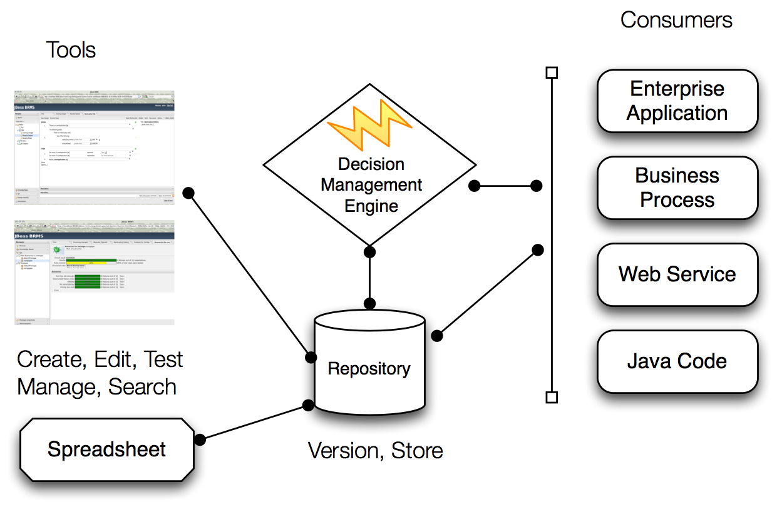
What's In JBoss Enterprise BRMS ?
Notes:
JBoss Enteprise BRMS (new in 2009)
Enables critical business rules to be managed in a more centralized manner (e.g. Insurance = policy risk assess and pricing; Heathcare = claims processing annual regulatory changes)
Avoids need to otherwise re-code business rules redundantly in multiple applications
Leverages JBoss Rules execution engine which has been available for years
Adds new browser-based Rules Mgmt app, enabling business users to participate in the review, editing, and maintenance of business rule changes
Also adds Repository to provide version management of multiple sets of business rules
Supports the deployment of business rules to JBoss middleware platforms and non-JBoss runtime environments

Slide 3
Business Rules
When
The driver hasn't have an accident during the 3 last years
and
The driver license is older than 5 years
Then
Apply 15% discount

Slide 4
JBoss Business Rules Engine
  rules
= $ Price
Age
Sex
Health
Occupation
Lifestyle
  facts
Execute
  The rules based on facts
Optimized
Notes:
This is an example of a use case for business rules.
There are many facts associated with an applicant that go into pricing insurance. Some are listed here.
These facts are presented to the rules engine which executes against them to calculate a price.
Given this price calculation is not buried in an application, it may be made available to multiple applications, business processes and other uses as a call from an application or available as an SOA service.
This chart is useful for customers who need a basic primer on business rules.

Slide 5
BRE
Working Memory Based Repository
  In-memory knowledge repository
  Forward chaining
  Based on RETE Algorithm
  Stateful and Stateless sessions
Deployment
  100% Java, can run in Java App, J2EE Application Server, JBoss SOA Platform
  Integrates with ESB, J2EE, JSP, Web services
  Standards-based: JSR-94 compliant (for what it’s worth)

Slide 6
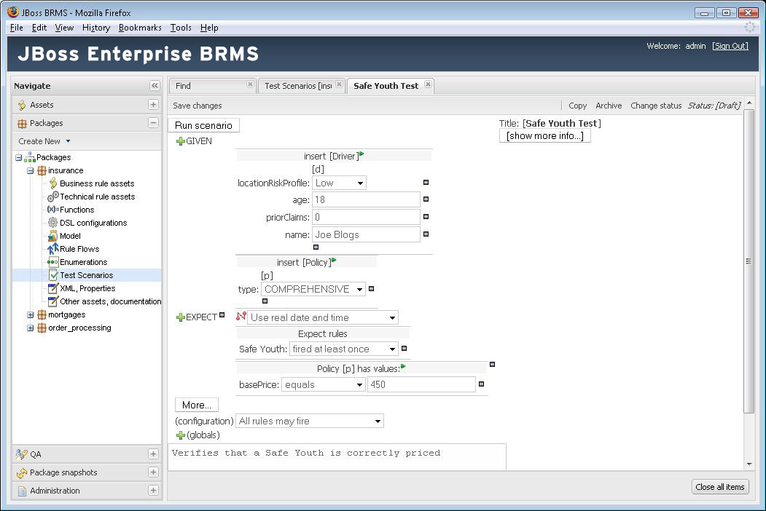
BRM
Business Rules life cycle
management
Write --> Execute
  Versioning
  Process
    Validation
    Test
Deployment Process
Secure (encryption,
access control)

Slide 7

100% Java
Java Application
JVM
Extract
Convert
Facts
Raw Data
Data model
Rules
Java libraries
Knowledge base
Notes:
This is an example of a use case for business rules.
There are many facts associated with an applicant that go into pricing insurance. Some are listed here.
These facts are presented to the rules engine which executes against them to calculate a price.
Given this price calculation is not buried in an application, it may be made available to multiple applications, business processes and other uses as a call from an application or available as an SOA service.
This chart is useful for customers who need a basic primer on business rules.

Slide 8
When to use BRMS?
Need Agile and Active Business Decisions
  Intelligent, active business decisions in IT
  Change in Hours/Days not Weeks/Months
Without BRMS
Application
Rules
Time line
With BRMS

Slide 9
When to use BRMS?
When there are lots of rules required to run the business.
When the domain expert needs to be closer to the implementation of the business logic.
When the business needs to be flexible and adaptable.

Slide 10
When to use BRMS?
When there is no satisfactory “traditional” solution.
When the problem is
  too complex
  no known algorithms
  too hard
  too “fluid”
  easily stated as a set of rules

Slide 11
JBoss BRMS 5.1
BRE – RETE based rule engine
JBoss Developer Studio – Eclipse IDE
BRM – Business Rules Manager
Rule Flow
Complex Event Processing

Slide 12
Forward Chaining
Only one rule fires per “cycle”
Conflict Set and conflict resolution is important
Process repeats until no more “new” rule/fact combination are found
As a rule fires, it can change working memory
Naturally recursive
Multiple phases: find conflict set, select rule, fire, repeat

Slide 13
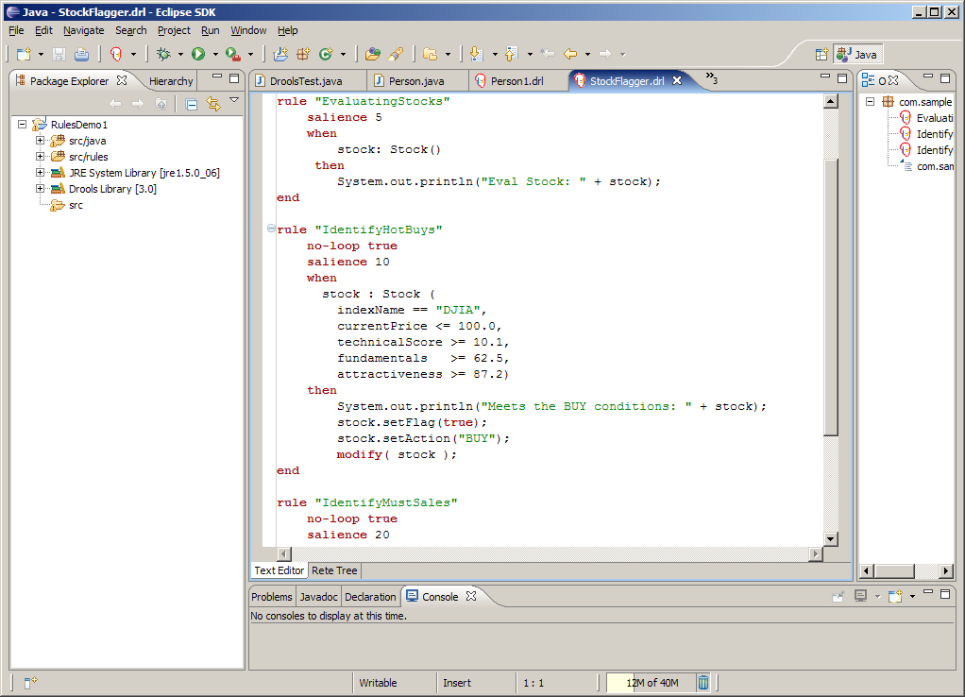
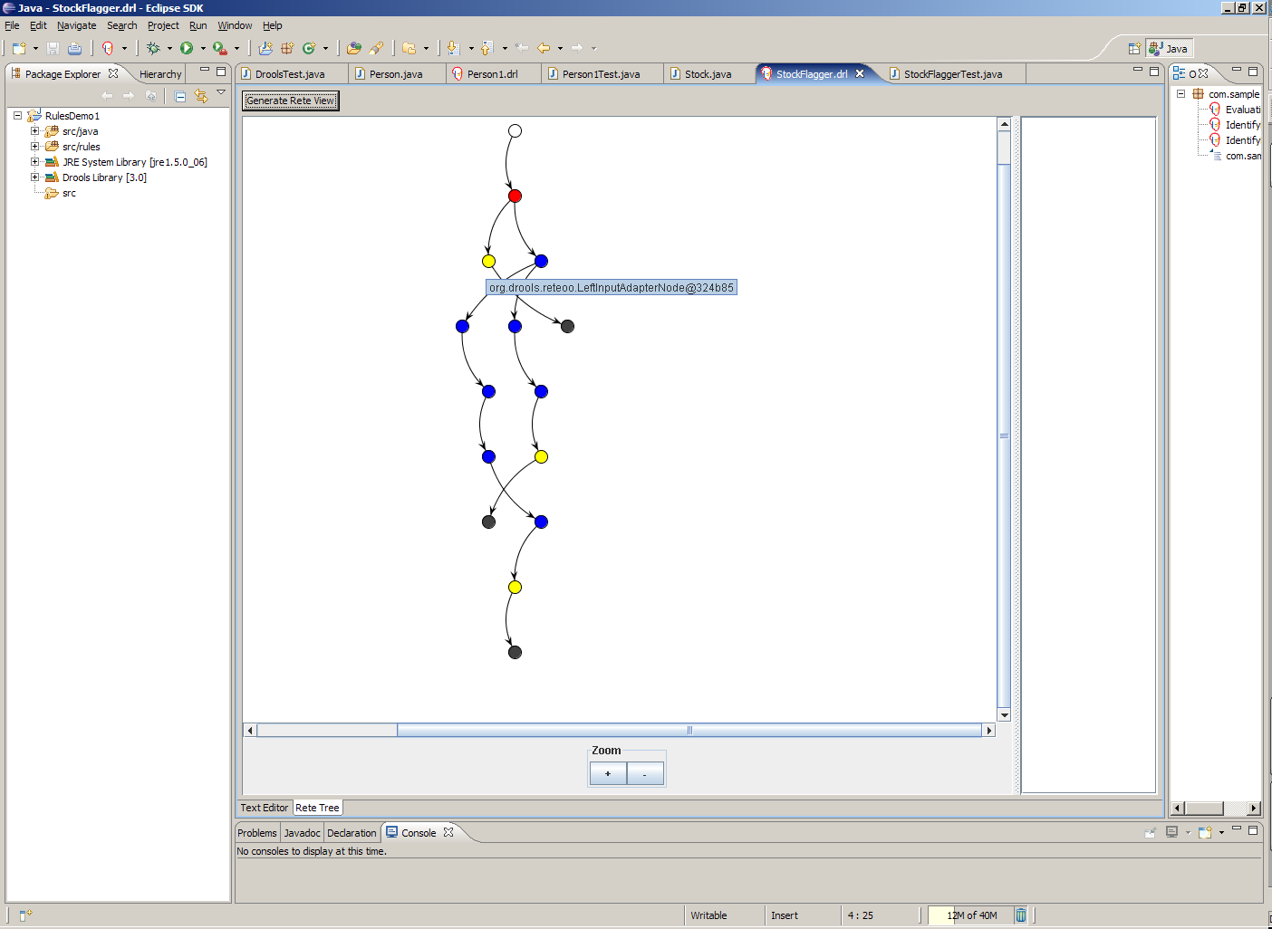
JBoss Developer Studio
Eclipse support for DRL files
  syntax coloring
  validation
  outline view
Debug views
  WorkingMemory
  Globals
  Agenda
  Execution Audit

Slide 14
JBoss Developer Studio
Breakpoints
RETE network view
New project and
  rule wizard
Graphical RuleFlow
BRM integration
DSL support

Slide 15
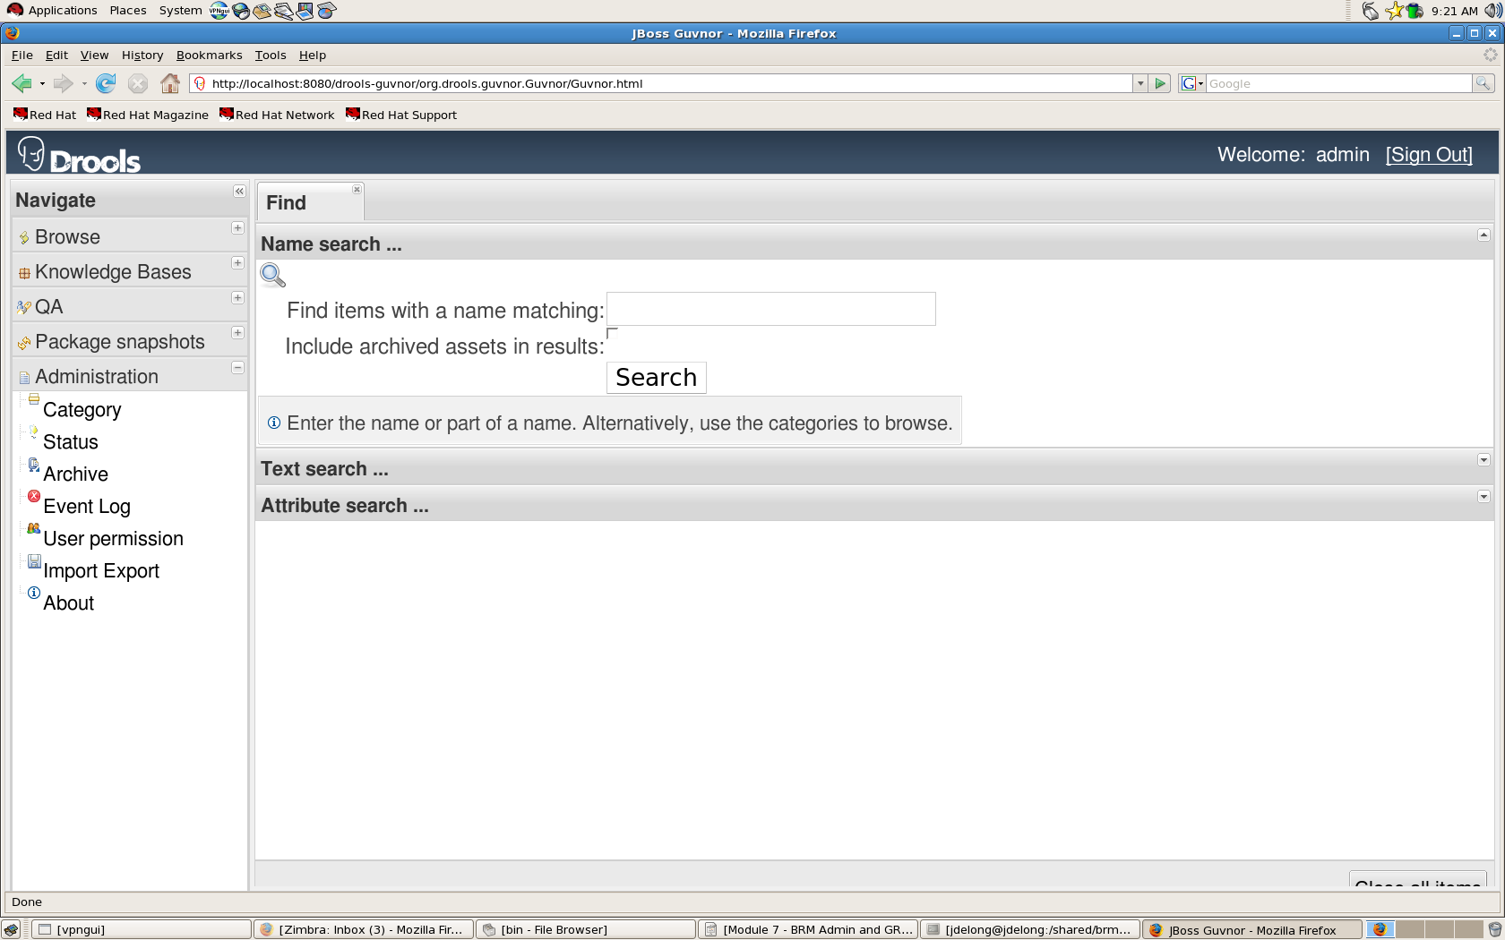
BRM
For managing a whole enterprise's declarative rules
  e.g., 5000+ rules for mortgage pricing
Business user focused view, not developer focused
Complements JBoss Developer Studio
Features:
  Authoring
  Storing
  Versioning
  Editing

Slide 16
BRM
Features:
  Editing
  Validating
  Finding
  Promoting
  Auditing
  Packaging
  Deploying

Slide 17
Rule Flow
When dealing with (possibly a lot of) large rule-sets, managing the order in which rules are evaluated might become complex.
Rule Flow allows you by using a graphical flow chart/activity diagram like drawing to:
  Specify the order in which rule sets should be evaluated
  Define which rule-sets should be evaluated in sequence or in parallel
  Specify conditions under which rule-sets should be evaluated, etc.

Slide 18
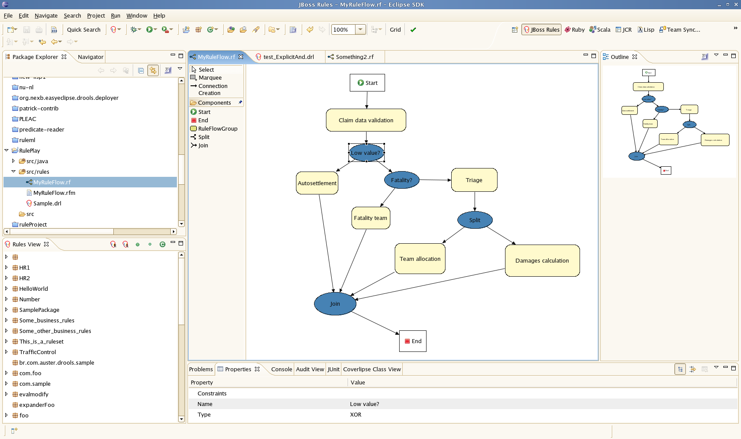
Rule Flow

Slide 19
Golfing Configuration Example
There are four Golfers standing at a tee, in a line from left to right.
  The golfer to Fred’s immediate right is wearing blue pants
  Joe is second in line
  Bob is wearing plaid pants
  Tom isn’t in position one or four, and he isn’t wearing the orange pants

Slide 20
Golfing Configuration Example
Class Golfer
  name
  color
  position
Write the rules
Create all possible combinations

Slide 21
Golfing Configuration Example
There is a golfer named Fred
fred : Golfer( name == "Fred" )

Slide 22
Golfing Configuration Example
Joe is second in line
joe : Golfer(name == "Joe", position == 2 && != fred.position, color != fred.color )

Slide 23
Golfing Configuration Example
Bob is wearing plaid pants
bob : Golfer( name == "Bob", position != fred.position && != joe.position, color == "plaid" && != fred.color && != joe.color)

Slide 24
Golfing Configuration Example
Tom isn’t in position one or four, and he isn’t wearing the orange pants
tom : Golfer(name == "Tom",
position not in (1, 4, fred.position,
joe.position, bob.position),
color not in ("orange", fred.color, joe.color, bob.color))

Slide 25
Golfing Configuration Example
The golfer to Fred's immediate right is wearing blue pants
Golfer( position == (fred.getPosition() + 1),
color == "blue",
this in ( joe, bob, tom ))

Slide 26
Golfing Configuration Example
String[] names = new String[]{"Fred", "Joe", "Bob", "Tom"};
String[] colors = new String[]{"red", "blue", "plaid", "orange" };
int[] positions = new int[] {1, 2, 3, 4};
for ( int n = 0; n < names.length; n++ ) {
for ( int c = 0; c < colors.length; c++ ) {
for ( int p = 0; p < positions.length; p++ ) {
new Golfer(names[n], colors[c], positions[p]);
}
}
}

Slide 27
Your turn to play with BRE!
Install JBoss Developer Studio
$ java -jar JBDS-3.0.1/jbdevstudio-eap-linux-gtk-x86_64-3.0.1.v201006010437R-H98-GA.jar
Start JBoss Developer Studio
Open the Drools Perspective and use the Drools Icon (or the File menu) to create a new Drools Project
Name it “Golfing Configuration”
Uncheck the box in the next window to create a HelloWorld rule as well as the one to create a New sample and select finish

Slide 28
Your turn to play with BRE!
As part of this dialog you may be asked to create a new Drools Runtime (if you did not do this previously). Select the Add, name it jboss-brms-engine, and browse to software/jboss-brms-engine (unzip the zip file with the same name if this has not already been done)
In src/main/java create the package com.sample and the the class Golfer within this package
Use the rule creation wizard to create an individual rule files in the src/main/rules folder

Slide 29
Your turn to play with BRE!
Choose File -> New -> Other, then choose Drools, then choose Rule Resource. Pick New Rule (individual rule)
Name it Golfer.drl and the package com.sample
Express the golfer position rule in DRL syntax
Copy com/sample/GolferTest from golferrules to src/main/java in order to test the rules
Examine the source code
Run the test class as a Java Application

Slide 30
Golfing Configuration Example
Results are:
Fred's position is 1 and his color is orange
Joe's position is 2 and his color is blue
Bob's position is 4 and his color is plaid
Tom's position is 3 and his color is red

Slide 31
Anatomy of a DRL File
Package
  Does not have to match the folder structure
Expander
  List of dsl files
Imports
  List of fact types / domain object (just like in Java)
  Facts are “asserted” into working memory (via the insert API)

Slide 32
Anatomy of a DRL File
Globals
  Are named “variables”
  Values can be set in working memory (via the setGlobal API)
  Mostly used to return results, or as reference data
  Use with care in the LHS (should be constant results, idempotent)

Slide 33
Anatomy of a DRL File
Functions
  Are blocks of semantic (Java) code.
  Can be used inside an eval or predicate expression on the LHS, or in the RHS.
Rules

Slide 34
Rule format
salience <int>
agenda-group <string>
no-loop <boolean>
auto-focus <boolean>
duration <long>
ruleflow-group <string>
Quotes on Rule names are optional if the rule name has no spaces.
rule “<name>”
<attribute> <value>
when
conditions
then
consequence
end
LHS is a list of constraints on facts based on patterns
RHS can be any valid Java or MVEL expression

Slide 35
Patterns
Pattern with no field constraints
  Person()
Pattern with a literal field constraint
  Person( name == “bob” )
Pattern with field binding
  Person( $name : name == “bob” )
  Variable names can be any valid Java variable, $ is optional but helps differentiate between fields and variables

Slide 36
Patterns
Pattern with Fact binding
  $bob : Person( name == “bob” )
Pattern with bound variable constraint
  Person( name == $name )
Pattern and field bindings are referred to as declarations.

Slide 37
Conditional Elements
Used on patterns
and
  is implicit for top level (i.e., non-nested) patterns
  can be added for clarity
  use keyword 'and' (symbol && is deprecated)
or
  columns can be explicitly or'd
  use keyword 'or' (symbol || is deprecated)

Slide 38
Conditional Elements
Exists
Not
Accumulate
Collect
From
Forall

Slide 39
Conditional Example
rule "Customer Discount"
when
order : Order(value >= 1000)
or
( order : Order( value < 1000 ) and
cust : Customer(status > 30) )
then
order.setOrderDiscount(6.0);
end

Slide 40
Field Constraint Operators
matches
contains
not matches
not contains
in
not in
memberOf
not memberOf

Slide 41
Consequence
A semantic block of code
  Java
  MVEL
Typical actions:
  Special keywords:
    update(fact);
    insert(new Fact());
    retract(fact);
  Set the value of a field on a fact or a global
  Add to a global collection

Slide 42
Consequence
Access to the RuleContext – kcontext.XXX
  getRule
    e.g., System.out.println(drools.getRule().getName()); will print out the name of the rule that executed.
  getKnowledgeRuntime
KnowledgeRuntime
  setFocus – for agenda groups
  startProcess – start a process from an initial rule
  halt – stops rule firings and return the control to the application

Slide 43
Execution Control – Rule Attributes
Salience
Agenda Groups
Activation Groups
No Loop
RuleFlow Groups

Slide 44
KnowledgeBase
KnowledgeBuilderFactory
DRL, DSLR, Workflow
used
KnowledgeBuilder
KnowledgeBaseFactory
KnowledgePackage
StatelessKnowledgeBaseSession
used
KnowledgeBase
StatefulKnowledgeBaseSession

Slide 45
FactHandle
When an Object is inserted in a session it returns a FactHandle
This FactHandle is the token used to represent your inserted Object inside the WorkingMemory.
It is also how you will interact with the Working Memory when you wish to retract or modify a fact.
Cheese stilton = new Cheese("stilton");
FactHandle stiltonHandle = statefulKnowledgeSession.insert( stilton ); workingMemory.fireAllRules();
workingMemory.retract(stiltonHandle);

Slide 46
Business Rules Manager

Slide 47
Rule Management process
Create users and permissions
Create statuses
Create categories
Create a package
Specify the fact model
Create / manage rules
  Import existing rules from Eclipse environment
  Write new rules in Guided Rule Editor
  Edit rules

Slide 48
Rule Management process
Create and execute test scenarios
Build the deployment package
Create a snapshot of the package
Deploy package / snapshot to runtime environment
Export repository for backup

Slide 49
Business Rules Manager
Unzip brms-standalone-5.1.0.zip into brms-lab (mkdir brms-lab if necessary)
Go to brms-lab/brms-standalone-5.1.0/jboss-as-web
Start the JBoss server:
  Open a command window and type ./run.sh -c default from the bin directory
  Check the console (command window) to make sure there are no exceptions.

Slide 50
Business Rules Manager
Open a browser to http://localhost:8080/jboss-brms
Sign on as user admin password admin
Go to "Administration", and choose "Categories".
  Add the hierarchy of categories Insurance > Policy > Pricing (highlight the higher lever category and then select New category)
Create a new package.
  Go to the Package management feature (Knowledge Bases).
  Click on the icon to create a new package (give it the name org.acme.insurance.pricing).

Slide 51
Business Rules Manager
Rules need a fact model (object model) to work with
  To upload a model, use the provided insurancepolicy.jar
  Select Upload POJO Model Jar from the Packages -> Create New.
  When you are in the model editor screen, you can upload a jar file,
  choose the package name from the list that you created in the previous step.

Slide 52
Business Rules Manager
Save the changes. At this point, the package is configured and ready to go (you generally won't have to go through that step very often)
We want to use the Business Rule Editor to create several exclusion rules. There are multiple rule "formats", but from the BRM point of view, they are all "assets".

Slide 53
Business Rules Manager
You create a rule by clicking the Create New -> New rule and from that you enter a Name.
You will also have to choose one category (choose Insurance > Policy > Pricing). Cateogies provide a way of viewing rules that is separate to packages (and you can make rules appear in multiple packages).
Also the package will have defaulted to the current package (org.acme.insurance.pricing).

Slide 54
Business Rules Manager
Create rules for the following:
Rule "TooYoung"
If the driver age is less than 16,
Then reject with reason Too Young
Rule "TooOld"
If the driver age is greater than 100,
Then reject with reason Too Old

Slide 55
Business Rules Manager
One you have finished each rule, select View source, then Validate, then Save changes
When you are done with rule editing, you can check in the changes (save), validate and "view source"
After you have created the two rules, click on the package, open the org.acme.insurance.pricing package, and build the whole package

Slide 56
Complex Event Processing: CEP
Huge number of events, but only a few of real interest
Usually events are immutable
Usually queries/rules have to run in reactive mode
Strong temporal relationships between events
Individual events are usually not important
The composition and aggregation of events is important

Slide 57
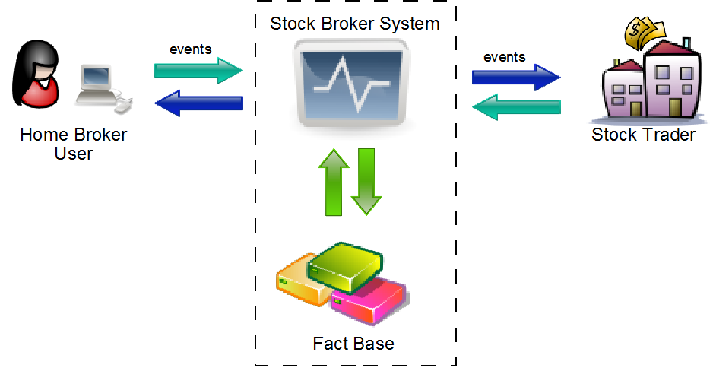
CEP Example Scenario

Slide 58
BRMS CEP
Event Semantics as First Class Citizens
Allow Detection, Correlation and Composition
Stream Processing
Temporal Constraints
Sliding Windows
Session Clock
CEP volumes (scalability)
(Re)Active Rules

Slide 59

Event Declaration and Semantics
An event is a fact with a few special characteristics:
  Usually immutable, but not enforced
  Strong temporal constraints
  Lifecycle may be managed
  Allow use of sliding windows
// declaring existing class
import some.package.VoiceCall
declare VoiceCall
@role( event )
@timestamp( calltime )
@duration( duration )
end
// generating an event class
declare StockTick
@role( event )
symbol : String
price : double
end

Slide 60
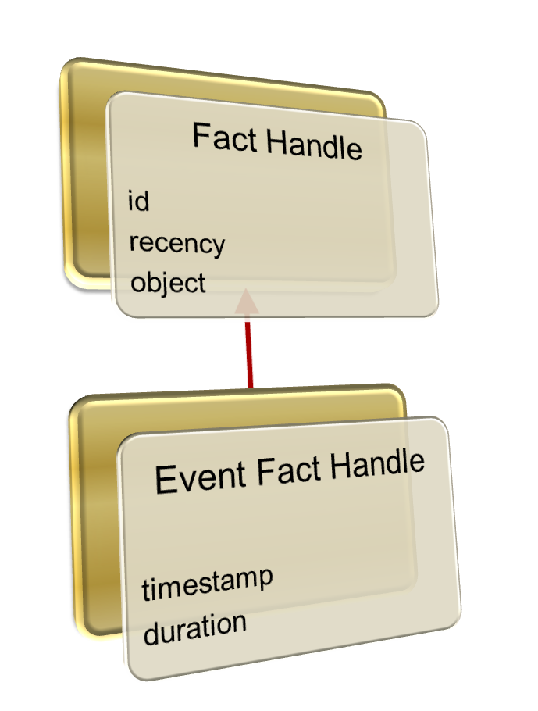
Event Fact Handles
All facts in BRMS are wrapped by a Fact Handle
An event is a Fact with a few more metadata info

Slide 61
Temporal Operators
Point-Point
Point-Interval
Interval-Interval
A before B
A meets B
A overlaps B
A finishes B
A includes B
A starts B
A coincides B

Slide 62
Temporal Operators Code Example
Point to Point(if both events have no duration) or Interval to Interval:
$eventA : EventA( this coincides $eventB )
You can specify a tolerance for this:
$eventA : EventA( this coincides[15s, 10s] $eventB )
This means:
abs( $eventA.startTimestamp - $eventB.startTimestamp ) <= 15s &&
abs( $eventA.endTimestamp - $eventB.endTimestamp ) <= 10s

Slide 63
Thank You

