Slide 1

Getting Started with
OpenShift
Eric D. Schabell
JBoss Solution Architect and OpenShift Subject Matter Expert

Slide 2
What is a PaaS?
A Platform-as-a-Service runs on top of Infrastructure-as-a-Service
Automation for deployment, management, and scaling the cloud
Enables developers to focus on code
Different levels of control, automation and ease-of-use

Slide 3
Why use a PaaS?
Speed - deploy to cloud quickly
Automation - less scripts to write and maintain
Management – versioning, rollbacks & upgrades
Monitoring - performance, logs and uptime
Auto-scaling – on-demand resources

Slide 4
Introducing OpenShift
A free auto-scaling PaaS from Red Hat
Supports multiple frameworks, languages, and middleware
Fast on-ramp to the cloud...upload code and go!

Slide 5
OpenShift Express
Free-as-in-Beer app hosting
Fastest on-ramp to the cloud
Easy-to-use command-line tools
Java, PHP, Perl, Python & Ruby
MySQL & SQLite
Deploy & update via Git
Shared-hosting model
Linux Control Groups (cgroups)
SELinux-based security

Slide 6
OpenShift Flex
30 hrs of free EC2 time to get started
Browser-based UI
Java EE (EE6, jruby, jython, jperl (just kidding – although it does exist)), and PHP
JBoss, Tomcat, Apache
MySQL, MongoDB, Memcached, Membase
Cloud server provisioning
Application deployment, versioning & rollback
Performance monitoring
Log management
Auto-scaling

Slide 7
Express Demo
Install client tools
Create a subdomain
Create an application
Add application files
Commit changes
Deploy to the cloud

Slide 8
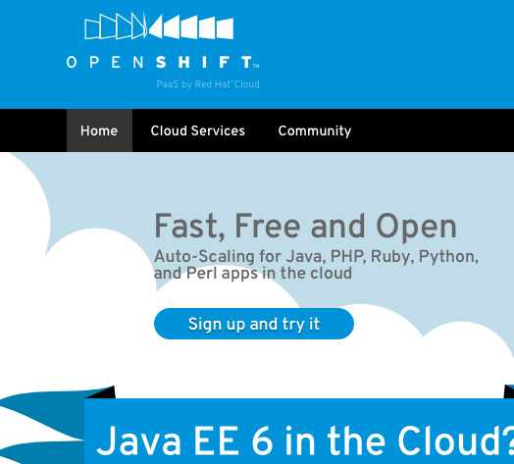
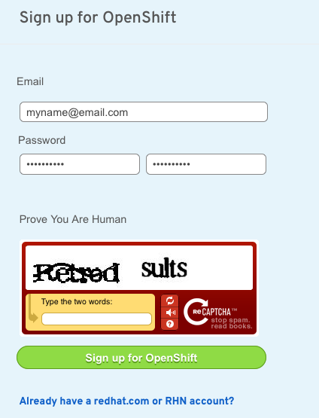
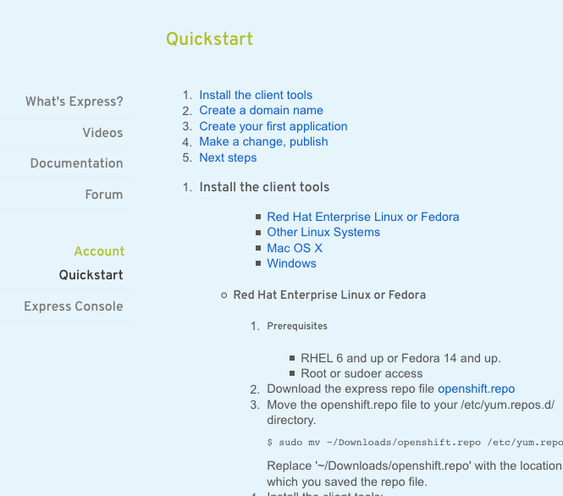
Step 1: Sign Up
openshift.com/try-it

Slide 9
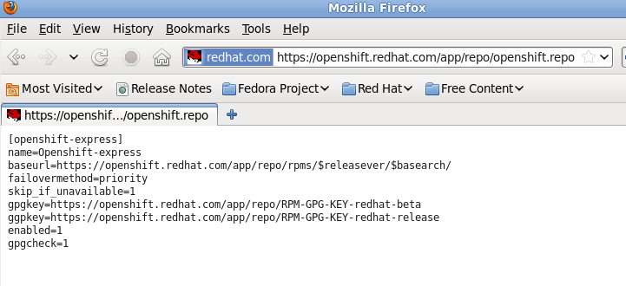
Step 2: Install the Client Tools
> Fedora / RHEL:
> The rest (OSX, Ubuntu, Cygwin):
> Download openshift.repo
> gem install rhc
Requires 'ruby' and 'gem'
http://rubyforge.org/projects/rubygems
> Move openshift.repo to yum.repos.d
$ sudo mv ~Downloads/openshift.repo \
/etc/yum.repos.d/
> Install the client tools
$ sudo yum install rhc

Slide 10
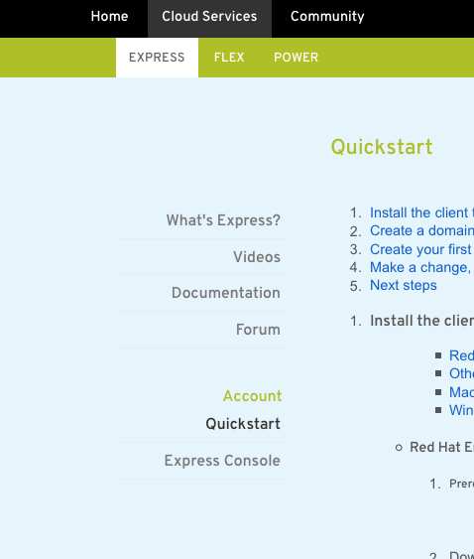
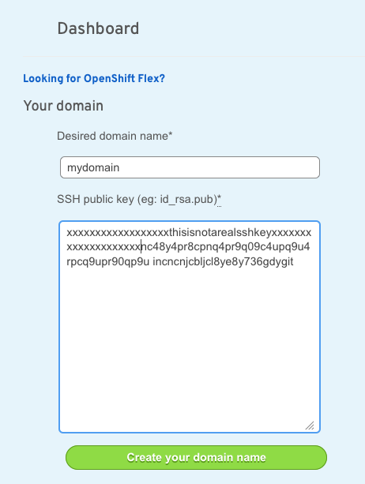
Step 3: Create a Domain Name
> Use the rhc-create-domain command
$ rhc-create-domain -n mydomain -l openshiftlogin
> OR use the Express console

Slide 11
Step 4: Create an Application
> Name your app and define its type
$ rhc-create-app -a appname -t apptype -l openshiftlogin
> Add your app to the local Git repository
$ git add -A
> Commit your changes
$ git commit -a -m “comment”

Slide 12
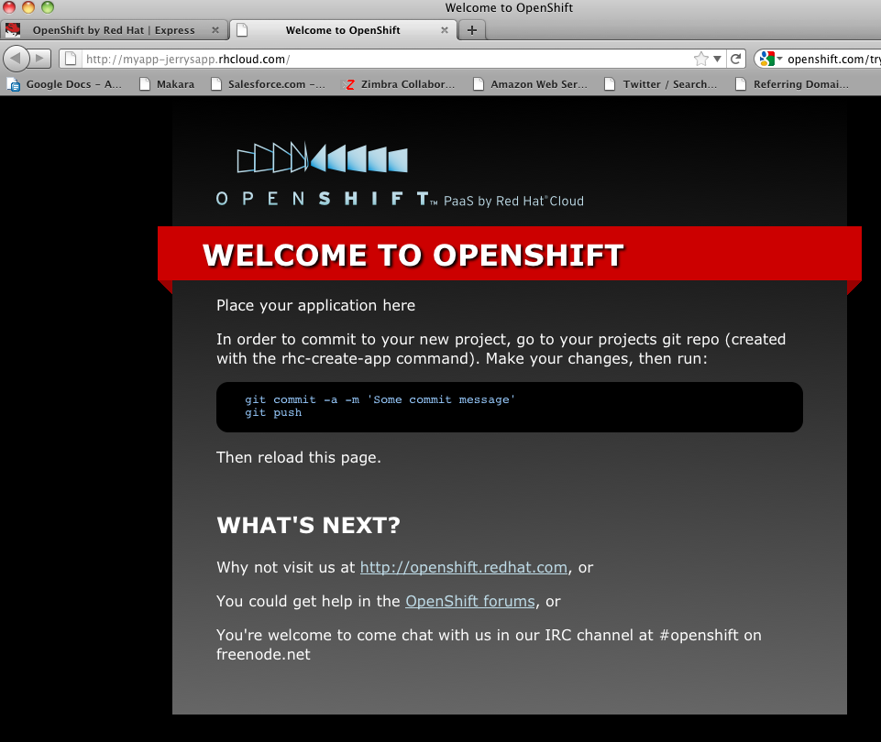
Step 5: Deploy to the Cloud
> Push the local Git repo to Express
$ git push
> Congratulations, your app is in the cloud!

Slide 13
OpenShift Flex Demo
Setup Cloud Account
Provision cloud servers
Build stack
Upload application code
Configure components
Deploy application
Versioning and Rollbacks
Performance monitoring
Log management
Auto-scaling

Slide 14
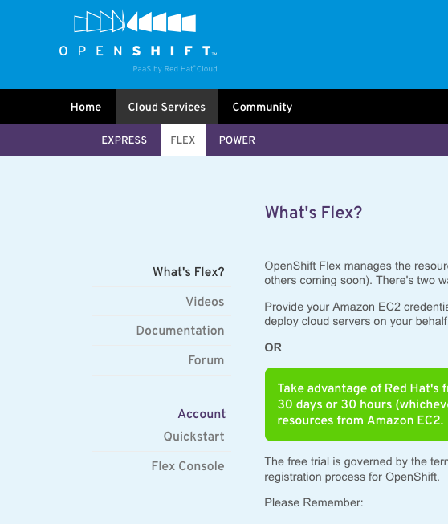
Step 1: Login
> Log into Flex

Slide 15
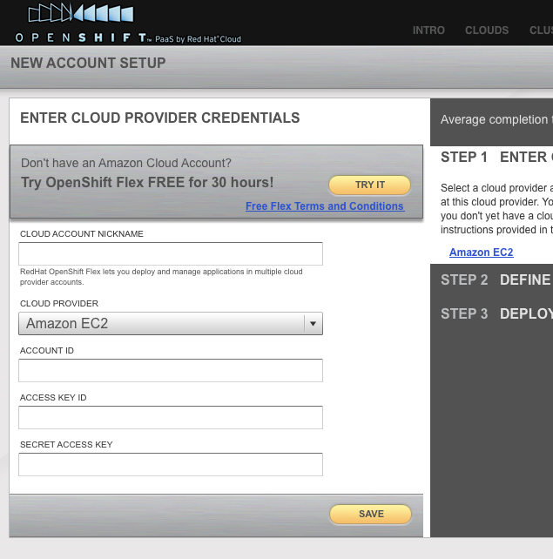
Step 2: Setup your Cloud Account
> Try it for free!
> OR input your credentials

Slide 16
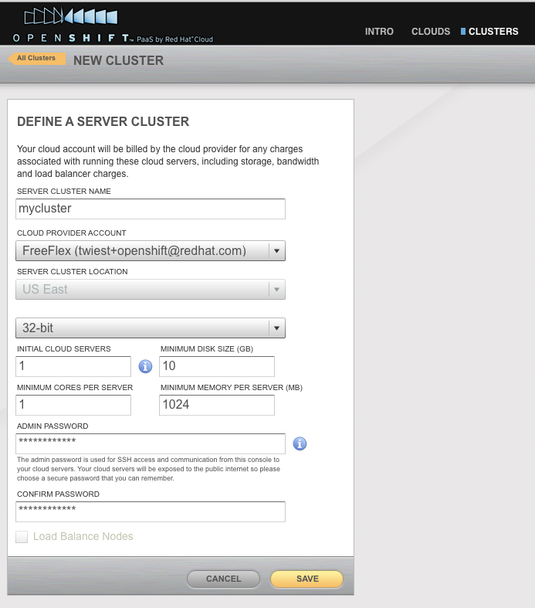
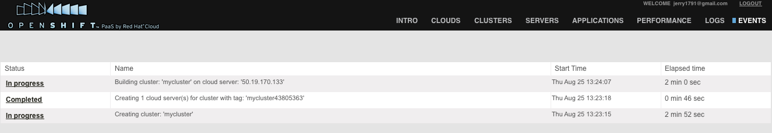
Step 3: Create a Cluster
> Click “Add Cluster”
> Define your cluster
> Check cluster creation status in “Events” view

Slide 17
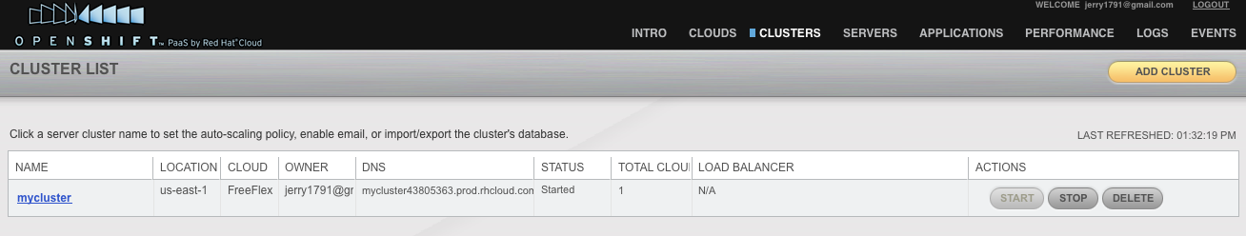
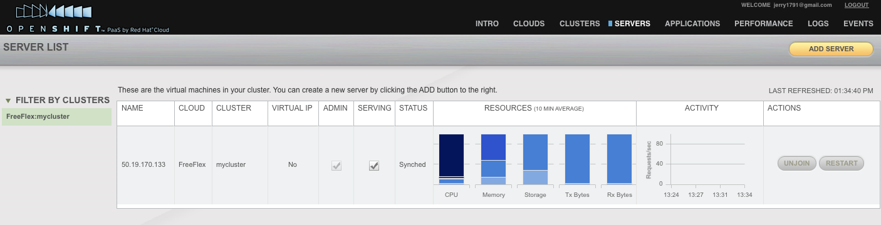
Step 4: Cluster and Server Views
> “Cluster” view
> “Server” view

Slide 18
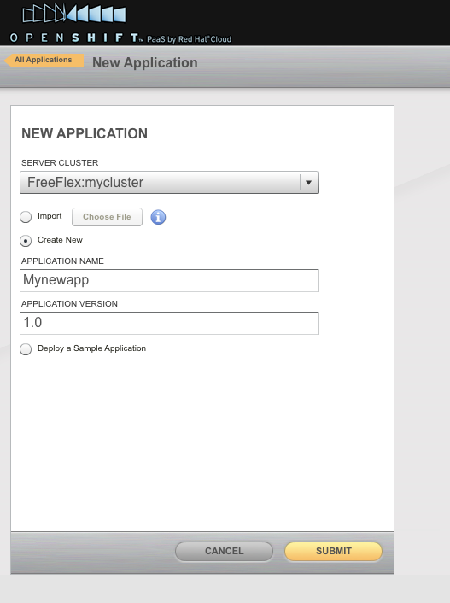
Step 5: Deploy an Application
> Click “Add Application” in the “Applications” view
> Name and version your app

Slide 19
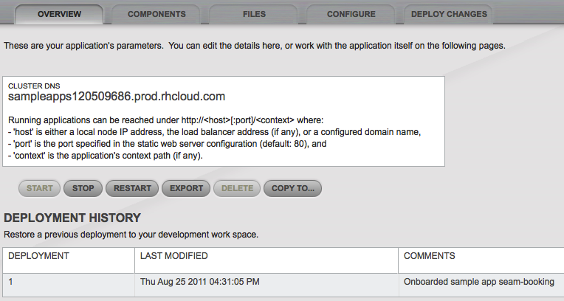
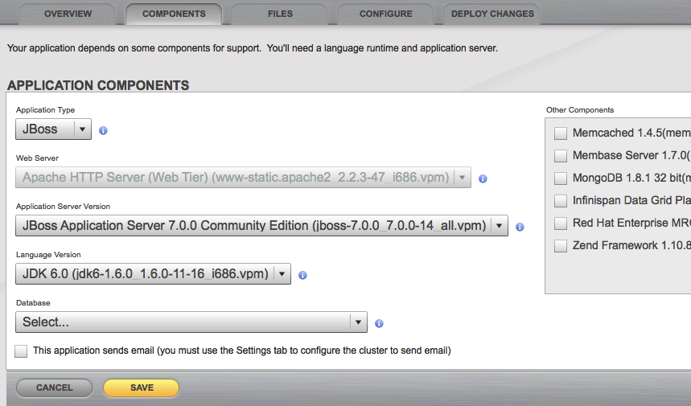
Step 5: Deploy an Application
> Click on your app
> Select components

Slide 20
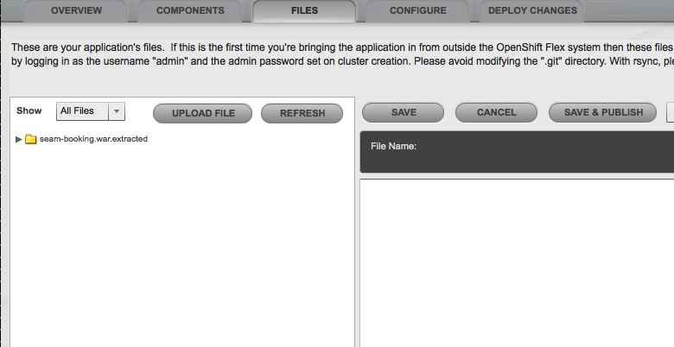
Step 5: Deploy an Application
> Upload application code

Slide 21
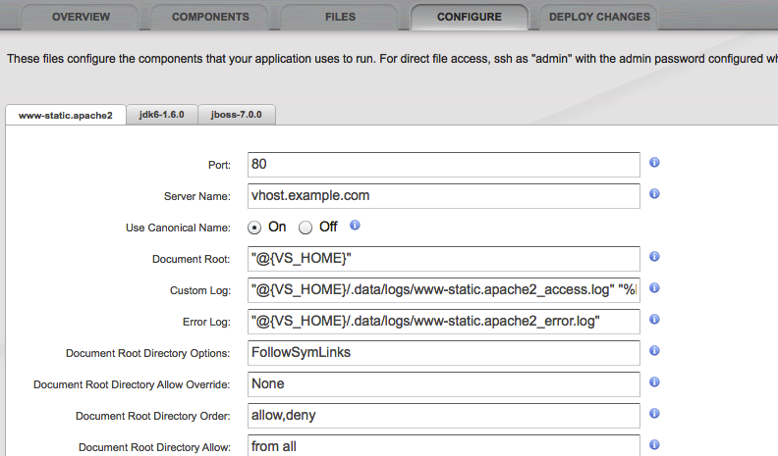
Step 5: Deploy an Application
> Configure components

Slide 22
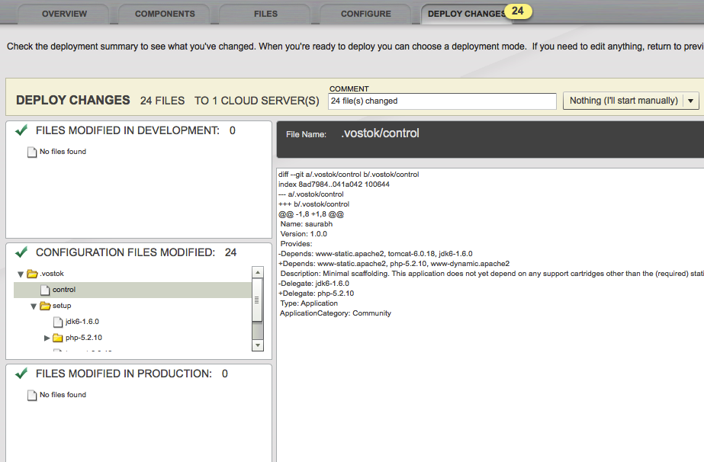
Step 5: Deploy an Application
> Review changes and deploy

Slide 23
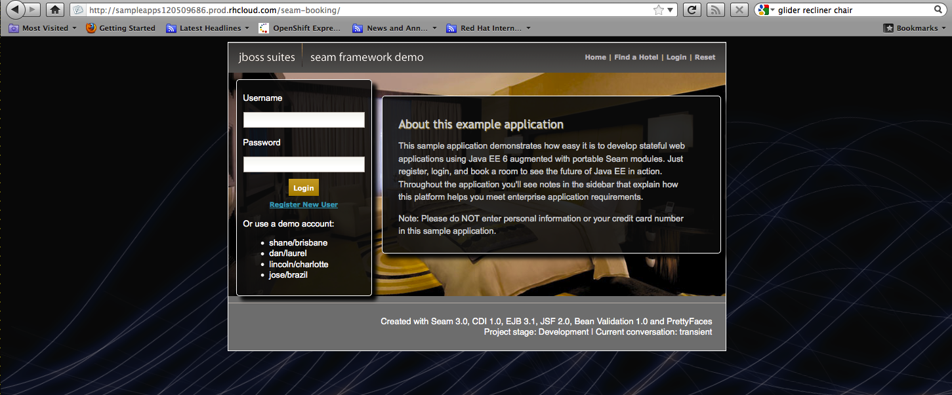
Step 5: Deploy an Application
> Congratulations, your app is in the cloud!

Slide 24
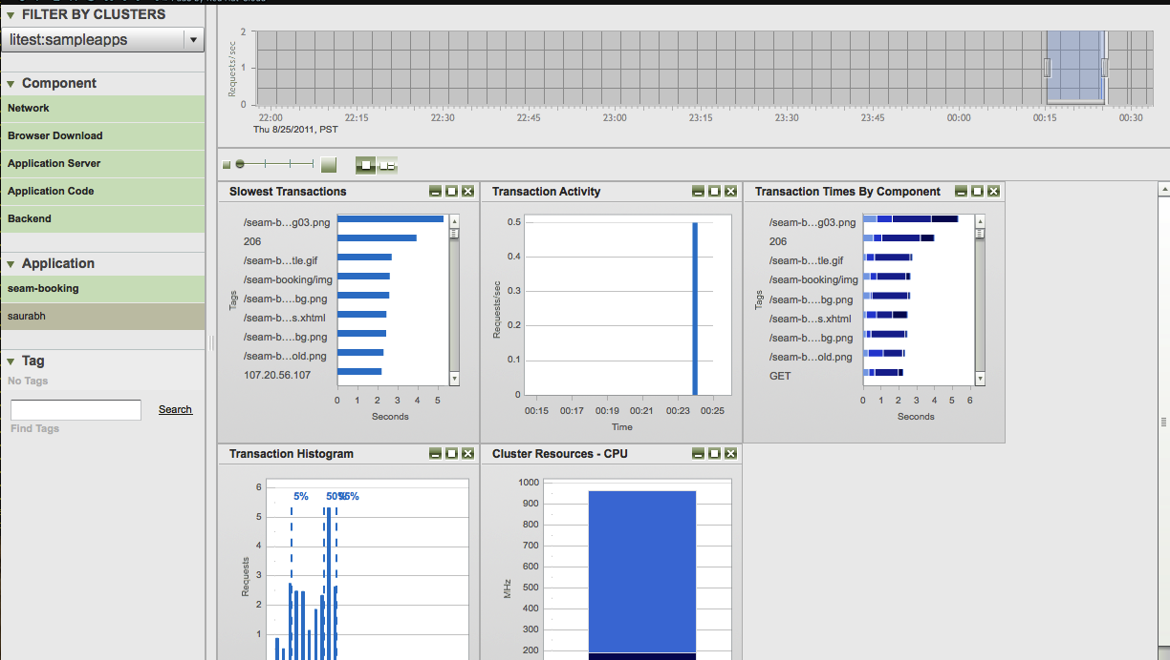
Step 6: Performance Monitoring
> Cluster to transaction-level monitoring
> Point-in-time and compare

Slide 25
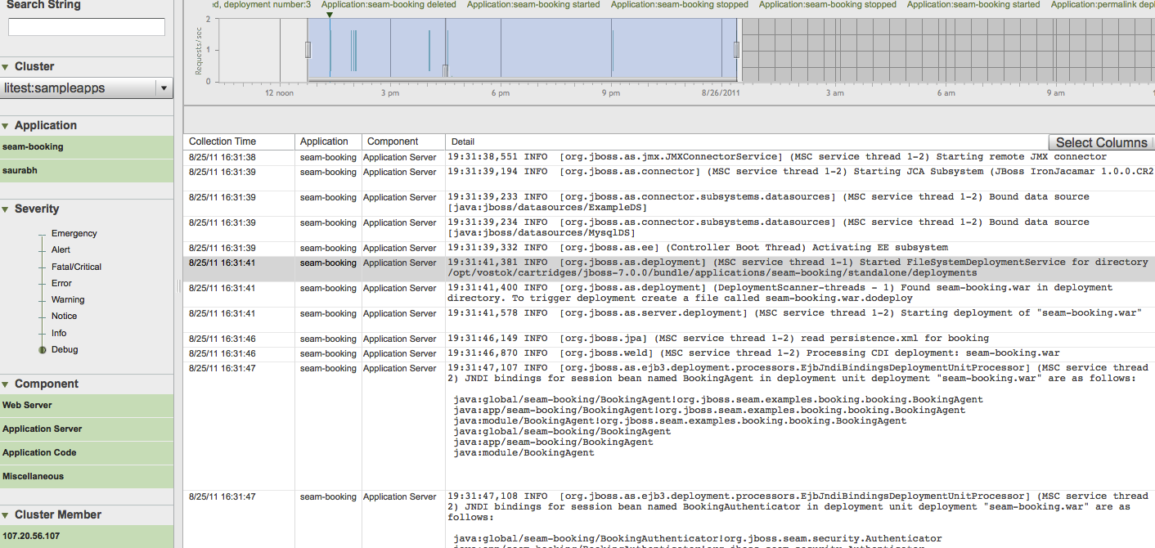
Step 7: Log Management
> Component and application log archiving
> Search logs regardless of current state or size of cluster

Slide 26
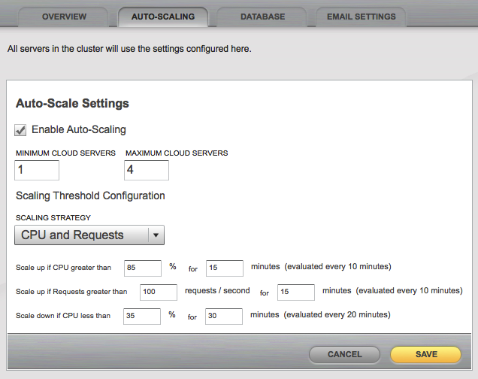
Step 8: Auto-Scaling
> Click on “Auto-Scaling” tab
> Define scaling strategy

Slide 27
Next Steps
Sign up – It's free!
  http://www.openshift.com - click “Try it!”
Example Git Repos You Can Deploy NOW!
  https://www.github.com/openshift
Help?
  IRC: freenode #openshift
  Forums: http://www.redhat.com/openshift/forums
  Email: openshift at redhat dot com

