Slide 1

Requirement Engineering:
Report from the trenches
Eric D. Schabell
JBoss Solution Architect JBoss
Radboud University Nijmegen, Jan 2010

Slide 2
About me
Born in USA (Oregon), traveled after school, 1987 – 1992
In NL since 1992
Professional:
  IBM Netherlands, 1998
  VU, Informatica 1996 - 2002
  SW Engineer Escador/Aramiska 2000 – 2001
  RUN, Wet. Programmer 2001 – 2007
  SNS Bank IT, 2007-2009
  Red Hat JBoss May 2009 - present

Slide 3
Agenda
A perfect world
Reality intrudes
Real life example: STP Aanvragen
  Introduction
  Life in the trenches
  Example: web service
  Example: jBPM process
Building on legacy: STP Contract Rekeningen (Deposito's)
  Use cases and legacy problems
Towards the future: STP Betalen
  Use cases, getting better?

Slide 4
Up to now...
The world is a pretty place:
Business rules
Use cases
Requirements
Workshops
etc...

Slide 5
How we like(d) to work
Overview of the work flow (iterations):
Business workshops (IA)
Functional designs (FO), use cases
--------------------------------------------------------------
Use cases, more detailed (requirements)
Technical designs (TO)
Unit test + code

Slide 6
Agenda
A perfect world
Reality intrudes
Real life example: STP Aanvragen
  Introduction
  Life in the trenches
  Example: web service
  Example: jBPM process
Building on legacy: STP Contract Rekeningen (Deposito's)
  Use cases and legacy problems
Towards the future: STP Betalen
  Use cases, getting better?

Slide 7
Reality is a wake up call
Sometimes there are other factors:
Business needs
Market changes (Crisis?)
Lack of personnel (quality / quantity)
Technical challenges
Planning problems

Slide 8
Agenda
A perfect world
Reality intrudes
Real life example: STP Aanvragen
  Introduction
  Life in the trenches
  Example: web service
  Example: jBPM process
Building on legacy: STP Contract Rekeningen (Deposito's)
  Use cases and legacy problems
Towards the future: STP Betalen
  Use cases, getting better?

Slide 9
All bets are off
Can you be flexible in this environment?
Business workshops (4x)
FO is 92 page PowerPoint presentation
Use cases done by developers
Coding (minimal unit tests, no mock services framework)
TO done after or iterative during coding

Slide 10
Architecture
Simple overview:
rule
engine
klant
front
BOM
Backend
office
SOAL
systemen
applicatie
business
proces
engine
medewerker
uitval

Slide 11
What is going on: technically?
A very fast time to market:
Challenging technical environment
  JBoss jBPM
  JBoss web services
  Back-ends: KIS and SAS mainframe
  Uitval application

Slide 12
What is going on: business?
A very fast time to market:
Four new savings products
  via internet channel
  request processing max 2 days (STP degree)
  Straight Through Processing (STP Aanvragen)
  customer insisting on unrealistic deadlines

Slide 13
What is going on: process?
A very fast time to market:
All banking issues and requirements remain
  privacy
  laws
  security
  validation
  data access / manipulation

Slide 14
Life in the trenches
In the trenches:
Receive task to implement functionality
Check FO (remember == ppt)
Extract use cases for task (discuss with IA)
Create TO
Write unit tests
Code implementation
Test it!

Slide 15
Example: web service
Postcode validation:
Receive task, postcode validation
Check FO (remember == ppt), slide 24
Extract use cases for task (discuss with IA), see example
Create TO, see SIC
Write unit tests, see SIC
Code implementation
Test it!

Slide 16
Functional Design (FO): slide 24
SNS XXXXXXXXXX
Verplichte tegenrekening
Internetbankieren of TIN code of softlogin
SNS XXXXXXXXXXX
Verplichte tegenrekening
Internetbankieren of TIN code of softlogin
SNS XXXXXXXXXX
Verplichte tegenrekening
Internetbankieren of TIN code of softlogin
SNS XXXXXXXXXXXX
Internetbankieren of TIN code of softlogin
...and the rest...
“...postcodevalidatie: als postcode niet in ons table
voorkomt dan uitval.”

Slide 17
Service Interface Contract
Sequence diagram:
sd Sequence
am
Betrokkenpartij
KisContactAdapter
Service
Cal
ling Applicat
ion /
KIS
Service
1:
findPostcode(PostcodeValidationSO)
PostcodeValidationSO
:
2:
val
idate(Po
stcodeValidationSO)
:PostcodeValidationSO
3:
findAddress
CityByPo
stcodeHou
seNum
berAdapter(Postcode
ValidationSO)
:PostcodeValidationSO
4:
SnsPostcode.getAddress
Details(postcode
houseNumb
er) :Jk
isResult
,

Slide 18
Java anyone?
/** {@inheritDoc} */
public PostcodeValidationSO findPostcode(PostcodeValidationSO postcodeSO) throws BetrokkenPartijServiceException {
PostcodeValidationSO returnPostcodeValidationSO = new PostcodeValidationSO();
logStart(postcodeSO);
try {
validate(postcodeSO);
} catch (ServiceValidationException e) {
throw createBetrokkenPartijServiceException(e, Originator.SERVICES);
}
try {
// call to KIS for postcode lookup.
returnPostcodeValidationSO = KISContactAdapter.getInstance().findAddressCityByPostcodeHouseNumber(postcodeSO);
if (returnPostcodeValidationSO == null || StringUtils.isEmpty(returnPostcodeValidationSO.address)
|| StringUtils.isEmpty(returnPostcodeValidationSO.city)) {
// found invalid postcode, setup for returning an empty SO.
returnPostcodeValidationSO.address = "";
returnPostcodeValidationSO.city = "";
}
} catch (ServiceException e) {
throw createBetrokkenPartijServiceException(e, Originator.KIS);
} finally {
// Do some logging at the end of the call.
logEnd(returnPostcodeValidationSO);
}
return returnPostcodeValidationSO;
}

Slide 19
Unit tests
/**
* Test for an invalid postcode.
* Note: there is no backend mock for services, thus is integration test.
*/
public void testFindPostcodeInvalid() {
// fill our invalid postcode service request object.
postcodeSO.postcode = invalidPostcode;
postcodeSO.houseNumber = invalidHouseNumber;
try {
PostcodeValidationSO so = bp.findPostcode(postcodeSO);
// should be empty SO attributes.
assertEquals(so.address, "");
assertEquals(so.city, "");
} catch (ServiceException e) {
e.printStackTrace();
}
}

Slide 20
Example: jBPM process
Aanmaak product:
Receive task
Check FO (remember == ppt), outside scope
Extract use cases for task (discuss with IA), outside scope
Create TO, received from lead developer, iterative updates
Write unit tests, ha ha, that's a good one!
Code implementation
Test it, SOAPUI

Slide 21
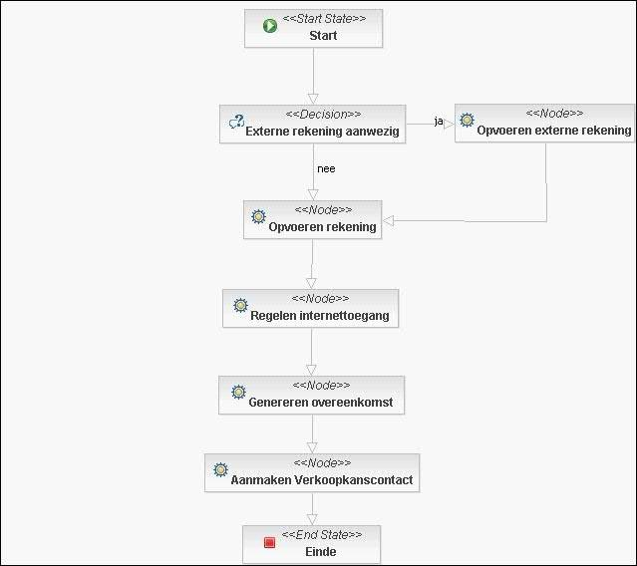
Aanmaak product (jBPM)

Slide 22
Agenda
A perfect world
Reality intrudes
Real life example: STP Aanvragen
  Introduction
  Life in the trenches
  Example: web service
  Example: jBPM process
Building on legacy: STP Contract Rekeningen (Deposito's)
  Use cases and legacy problems
Towards the future: STP Betalen
  Use cases, getting better?

Slide 23
How we (now) like to work
Overview of the work flow (iterations):
Business workshops (IA)
Functional designs (FO), set UC's & UCM
--------------------------------------------------------------
SW Architecture Document (SAD)
Use Case Realizations, more detailed (requirements).
Technical designs (SIC, components)
Unit test + code

Slide 24
STP Contractrekening use cases
Some facts:
Actually have UC's!
Very technical
Never (still to this day) seen non-concept versions!
Legacy process decisions haunt implementation:
  polling / scheduler growth (pre-processing, AI, Documentbewaking, saldo)
  business logic in process layer, expanded with more...
  reference project (jBPM) never applied == political / time pressures

Slide 25
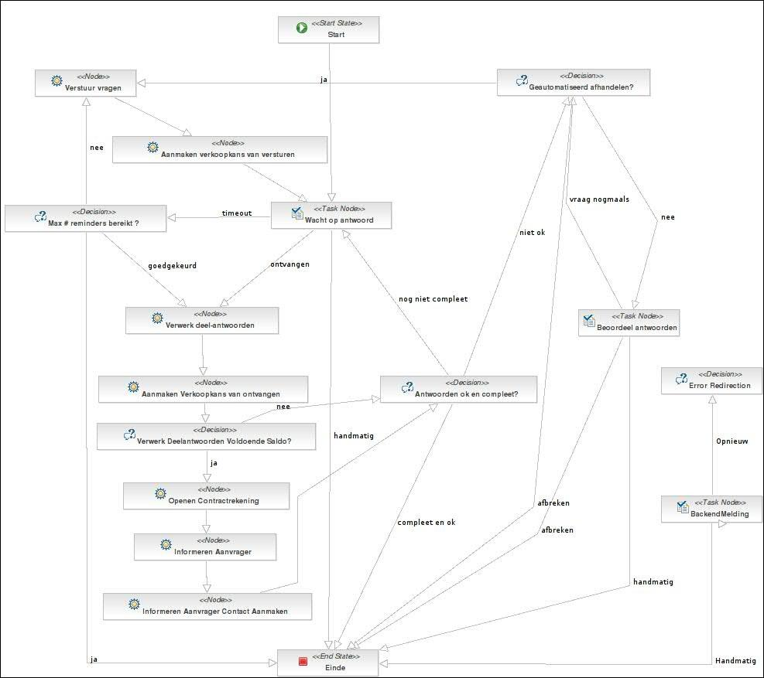
Documentbewaking (pre-project)

Slide 26
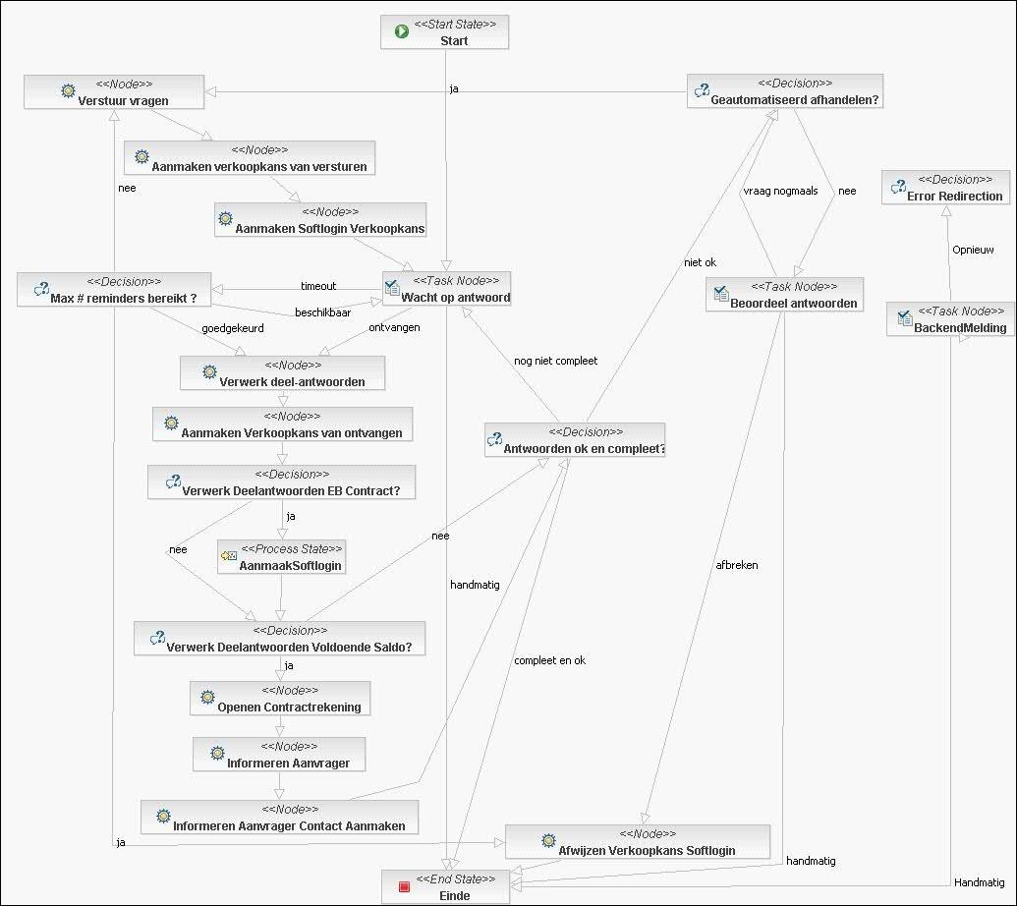
Documentbewaking (post-project)

Slide 27
Agenda
A perfect world
Reality intrudes
Real life example: STP Aanvragen
  Introduction
  Life in the trenches
  Example: web service
  Example: jBPM process
Building on legacy: STP Contract Rekeningen (Deposito's)
  Use cases and legacy problems
Towards the future: STP Betalen
  Use cases, getting better?

Slide 28
STP Betalen UCM / UC's
Some facts:
1x UCM, 10x UC's
65 findings in team review (one team member):
  object model in UCM!
  'boolean' appears 2x in UC's
  instructs where data elements need to go
  describes exact contents of data element to be stored
  details system components as actors!
  2x technically impossible to implement process steps

Slide 29
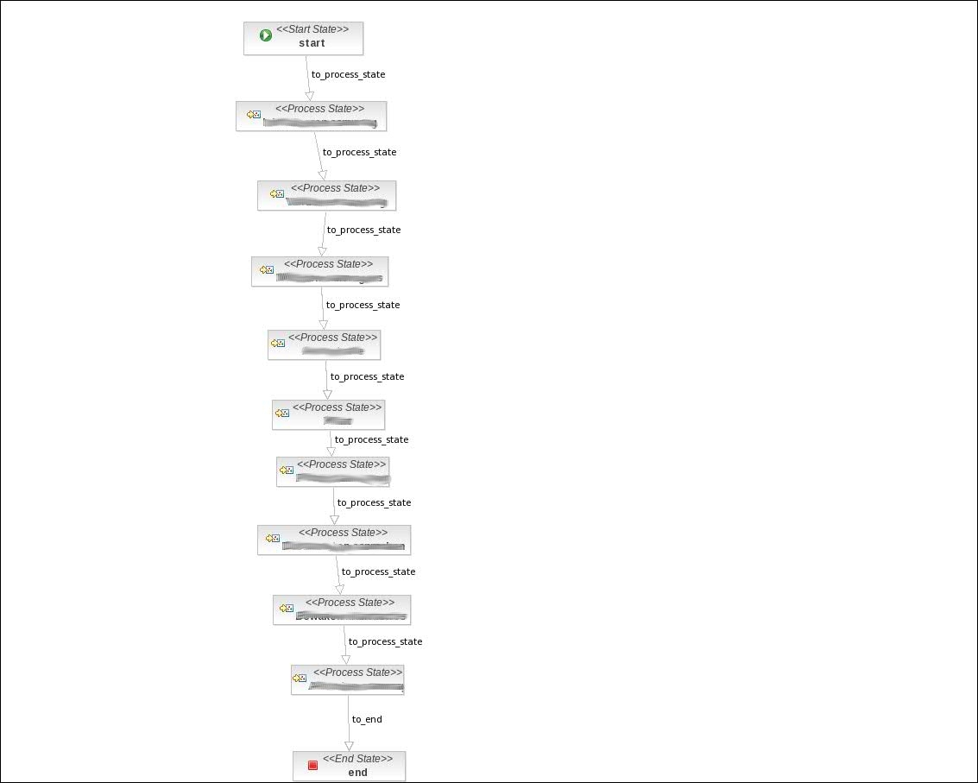
STP Betalen optimized
General product process:
Provides cost effective product platform
written May 2009, planned 2010

Slide 30

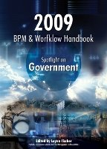

SNS Bank STP final report
Current status:
UC's != final, business redefined requirements ½ way
Credit crisis caused some problems end 2009
Published chapters (2x) and Silver Award!
  follow on http://www.schabell.org (jBPM tag)
  http://www.twitter.com/ericschabell

Slide 31
Questions?
Eric D. Schabell
JBoss Solution Architect JBoss
erics@redhat.com

