Slide 1


JBoss Enterprise BRMS
Business Rules Management System
Eric D. Schabell
JBoss Solution Architect Benelux
November 2010

Slide 2
Agenda
Introduction
  who am I?
JBoss BRMS
  overview
  future directions
Lab overview
Questions?

Slide 3
Who am I?
American
  in NL since 1992
  MSc VU in Amsterdam
Professional
  13 yrs SW engineering / lead development / architect
  Open Source
  IBM / SNS Bank / Red Hat
  EMEA SME jBPM / BRMS

Slide 4
Agenda
Introduction
  who am I?
JBoss BRMS
  overview
  future directions
Lab overview
Questions?

Slide 5
JBoss BRMS v5
Declarative Business Rules
  Avoids hard-coding business rules in business logic
  Rules can change without Java code changes or re-compilation
  Expert system allowing solution of complex problems
Multiple Authoring Options: DRL, DSL, CSV and Programmatic Rules Definition
  Application objects (facts) mixed with conditions (rules) – similar to HQL
  POJO and Declarative Fact Model
  Decision Tables in Excel/Open Office
  DSL Natural Language Extensions
Rule Repository
  Versioning of business rule-related artifacts (e.g. Fact models, enumerations, functions, DSL definitions, rules, tests, etc.)
Rule Manager
  RIA for creation & maintenance of business rule artifacts

Slide 6
JBoss BRMS
What is a rule engine?
A rule engine at its core is an environment/shell for capturing knowledge
  Applying that knowledge to specific data (facts)
  Uses production rules
    IF <conditions> THEN <actions>
    rules express logic
Has roots in AI research
  Success of “expert” systems in the past triggered popularity of rule engines

Slide 7
JBoss BRMS
What is it going to do for me?
Externalize business logic
  Logic that is complex
  Logic that changes often
  Logic that just doesn’t fit neatly in code
  Logic that means more to domain experts than it does programmers
Keep application and user interface logic in your application
  Business logic in the rule engine
Use domain objects as interface to rule engine

Slide 8
JBoss BRMS
When should I use a rules engine?
When there is no satisfactory “traditional” solution
The problem becomes to complex to express using traditional methods
No known algorithms for solving the problem traditionally
Too hard
Too “fluid”

Slide 9
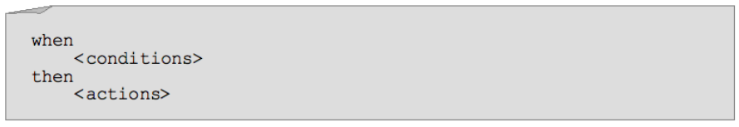
JBoss BRMS
What is a rule?
In short, a rule is an premise and conclusion
  If it is raining, then the ground must be wet
A rule is made of conditions and actions. When all the conditions are met, a rule may “fire”.
The conditions are collectively referred to as the LHS (left hand side) and the actions are referred to as the RHS (right hand side, or consequence).
A rule operates on facts (data). In our case, these facts are instances of objects in our application.

Slide 10

JBoss BRMS
What is inferencing?
We want to take all of our data (facts) and combine it with our knowledge (rules) and come up with some conclusions (inferencing)

Slide 11

JBoss BRMS
What is inferencing?
We want to take all of our data (facts) and combine it with our knowledge (rules) and come up with some conclusions (inferencing)

Slide 12
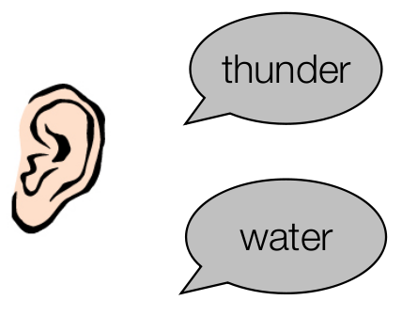
JBoss BRMS
What is inferencing?
We want to take all of our data (facts) and combine it with our knowledge (rules) and come up with some conclusions (inferencing)

Slide 13
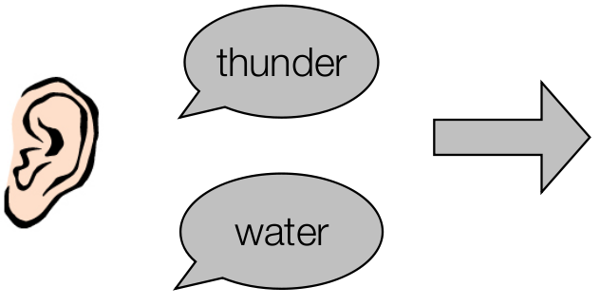
JBoss BRMS
What is inferencing?
We want to take all of our data (facts) and combine it with our knowledge (rules) and come up with some conclusions (inferencing)

Slide 14
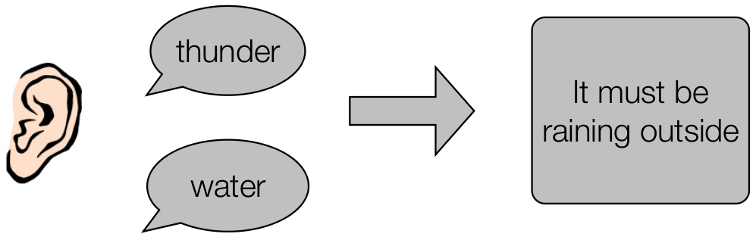
JBoss BRMS
What is inferencing?
We want to take all of our data (facts) and combine it with our knowledge (rules) and come up with some conclusions (inferencing)

Slide 15
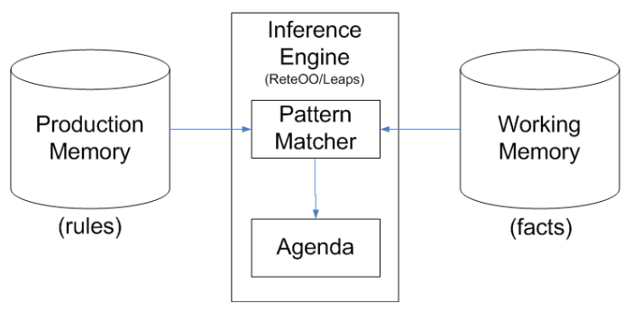
JBoss BRMS
Inference Engine
The brain of a Production Rule System is an Inference Engine which matches facts against Production Rules.
When matches are found, the rules actions are fired.
Actions most often change the state of the facts, or perform some external action on the application.

Slide 16
JBoss BRMS
How it Works
Agenda
Rule
Activation
Rule
1.Parse DRL
Rule
RuleBase
Rule
Fact
Rule
Rule
Activation
Fact
Rule
Fact
2. Create
Fact
Fact
Fact
3. Assert Facts
WorkingMemory
Fact
Fact
Fact
Fact
Fact
Fact
4. Fire All Rules
Fact
Rule
(5) activation
-> consequence
Rule
Rule
Rule
Rule

Slide 17
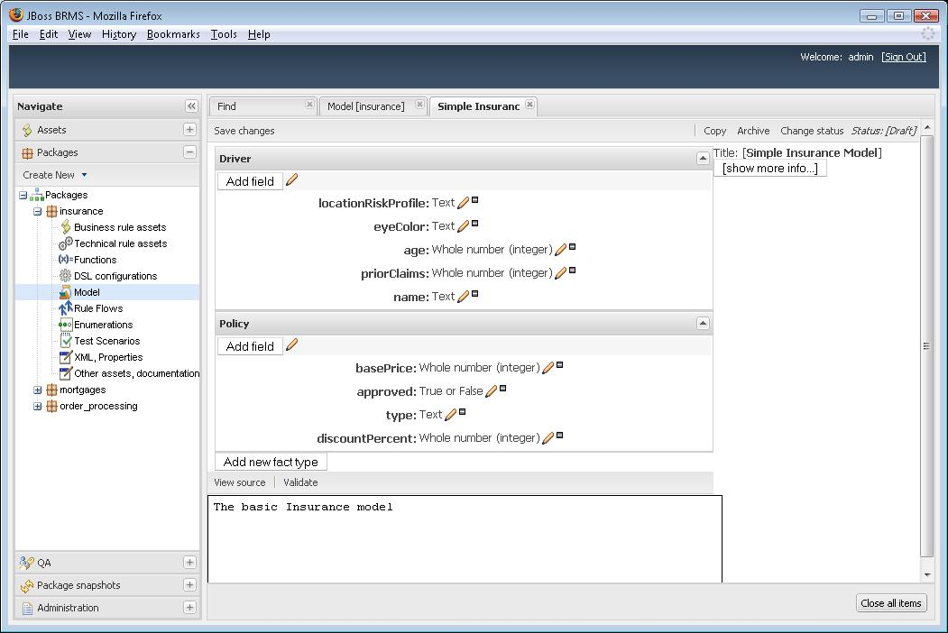
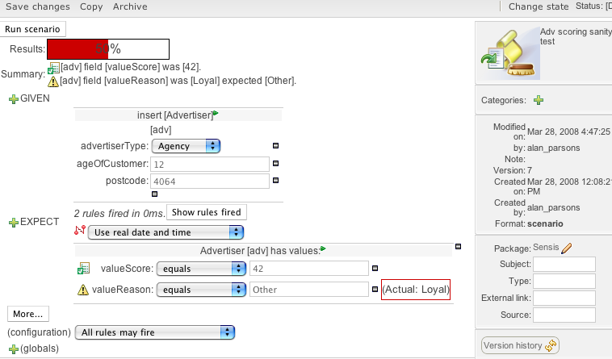
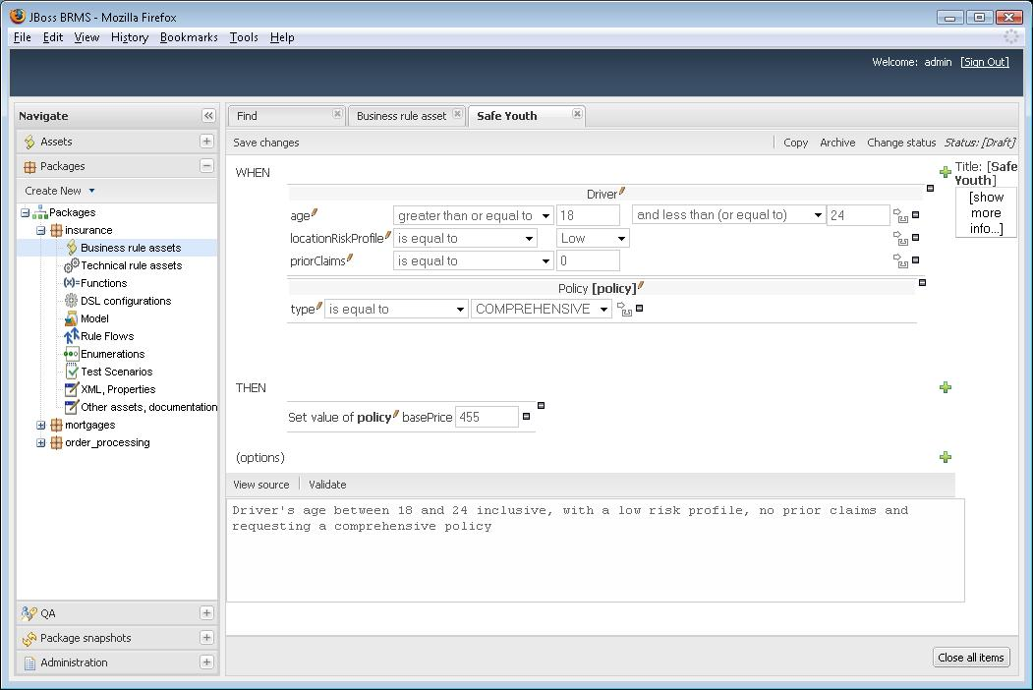
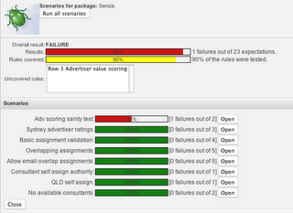
BRMS – Rich UI for Business Rules

Slide 18
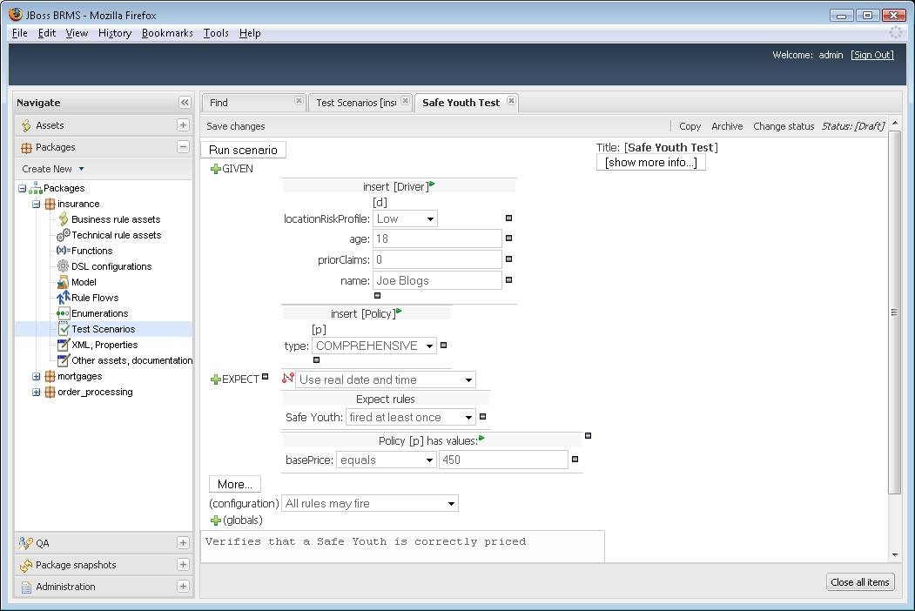

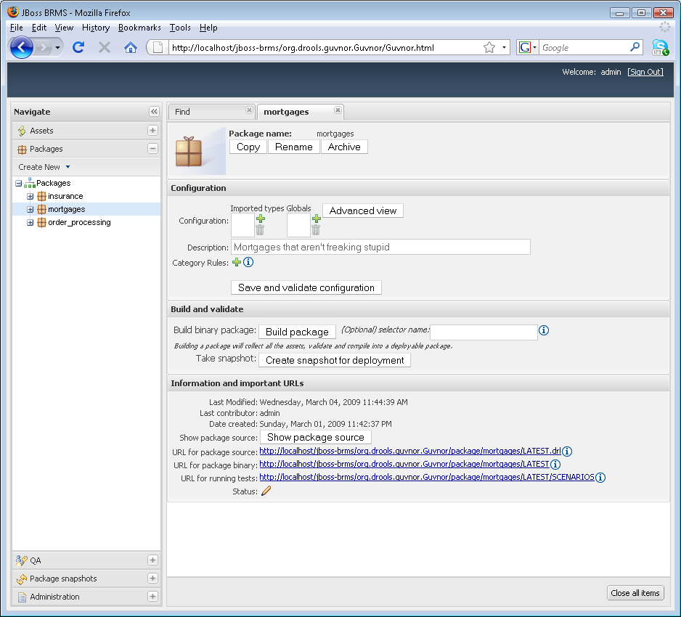
Analysis Perspective
Test the Rules
JBoss BRMS Web Manager
Model the Facts
Prototype the Rules
J2SE
JBoss Developer Studio
Check-Out Artifacts from Repository
Build & Test Application
Check-In changes to Repository
Deployment
EAP-WS,WAR,EAR
SOA-P,
Mediated Services
JBoss BRMS Web Manager
Create Package

Slide 19
Fact Model Editor

Slide 20
Guided Rule Editor (Web)

Slide 21
Guided Rule Editor (Web)

Slide 22
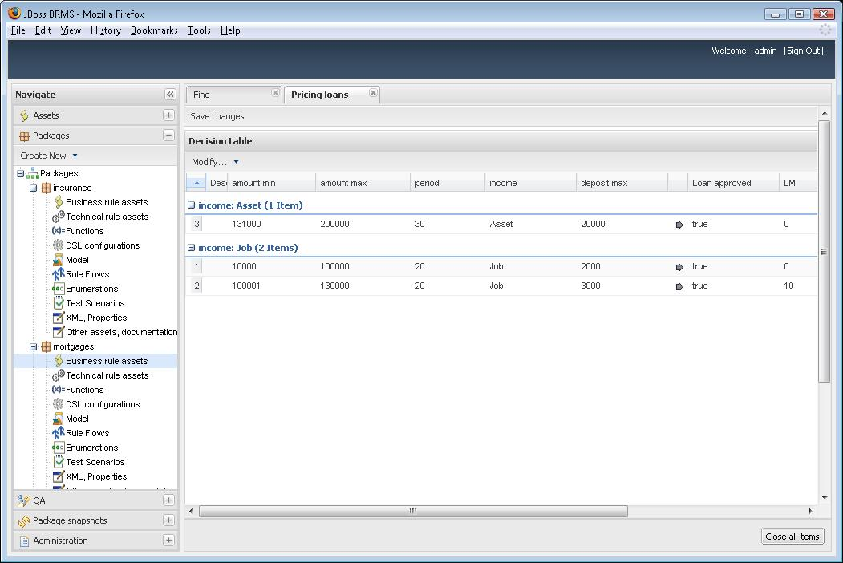
Web Decision Table Editor

Slide 23
Test Scenario Editor

Slide 24
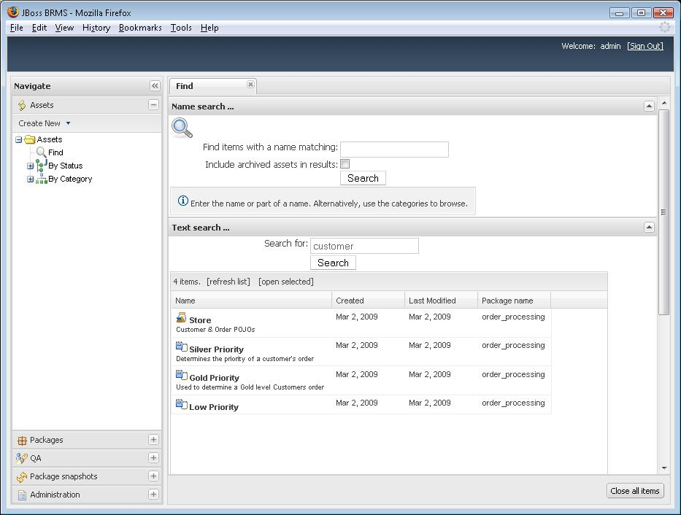
Developer Perspective
JBoss Developer Studio
Fact Model
DSL Template
Check-In Artifacts to Repository
JBoss BRMS Web Manager
Use Facts & DSL
to create Business Rules
J2SE
EAP-WS,WAR,EAR
Deployment
SOA-P,
Mediated Services
JBoss BRMS Web Manager
Create Package
JBoss BRMS Web Manager
Create Test Scenarios

Slide 25
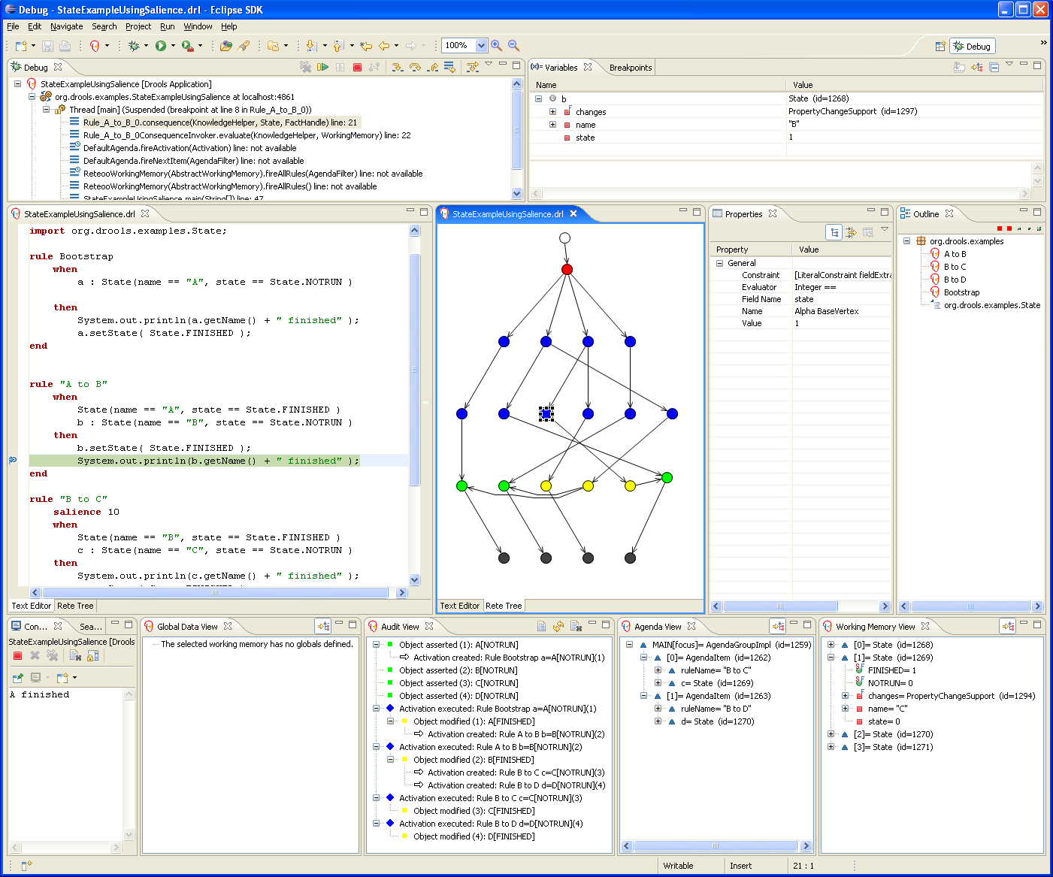
Eclipse – Developer Perspective

Slide 26
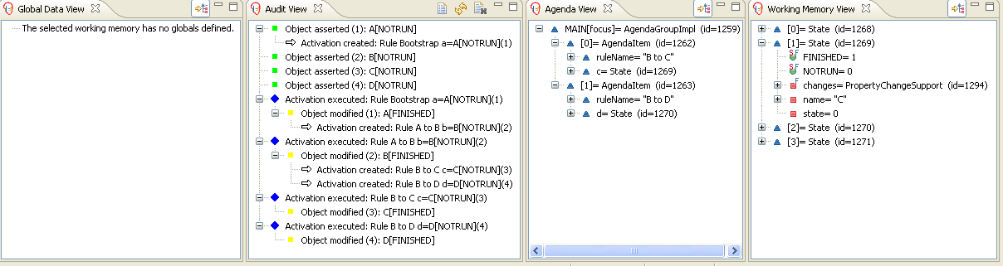
Debugging
Debug Views
  New rule “perspective” to configure IDE for rules as needed

Slide 27
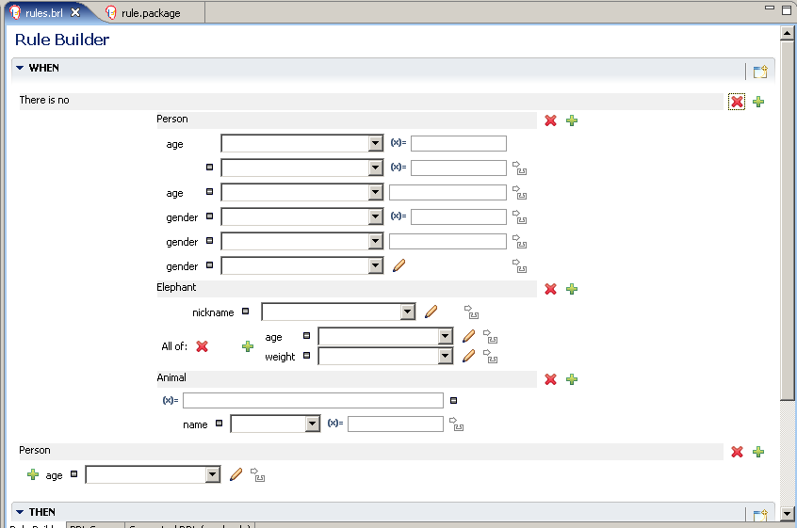
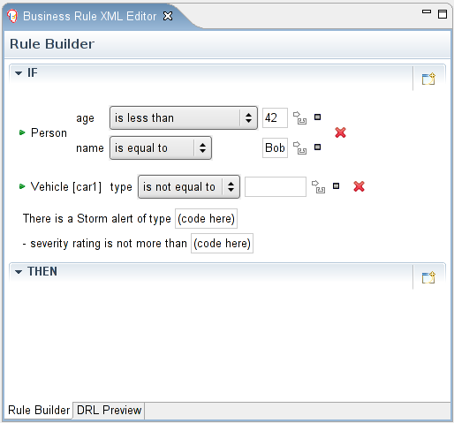
Guided Rule Editor (Eclipse)
Eclipse Guided Editor

Slide 28
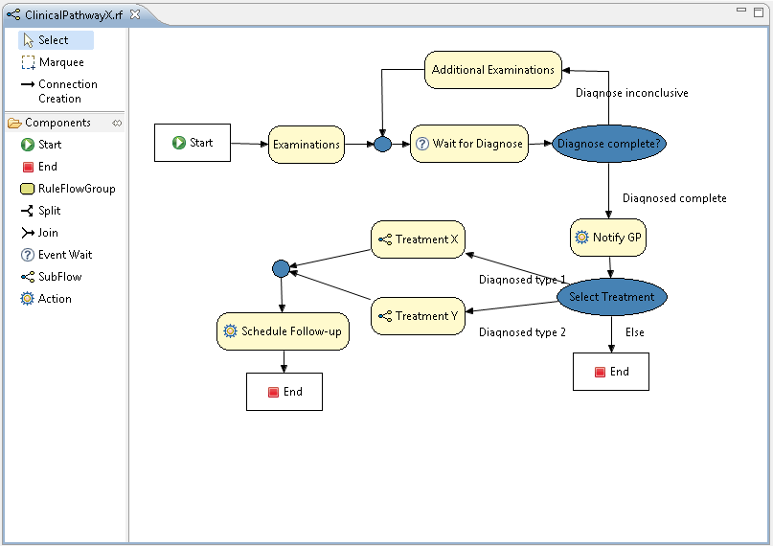
Rule Flow

Slide 29
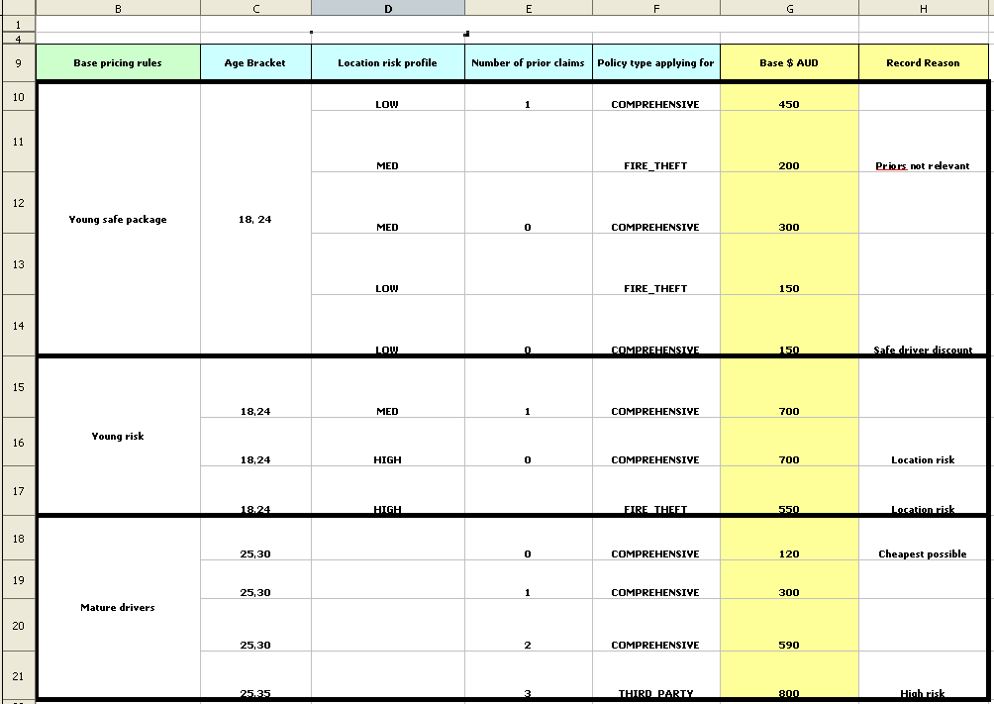
Decision Tables
Decision Tables – Excel/Open Office

Slide 30
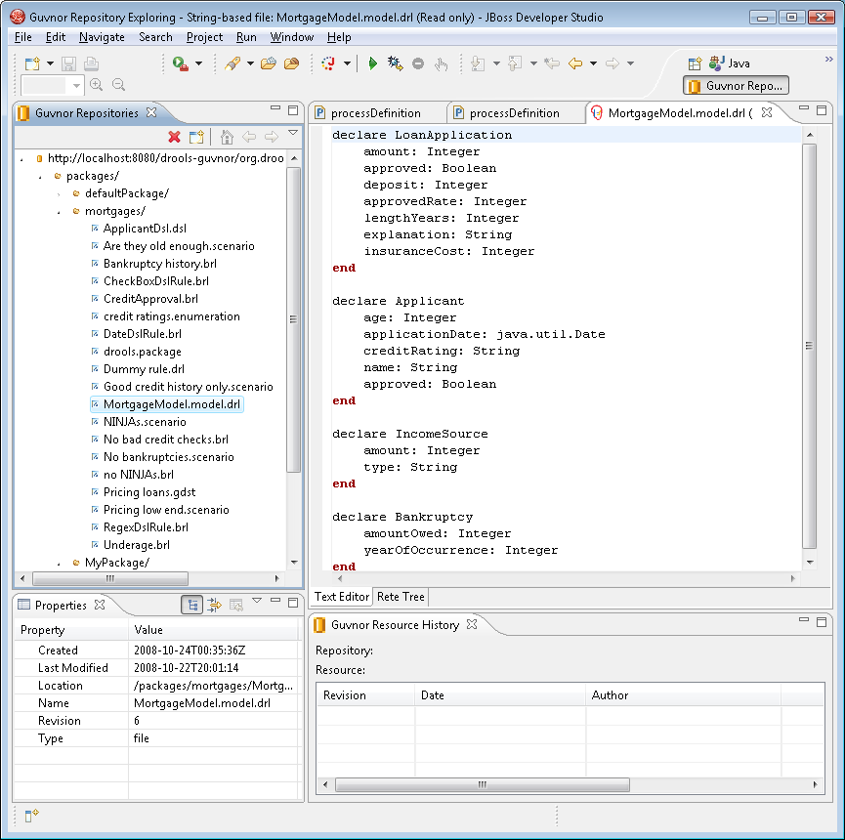
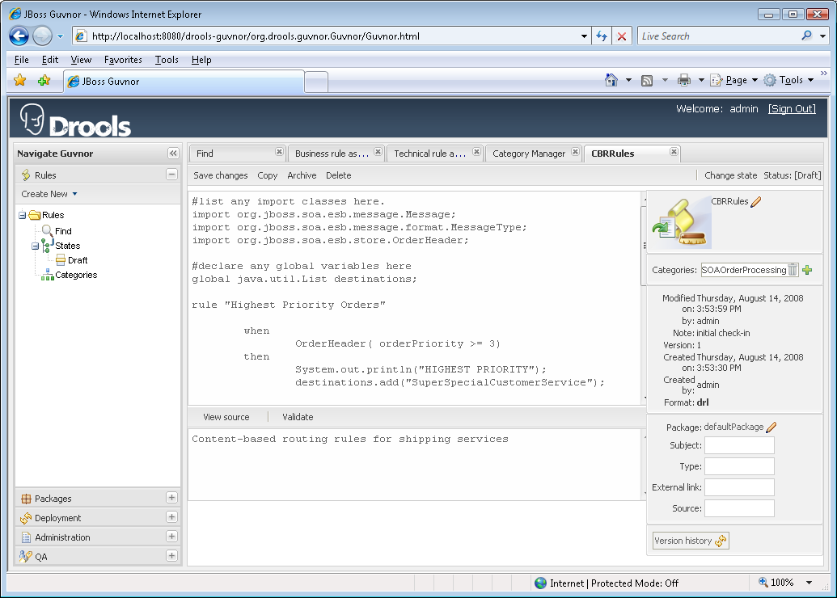

Eclipse to BRMS Synchronization
JBoss Developer Studio
BRMS 5
JCR
Repository

Slide 31

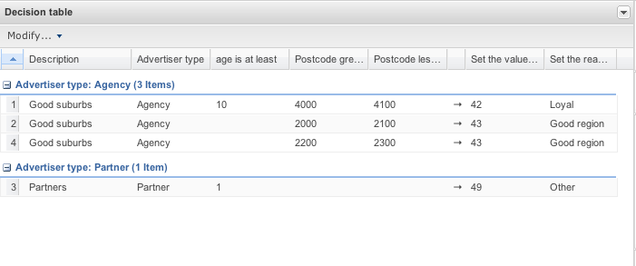
BRMS/Rules Deployment Scenario
J2SE
JBoss Rules Runtime
RuleAgent
BRMS
EAP 4.3
J2EE use cases
Seam use cases
Clustered
RuleAgent
SOA-P 5.0 (future)
Stateless Rule Services
Stateful Rule Services
CBR & CBF
Federated Hot Deployment
RuleAgent
JCR
Repository
Delivery of proper version of a rule package via the ruleagent to any of the above “containers”.
EE and SOA containers allow for hot deployment/reload of the changed rules without component restart and no loss of transactions/messages.

Slide 32
BRMS v5: Summary of Features
Graphical User Interface and repository for Business Rule Editing, Versioning & Deployment management that is usable by the non-Java Programmer and non-System Administrator.
Manages the following artifacts:
  Rule Packages
  Business Rules (via Guided Rule Editor)
  Business Fact Model
  Technical Rules (sync with Eclipse and/or BRMS UI)
  Technical POJO Fact Model
  Domain Specific Languages – DSL
  Web-based Decision Tables
  Spreadsheet-based Decision Tables
  Rule Categories (for searching)
  Users & Roles associated with rule life cycle states
  Rule Promotion (Dev, QA, Production)
  Test Scenarios

Slide 33
TITLE SLIDE: HEADLINE
JBoss Enterprise BRMS
Business Rules Management System
Roadmap CY 2009 – 20011
(Tentative – Subject to Change)
Presenter name
Title, Red Hat
Date

Slide 34

Future: Event Stream Processing
Some Process: Order Fulfillment, Replenishment, Customer Service, Financial Analysis
Stateless Rules Services identify “interesting ”information
Collect
Suspect
Data
Potentially Significant Event
Stateful Rules Services
hold, analyze & raise events
Other Process also capturing interesting data points and routing them to the “stateful” rules service for keeping and analysis.

Slide 35


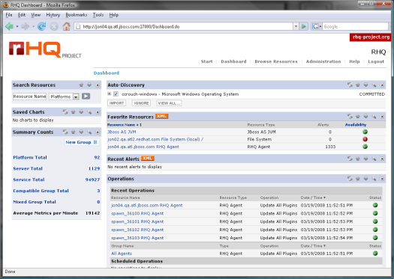
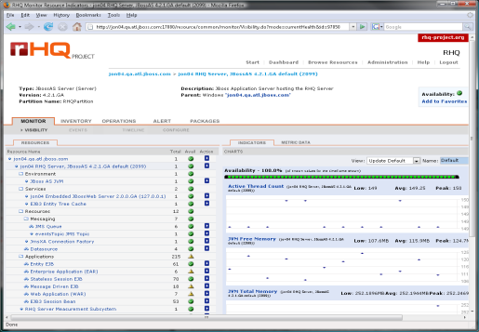
Features: ESP + CEP via ESB, Rules & JON
ESB: consumption, capture, transformation, routing, orchestration
Rules: selection, aggregation, correlation, generation and publication
Governance
Tools
Repository: for editing, versioning, testing
and publishing rules and SOA artifacts
JON: start/stop services, monitor and alert on service and action-level performance, monitor and alert on business metric values

Slide 36
Agenda
Introduction
  who am I?
JBoss BRMS
  overview
  future directions
Lab overview
Questions?

Slide 37
Lab overview
Room HG00.029/HG00.307 1030-1230 hrs
  Friday, 03 December 2010
  Friday, 10 December 2010
  Friday, 17 December 2010
Lab1
  start server & login
  setup knowledge base, categories and model
  create rules and tests

Slide 38
Students
Acun, Mikail Arents, Roel
Bebber, Philipp Cornelissen, Adam
Derks, Koen Deunk, Jodocus
Devillers, Martin Dorigo, Sander
Gijsen, Vincent Gool, Maarten-Jan
Grunberg, S. Gök, Tolga
Holweg, Tim Huisman, Dimitri
Hulsman, Koen Janssen, Robbin
Janssen Lok, Giel Koning, Edwin
Kussy, Leroy Leusink, Bart
Mennen, Gert Oberscheven, MF
Pardo Gonzáles Scholten, Chris
Schraven, Daan Sewuster, Pim
Speksnijder, Martijn Sprengers, Martijn
Summeren, Rens Swinkels, Leon
Verhoeven, P Verpoort, Jeffrey
Verpoort, Kevin Vervuurt, Willem
Özdemir, Orhan

Slide 39
Questions?
Eric D. Schabell
JBoss Solution Architect JBoss
erics@redhat.com

