Slide 1

An OpenShift Primer
Get your code into the Cloud!
Eric D. Schabell NLUUG Spring 2012
JBoss Senior Solution Architect
erics@redhat.com / @ericschabell

Slide 2
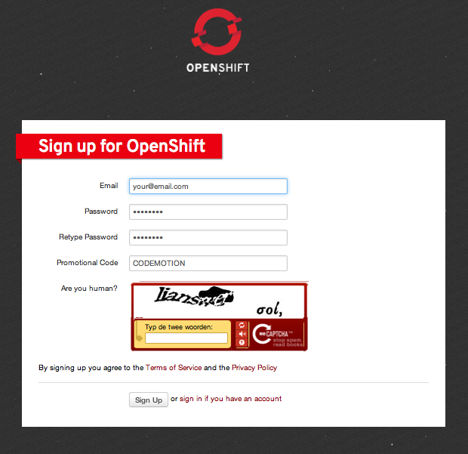
Sign up, it's free!
http://openshift.redhat.com – “Sign up and Try it!”
Example projects you can deploy now!
  https://www.github.com/openshift
Help?
  IRC: freenode #openshift
  Forums: http://www.redhat.com/openshift/community/forums
  Email: openshift at redhat dot com
Promotional Code: NLUUG

Slide 3


Slide 4

Immersion...
Shift happens?

Slide 5

Never look back...

Slide 6



PaaS?

Slide 7

Why am i DORKING
with the stack?!

Slide 8
Express
Sign Up
Install Client Tools
Create Domain
Create Application
Deploy Application (GIT)

Slide 9
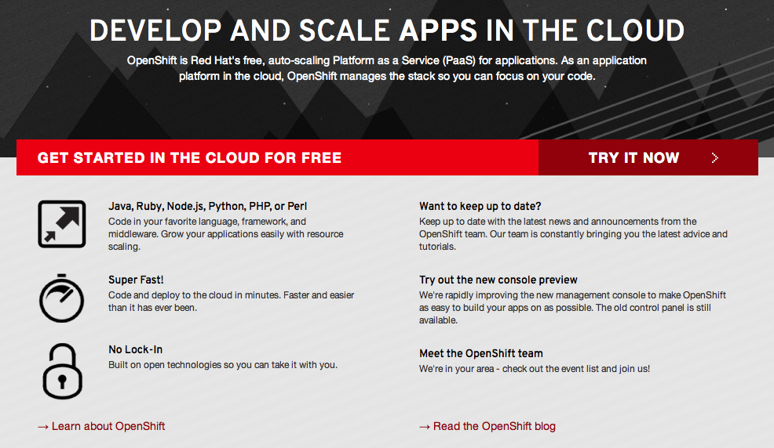
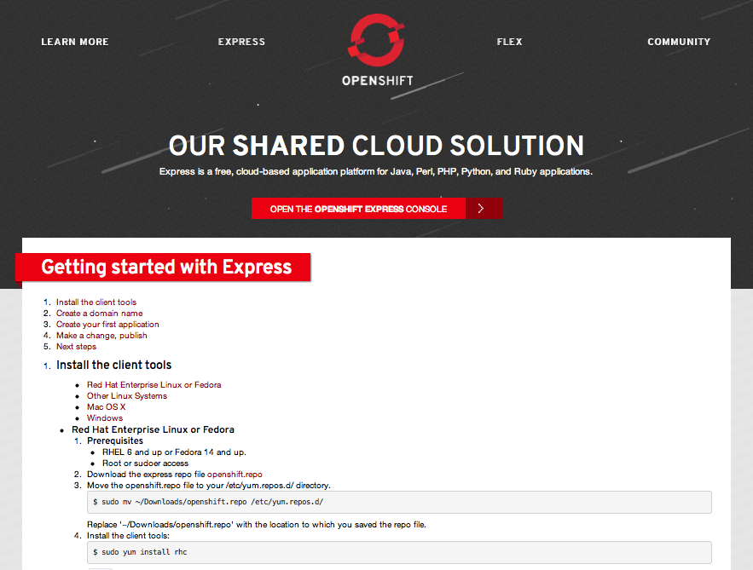
Sign Up
http://openshift.redhat.com

Slide 10
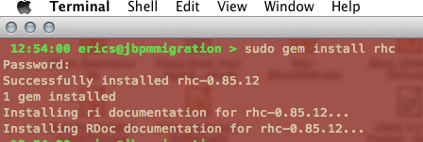
Install Client Tools
The rest (osX, Ubuntu, Cygwin):
  gem install rhc (json_pure)
  see forums, blogs
Fedora / RHEL
  openshift.repo
Move to yum.repos.d
$ sudo mv openshift.repo /etc/yum.repos.d
Install client tools
$ sudo yum install rubygem-rhc

Slide 11
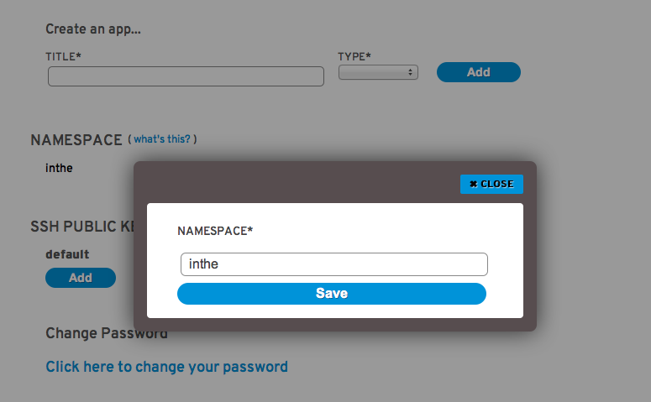
Create Domain
Use rhc command
  $ rhc domain create -n mydomain -l openshiftlogin
use Express console!

Slide 12

Gears
500MB memory + 1GB storage

Slide 13
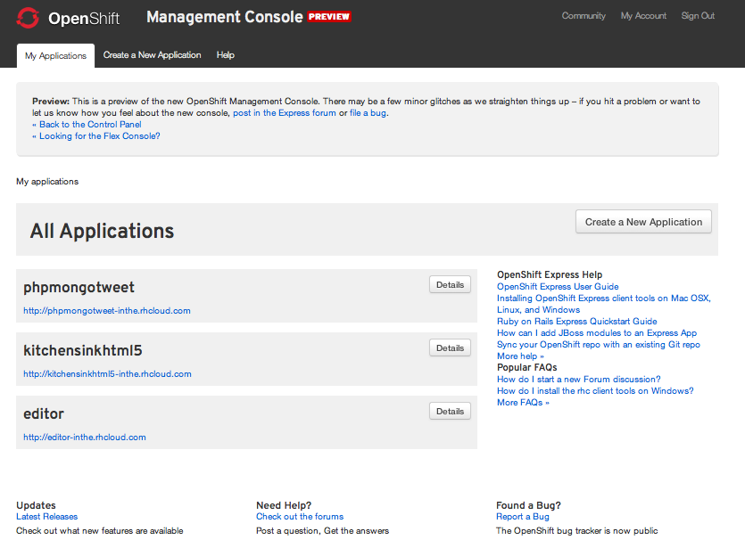
Web Administration

Slide 14
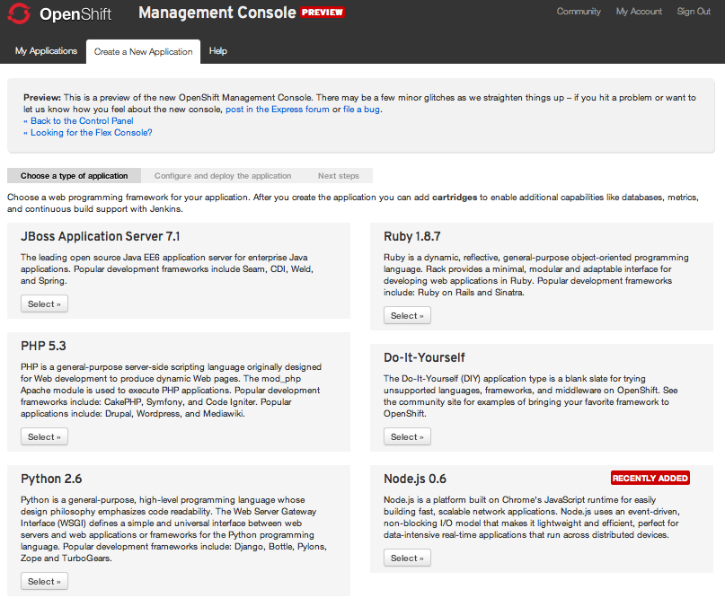
Create Application

Slide 15
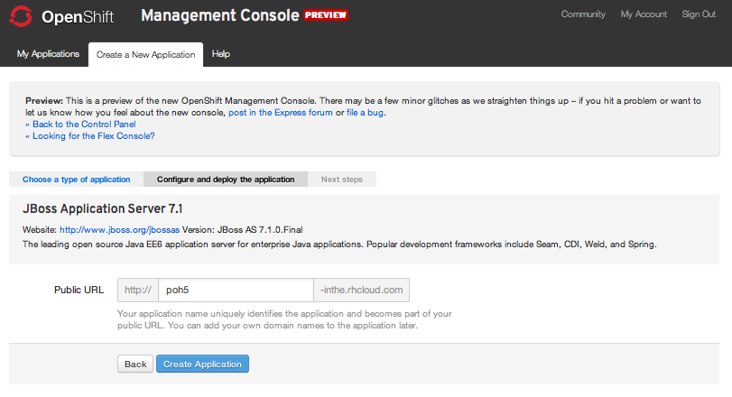
Configure Application

Slide 16
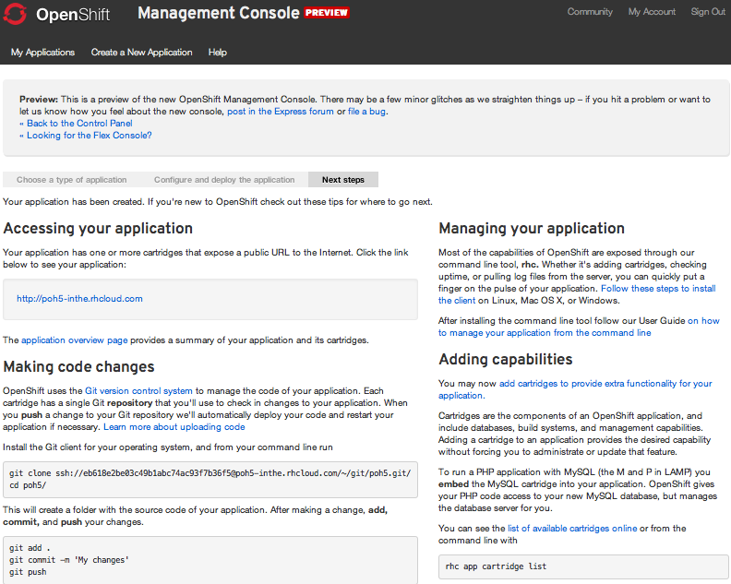
Ready to code!

Slide 17
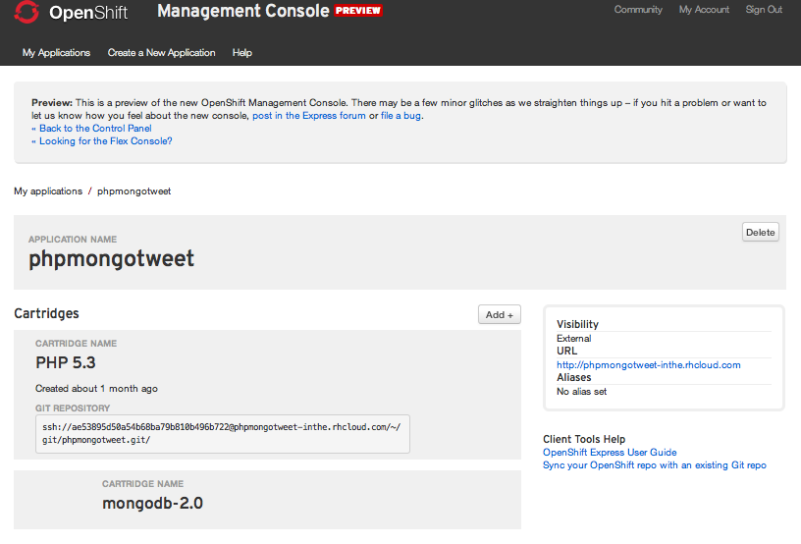
Application Details

Slide 18
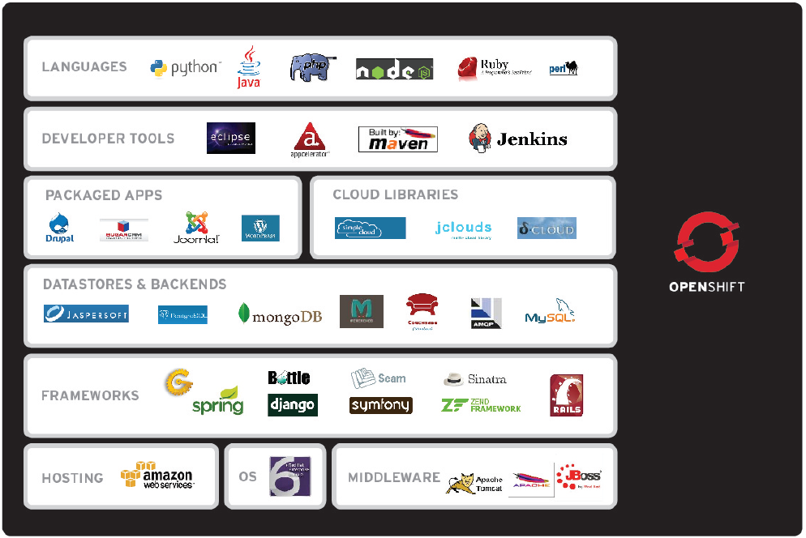
Why OpenShift? It's you.
Notes:
But one of the best things about OpenShift (in addition to being Easy and Solid) is that it is exactly what You need, no matter who you are. This slide shows the wealth of languages, frameworks, tools, applications, vendors, and cloud providers that are part of the OpenShift family.
Whether you are a Ruby coder, or a Java EE programmer, OpenShift will help you be fast and efficient in your application development efforts.

Slide 19







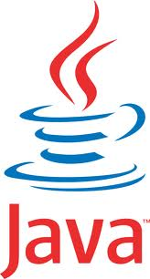



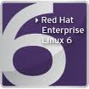
























Your language / framework

Slide 20

Other Options: create apps
Name app and define type
  $ rhc app create -a appname -t apptype -l openshiftlogin
  (Node.js, DIY, Jenkins, PHP, Ruby, Python, Perl and most important, Java!)
Add application to local repo
  $ git add .
Commit changes
  $ git commit -m “Initial app import.”

Slide 21
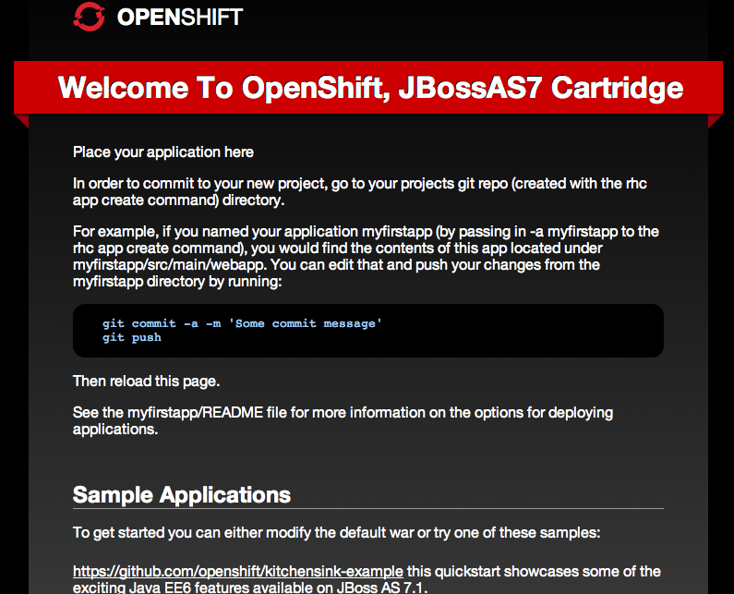
Deploy to Cloud
Push the code to Express
  $ git push
Congratulations, your app is in the cloud!

Slide 22


Slide 23
Demo CloudTour Mobile App
$ rhc app create -a cloudtour -t jbossas-7
$ cd cloudtour
$ git remote add upstream -m master git://github.com/eschabell/openshift-cloudtour.git
$ git pull -s recursive -X theirs upstream master
$ git push
http://cloudtour-$your_domain.rhcloud.com

Slide 24
Demo Wordpress
$ rhc app create -a wordpress -t php-5.3
$ rhc app cartridge add -a wordpress -c mysql-5.1
$ cd wordpress
$ git remote add upstream -m master git://github.com/openshift/wordpress-example.git
$ git pull -s recursive -X theirs upstream master
$ git push
http://wordpress-$your_domain.rhcloud.com

Slide 25
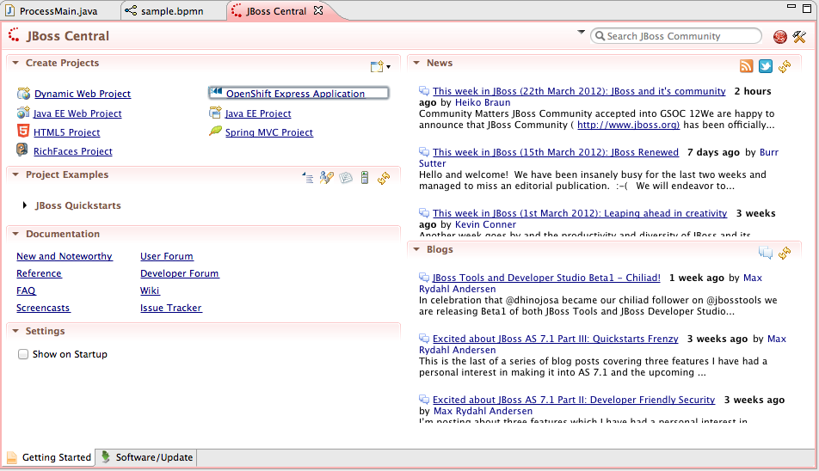
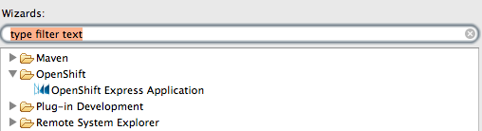
JBoss Developer Studio

Slide 26
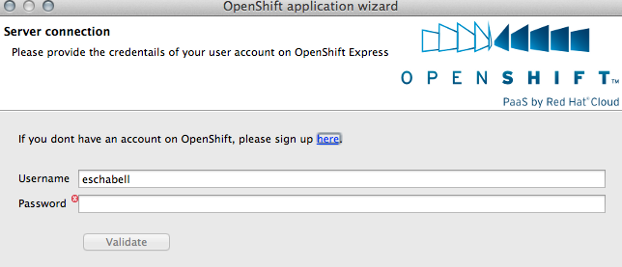
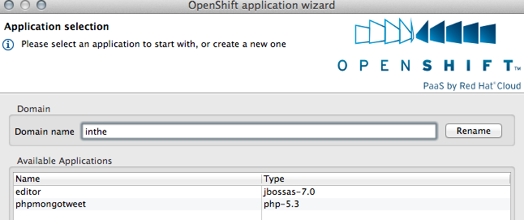
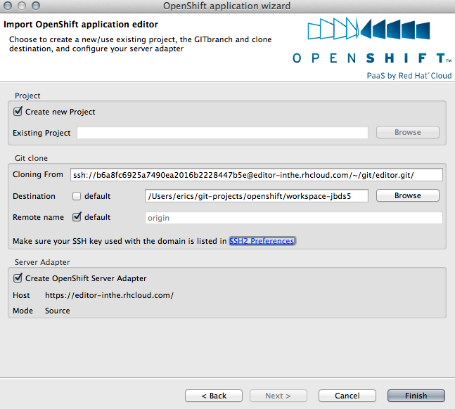
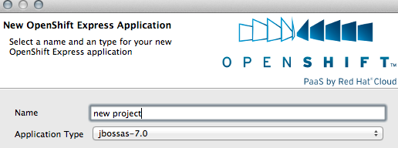

Slide 27
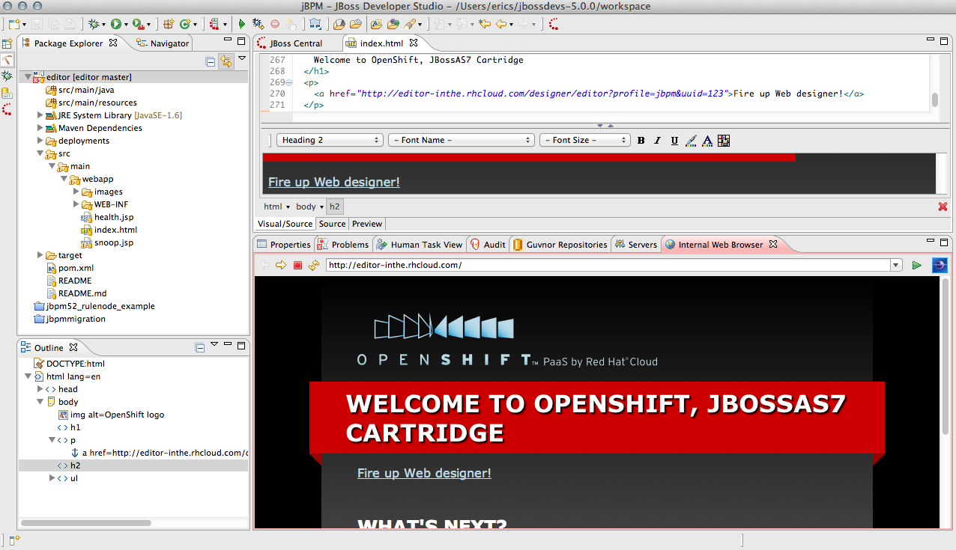
JBDS in action...

Slide 28
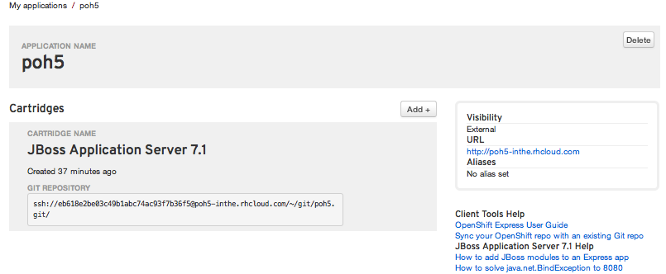
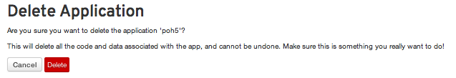
Remove Application

Slide 29
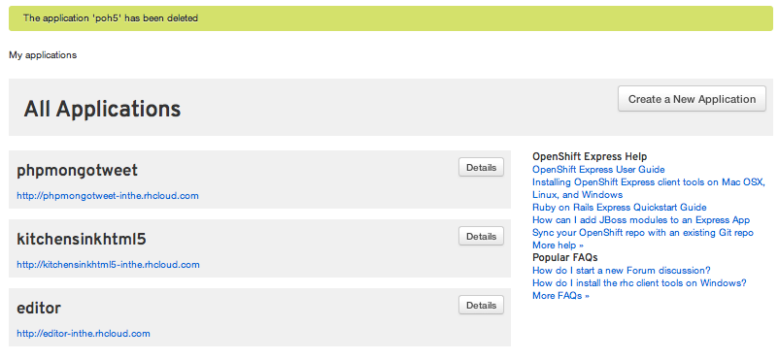
Time for a new project!

Slide 30

What will the future bring?
Express / Flex unification
JBoss++
Commercial Service / Pricing
Mobile
Open Source (SDK + project)
2012

Slide 31




Loving your hammer?

Slide 32

OpenShift: http://openshift.redhat.com
OpenShift Express: https://openshift.redhat.com/app/express
Blogs: https://www.redhat.com/openshift/community/blogs
CloudTour mobile application demo on OpenShift: https://github.com/eschabell/openshift-cloudtour
Deploy an application to OpenShift with JBossTools (video): http://vimeo.com/33988381
Deploying mobile application with JBoss Dev Studio: https://community.jboss.org/wiki/DeployingHTML5ApplicationsToOpenshift
Rise above the Cloud hype with OpenShift: http://www.schabell.org/2012/01/rise-above-cloud-hype-with-openshift.html

