Slide 1

An OpenShift Primer
Get your code into the Cloud!
Eric D. Schabell
JBoss Senior Solution Architect
erics@redhat.com / @ericschabell

Slide 2
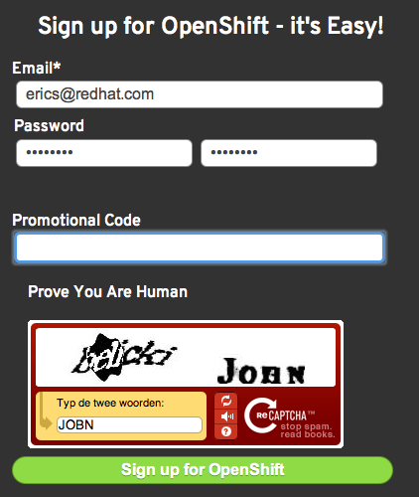

Sign up, it's free!
http://openshift.redhat.com – “Sign up and Try it!”
Example projects you can deploy now!
  https://www.github.com/openshift
Help?
  IRC: freenode #openshift
  Forums: http://www.redhat.com/openshift/community/forums
  Email: openshift at redhat dot com
PJUG
Promo code:
PJUG

Slide 3


Slide 4

Immersion...
Shift happens?

Slide 5

Never look back...

Slide 6



PaaS?

Slide 7

Why am i DORKING
with the stack?!

Slide 8
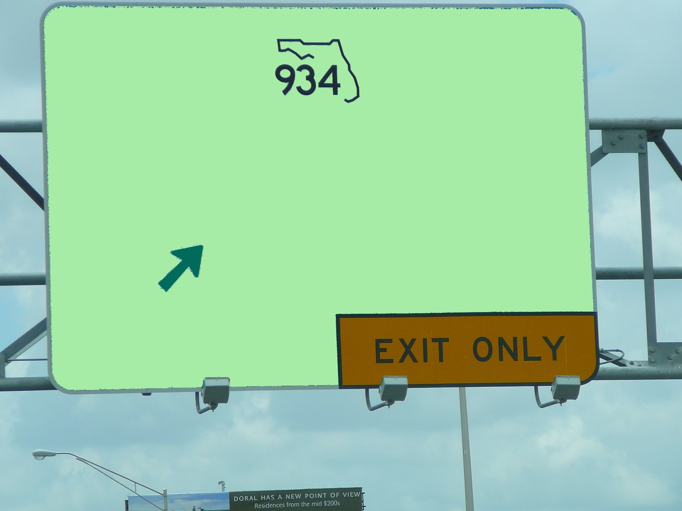


Slide 9
OpenShift Express
Sign Up
Install Client Tools
Create Domain
Create Application
Deploy Application (GIT)

Slide 10
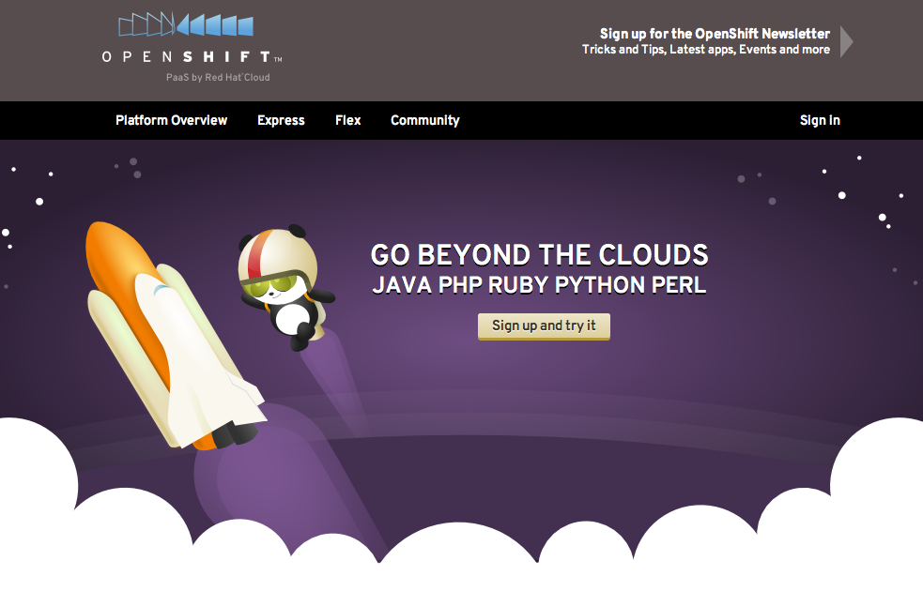
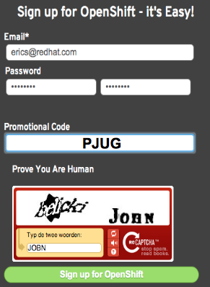
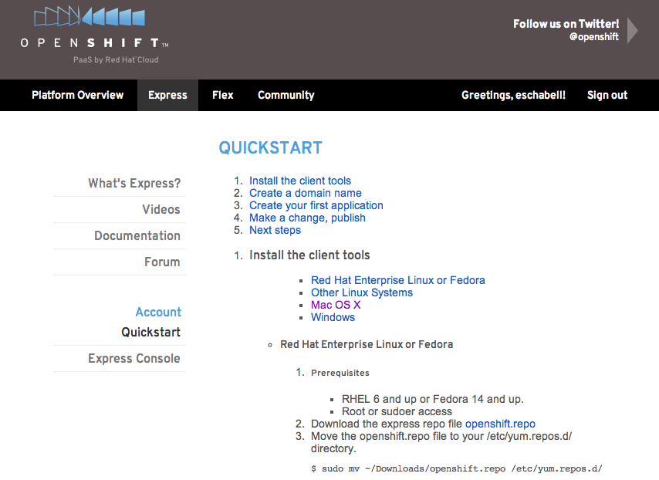
Sign Up
http://openshift.redhat.com
CODEMOTION

Slide 11
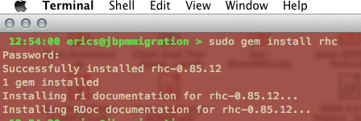
Install Client Tools
The rest (osX, Ubuntu, Cygwin):
  gem install rhc (json_pure)
  see forums, blogs
Fedora / RHEL
  openshift.repo
Move to yum.repos.d
$ sudo mv openshift.repo /etc/yum.repos.d
Install client tools
$ sudo yum install rubygem-rhc

Slide 12
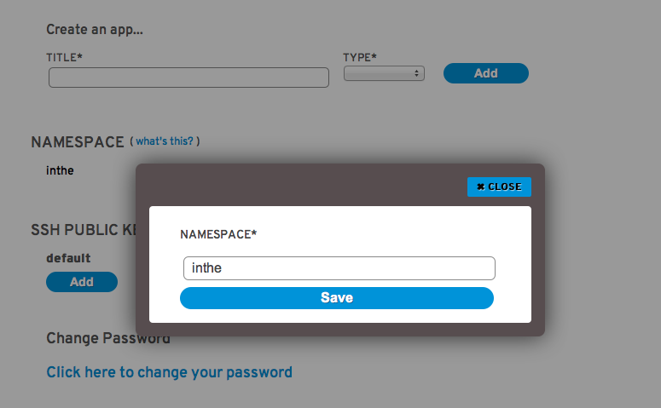
Create Domain
Use rhc-create-domain command
  $ rhc-create-domain -n mydomain -l openshiftlogin
use Express console!

Slide 13
rhc-create-domain
Usage: /usr/bin/rhc-create-domain
Bind a registered rhcloud user to a domain in rhcloud.
-n|--namespace namespace Namespace for your application(s) (alphanumeric - max 16 chars)
-l|--rhlogin rhlogin Red Hat login (RHN or OpenShift login with OpenShift Express access)
-p|--password password RHLogin password (optional, will prompt)
-a|--alter Alter namespace (will change urls) and/or ssh key
-d|--debug Print Debug info
-h|--help Show Usage info
--config path Path of alternate config file
--timeout # Timeout, in seconds, for connection

Slide 14

Create App
Name application and define type
  $ rhc-create-app -a appname -t apptype -l openshiftlogin
  (PHP, Ruby, Python, Perl and most important, Java!)
Add application to local repo
  $ git add .
Commit changes
  $ git commit -m “Initial app import.”

Slide 15
rhc-create-app
Obtaining list of cartridges (please excuse the delay)...
Usage: /usr/bin/rhc-create-app Create an OpenShift Express app.
-a|--app application Application name (alphanumeric - max 32 chars) (required)
-t|--type type Type of app (python-2.6, jenkins-1.4, ruby-1.8, php-5.3, jbossas-7.0, perl-5.10) (required)
-r|--repo path Git Repo path (defaults to ./$app_name)
-n|--nogit Only create remote space, don't pull it locally
-d|--debug Print Debug info
--no-dns Skip DNS check. Must be used in combination with --nogit
--config path Path of alternate config file
--timeout # Timeout, in seconds, for connection
--enable-jenkins [name] Indicates to create a Jenkins application (if not already available) and
embed the Jenkins client into this application. The default name will be
'jenkins' if not specified.

Slide 16
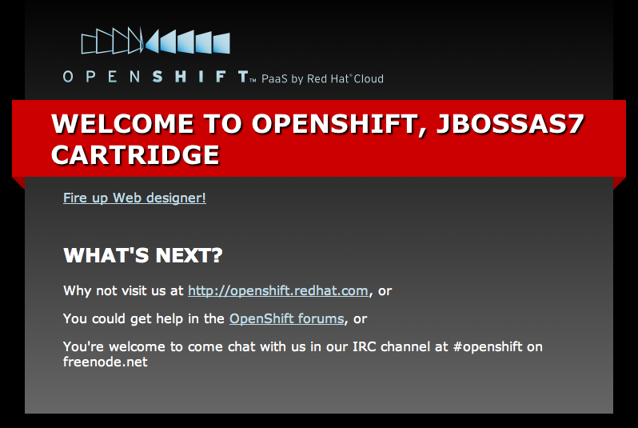
Deploy to Cloud
Push the code to Express
  $ git push
Congratulations, your app is in the cloud!

Slide 17


Slide 18

Demo jBPM Migration Tool
$ rhc-create-app -a jbpmmigration -t jbossas-7.0
$ cd jbpmmigration
$ git remote add upstream -m master git://github.com/eschabell/openshift-jbpmmigration.git
$ git pull -s recursive -X theirs upstream master
$ git push
http://jbpmmigration-$your_domain.rhcloud.com/jbpmmigration_upload-0.4

Slide 19
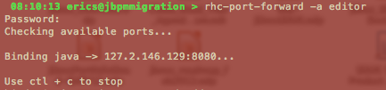
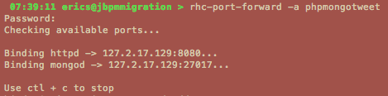
Port Forwarding
Enable tooling access to DB's and debugging of your application container:
Eclipse DTP tooling
Eclipse remote debug

Slide 20
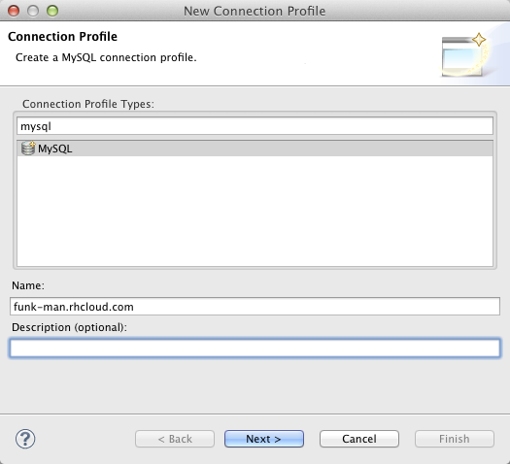
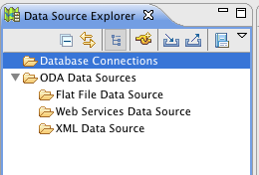
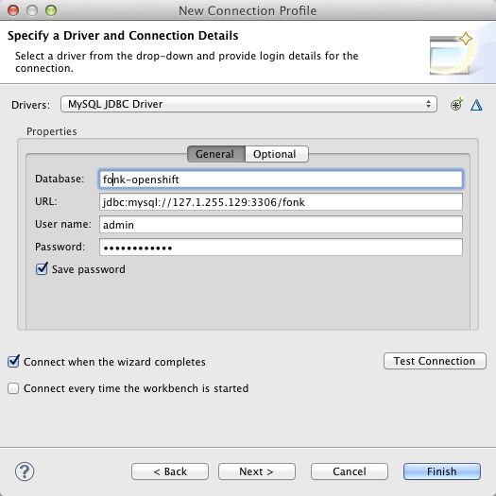
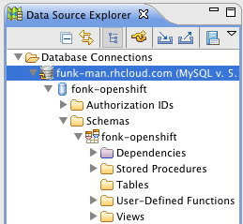
Explore...

Slide 21
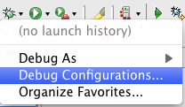
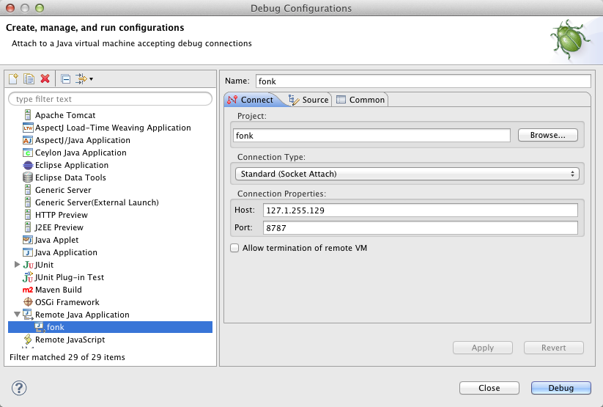
Setup...
cd $project
touch .openshift/markers/enable_jpda
git add .openshift/markers/enable_jpda
git commit -a -m “enable jpda.”

Slide 22
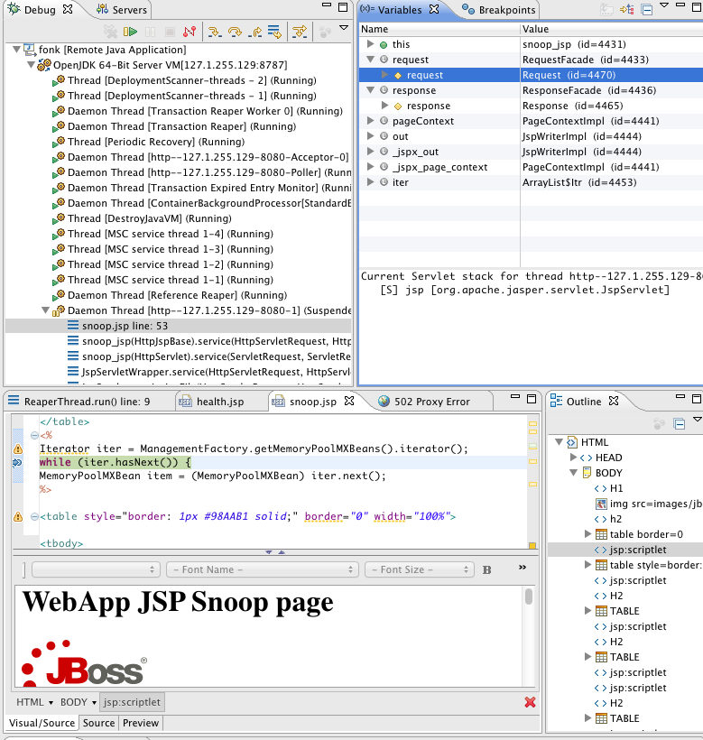
Debugging

Slide 23
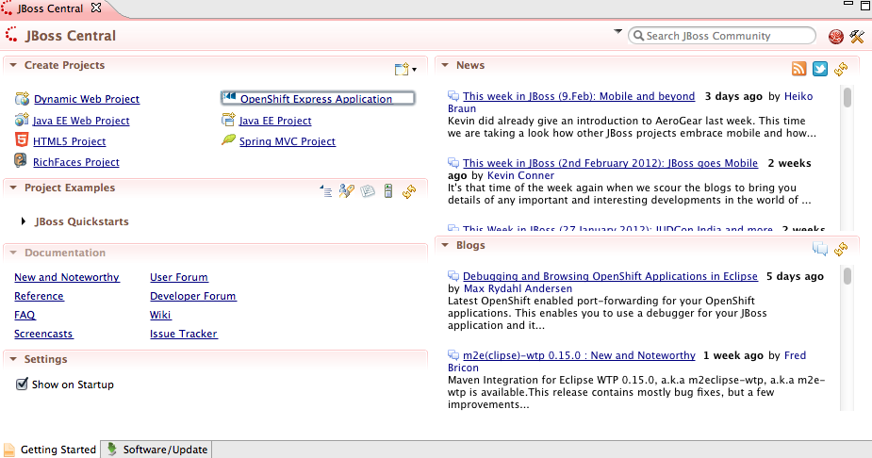
JBoss Developer Studio

Slide 24
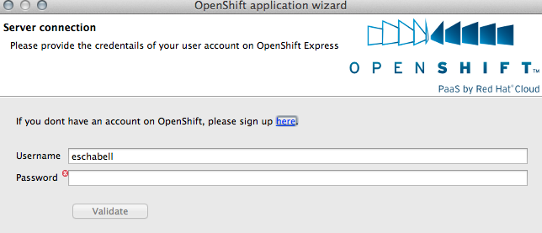
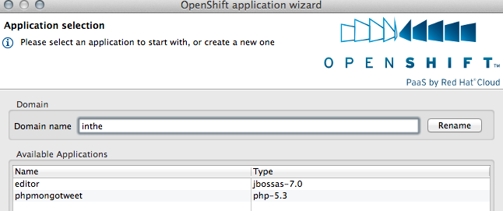
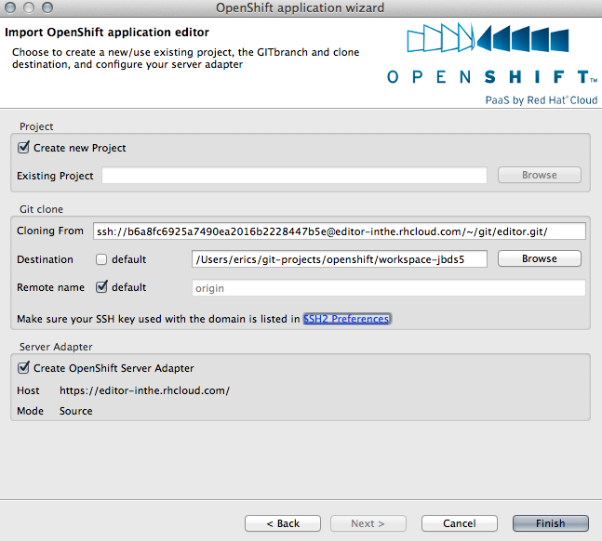
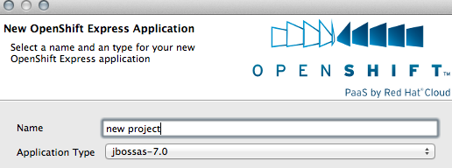

Slide 25
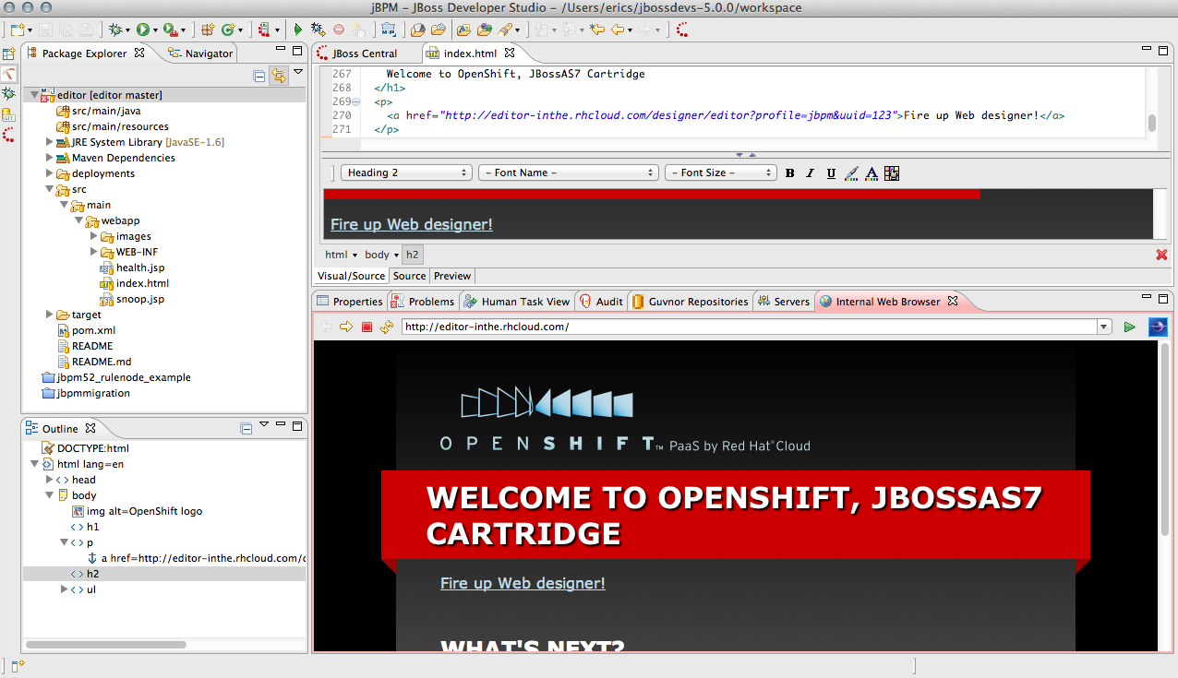
JBDS in action...

Slide 26

What will the future bring?
Express / Flex unification
JBoss++
Commercial Service / Pricing
Mobile
Open Source (SDK + project)
2012

Slide 27


Loving your hammer?

Slide 28

OpenShift: http://openshift.redhat.com
OpenShift Express: https://openshift.redhat.com/app/express
OpenShift Flex: https://openshift.redhat.com/app/flex
JBPM Web Designer in the Cloud (example): http://www.schabell.org/2011/10/jbpm-web-designer-integrates-jbpm.html
Deploy an application to OpenShift with JBossTools (video): http://vimeo.com/33988381
Debugging and Browsing OpenShift Applications in Eclipse: http://tinyurl.com/7x94use
Rise above the Cloud hype with OpenShift: http://www.schabell.org/2012/01/rise-above-cloud-hype-with-openshift.html

Slide 29
Extra slides, screenshots OpenShift Flex

Slide 31

Enterprise
Flexibility?
Auto
Scaling
Speed
Deployment
Provisioning
Monitoring
Automation
Log Mgmt
Roll-backs,
Upgrades
Databases

Slide 32
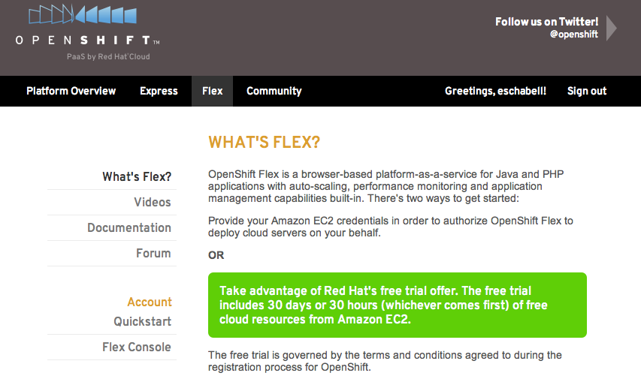

Login
Creds

Slide 33



Deploy
Application
Name
App
Version
Components

Slide 34


Deploy code
Congrat's,
you're in the Cloud!

Slide 35


Performance & Logs
Point-in-time
Trans levels
Search
Applications
Components

Slide 36

Define Scaling Strategy
How?
What?
Why?

