Slide 1

The Intelligent Cloud
Application Infrastructure
Red Hat Cloud Tour
Amsterdam
April 2012

Slide 2


Agenda
Mega trends shaping the enterprise
The hybrid cloud
Explosion of mobile & devices
Scale and integration
Architecting the intelligent application infrastructure
Portable across clouds and infrastructures
Web & cloud scale
Web api capable
Business process aware
Notes:
Welcome to our discussion about creating an intelligent cloud application infrastructure.
As you start adopting cloud computing, you will be making many decisions about why you choose to use the cloud and how to optimize it for your business. You will be making important decisions about how to take advantage of the economics of the cloud. You will also be making decisions about how the cloud will simplify IT and infrastructure.
This discussion is about how to future-proof your application infrastructure to tactically migrate and take advantage of cloud computing, then strategically extend and enhance your systems to adapt to the massive changes underway in the industry.
Realizing the benefits of cloud requires new thinking in how you build and deploy applications and how you architect an intelligent infrastructure to deliver agility, efficiency, and portability across a variety of on-premises, public cloud, and hybrid environments.
There are several mega-trends transforming the way people work and is resulting in a radical shift in how new applications are being architected.
The first is the hybrid cloud – having assets run in multiple cloud environments and the need to connect and synchronize those systems.
The second is the explosion of mobile computing and device form factors from smartphone to tablets which requires an infrastructure that embraces
interoperability and heterogeneity to connect to those devices.
The third is the scale required today, from collecting data from billions of connected devices and appliances across globally distributed networks, to connecting to a multitude of devices, business partners and clouds.
We are going to talk about these mega-trends reshaping the industry and go over the four things you need to do to architect applications for the cloud:
1. Making them portable across clouds and infrastructures
2. Making them web and cloud scale
3. Able to consume and expose Web APIs
4. And making them business process aware

Slide 3
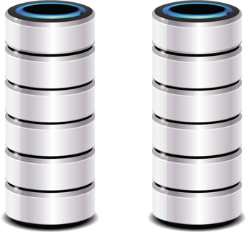
Megatrend: hybrid clouds
On-premises cloud. Public cloud. Now both.
Private cloud
Physical servers
Public cloud
Worldwide ip traffic will quadruple by 2015.
80% of it will adopt some form of cloud by 2014.
83% of organizations ask for deploy anywhere.
IDC expects that by 2015, the majority of the enterprise…will require integrated hybrid cloud management capabilities.
How do you make applications portable among clouds?
How do you make applications connect across clouds?
Source: IDC Cloud Management Study, 2011 Survey
Source: IDC
Notes:
The next mega-trend are hybrid clouds. There are several flavors of clouds – from a private, virtualized infrastructure, to a public cloud infrastructure provider, or a platform-as-a-service (PaaS) approach – both internally or with a public PaaS provider.
Your business will likely adopt one of these approaches. And it’s even more likely that you will adopt more than one. According to IDC, 83% of organizations are requiring the ability to deploy anywhere – across any type of cloud, public or private/virtualized.
Worldwide IP traffic will quadruple by 2015. Much of this will be fueled by the increase in devices, but a significant portion of it will be used to communicate across clouds. For most enterprises, on-premises datacenters will continue to be a reality, with elastic workloads running on a public cloud. Communicating between those environments will become a higher priority to keep mission critical systems synchronized and aggregated.
Is your application infrastructure adaptable enough to embrace this level of flexibility? Can your applications easily move between different types of cloud environments? Are they architected to synchronize data across disparate systems separated by geography and firewalls?

Slide 4
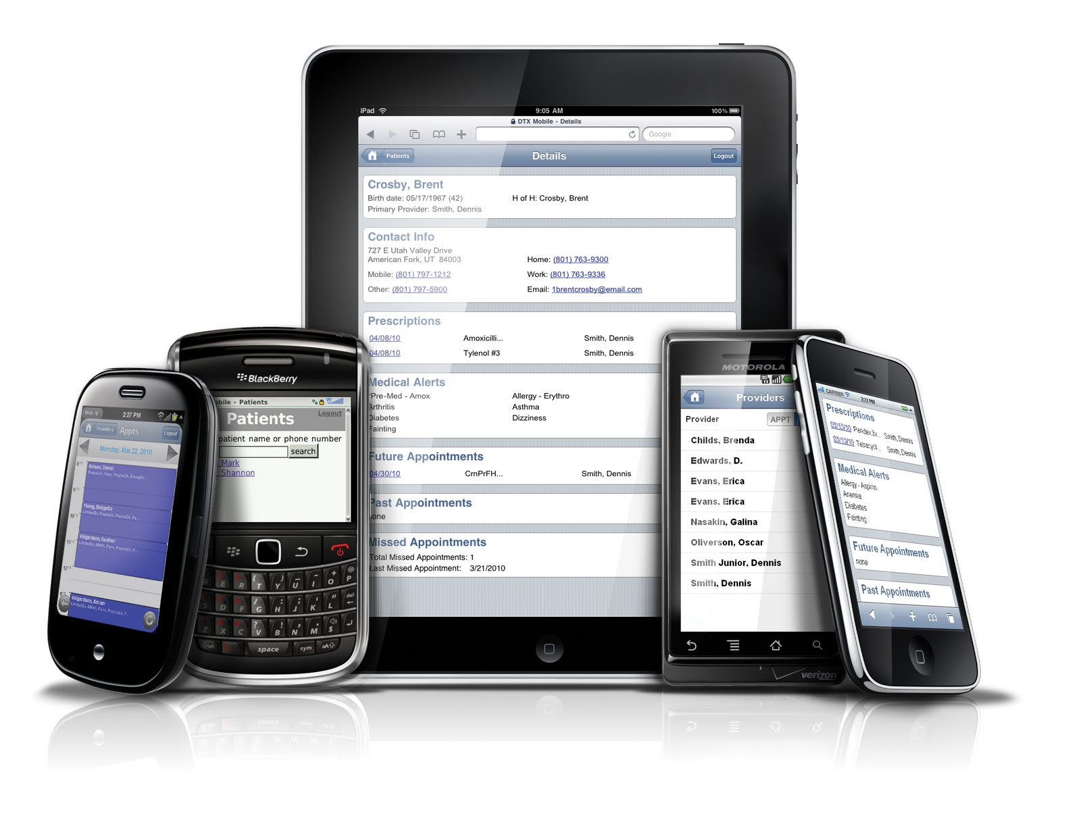
Mobile explosion
In 2014 there will be 1.7 billion connected pcs, smartphones, and tablets.
820m will be smartphones running android, ios, & windows phone. How do you
use the cloud to architect for heterogeneity, interoperability and connectivity?
Notes:
The first mega-trend is the explosion of the total number of devices with internet connectivity. By 2014, there will be 820 million smartphones on the market, growing at a 22% compounded annual rate. The idea of 1 billion mobile computing devices, once considered science-fiction a few years ago will soon be the new reality.
And this smartphone market will be fragmented among form factors and size, as well as by platform. According to Gartner, Android will power 46% of these devices, followed by Windows Phone at 20%, and Apple’s iOS at 15%, followed by a litany of other operating systems.
By 2014, the estimated number of internet-capable desktops, notebooks, tablets, and smartphones will be 1.7 billion. That’s a staggering number, but only a small portion of the number of internet-connected devices, which is estimated to reach 10 billion. Automobiles, home entertainment, televisions, appliances, and e-readers have connectivity now. And nearly every vertical industry including transportation, manufacturing, healthcare are utilizing devices to optimize the supply chain and improve logistics.
So this is the question you need to ask yourself at this moment: Are our systems equipped with the interoperability and connectivity required to thrive in this landscape?

Slide 5
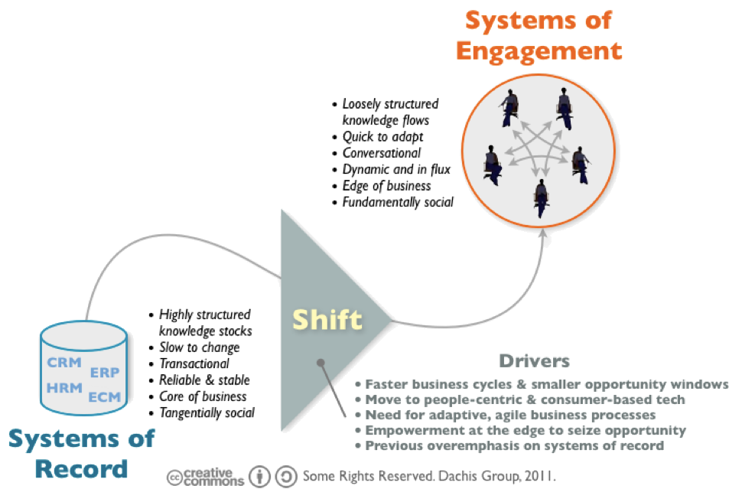
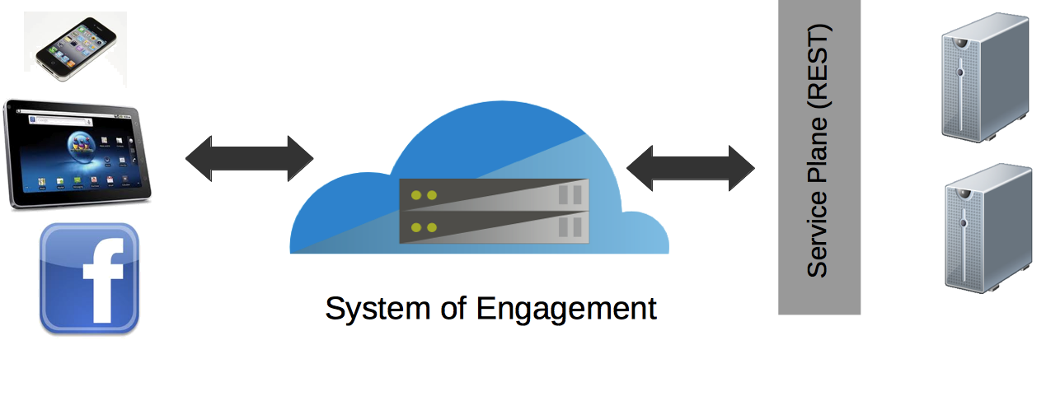
Megatrend: scale & integration
Connecting Clouds. Connecting Services
Integration and soa are fundamentally changing. A rapidly increasing number of web APIs are targeted to the enterprise.
How do you adapt to:
utilize the latest services
create the newest service
integrate it into processes
...for competitive advantage?
Smartphone Shipments Forecast (Millions)
Notes:
The third mega-trend is the exponential increase in scale and amount of integration required to power applications in the age of the cloud.
The fundamental nature of Service Oriented Architecture (SOA) and integration are changing. Historically, information in critical systems has been architected, accessed, and stored in a highly structured, transactional manner as the one “source of truth” for an enterprise.
Over time the “system of record” has evolved to be less structure, brought about by competitive pressures for faster business cycles, and making the information more easily accessible and shared with knowledge workers across more devices.
Where we see the industry heading is towards a “system of engagement”, defined by less rigidity and structure in accessing information and empowering workers to seize opportunities, shared in social networking situations, and having the ability to quickly adapt to changing business conditions by creating Web APIs utilizing simple web services with REST or SOAP endpoints.
At first glance it is easy to dismiss this trend as saying this only occurs at the fringes of your application portfolio. But systems of record are evolving to be accessed as systems of engagement within the enterprise. An example of this is basic storage like Amazon Web Services’ S3 service, stored in a public cloud and accessible via REST, storing business-sensitive documents. Another example is SalesForce – available as a software-as-a-service (SaaS), or via web services.
Here you need to ask – are we able to quickly integrate the latest services for competitive advantage? Can we create a service quickly?

Slide 6








Megatrend: scale & integration
Connecting Clouds. Connecting Services
Web API
Billionaires Club:
15 billion API calls / day (July 2011)
10 billion API calls / month (January 2011)
762 billion objects stored in S3 (January 2012, 260B 2011)
5 billion API calls / day (April 2010)
5 billion API calls / day (October 2009)
8 billion API calls / month (Q3 2009)
3 billion API calls / month (March 2009)
50% of all site traffic via API calls
How do you create services that are web & cloud scale, available to a multitude of devices,
and available to business partners?
Source: ProgrammableWeb.com
Smartphone Shipments Forecast (Millions)
Notes:
Let’s look at examples of some of the biggest Web APIs on the internet that represent this new approach to sharing information as part of their business on a massive scale.
In July 2011, Twitter had 15B APi calls a day. It’s undoubtedly much higher now. And look at Amazon Web Services in January 2012. Just in their S3 storage service alone they are storing 762B objects. At the end of 2011 it was only 260B objects. The flexibility of these services enable them to be utilized in a multitude of ways: with business partners, across systems, on devices, or via the browser.
So in addition to agility, do your applications have the ability to scale to the needs of the web and cloud? Are they able to communicate to a multitude of devices and new business partners to aggressively pursue new business opportunities?

Slide 7
Agenda
Mega trends shaping the enterprise
The hybrid cloud
Explosion of mobile & devices
Scale and integration
Architecting the intelligent application infrastructure
Portable across clouds and infrastructures
Web & cloud scale
Web api capable
Business process aware
Notes:
Welcome to our discussion about creating an intelligent cloud application infrastructure.
As you start adopting cloud computing, you will be making many decisions about why you choose to use the cloud and how to optimize it for your business. You will be making important decisions about how to take advantage of the economics of the cloud. You will also be making decisions about how the cloud will simplify IT and infrastructure.
This discussion is about how to future-proof your application infrastructure to tactically migrate and take advantage of cloud computing, then strategically extend and enhance your systems to adapt to the massive changes underway in the industry.
Realizing the benefits of cloud requires new thinking in how you build and deploy applications and how you architect an intelligent infrastructure to deliver agility, efficiency, and portability across a variety of on-premises, public cloud, and hybrid environments.
There are several mega-trends transforming the way people work and is resulting in a radical shift in how new applications are being architected.
The first is the hybrid cloud – having assets run in multiple cloud environments and the need to connect and synchronize those systems.
The second is the explosion of mobile computing and device form factors from smartphone to tablets which requires an infrastructure that embraces
interoperability and heterogeneity to connect to those devices.
The third is the scale required today, from collecting data from billions of connected devices and appliances across globally distributed networks, to connecting to a multitude of devices, business partners and clouds.
We are going to talk about these mega-trends reshaping the industry and go over the four things you need to do to architect applications for the cloud:
1. Making them portable across clouds and infrastructures
2. Making them web and cloud scale
3. Able to consume and expose Web APIs
4. And making them business process aware

Slide 8
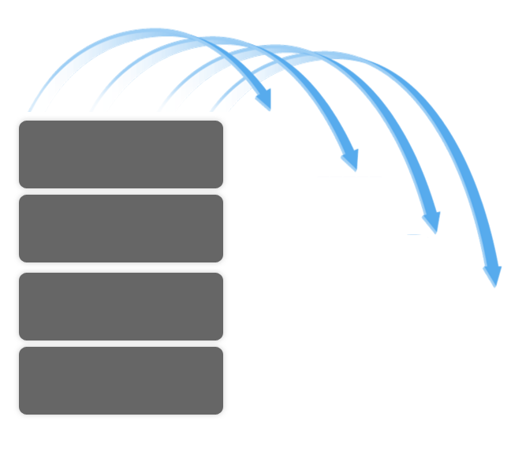

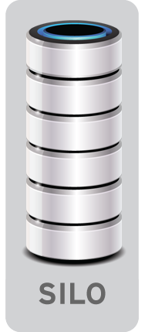
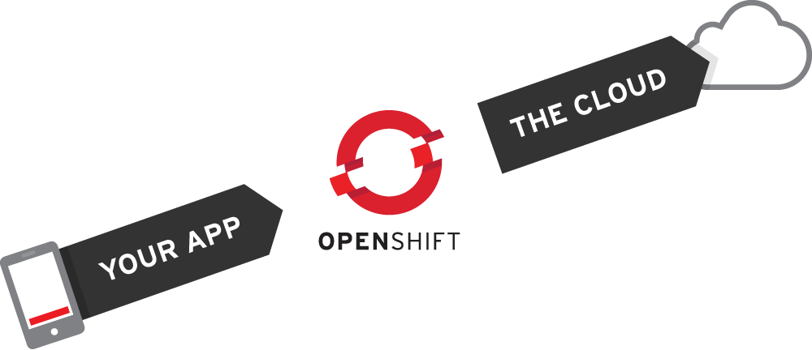
The intelligent application infrastructure
Portable across clouds and infrastructures
PORTABLE APPLICATIONS
Runs in any physical environment
Runs in any virtualized environment
Runs in any cloud environment
PORTABLE PROGRAMMING MODELS
Traditional
Data Center
PORTABLE SERVICES
Virtual
Data
Center
Private
Cloud
PORTABLE COMPUTING
Certified
Public
Cloud
Notes:
Your application infrastructure needs to be flexible to fit today’s environment and the future state of your IT without re-writing the applications. It needs to run on physical servers. It needs to run in a virtualized environment. And it needs to run in a cloud environment to provide you the most flexibility and choice.
Architecting solutions by utilizing JBoss as the foundation offers several advantages.
1. JBoss is a lightweight JEE-certified application server that powers traditional enterprise workloads and new mobile and services applications at scale.
2. And since it’s written in Java, it will run on a multitude of operating systems - Linux, Unix or Windows. It will also run in any combination of operating system and physical, virtual, or cloud environment that’s certified by Red Hat.
3. You also have the flexibility of adopting a PaaS approach by utilizing JBoss within OpenShift, Red Hat’s PaaS solution.

Slide 9


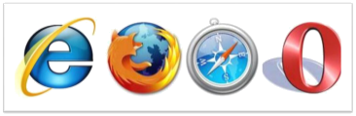

The intelligent application infrastructure
Web & cloud scale
X 1,000,000
Web
Service
elastic
scalable & highly available
failover & redundancy
secure
web, mobile & web api frameworks
Smartphone Shipments Forecast (Millions)
Notes:
The application infrastructure also needs to be elastic to scale up and down to respond to burst loads in traffic that may occur during seasonal events such as the holidays, as well as scale back down to make the most efficient use of your resources. By architecting your application infrastructure with JBoss, these capabilities become closer to reality by utilizing JBoss’ advanced management features or using it in conjunction with Red Hat’s PaaS, OpenShift, or with CloudForms.
As you reach an ever-increasing number of users, high-availability, failover, and redundancy become critical to keeping your systems running and making the most of every business opportunity.
JBoss’ advanced clustering features let you focus on user requirements and business needs. Elasticity and scalability are critical for success – JBoss provides these advanced capabilities so you and your architects can focus on surpassing the requirements of your users and less about keeping systems running.

Slide 10

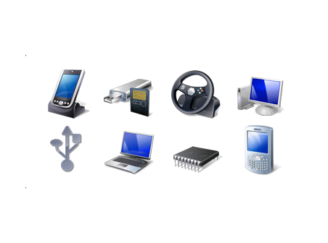
The intelligent application infrastructure
Web api capable
Web
Service
Publish information, integrate data
Across a variety of platforms and
web 2.0 architectures
Web
Service
Other Clouds
SaaS
Consume information from other
clouds and SaaS providers
Messaging
High speed messaging with a
sea of devices
Smartphone Shipments Forecast (Millions)
Notes:
The third critical characteristic is adopting service-orientation and web APIs throughout all aspects of the application infrastructure. Creating solutions with easy-to-use, standards-based SOAP and REST endpoints enable future agility and adaptability to the unique intellectual property of your business.
Many websites utilize services such as Google Maps to provide geo-spatial capability to their applications. Creating this service by yourself is impractical. But by utilizing the best of commercially available services you can rapidly innovate and augment your core business capabilities with third party services. Or vice versa – by creating your own services it provides your business the ability to reach business partners and customers in new ways that makes you a critical part of their business.
A service-oriented mindset frees up new possibilities of publishing information, integrating data much more quickly, and provides reach across SaaS providers and systems residing in other clouds. It also creates an entirely new level of re-usability for a multitude of new Web 2.0, mobile, and device connectivity.
JBoss offers a range of developer frameworks and capabilities to quickly create performant, standards-based web services, and management capabilities when you deploy and manage them.

Slide 11









The intelligent application infrastructure
Business process aware
Web API
Integration
ERP
Systems
Complex
Business Rules
Business
Logic
Transactional
Data
Web Service
Orchestrate and automate complex processes
Enhance processes with 3rd party services
Expose reusable processes for partners and devices
Notes:
The fourth critical characteristic is having systems that can automate and orchestrate business processes.
In the cloud era, expectations to capture and execute complex business requirements will increase for competitive advantage and fast time to market. Effectively implementing processes requires communicating with existing systems, external partners and services, and communicating these changes across clouds. Weaving together and orchestrating the individual steps of this process across multiple systems, executing business logic, verifying complex business rules, and handling a myriad of exceptions are requirements of the cloud-enabled application server.
In addition to its portability across clouds, scaling to millions of requests and users, and service-oriented and web API capabilities, JBoss also provides advanced business process management features to created automated business processes, evaluate complex business rules, and perform complex event-processing that spans systems and across clouds.

Slide 12
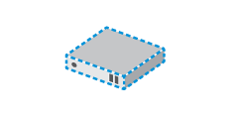
Cloud-ready architecture
High degree of automation
Flexible Management
Frugal use of resources
Lean, agile development
Open Platform
JBOSS ENTERPRISE MIDDLEWARE
PHYSICAL VIRTUAL PRIVATE PUBLIC

Slide 13


JBoss EAP 6
(AS 7)
OpenShift

Slide 14
blazingly fast (<3s startup)
lightweight
modular
hot parallel deployment
elegant administration
domain management
easy testable

Slide 15
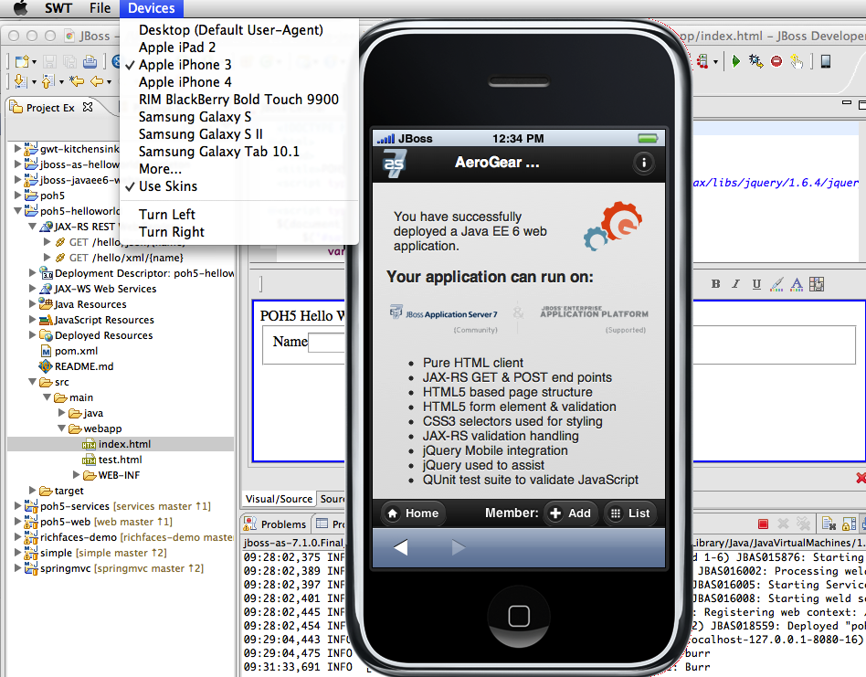
World Class Developer Productivity
Agile, Flexible Developer Experience
  Java EE6
  HTML 5 and Mobile
  Maven Support

Slide 16
Developer Productivity
Java EE 6
Lighter
  Profiles, Pruning – JSR-77 & 88, EJB2, JAXR, JAX-RPC
  Embedding – testing, batch
Better Integrated
  Managed Beans
  CDI 1.0 - Unifies JSF, JPA, and EJB3
  Bean Validation
Richer APIs
  JPA 2.0
  EJB 3.1
  JAX-RS 1.1
  JSF 2.0 / Servlet 3.0

Slide 17
OpenShift
(AKA a Cloud Application Platform)
is the PaaS offering by Red Hat

Slide 18
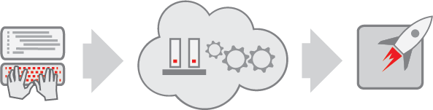
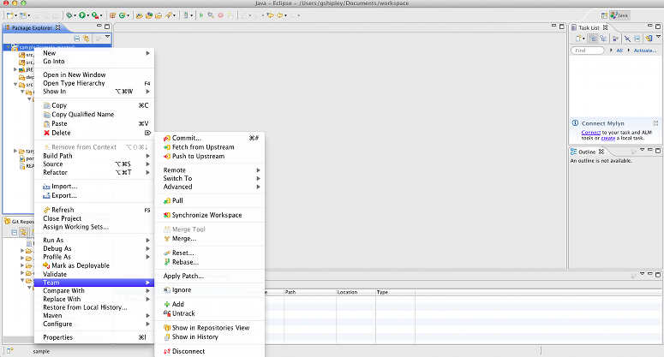



What is PaaS?
PaaS = Platform-as-a-Service
(AKA, a Cloud Application Platform)
Code
Deploy
Enjoy
Push-button Deploy, and your App is running in the Cloud!
Save Time and Money
Code your app
Notes:
So, what is PaaS?
PaaS stands for Platform-as-a-Service. Platform-as-a-Service is a delivery model in the world of Cloud Computing. Gartner refers to PaaS as a “Cloud Application Platform”. What they mean is that PaaS is a service that allows you to easily deploy and run applications in the Cloud.
With a PaaS, you only need to focus on designing and coding your application.
With the push of a button, you can take your fresh code and deploy it to the Cloud. The PaaS will provide all the infrastructure, middleware, and management that is needed for your app to run. All behind the scenes to you.
Utilizing a PaaS can allow you to save both time and money in your app dev process.

Slide 19
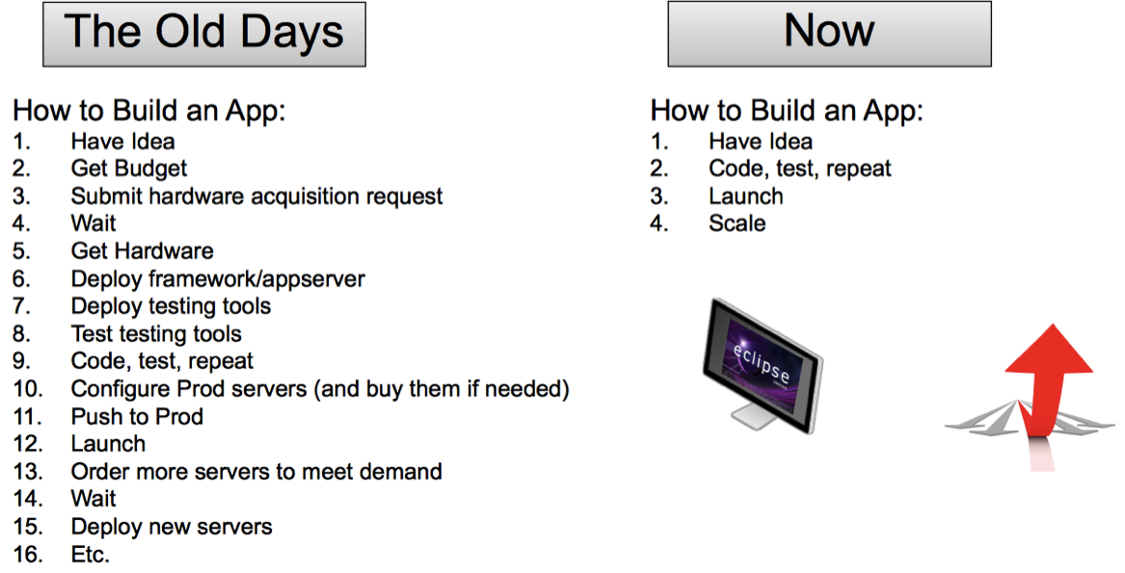
PaaS is the new age

Slide 20
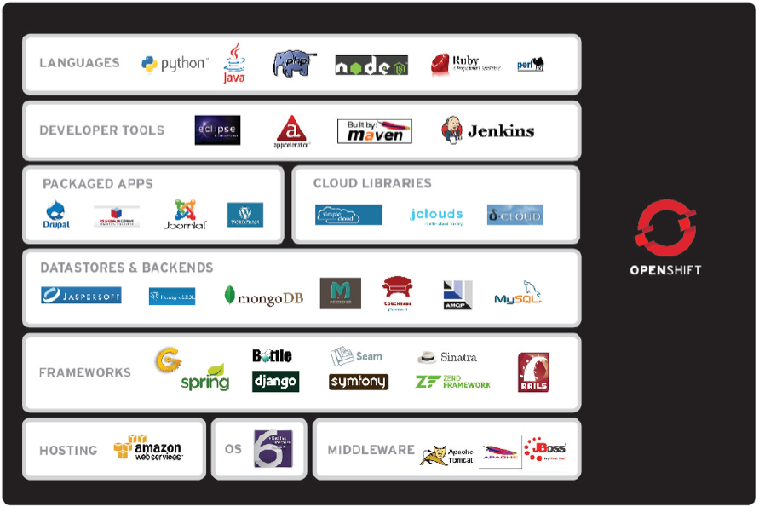
Why OpenShift? It’s You.

Slide 21
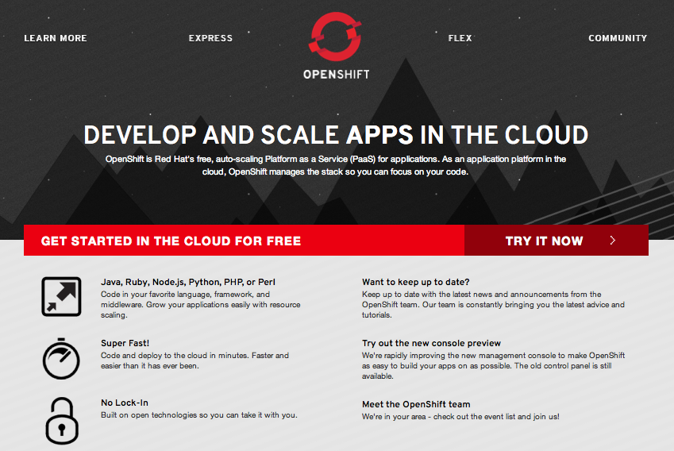
But don't take my word for it!
openshift.redhat.com
Promotional code: RHCT

Slide 22

Questions?
Smartphone Shipments Forecast (Millions)

