Slide 1

JBoss jBPM, the future is now for all your Business Processes
Eric D. Schabell
JBoss Senior Solution Architect

Slide 2


What is BPM?
Overview jBPM5
Cool Stuff

Slide 3

Business Process Management
is a
systematic approach
to making an organization's
workflow
more effective, more efficient
and more capable of
adapting
to an ever-changing
environment.

Slide 4


Shiny new, must have...

Slide 5
What is BPM?
Overview jBPM5
Cool Stuff

Slide 6
From Workflow...
Core engine is a workflow engine in pure Java
  state transitions
  lightweight
  embeddable
  generic, extensible
Core
Engine

Slide 7
Core Engine
Knowledge
Base
Stateful
Knowledge
Session
Process
Definition
Process
Instance

Slide 8

ProcessRuntime interface
startProcess(processId)
startProcess(processId, parameters)
signalEvent(type, event)
signalEvent(type, event, instanceId)
abortProcessInstance(instanceId)
getProcessInstance(instanceId)

Slide 9
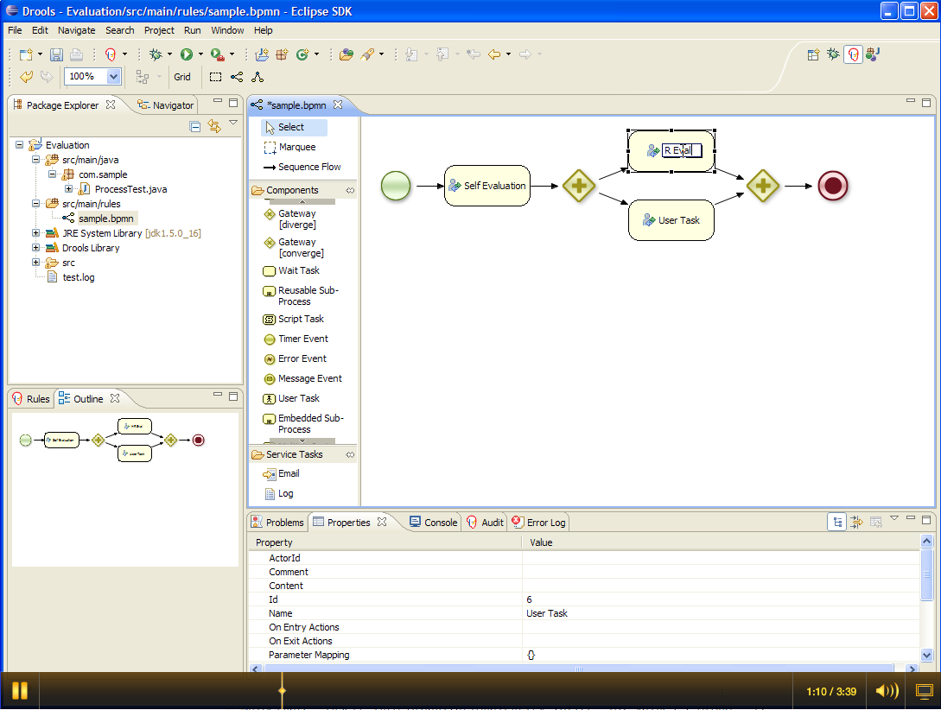
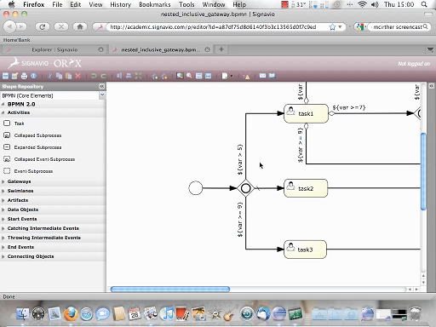

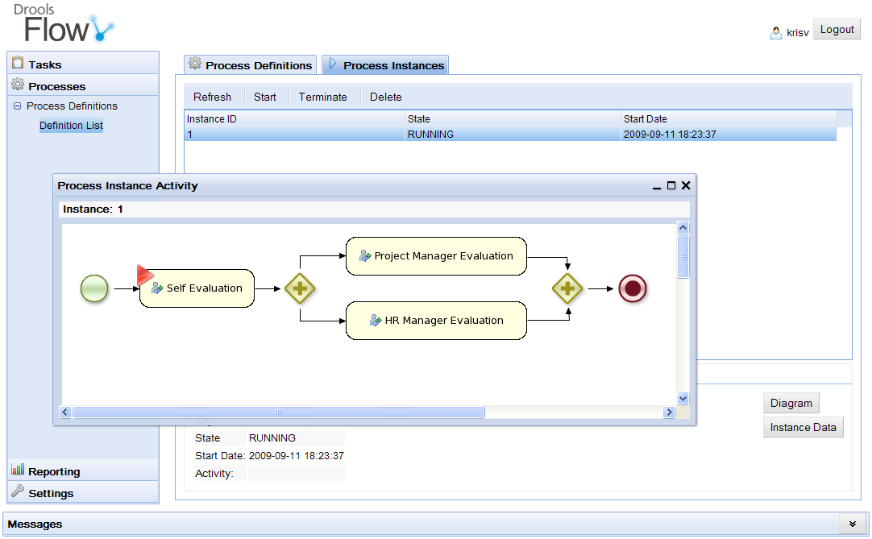
BPMS future at JBoss
Pluggable
&
Standards
Eclipse
BPMN2
Editor
Persistence
XML
Core
Engine
Trans-
actions
Oryx Web-
Based Editor
History
Log
BPMN
2.0
Events
Management
Console
Integration
Domain-specific
Processes
Human Task
Service
BAM
ESB

Slide 10
BPMN 2.0
OMG specification
  Model
  Notation
  Execution semantics
Understandable by all business users
Process, collaboration, choreography
Extensible

Slide 11
jBPM5 and BPMN2
Focus on executable processes
  Java environment
  Native execution
Subset
  Common Executable ++
High-level and domain-specific
Minimal custom extensions

Slide 12
BPMN2 positioning
BPMN2
Model
Savara
BRMS
jBPM
Rules
Process
Choreography
Event
Collaboration
WS-BPEL
Services
RiftSaw
SOA

Slide 13
What is BPM?
Overview jBPM5
Cool Stuff

Slide 14

Web based artifact management
BRM as knowledge repository
  BPMN2 processes
  Task and process forms
Web designer (Oryx)
Build, deploy, test, manage and collaboration features

Slide 15

That's awesome!

Slide 16

Domain-specific Processes
Extend palette with domain-specific, declarative service nodes
  define input / output parameters
  runtime binding

Slide 17


Service Repository
[
[
"name" : "JavaNode",
"parameters" : [
"class" : new StringDataType(),
"method" : new StringDataType(),
],
"displayName" : "Java Node",
"icon" : "icons/java.gif"
]
]
http://people.redhat.com/kverlaen/repository

Slide 18

There's
more?

Slide 19

Get your ducks in a row...

Slide 20

jBPM
everywhere
you can
imagine...

Slide 21

What about us?
jPDL != BPMN

Slide 22



Notes:
Demo web designer:
- singleTask
- ?
- ?

Slide 23


Slide 24

Welcome to the family...
https://github.com/droolsjbpm/jbpmmigration

Slide 25

jBPM5 community: http://www.jboss.org/jbpm
jBPM5 source: http://github.com/droolsjbpm/jbpm
jBPM5 Hudson: http://hudson.jboss.org/hudson/job/jBPM
Blog: http://kverlaen.blogspot.com
#jbpm on irc.codhaus.org / jbpm-dev@jboss.org
jBPM user forums: http://community.jboss.org/en/jbpm?view=discussions
jBPM migration strategies: http://www.schabell.org/2010/03/jbpm-migration-strategies-introduction.html
Migration tool project: https://github.com/droolsjbpm/jbpmmigration
Migration story JUDCon 2010: http://www.schabell.org/2010/10/judcon-2010-berlin-get-your-bpm-ducks.html
Migration project update JUDCon 2011: http://www.schabell.org/2011/05/judcon-2011-jbpm-migration-tooling-no.html
Eric D. Schabell | erics@redhat.com | @ericschabell

