Slide 1
Eric D. Schabell
Solution Architect Red Hat
From Code to Cloud:
PHP on Red Hat's OpenShift

Slide 2


Slide 3

Exposure...

Slide 4

Meditation...

Slide 5

Immersion...
Shift happens?

Slide 6

Never look back...

Slide 7


Slide 8


SaaS?

Slide 9





IaaS?

Slide 10


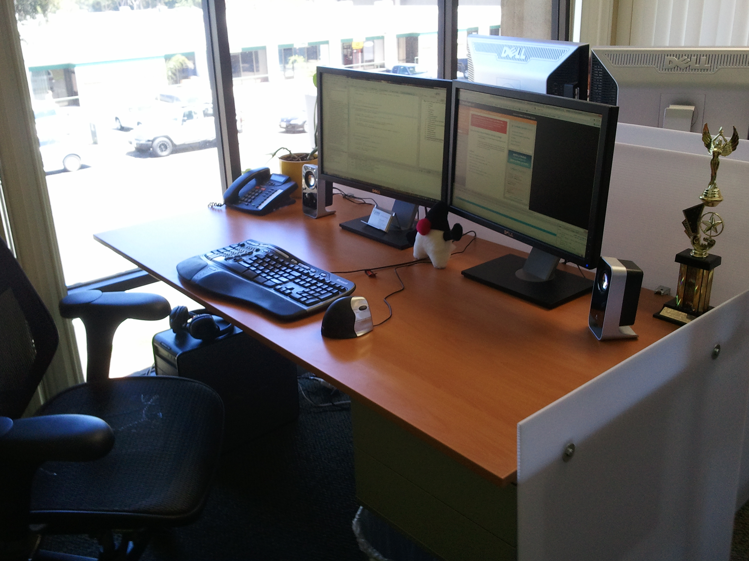
PaaS?

Slide 11

Why am i DORKING
with the stack?!

Slide 12



Slide 13
OpenShift Express
Sign Up
Install Client Tools
Create Domain
Create Application
Deploy Application (GIT)

Slide 14



Sign Up
http://openshift.com/try-it

Slide 15

Install Client Tools
Fedora / RHEL
  openshift.repo
Move to yum.repos.d
$ sudo mv openshift.repo /etc/yum.repos.d
Install client tools
$ sudo yum install rhc
The rest (osX, Ubuntu, Cygwin):
  gem install rhc
  see forums, blogs

Slide 16

Create Domain
Use rhc-create-domain command
  $ rhc-create-domain -n mydomain -l openshiftlogin
use Express console!

Slide 17
Create Application
Name application and define type
  $ rhc-create-app -a appname -t apptype -l openshiftlogin
  (Java, Ruby, Python, Perl and most important, PHP!)
Add application to local repo
  $ git add .
Commit changes
  $ git commit -m “Initial app import.”

Slide 18

Deploy to Cloud
Push the code to Express
  $ git push
Congratulations, your app is in the cloud!

Slide 19


Slide 20

Demo ZendFramework
$ rhc-create-app -a zendphp -t php-5.3
$ cd zendphp
$ git remote add upstream -m master git://github.com/eschabell/openshift-zendframework.git
$ git pull -s recursive -X theirs upstream master
$ git push
http://zendphp-$your_domain.rhcloud.com

Slide 21
Demo Cake
$ rhc-create-app -a cake -t php-5.3
$ rhc-ctl-app -a cake -e add-mysql-5.1
$ cd cake
$ git remote add upstream -m master git://github.com/openshift/cakephp-example.git
$ git pull -s recursive -X theirs upstream master
$ git push
http://cake-$your_domain.rhcloud.com

Slide 22

Demo Symfony
$ rhc-create-app -a symfonyphp -t php-5.3
$ cd cake
$ git remote add upstream -m master git://github.com/eschabell/openshift-symfony.git
$ git pull -s recursive -X theirs upstream master
$ git push
http://sympfonyphp-$your_domain.rhcloud.com

Slide 23

Enterprise
Flexibility?
Auto
Scaling
Speed
Deployment
Provisioning
Monitoring
Automation
Log Mgmt
Roll-backs,
Upgrades
Databases

Slide 24

OpenShift Flex
Setup Cloud Account
Provision Cloud Servers
Build Stack
Upload Application Code
Configure Components
Deploy
Performance Monitoring
Log Management
Auto-Scaling

Slide 25


Login
Creds

Slide 26
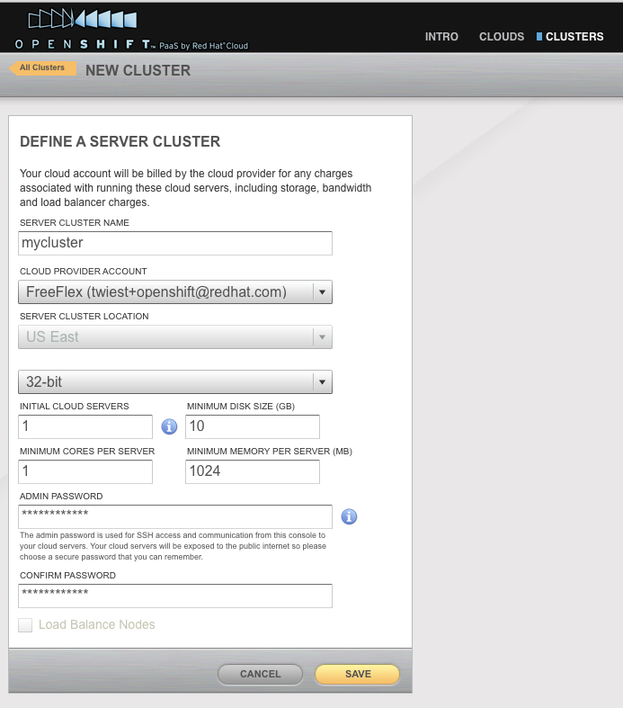
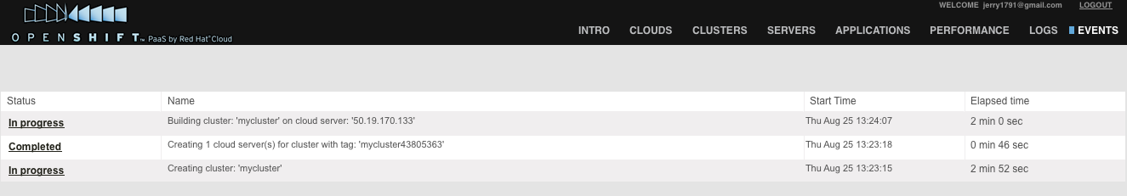
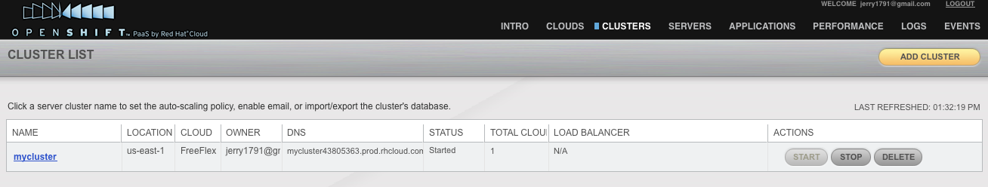
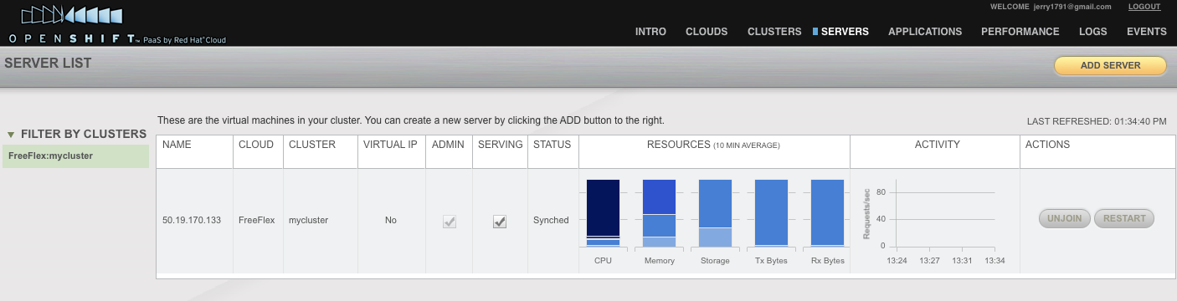
Create cluster...
check it out!
Provision
Events
Clusters
Servers

Slide 27



Deploy
Application
Name
App
Version
Components

Slide 28
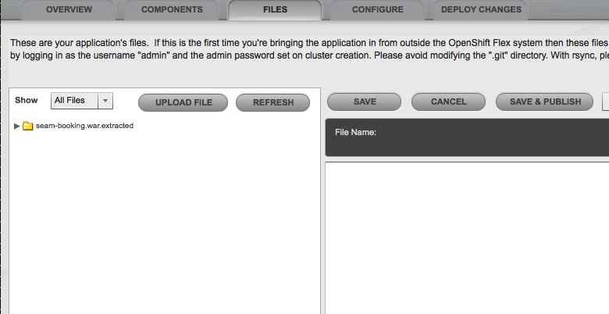
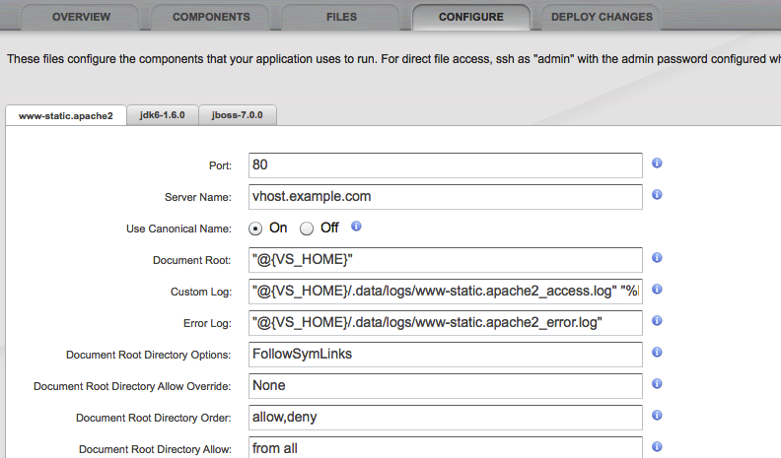
Add code
babygame.zip
Configure

Slide 29


Deploy code
Congrat's,
your in the
Cloud!

Slide 30


Performance & Logs
Point-in-time
Trans levels
Search
Applications
Components

Slide 31

Define Scaling Strategy
How?
What?
Why?

Slide 32
Sign up, it's free!
http://www.openshift.com – click “Try it!”
Example projects you can deploy now!
  https://www.github.com/openshift
Help?
  IRC: freenode #openshift
  Forums: http://www.redhat.com/openshift/forums
  Email: openshift at redhat dot com

Slide 33



Loving your hammer?

