Slide 1
Designing SOA
with
JBoss tools
Eric D. Schabell
JBoss Solution Architect
08 June 2011

Slide 2
Overview
Design Patterns and SOA
Logical Inventory Layer Patterns
  Utility service
    JBoss ESB tooling
  Entity serivce
    JBoss Teiid tooling
  Task service
    JBoss Savara tooling
    JBoss BPEL tooling
    JBoss jBPM tooling

Slide 3
Definition of Design Pattern
A proven design solution for a common design problem
Formally documented in a consistent manner
Introduced by GOF 1994, used all over the software industry since then.
Example's of software development design patterns are:
  Singelton, Adaptor, Decorator Pattern, etc

Slide 4
SOA Design Pattern
A book written by Thomas Erl that quickly became popular within the SOA community
Defines a set of common design problems when implementing SOA
Some patterns can be solved by using a product like JBoss SOA Platform that implement patterns
Some patterns are design concepts and cannot be implement by a product, but may be assisted with tools
Some are “pure” design principles where tools and products won't help.

Slide 5
Scope of this session
For the scope of this session we will focus on Logical Inventory Layer Patterns:
  Are a set of patterns to identify and abstract task, utility and entity services.
Pattern | JBoss Tools
Utility Service | Java, Bean Shell, EJB, Rules, etc
Entity Service | Hibernate, Data Services
Task Service | Riftsaw (BPEL)

Slide 6
Overview
Design Patterns and SOA
Logical Inventory Layer Patterns
  Utility service
    JBoss ESB tooling
  Entity serivce
    JBoss Teiid tooling
  Task service
    JBoss Savara tooling
    JBoss BPEL tooling
    JBoss jBPM tooling

Slide 7
Utility Abstraction - Definition*
Problem: When non-business centric processing logic is packaged together with business specific logic, it results in the redundant implementation of common utility functions across different services
Solution: A service layer dedicated to utility processing is established, providing reusable utility services for the use by other services in the inventory.
* = according to the SOA Design Pattern Book

Slide 8
Utility Abstraction – Definition by example
Example: Depending on country of delivery and product type different VAT must be used
Problem: if all services returning a price should calculate taxes independently there are allot of redundant code and multiple locations to maintain this code.
Solution: Create a utility service that depending on country of delivery and product type will return correct VAT.
Tip of the day: Using JBoss SOA-P the VAT utility service can be implemented as a business rule, which is easy to maintain and can be adopted to changes quickly.

Slide 9
Utility Abstraction - Examples
Examples of utility services may be:
  Notification Service
  Logging Service
  Audit Service
  Tax calculation Service
  etc

Slide 10
Utility Abstraction - Implementation
Can be implemented using various technologies like:
  Native Java
  Business Rules
  EJB's
  etc

Slide 11
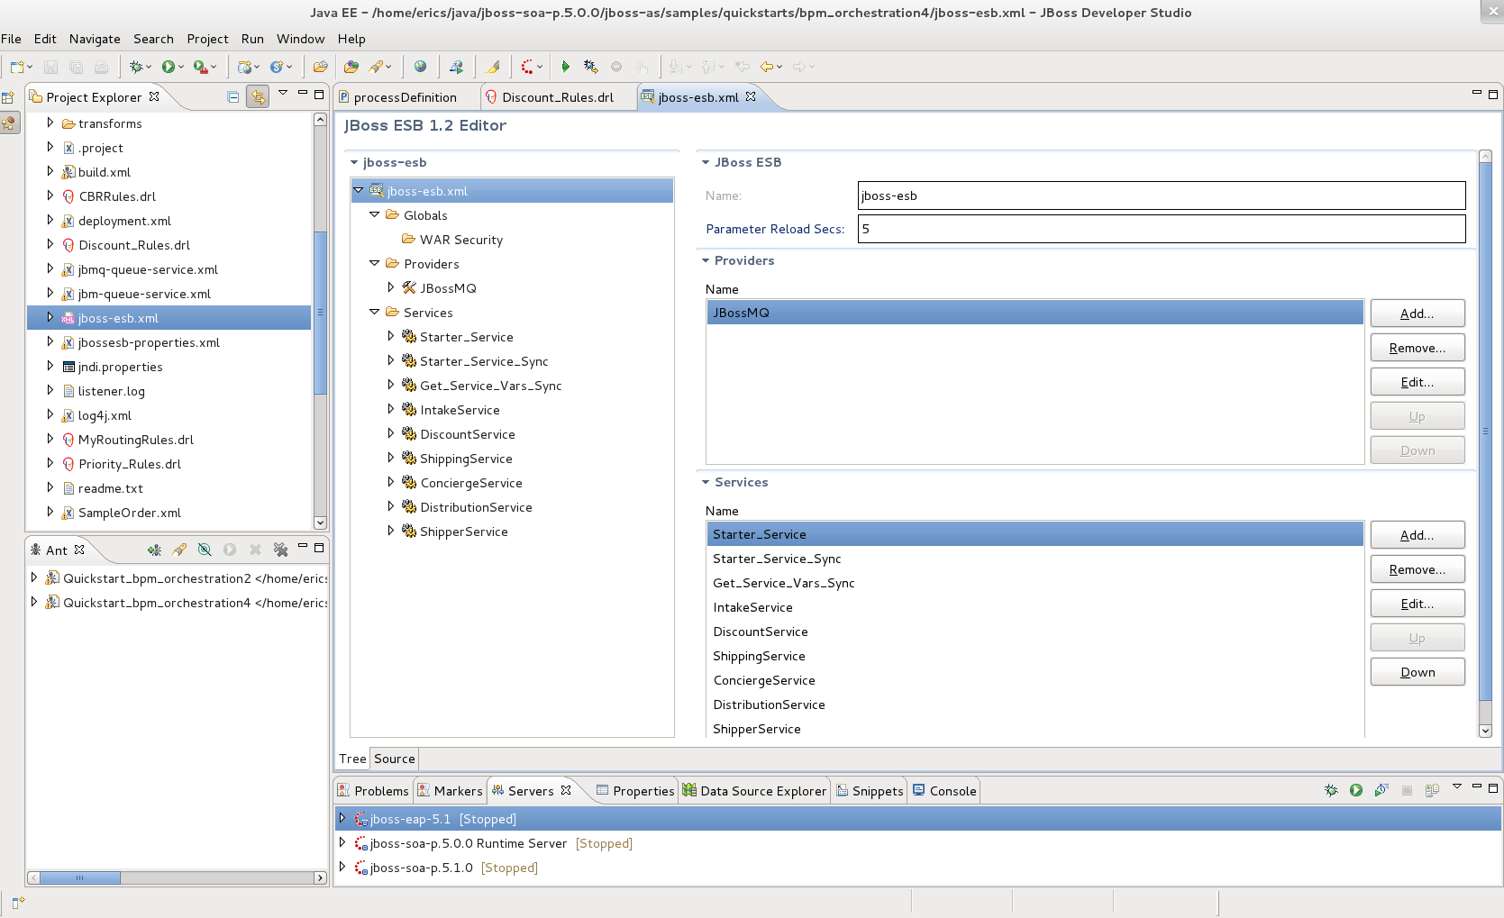
Screen shot of ESB Tooling

Slide 12
Demo ESB orchestration

Slide 13
Overview
Design Patterns and SOA
Logical Inventory Layer Patterns
  Utility service
    JBoss ESB tooling
  Entity serivce
    JBoss Teiid tooling
  Task service
    JBoss Savara tooling
    JBoss BPEL tooling
    JBoss jBPM tooling

Slide 14
Entity Abstraction - Definition*
Problem: Bundling both process-agnostic and process -specific business logic into the same service eventually results in the creation of redundant agnostic business logic across multiple services
Solution: An agnostic business service layer can be established, dedicated to services that base their functional context on existing business entities.
* = according to the SOA Design Pattern Book

Slide 15
Entity Abstraction - Definition by example
Example: Products are stored in a database with base prices, depending of customer discount and VAT the final product price must be calculated.
Problem: A service responsible for getting the prices for products in a quote returns products with the final prices. Another service which are used internally for financial reporting returns the products base price.
Solution: Using entity abstraction a service for returning products with base price are created and then a utility services can be used to calculate TAX etc.

Slide 16
Entity Abstraction - Examples
Business entity are typically good candidates for Entity services, like
  Product
  Employee
  Order
  Invoice
  etc

Slide 17
Entity Abstraction - Implementation
Simple cases Hibernate together with JAX-WS
Data virtualization products like JBoss Enterprise Data Services that can combine data from several sources and expose them as Web Services

Slide 18
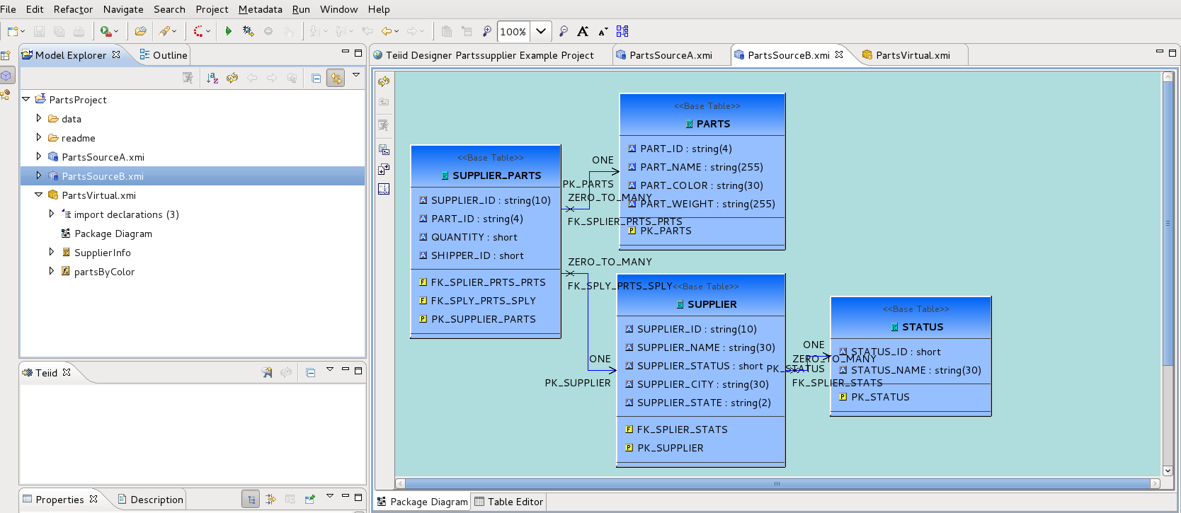
Screen shot of Teiid designer

Slide 19
Overview
Design Patterns and SOA
Logical Inventory Layer Patterns
  Utility service
    JBoss ESB tooling
  Entity serivce
    JBoss Teiid tooling
  Task service
    JBoss Savara tooling
    JBoss BPEL tooling
    JBoss jBPM tooling

Slide 20
Process Abstraction - Definition
Problem: Grouping task-centric logic together with task-agnostic logic hinders the governance of the task-specific logic and the reuse of the agnostic logic
Solution: A dedicated parent business process service layer is established to support governance independence and the positioning of task service as potential enterprise resources.

Slide 21
Process Abstraction – Definition by example
Example: A Policy Quote Service, which notifies sales about all outgoing quotes. (a task specific service)
Problem: If we don't divide entity and utility we won't achieve service reputability, but dividing them causes allot of complex dependency.
Solution: Using a orchestration solution to implement our task service we can visualize and monitor the interaction between services making it solution less complicated and loosely coupled.

Slide 22
Process Abstraction - Implementation
WS-CDL (using BPEL or BPMN)
jBPM

Slide 23
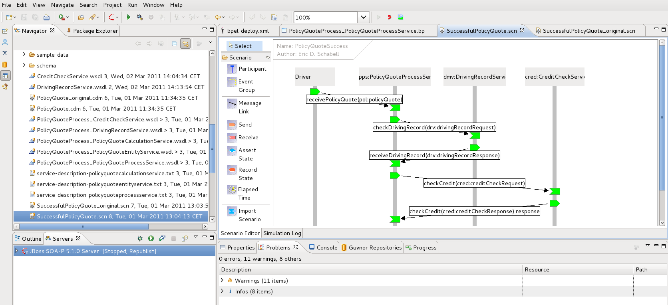
Screen shot or demo of SAVARA

Slide 24
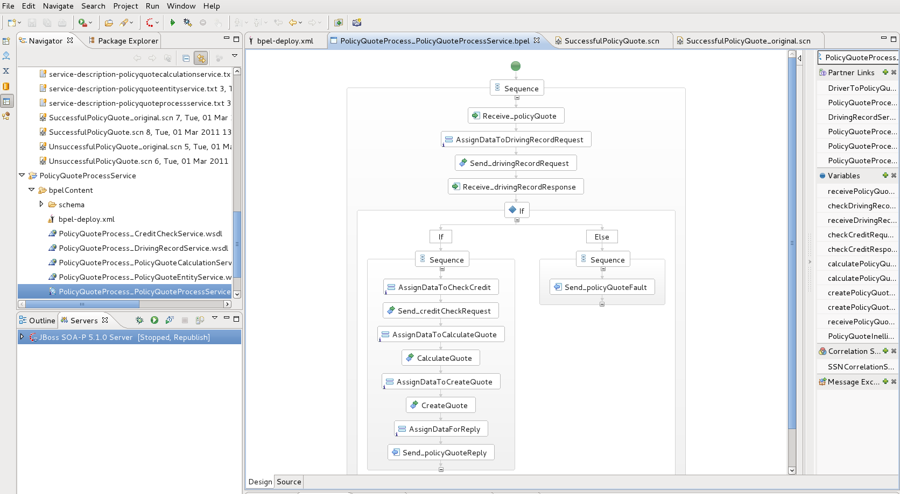
Screen shot of BPEL Designer

Slide 25
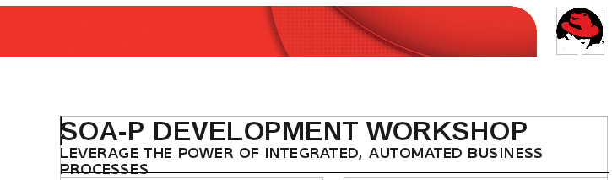
SOA-P Development Workshop (5d)
Ask for it at your local Red Hat Partner Manager!

Slide 26
Demo jBPM5

Slide 27
Review
Design Patterns and SOA
Logical Inventory Layer Patterns
  Utility service
    JBoss ESB tooling
  Entity serivce
    JBoss Teiid tooling
  Task service
    JBoss Savara tooling
    JBoss BPEL tooling
    JBoss jBPM tooling

Slide 28
Questions?

