Slide 1
jBPM5
Bringing More Power to your Business Processes
Eric D. Schabell
JBoss Solution Architect
07 June 2011

Slide 2
Overview
What is BPM?
Overview jBPM5
Flexible processes
Integration into architecture
Migrations

Slide 3
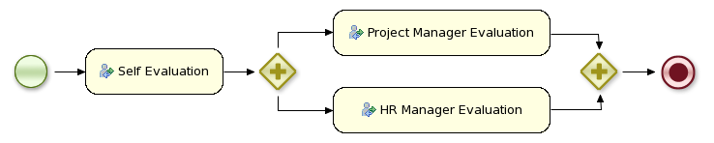
What is BPM?
Business Process Management
A business process is a process that describes
the order in which a series of steps need to be executed,
using a flow chart.

Slide 4
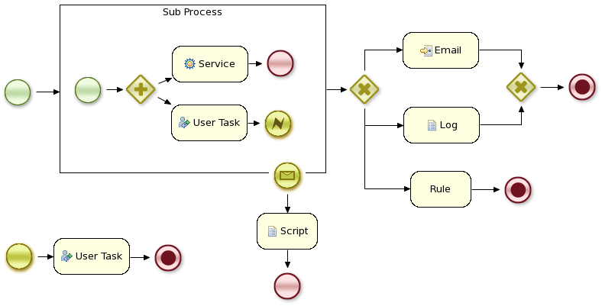
Why BPM?
Visibility
Monitoring
Higher-level
Continuous improvement
Speed of development
Increased agility

Slide 5
Overview
What is BPM?
Overview jBPM5
Flexible processes
Integration into architecture
Migrations
Roadmap

Slide 6

Key Characteristics of jBPM5
Open-source business process management project offering:
  generic process engine supporting native BPMN 2.0 execution
  targeting developers and business users
  collaboration, management and monitoring using web-based consoles
  powerful rules and event integration

Slide 7
From Workflow to BPM
Core engine is a workflow engine in pure Java
  state transitions
  lightweight
  embeddable
  generic, extensible
Core
Engine

Slide 8
Core Engine
Knowledge
Base
Stateful
Knowledge
Session
Process
Definition
Process
Instance

Slide 9
Java Example
// (1) Create knowledge base and add process definition
KnowledgeBuilder kbuilder = ...
kbuilder.add( ..., "sample.bpmn", ResourceType.BPMN2);
KnowledgeBase kbase = kbuilder.newKnowledgeBase();
// (2) Create new stateful knowledge session
StatefulKnowledgeSession ksession =
kbase.newStatefulKnowledgeSession();
// (3) Start a new process instance
ksession.startProcess(“com.sample.bpmn.hello”);

Slide 10
Java Interface
ProcessRuntime interface
startProcess(processId)
startProcess(processId, parameters)
signalEvent(type, event)
signalEvent(type, event, instanceId)
abortProcessInstance(instanceId)
getProcessInstance(instanceId)
…

Slide 11
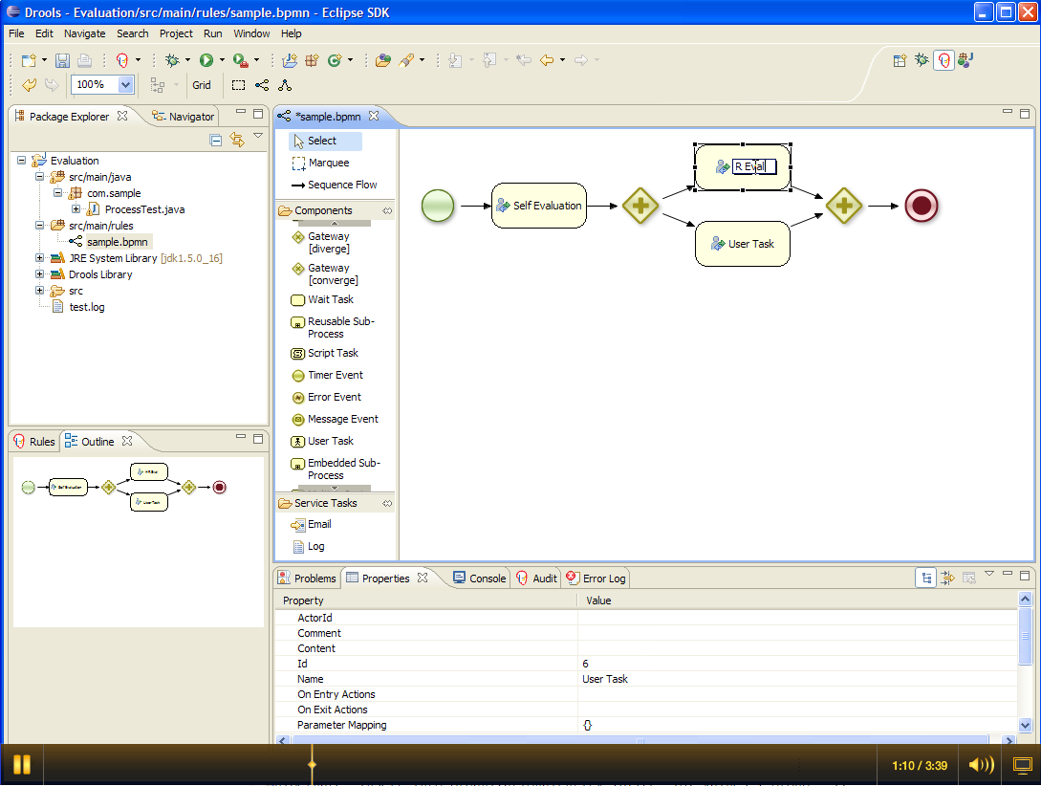
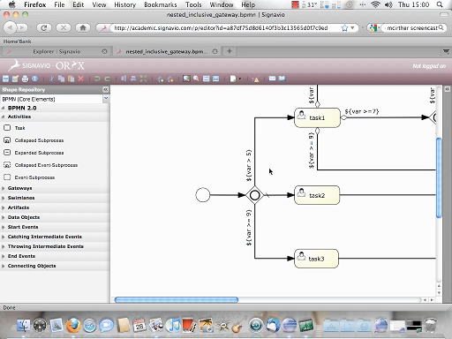
From Workflow to BPM
Eclipse
BPMN2
Editor
XML
Core
Engine
BPMN
2.0
Oryx Web-
Based Editor

Slide 12
BPMN 2.0
OMG specification
  Model
  Notation
  Execution semantics
Understandable by all business users
Process, collaboration, choreography
Extensible

Slide 13
jBPM5 and BPMN2
Focus on executable processes
  Java environment
  Native execution
Subset
  Common Executable ++
High-level and domain-specific
Minimal custom extensions

Slide 14

BPMN 2.0 Example
<definitions ... >
<process id="com.sample.bpmn.hello" name="Hello World" >
<startEvent id="_1" name="StartProcess" />
<sequenceFlow sourceRef="_1" targetRef="_2" />
<scriptTask id="_2" name="Hello" >
<script>System.out.println("Hello World");</script>
</scriptTask>
<sequenceFlow sourceRef="_2" targetRef="_3" />
<endEvent id="_3" name="EndProcess" />
</process>
</definitions>
<definitions ... >
<process id="com.sample.bpmn.hello" name="Hello World" >
<startEvent id="_1" name="StartProcess" />
<sequenceFlow sourceRef="_1" targetRef="_2" />
<scriptTask id="_2" name="Hello" >
<script>System.out.println("Hello World");</script>
</scriptTask>
<sequenceFlow sourceRef="_2" targetRef="_3" />
<endEvent id="_3" name="EndProcess" />
</process>
</definitions>

Slide 15
BPEL Vs BPMN
Red Hat does not intend to create 2 BPM solutions
BPMN2 is the strategic direction
BPEL requirements will be fulfilled with implementation.
Project Riftsaw – implementation of BPEL will be included in SOA-P 5.x
Future BPM solutions will be built on BPMN2 standards
JBoss BPM platform is our answer to all process flow / workflow solutions
Notes:
JBoss Enteprise BRMS (new in 2009)
Enables critical business rules to be managed in a more centralized manner (e.g. Insurance = policy risk assess and pricing; Heathcare = claims processing annual regulatory changes)
Avoids need to otherwise re-code business rules redundantly in multiple applications
Leverages JBoss Rules execution engine which has been available for years
Adds new browser-based Rules Mgmt app, enabling business users to participate in the review, editing, and maintenance of business rule changes
Also adds Repository to provide version management of multiple sets of business rules
Supports the deployment of business rules to JBoss middleware platforms and non-JBoss runtime environments

Slide 16
BPMN2 positioning
BPMN2
Model
Savara
BRMS
jBPM
Rules
Process
Choreography
Event
Collaboration
WS-BPEL
Services
RiftSaw
SOA

Slide 17
From Workflow to BPM
JPA
Persistence
XML
JTA
Core
Engine
Trans-
actions
BPMN
2.0

Slide 18
Persistence and Transactions
Persistence (JPA, pluggable)
  Runtime persistence
  History logging
  Services
Transactions (JTA, pluggable)
  Command-scoped
  User-defined

Slide 19
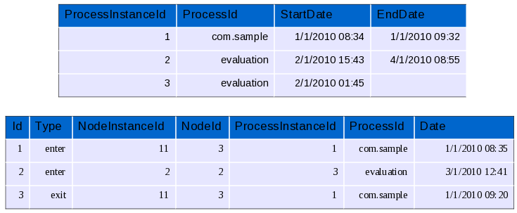
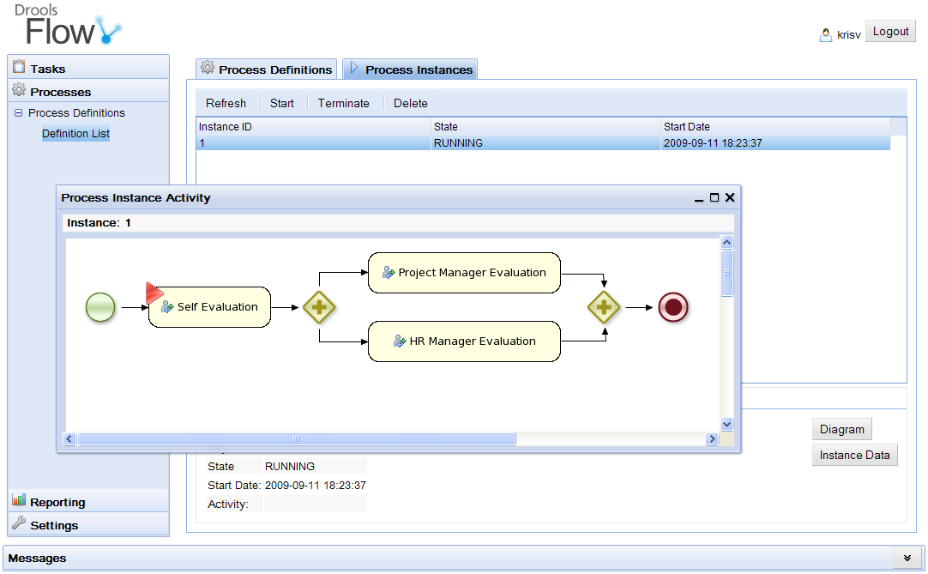
From Workflow to BPM
Persistence
XML
Core
Engine
Trans-
actions
History
Log
BPMN
2.0
Events
Management
Console
BAM

Slide 20
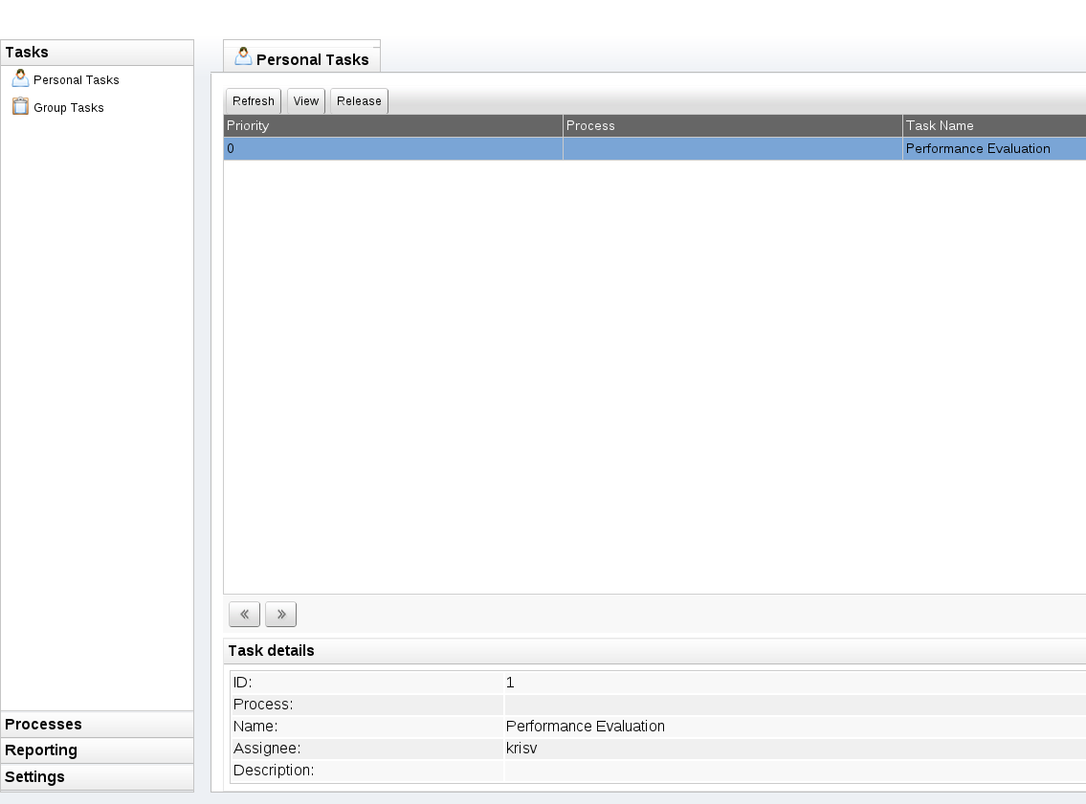
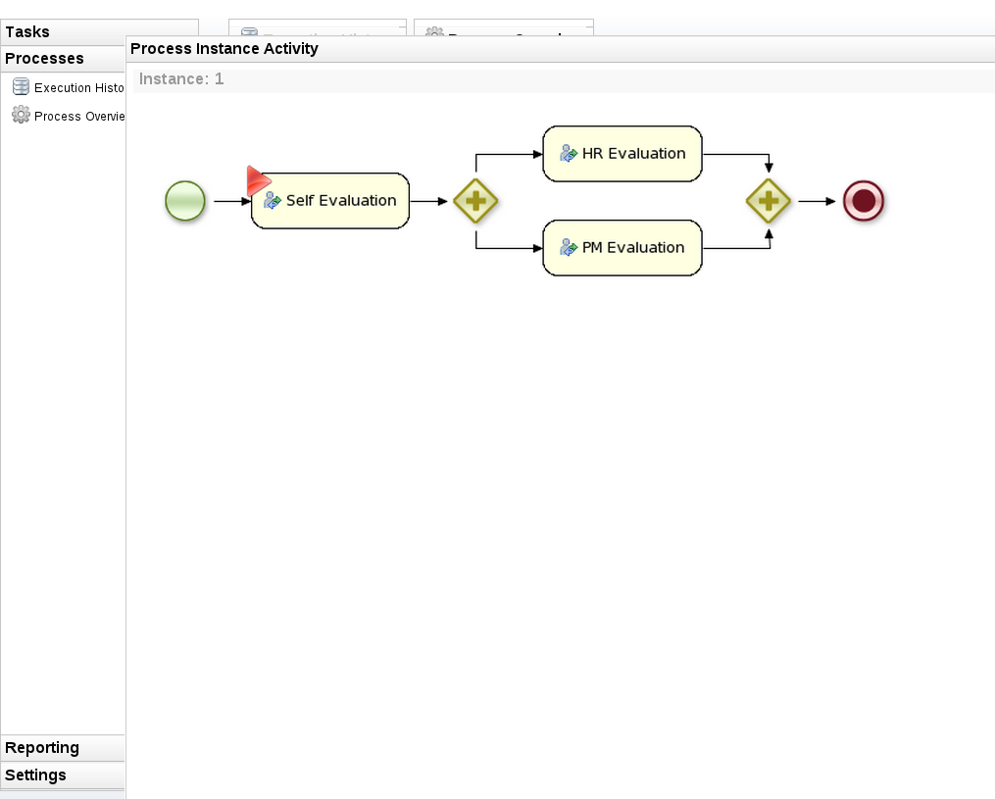
Console
Web-based management
Business user
Features
  Process instance management
  User task lists / forms
  Reporting

Slide 21
From Workflow to BPM
Persistence
XML
Core
Engine
Trans-
actions
BPMN
2.0
Events
Domain-specific
Processes
Integration
Human Task
Service
ESB

Slide 22
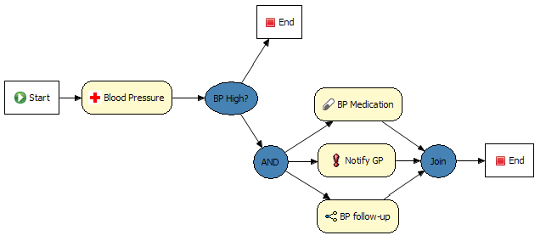
Domain-specific Processes
Extend palette with domain-specific, declarative service nodes
  define input / output parameters
  runtime binding

Slide 23
Example: Notification
[
[
"name" : "Notification",
"parameters" : [
"Message" : new StringDataType(),
"From" : new StringDataType(),
"To" : new StringDataType(),
"Priority" : new StringDataType(),
],
"displayName" : "Notification",
"icon" : "icons/notification.gif"
]
]

Slide 24
Example: Notification
class NotificationHandler implements WorkItemHandler {
public void executeWorkItem(WorkItem wI,
WorkItemManager manager) {
String from = (String) wI.getParameter("From");
String to = (String) wI.getParameter("To");
String m = (String) wI.getParameter("Message");
// send email
EmailService service = ...;
service.sendEmail(from, to, "Notification", m);
manager.completeWorkItem(wI.getId(), null);
}
}

Slide 25
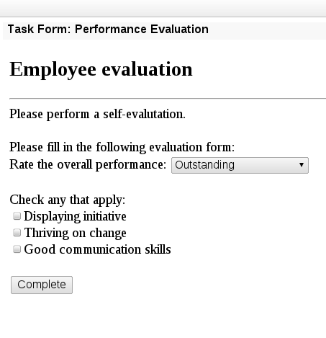
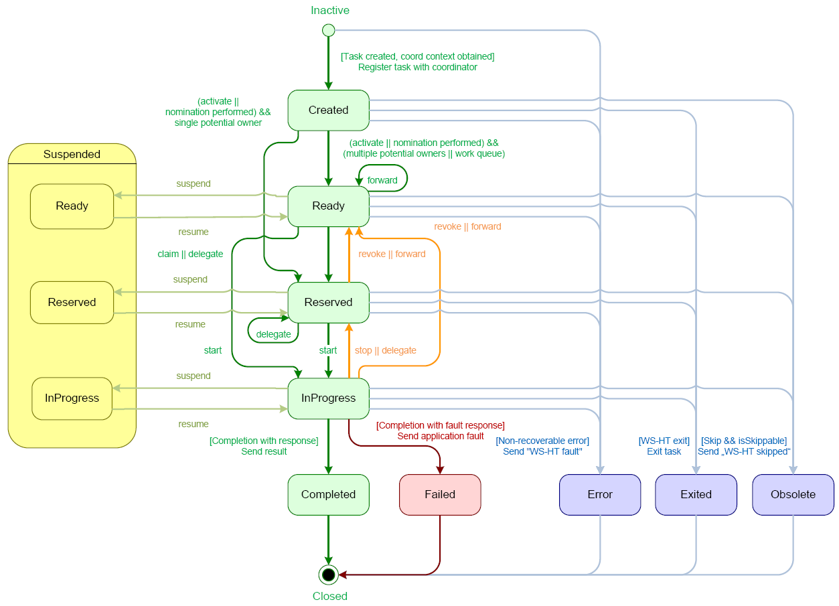
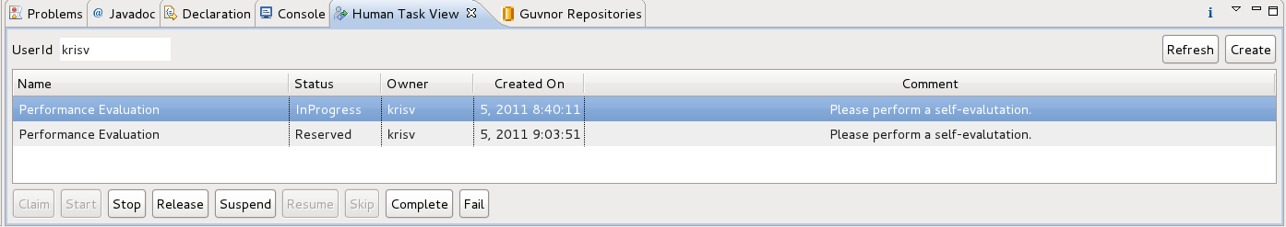
Human task service
User task
Human task service (WS-HT)
  Task lists
  Task life cycle
Task clients
  Task forms

Slide 26
Overview
What is BPM?
Overview jBPM5
Flexible processes
Integration into architecture
Migrations

Slide 27
What is flexibility?
“The quality of being adaptable or variable”

Slide 28
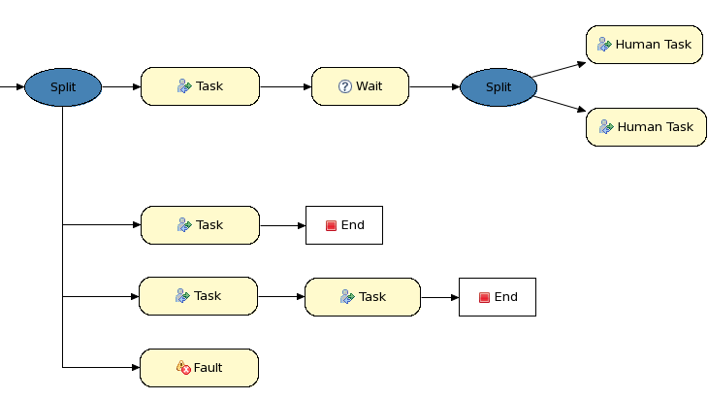
Exceptional Control Flow
90%
5%
3%
2%

Slide 29
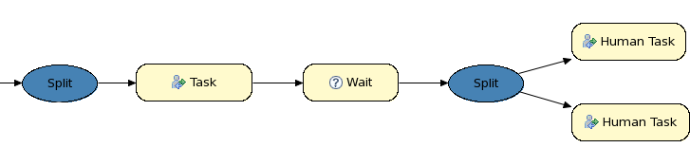
Exceptional Control Flow
90%
Rule1
When
...
Then
...
Rule2
When
...
Then
...
Rule3
When
...
Then
...
5%
3%
2%

Slide 30
Processes + Rules + Events

Slide 31
Combining processes and rules
Integration
  From loose coupling (decision services)
  To advanced integration (process rules)
Unification
  Rules and processes are different types of business knowledge assets
  Tooling (IDE, repository, management)

Slide 32
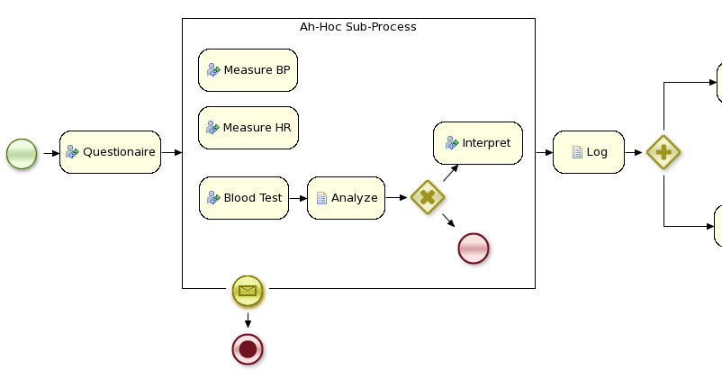
Example: Clinical DSS

Slide 33
Overview
What is BPM?
Overview jBPM5
Flexible processes
Integration into architecture
Migrations

Slide 34
Architecture
From “embedded” to “as a service”
Command-based
Different underlying technologies
  Java component (embedded, JNDI)
  REST service
  Web service
  EJB
# of (independent) session

Slide 35
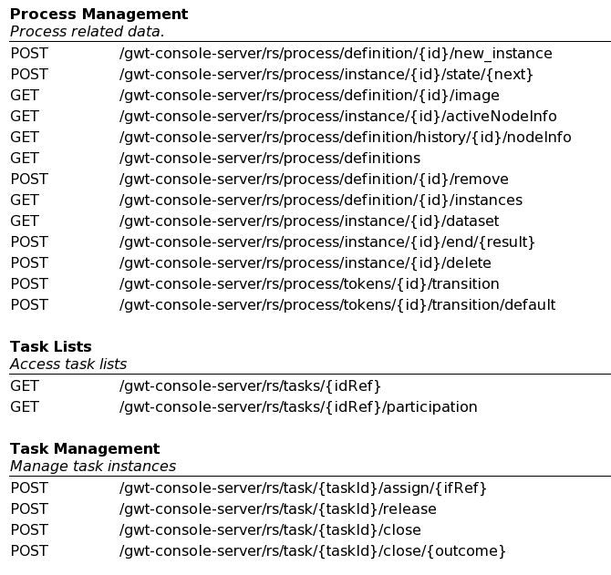
REST API

Slide 36
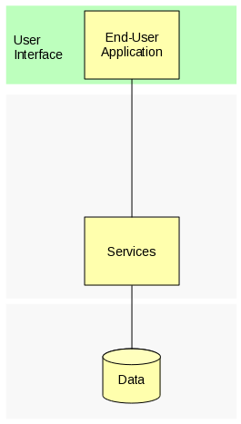
Integration

Slide 37
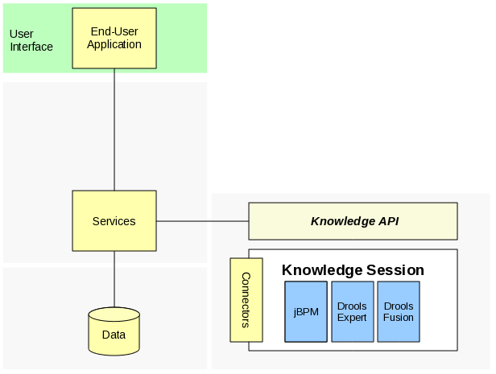
Integration
jBPM / BRMS

Slide 38
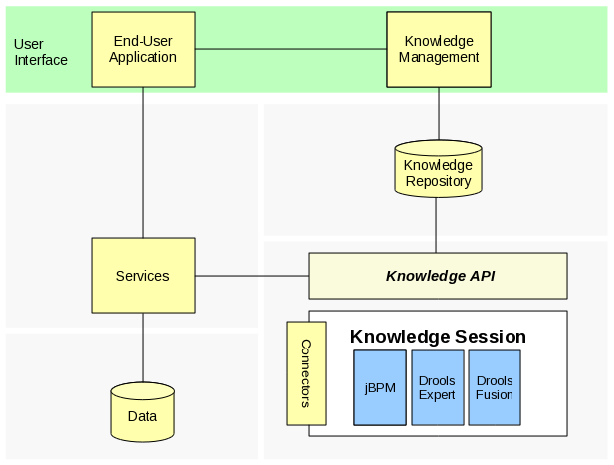
Integration
jBPM / BRMS

Slide 39
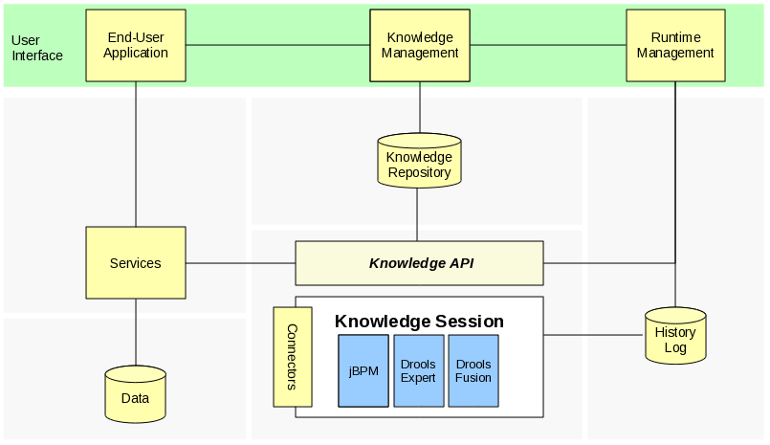
Integration
jBPM / BRMS

Slide 40
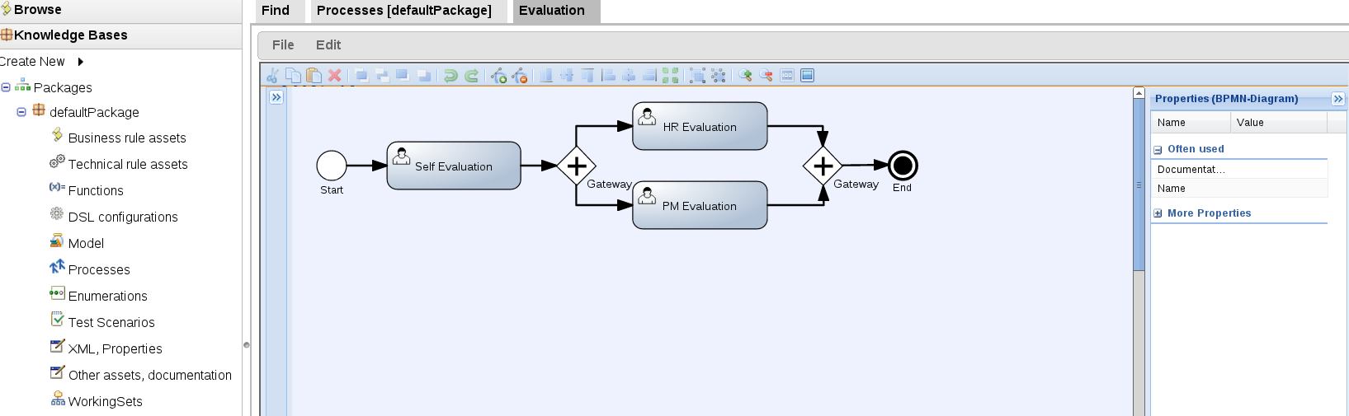
Web based artifact management
BRM as knowledge repository
  BPMN2 processes
  Task and process forms
  Model
Web-based process editor (Oryx)
Build, deploy, test, manage and collaboration features

Slide 41
Overview
What is BPM?
Overview jBPM5
Flexible processes
Integration into architecture
Migrations

Slide 42
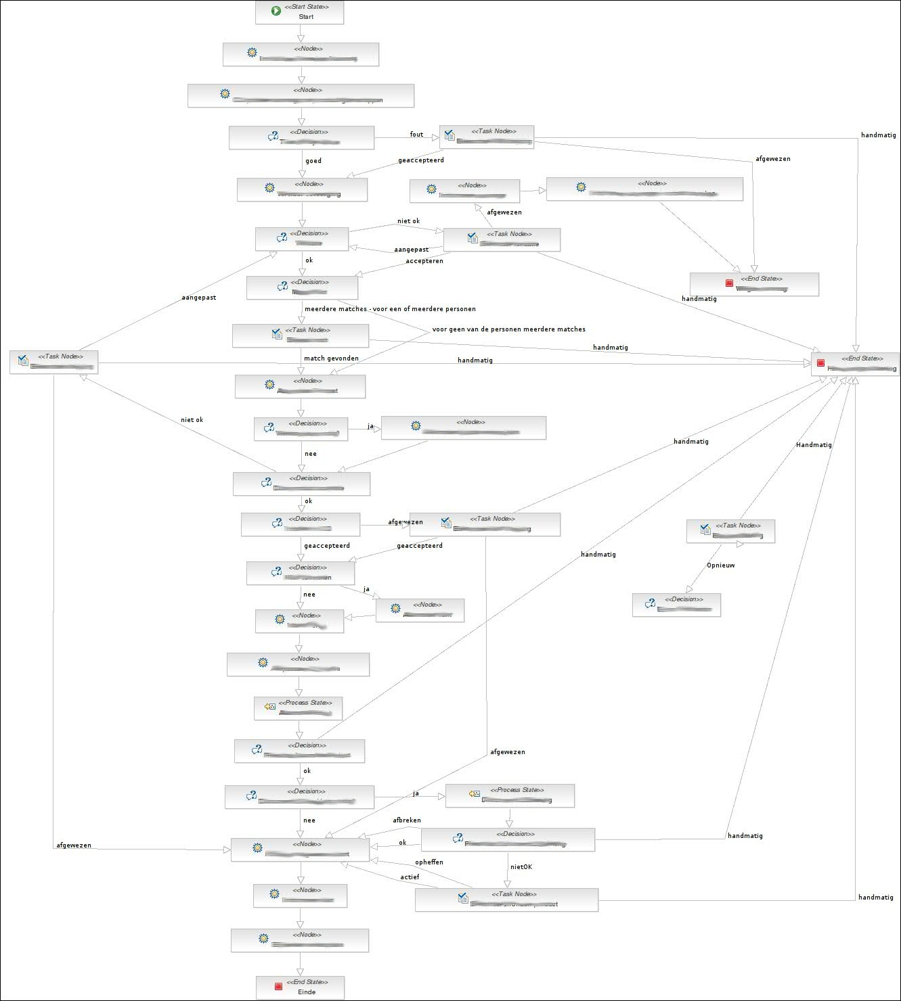

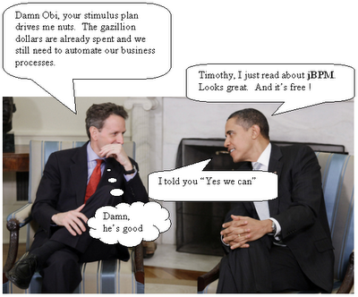
We have been architecting, implementing and deploying jBPM solutions in the strangest places for years now...

Slide 43
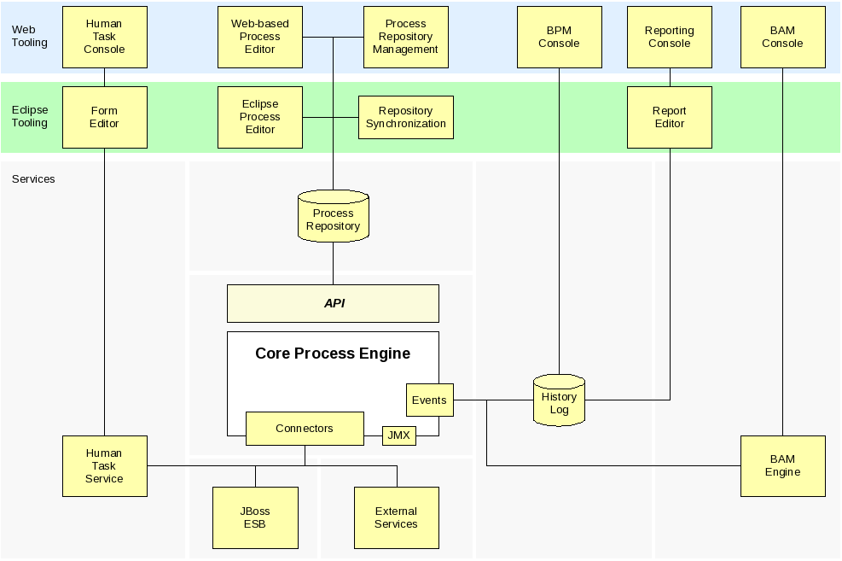

What about us...
jPDL != BPMN

Slide 44

What are we up to?
Tooling targets
  jPDL 3.2.x to BPMN 2 (CLI)
  community welcome for jBPM 4.x
  working with use cases
    send us projects
    raise issues
  jBPM 3.x API mapping

Slide 45
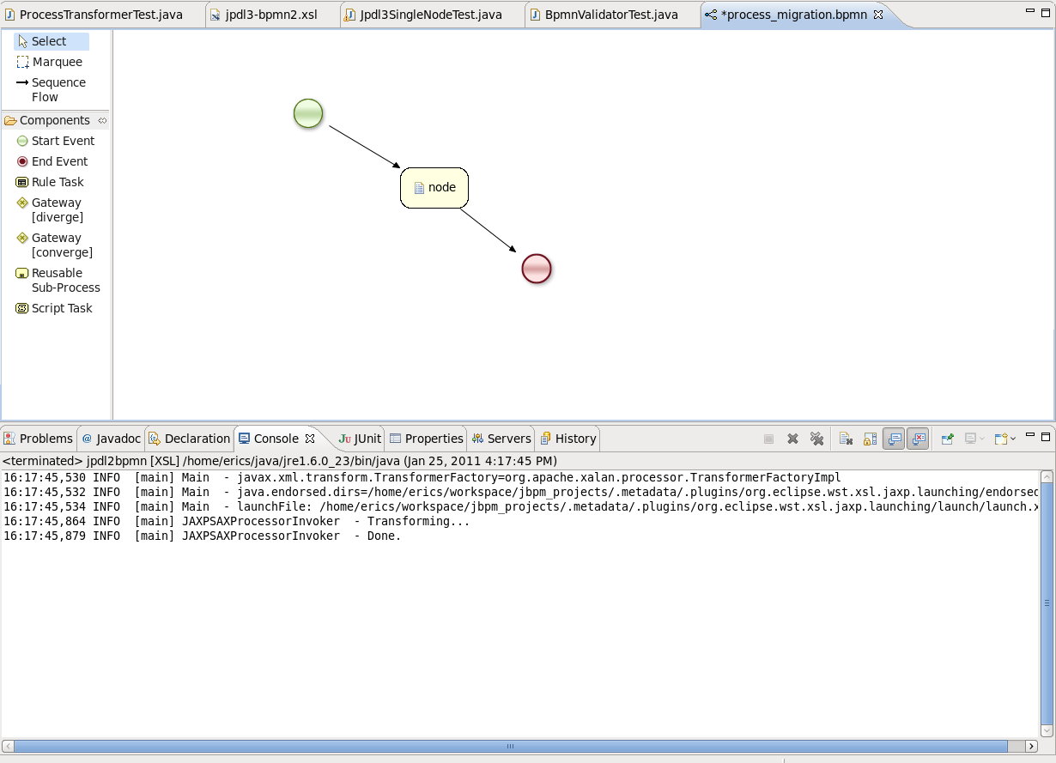
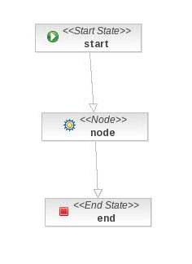
Historical migration...

Slide 46

References
jBPM5 community: http://www.jboss.org/jbpm
jBPM5 source: http://github.com/droolsjbpm/jbpm
jBPM5 Hudson: http://hudson.jboss.org/hudson/job/jBPM
Blog: http://kverlaen.blogspot.com
#jbpm on irc.codhaus.org / jbpm-dev@jboss.org
jBPM user forums: http://community.jboss.org/en/jbpm?view=discussions
jBPM migration strategies: http://www.schabell.org/2010/03/jbpm-migration-strategies-introduction.html
Migration tool project: https://github.com/eschabell/jbpmmigration/wiki
Migration story JUDCon 2010: http://www.schabell.org/2010/10/judcon-2010-berlin-get-your-bpm-ducks.html
Migration project update JUDCon 2011: http://www.schabell.org/2011/05/judcon-2011-jbpm-migration-tooling-no.html

Slide 47
Questions?

