Slide 2
Pioneering a path to the future
with JBoss Business Process Management
Michel de Blok
Senior Software Engineer, SNS Bank
Eric D. Schabell
JBoss Solution Architect, Red Hat
May 5, 2011

Slide 3

Road Map
About SNS Bank
Mission and Strategy
BPM Architecture
BPM Impact
Lessons learned
Conclusions

Slide 4

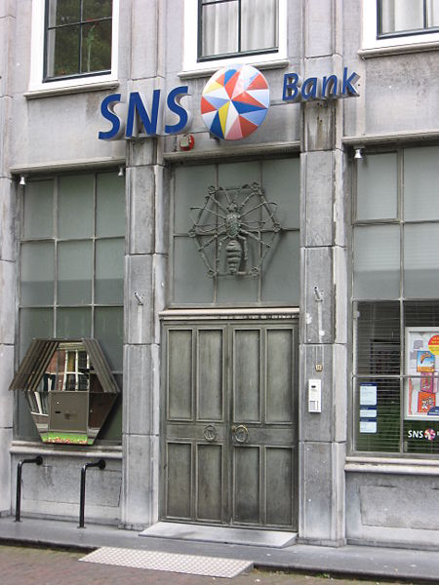
About
One of the top 4 Dutch financial institutions
Almost 200 years old
Focus on retail banking:
  Mortgages
  Savings
  Investments
Our motto:
There's always another way!

Slide 5

The Mission
Provide innovative new products and services
High quality with minimal costs
More power to the customer!
But how do we get there?

Slide 6


A New Strategy
The customer takes the steering wheel
DIY: Do It Yourself!
Become the “best self-
service bank” in The
Netherlands
=> We need “Straight-Through-Processing” (STP)

Slide 7

The Solution
This calls for a whole new architecture
Enabling legacy systems to participate at any time
Automating and managing our Business Processes
Ouch!! this sounds very expensive..

Slide 8

OSS to the rescue!
We found the treasure to be in Open Source Software
E.g. migrating our AIX servers with IBM WebSphere AS
to Suse Linux servers with JBoss AS in 2005
Reduced costs by 90%
  (saving millions of $)
=> New policy: OSS, unless..

Slide 9






The BPM Architecture
Rule Engine
Process
Engine
Web
Services
SAS
EAS
CIS
BOM
DOC1
...

Slide 10
The BPM Architecture (2)
Java based
Running on JBoss EAP 4.3
(All except the legacy systems)
Providing a canonical data model (our BOM)
Used as a common language for services and business processes (e.g. Customer, Contract, Lead/Deal, …)
Invoked by various distribution channels

Slide 11


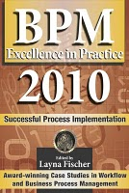
Survival in the Financial Crisis (I)
Our BPM architecture in action
  Time line of events:
    Aug 2008 – first BPM savings products online
    Mar 2008 – first draft to BPM 2008
    Sep 2008 – crisis hits... recorded impact BPM
    Oct 2008 – presented JFall 2008 (NLJUG)
    Nov 2008 – chapter CaiSE / PRET 2009
    Dec 2008 – chapter to BPM & Worlflow Handbook 2009
    Apr 2009 – published BPM & Workflow Handbook 2009
    Jun 2009 – published CaiSE / PRET 2009
    Aug 2009 – letter to President Obama
    Nov 2009 – Silver award BPM Excellence in Europe
    Sep 2010 – final publishing BPM Excellence in Practice 2010

Slide 12







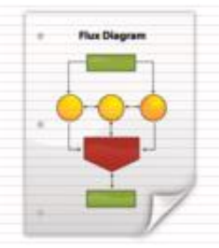



Survival in the Financial Crisis (II)
Services
SAS
CIS
In2Flow
DOC1
...
GX
Scheduler
Process
DB
DWH
MySNS

Slide 13
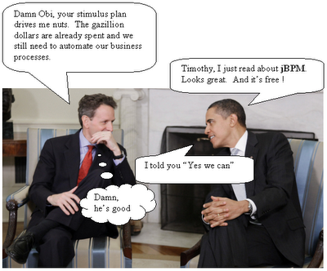
Survival in the Financial Crisis (III)
Empirical data
  Feb – Aug 2008 : ~1200 per month
  Sep – Feb 2009 : ~3300 per month
Overview effectiveness
    52% completed on time
    12% document monitoring
    8% rejected for various reasons
    0.7% Human action (functional)
    0.3% Human action (technical)
    23% removed, completed by hand
Best practices / Pitfalls BPM

Slide 14

Road Map
About SNS Bank
Mission and Strategy
BPM Architecture
BPM Impact
Lessons learned
Conclusions

Slide 15

BPM impact on IT systems
Availability: 24 /7
new SLA's, no/less maintenance windows & batch jobs
Integrity: what data is “leading” ?
integration and normalization of both systems and data
Security: more open means less secure?
“new” signing/encryption technologies, WS-Security
=> More agile and flexible: shorter time-to-market

Slide 16
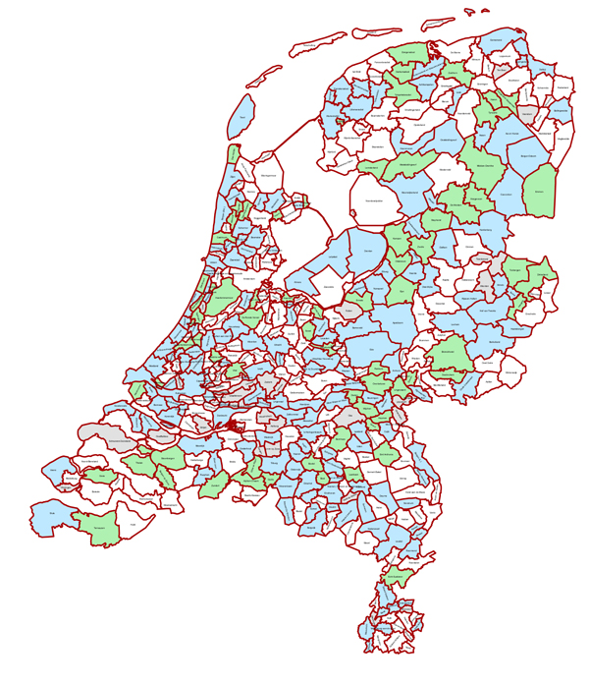
BPM impact on employees
Don't underestimate:
full scale BPM can cause a
major change for personnel!
From Branch Offices to Service Centers

Slide 17
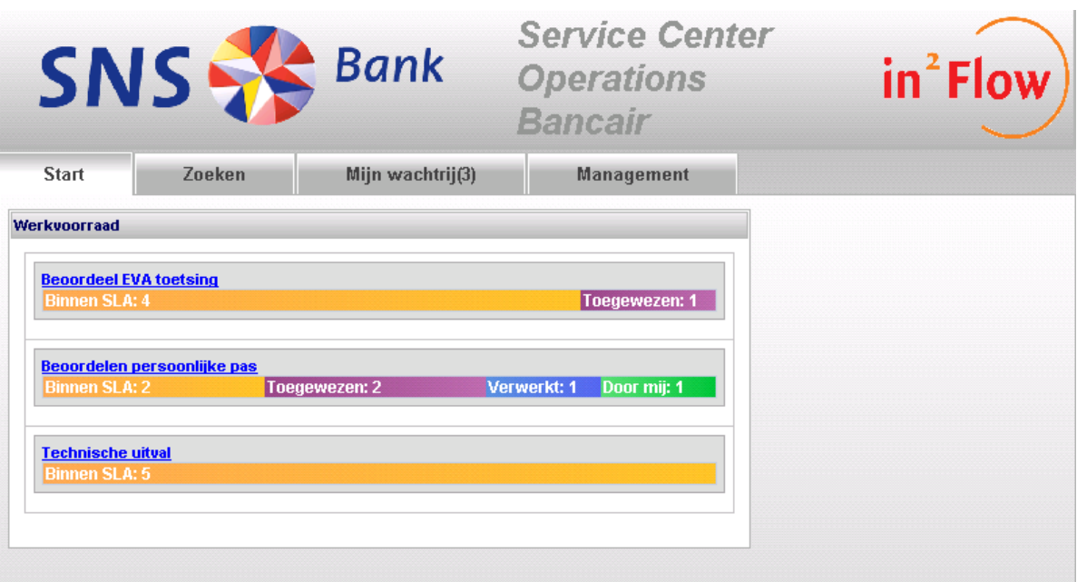

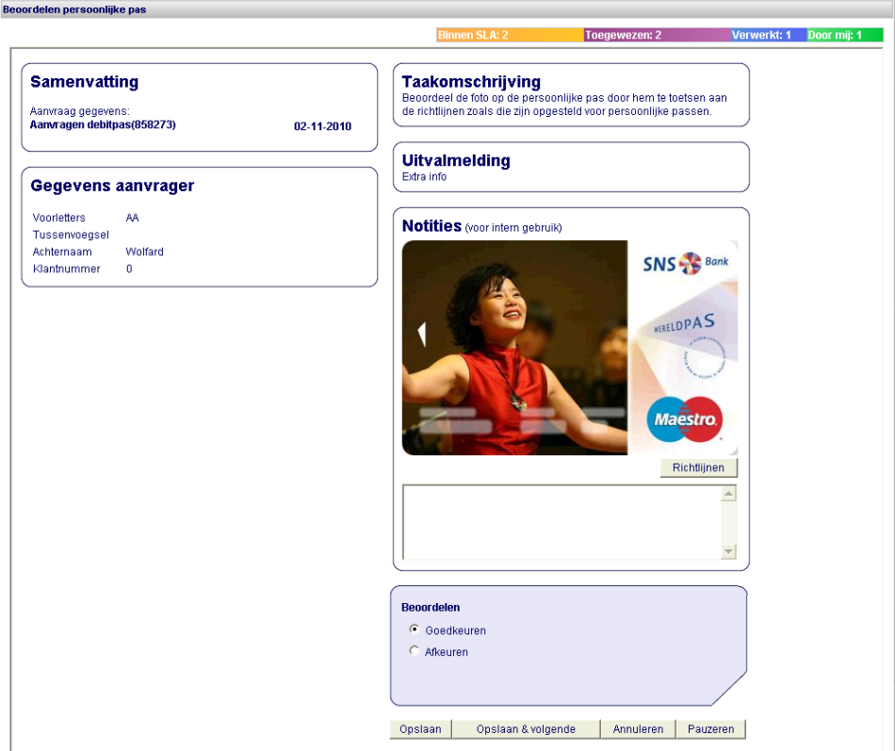
The BPM console (In2Flow)
JBoss Seam

Slide 18

BPM impact on employees (2)
Moving to centralized service centers means:
  Hard to reach customers without Internet
  No “human contact” with our customers
  Less visibility, warmth,
  trust and reassurance
=> Risk of losing customers

Slide 19
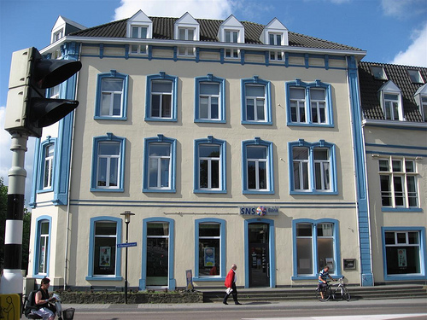
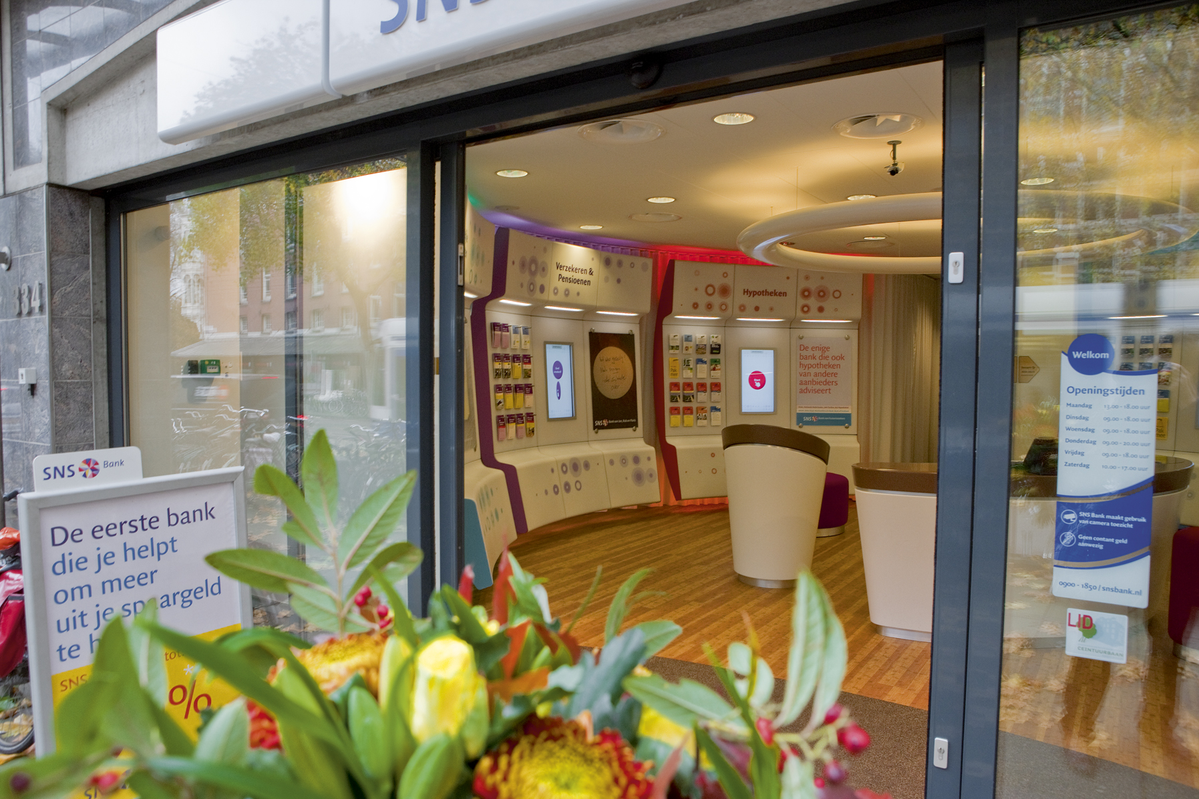
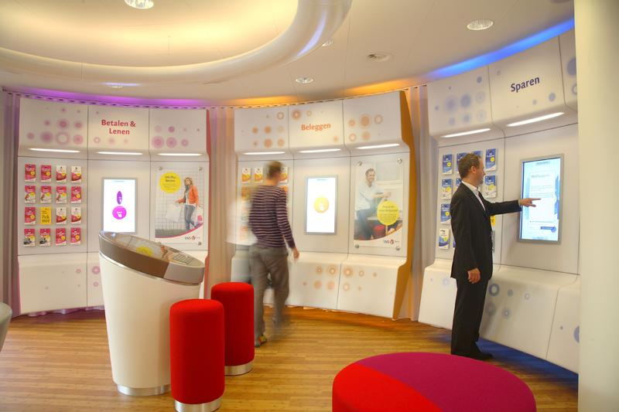
From Branch Offices to “Shops”
Still focused on DIY

Slide 20
The new “SNS Shop”
Open during shopping hours (also on Saturday)
Cashless (no deposits, ATM is outside)
Product information through touchscreen interfaces
Assisted “self-service” by shop employees
Appointment scheduling for sales advisor
1/3 owned by SNS Bank, 2/3 run as Franchises
=> It fills the gaps created by the new BPM solution

Slide 21

Impact on customers
More freedom in banking
Quicker service request processing
Better insight in request status
Cheaper products & service
Downsides:
  Some services are no longer possible (or profitable)
  Some customers prefer to be served

Slide 22

Road Map
About SNS Bank
Mission and Strategy
BPM Architecture
BPM Impact
Lessons learned
Conclusions

Slide 23
Lessons Learned – BPM Console
One of the key features of a successful BPM solution!
A not fully automated business process with good BPM console support is cheaper to implement and in the end more valuable to the Business
Not all tasks can be automated and expect failure
A productive Service Center is worth its weight in gold

Slide 24
Lessons Learned – Process Status / BAM
BPM needs to be transparent: What's going on?
A centralized process status is essential to provide the correct information to both customers and employees
Not everything has to be STP, as long as it's visible
Implement BAM (Business Activity Monitoring) to continuously improve your processes

Slide 25
Lessons Learned – Business / IT mismatch
A business process definition ≠ jBPM process flow
Mind-shift from “systems” to “services”
Try to close the gap between Business & IT
Appoint Business Process Architects and involve them!
BPMN-2 looks promising (jBPM v5)

Slide 26
Lessons Learned – Maintainability
Expect your BPM solution to be a success!
Modularize every aspect of your BPM architecture
Avoid “exploding” data models or monolithic systems
Use shared modules (framework, sub-processes)
Minimize dependencies between modules

Slide 27
Lessons Learned – Process Updates
How to update long-running processes (e.g. 6 months)
Ideally, a business process is fully idempotent
Unfortunately, a lot of legacy systems are not
Process logic that's subject to change should be extracted from the process and moved into services (static) or a rules engine (dynamic)
Use versioning and respect backwards compatibility

Slide 28
Road Map
About SNS Bank
Mission and Strategy
BPM Architecture
BPM Impact
Lessons learned
Conclusions

Slide 29

Conclusions
Open Source Software today is a very rewarding and mature alternative to expensively licensed solutions.
Especially with commercial OSS support - such as Redhat offers for the JBoss platform - there are no drawbacks
Full scale BPM is much more than “just another IT trick”. To be successful you must be prepared to fully involve and change your Business

Slide 30

Results
Expectations for the end of 2012
  20% increase in main bank customers
  Three times more online sales
  40% decrease in branch operating costs
  Doubling of complex product sales (mobile sales advisors)
Forrester Case Study
How SNS Bank Put The Web At The Heart Of Its New Multichannel Strategy
http://www.forrester.com/rb/Research/case_study_how_sns_bank_put_web/q/id/57867/t/2

Slide 31

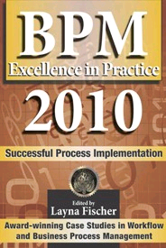
References
Our implementations of jBPM and JBoss EAP:
http://customers.redhat.com/2009/07/31/sns-bank-success-story-jboss-jbpm/
http://customers.redhat.com/2007/11/05/sns-bank-migrates-to-jboss-enterprise-platform/
http://www.schabell.org/2010/11/jfall-2010-rocking-jbpm-tasks-with.html
2009 Silver award for Global Excellence in BPM & Workflow
http://www.schabell.org/2009/04/2009-bpm-workflow-handbook-financial.html
http://www.schabell.org/2009/11/2009-silver-winner-for-europe-financial.html
http://www.schabell.org/2010/09/financial-crisis-front-lines-sns-bank.html

Slide 32
Q & A

Slide 33


