Slide 2
Pioneering a path to the future
with JBoss Business Process Management
Michel de Blok
Senior Software Engineer, SNS Bank
Eric D. Schabell
JBoss Solution Architect, Red Hat
May 5 2011

Slide 3

Road Map
About SNS Bank
Vision and Strategy
BPM Architecture
BPM Impact
Lessons learned
Conclusions

Slide 4
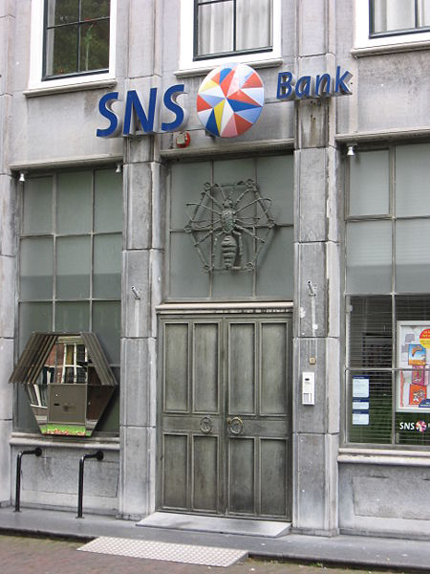
About
One of the top 4 Dutch financial institutions
Established in 1817
Focus on retail banking:
  Mortgages, Savings & Investments
Our values:
  Personal, Accessible & Innovative

Slide 5
SNS Bank's Vision back in 2006
Increased competition lead to narrower interest margins
An office based organisation is a costly distribution channel
Internet becomes increasingly important in the orientation and sales cycle
Online banking is the future
At the same time, the need for quality, independent advice is increasing
The value is in the relationship with the client, not in the relationship with the product

Slide 6


A New Strategy
The customer behind the steering wheel:
  A fully-fledged online bank
  with sales and services
  Simple processes based
  on self-service
  5-clicks, paperless and
  in realtime
=> We need “Straight-Through-Processing” (STP)

Slide 7

The Solution
This calls for a whole new architecture
Enabling legacy systems to participate at any time
Automating and managing our Business Processes
Ouch!! this sounds very expensive..

Slide 8

OSS to the rescue!
We found the treasure to be in Open Source Software
E.g. migrating our AIX servers with IBM WebSphere AS
to Suse Linux servers with JBoss AS in 2005
Reduced costs by 90%
  (saving millions of $)
=> New policy: OSS, unless..

Slide 9






The BPM Architecture
Rule Engine
Process
Engine
Web
Services
SAS
EAS
CIS
BOM
DOC1
...

Slide 10
The BPM Architecture (2)
Java based
Running on JBoss EAP 4.3
(All except the legacy systems)
Providing a canonical data model (our BOM)
Used as a common language for services and business processes (e.g. Customer, Contract, Lead/Deal, …)
Invoked by various distribution channels

Slide 11


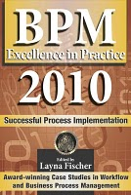
Survival in the Financial Crisis (I)
Our BPM architecture in action
  Time line of events:
    Aug 2008 – first BPM savings products online
    Mar 2008 – first draft to BPM 2008
    Sep 2008 – crisis hits... recorded impact BPM
    Oct 2008 – presented JFall 2008 (NLJUG)
    Nov 2008 – chapter CaiSE / PRET 2009
    Dec 2008 – chapter to BPM & Worlflow Handbook 2009
    Apr 2009 – published BPM & Workflow Handbook 2009
    Jun 2009 – published CaiSE / PRET 2009
    Aug 2009 – letter to President Obama
    Nov 2009 – Silver award BPM Excellence in Europe
    Sep 2010 – final publishing BPM Excellence in Practice 2010

Slide 12







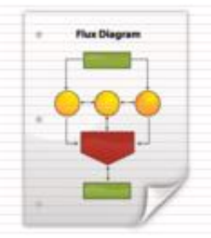



Survival in the Financial Crisis (II)
Services
SAS
CIS
In2Flow
DOC1
...
GX
Scheduler
Process
DB
DWH
MySNS

Slide 13
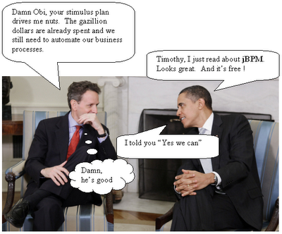
Survival in the Financial Crisis (III)
Empirical data
  Feb – Aug 2008 : ~1200 per month
  Sep – Feb 2009 : ~3300 per month
Overview effectiveness
    52% completed on time
    12% document monitoring
    8% rejected for various reasons
    0.7% Human action (functional)
    0.3% Human action (technical)
    23% removed, completed by hand
Best practices / Pitfalls BPM

Slide 14

Road Map
About SNS Bank
Vision and Strategy
BPM Architecture
BPM Impact
Lessons learned
Conclusions

Slide 15

BPM impact on IT systems
Availability: 24 /7
new SLA's, no/less maintenance windows & batch jobs
Integrity: what data is “leading” ?
integration and normalization of both systems and data
Security: more open means less secure?
“new” signing/encryption technologies, WS-Security
=> More agile and flexible: shorter time-to-market

Slide 16
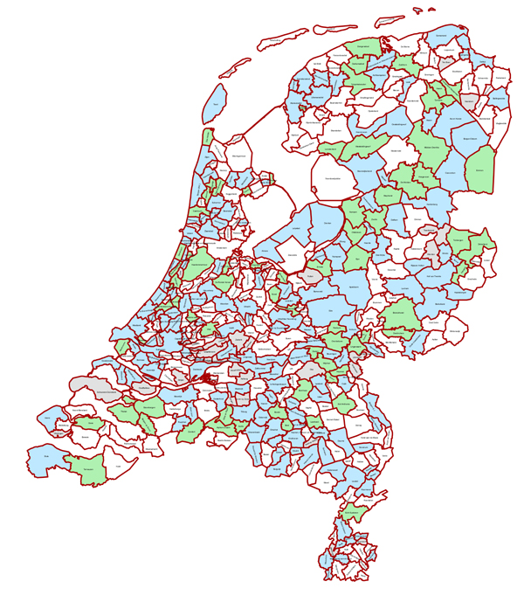
BPM impact on employees
Don't underestimate:
full scale BPM can cause a
major change for personnel!
From Branch Offices to Service Centers

Slide 17
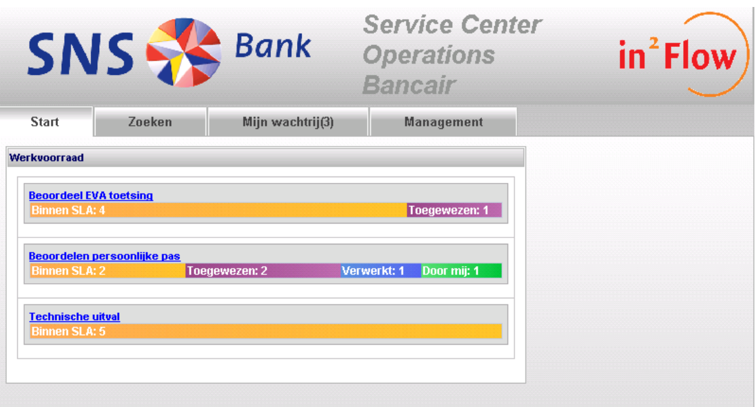

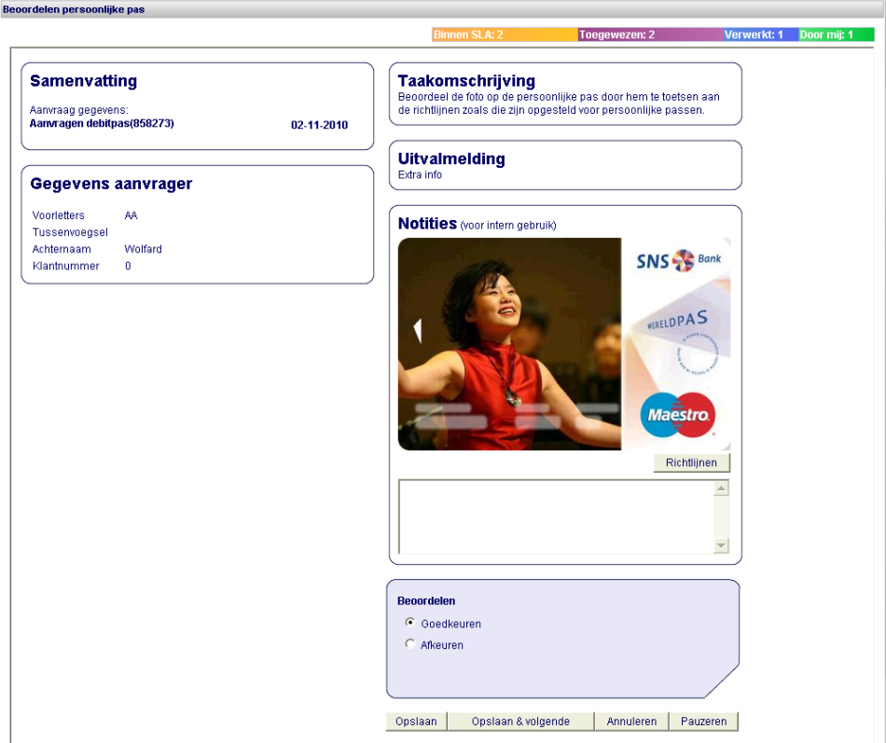
The BPM console (In2Flow)
JBoss Seam

Slide 18

BPM impact on employees (2)
Moving to centralized service centers means:
  Hard to reach customers without Internet
  No “human contact” with our customers
  Less visibility, warmth,
  trust and reassurance
=> Risk of losing customers

Slide 19
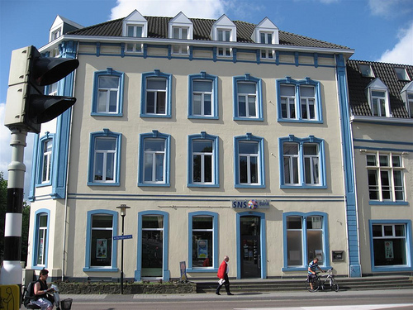
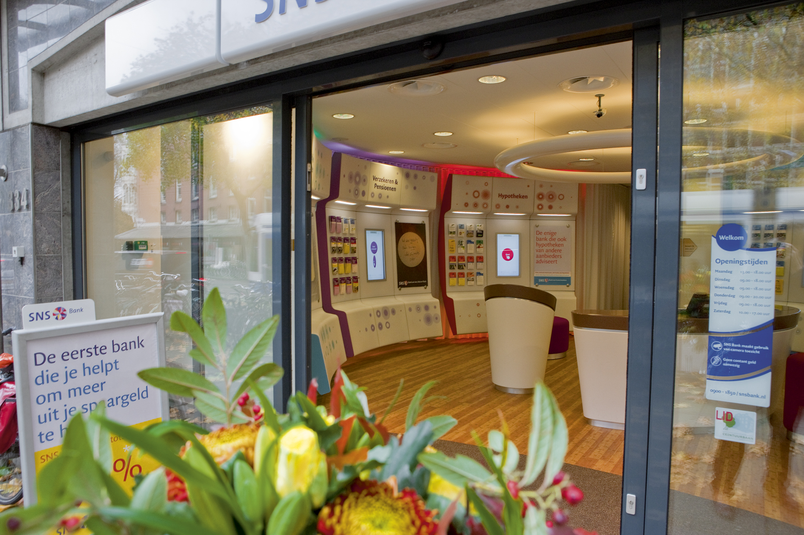
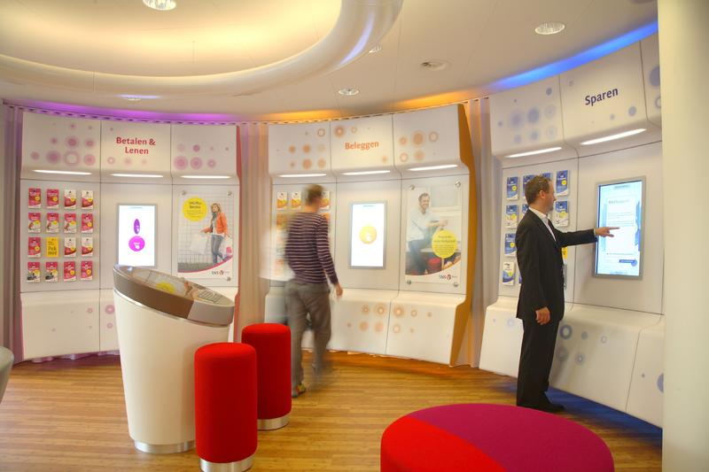
From traditional Branches to “Shops”

Slide 20
The new distribution model

Slide 21
The new “SNS Shop”
From < 150 traditional branches to > 250 SNS Shops
Cashless (no deposits, no ATMs)
DIY banking and assisted banking
Longer opening hours, opposed to traditional banking hours
Franchise model for 2/3 of SNS Shops
=> It fills the gaps created by the new BPM solution

Slide 22

Impact on customers
More freedom in banking
Quicker service request processing
Better insight in request status
Cheaper products & service
Downsides:
  Some services are no longer possible (or profitable)
  Some customers prefer to be served

Slide 23

Road Map
About SNS Bank
Vision and Strategy
BPM Architecture
BPM Impact
Lessons learned
Conclusions

Slide 24
Lessons Learned – BPM Console
One of the key features of a successful BPM solution!
A not fully automated business process with good BPM console support is cheaper to implement and in the end more valuable to the Business
Not all tasks can be automated and expect failure
A productive Service Center is worth its weight in gold

Slide 25
Lessons Learned – Process Status / BAM
BPM needs to be transparent: What's going on?
A centralized process status is essential to provide the correct information to both customers and employees
Not everything has to be STP, as long as it's visible
Implement BAM (Business Activity Monitoring) to continuously improve your processes

Slide 26
Lessons Learned – Business / IT mismatch
A business process definition ≠ jBPM process flow
Mind-shift from “systems” to “services”
Try to close the gap between Business & IT
Appoint Business Process Architects and involve them!
BPMN-2 looks promising (jBPM v5)

Slide 27
Lessons Learned – Maintainability
Expect your BPM solution to be a success!
Modularize every aspect of your BPM architecture
Avoid “exploding” data models or monolithic systems
Use shared modules (framework, sub-processes)
Minimize dependencies between modules

Slide 28
Lessons Learned – Process Updates
How to update long-running processes (e.g. 6 months)
Ideally, a business process is fully idempotent
Unfortunately, a lot of legacy systems are not
Process logic that's subject to change should be extracted from the process and moved into services (static) or a rules engine (dynamic)
Use versioning and respect backwards compatibility

Slide 29
Road Map
About SNS Bank
Vision and Strategy
BPM Architecture
BPM Impact
Lessons learned
Conclusions

Slide 30

Conclusions
Open Source Software today is a very rewarding and mature alternative to expensively licensed solutions.
Especially with commercial OSS support - such as Redhat offers for the JBoss platform - there are no drawbacks
Full scale BPM is much more than “just another IT trick”. To be successful you must be prepared to fully involve and change your Business

Slide 31

Results
Expectations for the end of 2012
  20% increase in main bank customers
  Three times more online sales
  40% decrease in branch operating costs
  Doubling of complex product sales (mobile sales advisors)
Forrester Case Study
How SNS Bank Put The Web At The Heart Of Its New Multichannel Strategy
http://www.forrester.com/rb/Research/case_study_how_sns_bank_put_web/q/id/57867/t/2

Slide 32

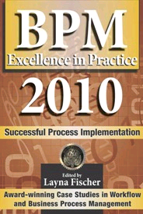
References
Our implementations of jBPM and JBoss EAP:
http://customers.redhat.com/2009/07/31/sns-bank-success-story-jboss-jbpm/
http://customers.redhat.com/2007/11/05/sns-bank-migrates-to-jboss-enterprise-platform/
http://www.schabell.org/2010/11/jfall-2010-rocking-jbpm-tasks-with.html
2009 Silver award for Global Excellence in BPM & Workflow
http://www.schabell.org/2009/04/2009-bpm-workflow-handbook-financial.html
http://www.schabell.org/2009/11/2009-silver-winner-for-europe-financial.html
http://www.schabell.org/2010/09/financial-crisis-front-lines-sns-bank.html

Slide 33
Q & A

Slide 34


