Slide 2
Pioneering a Path to the Future with JBoss BPM
Michel de Block
Senior Software Engineer, SNS Bank
Eric D. Schabell
JBoss Solution Architect Benelux
Thursday, May 5th 2011

Slide 3



Survival in the Financial Crisis (I)
Case study – SNS Bank
  Time line of events:
    Aug 2008 – first BPM savings products online
    Mar 2008 – first draft to BPM 2008
    Sep 2008 – crisis hits... recorded impact BPM
    Oct 2008 – presented JFall 2008 (NLJUG)
    Nov 2008 – chapter CaiSE / PRET 2009
    Dec 2008 – chapter to BPM & Worlflow Handbook 2009
    Apr 2009 – published BPM & Workflow Handbook 2009
    Jun 2009 – published CaiSE / PRET 2009
    Aug 2009 – letter to President Obama
    Nov 2009 – Silver award BPM Excellence in Europe
    Sep 2010 – final publishing BPM Excellence in Practice 2010

Slide 4
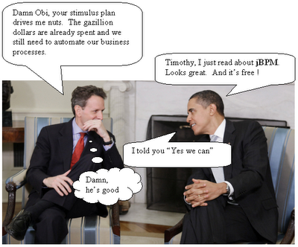
Survival in the Financial Crisis (III)
Empirical data
  Feb – Aug 2008 : ~1200 per month
  Sep – Feb 2009 : ~3300 per month
Overview effectiveness
    52% completed on time
    12% document monitoring
    8% rejected for various reasons
    0.7% Human action (functional)
    0.3% Human action (technical)
    23% removed, completed by hand
Best practices / Pitfalls BPM

Slide 5


