Slide 1

jBPM Migration Tool
No one is left behind...
Eric D. Schabell
JBoss Solution Architect Benelux
erics@redhat.com | @ericschabell
Maurice de Chateau
Senior Consultant, Ciber NL
maurice.de.chateau@gmail.com | @mauricedchateau

Slide 3

Are you in a rush?
Here is a quickie...

Slide 4

You put your faith in jBPM for your processes...

Slide 5

...help us by ensuring you position projects with best practices...

Slide 6

...and we have a good shot at tooling your migration to a bright future with jBPM!

Slide 7

Agenda
Where are my jBPM projects now?
Migration complexities in the enterprise
Status jBPM Migration Tool project
Does it work?

Slide 8

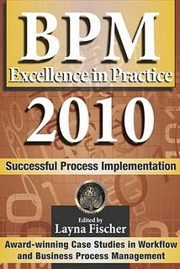

jBPM 3.x
The first productized version of jBPM
  jBPM 3.2 Sep 2007 to Sep 2013
    latest SOA-P 5 == jBPM 3.2.6
    Feb 2010 to Feb 2015
  SOA-P 5.1 scheduled released Q4 2010
    will contain jBPM 3.2.x == support 2013!
  tried, trusted, proven, rock solid enterprise component!

Slide 9
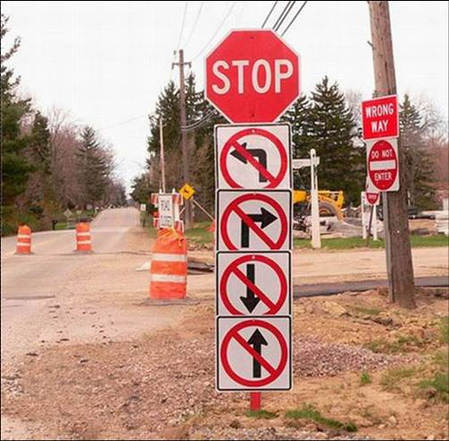
jBPM 4.x
Community only version of jBPM
  jBPM 4.x releases community run
  no product
  no support
  migration to jBPM 5 == community
    or maybe we get around to it...

Slide 10

jBPM 5.x
The future of jBPM
  RFC online
    leverage existing Drools project
    leverage PVM ?= jBPM 4.x
  roadmap available online
  released into the community 2010
  will become part of JBoss products

Slide 11
Agenda
Where are my jBPM projects now?
Migration complexities in the enterprise
Status jBPM Migration Tool project
Does it work?

Slide 12
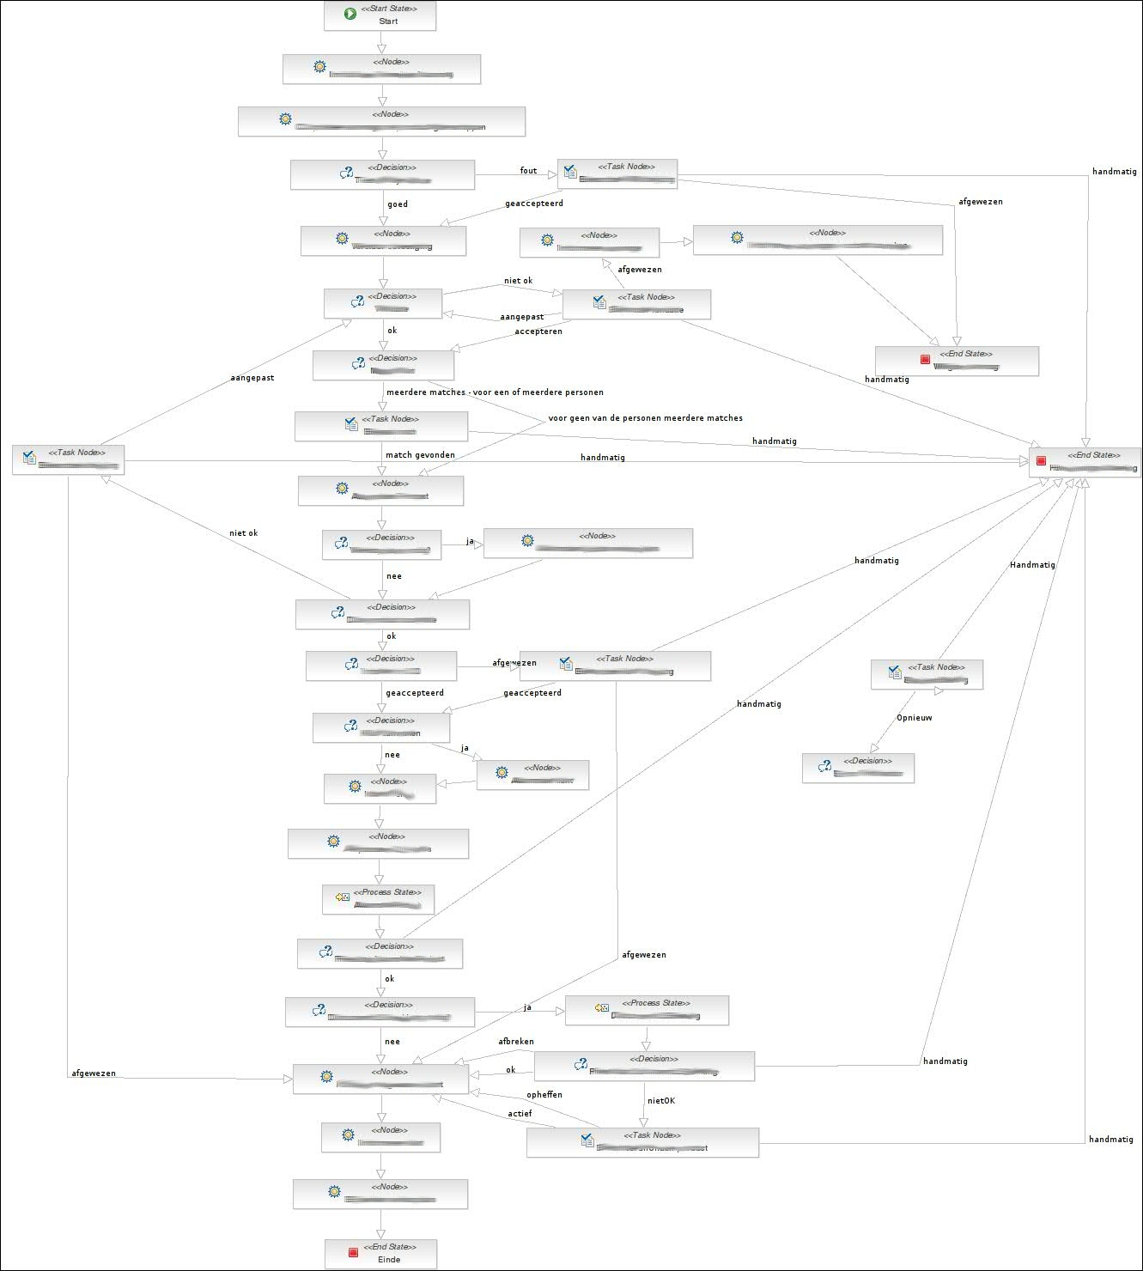

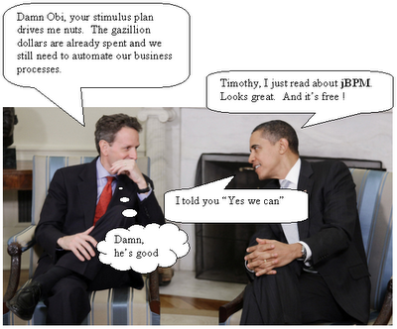
We have been architecting, implementing and deploying jBPM solutions in the strangest places for years now...

Slide 13
But wait a minute...

Slide 14
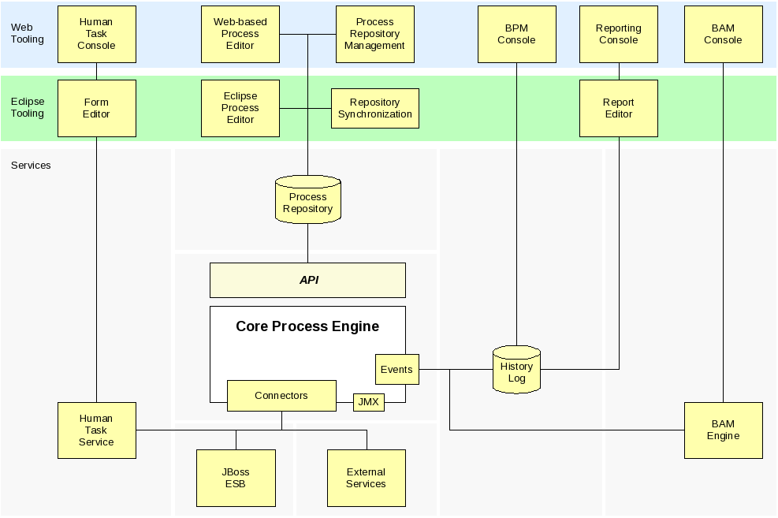

What about us...
jPDL != BPMN

Slide 15


Slide 16
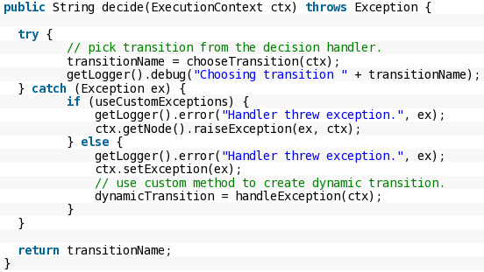
Process implementation
Java handlers
  do you keep it clean?
    atomic unit of action per process step
    human task / admin interfaces
    exception handling (jump-to)
    custom jBPM DB access
Centralize you jBPM API access
  single WS / DAO / BOM
  migration made easy (or easier)?

Slide 17

SOA interaction
Gateway to the Enterprise
  Web Services, EJB, GUI, POJO, Exceptions, Bean Script, Rules...
    jBPM API & jBPM DB
    history / tasks / reporting
      single DAO
      single Web Service
      externalize rules calls in Web Service(s)

Slide 18

Some best practices...
Simplify everything (KISS)
  apply OO to process design
    methods == sub-flows + context in/out
    encapsulate == sub-flows
    reuse == PAR repo (maven potential)
    unit testing == per node, sub-flow, flow
    keep it all visible (transitions for travel only)
    exception handling (Exception Framework)

Slide 19
Agenda
Where are my jBPM projects now?
Migration complexities in the enterprise
Status jBPM Migration Tool project
Does it work?

Slide 20

What are we up to?
Tooling targets
  jPDL 3.2.x to BPMN 2 (CLI)
  community welcome for jBPM 4.x
  working with use cases
    send us projects
    raise issues
  jBPM 3.x API mapping

Slide 21

Look under the hood
Research phase
  jaxb, smooks, XSLT
Based on main style sheet
  jpdl2-bpmn2.xsl
  modular setup
  positioning ignored (gpd.xml)
  large test setup in project
See github wiki for setup

Slide 22


Historical migration...

Slide 23

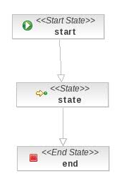

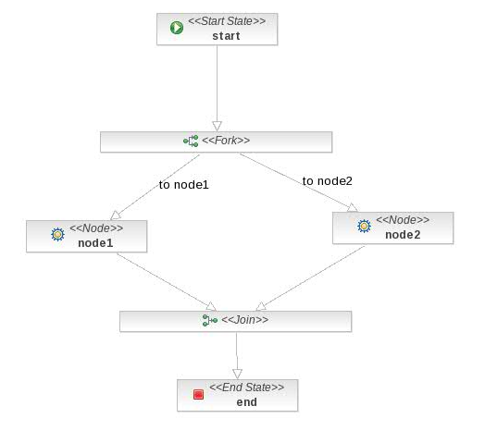
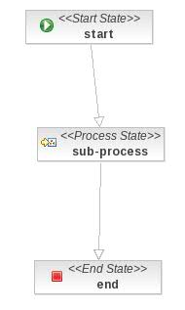
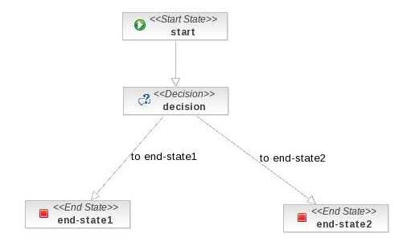
More cases filled the gaps...
jpdl2bpmn

Slide 24
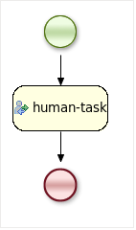
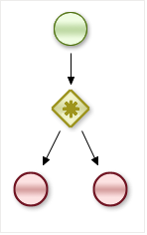
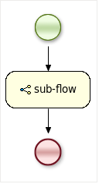
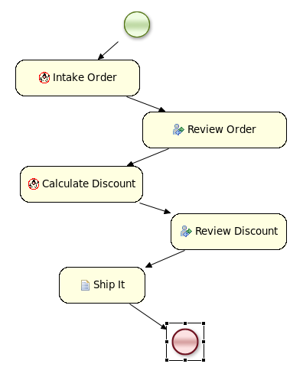
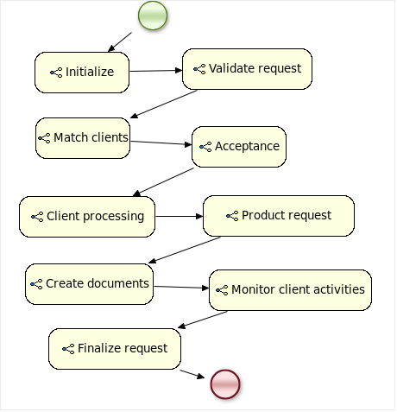
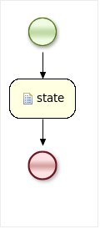
Booking results...

Slide 25

Conceptual or Pragmatic?
Ideally map concepts
  node/state: scriptTask
  decision: gateway
Which gateway?
  complex, parallel, inclusive...
Event/Action spoilers
  running java code in handlers
  answer: Java Node!

Slide 26
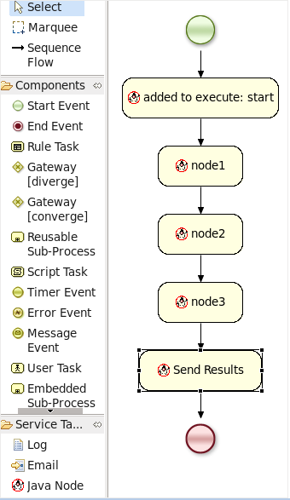
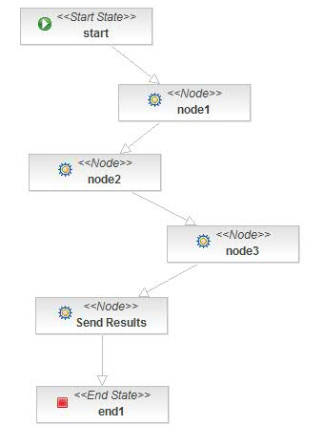
Pragmatic choices... part I
jpdl2bpmn

Slide 27
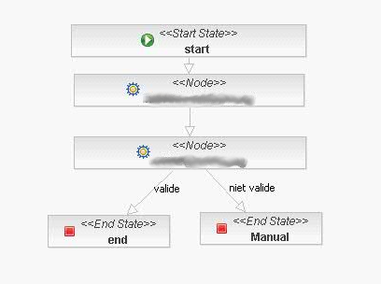
Pragmatic choices... part II
Add a gateway,
but changes the
process?
jpdl2bpmn

Slide 28
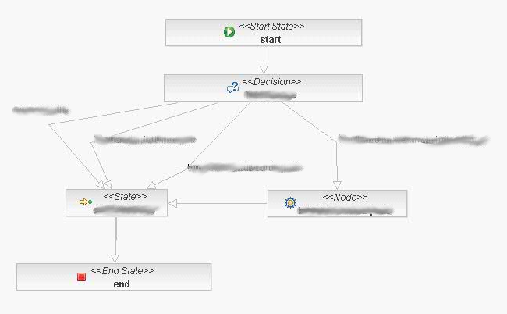
Pragmatic choices... part III
?????
jpdl2bpmn

Slide 29
Agenda
Where are my jBPM projects now?
Migration complexities in the enterprise
Status jBPM Migration Tool project
Does it work?

Slide 30

References
jBPM5 Roadmap: https://community.jboss.org/wiki/jBPM5Roadmap
jBPM migration strategies: http://www.schabell.org/2010/03/jbpm-migration-strategies-introduction.html
Migration tool project: https://github.com/eschabell/jbpmmigration/wiki
Exception framework: https://github.com/eschabell/jbpm3_exception_framework
Migration story JUDCon 2010: http://www.schabell.org/2010/10/judcon-2010-berlin-get-your-bpm-ducks.html
2009 BPM & Workflow Handbook: http://www.schabell.org/2009/04/2009-bpm-workflow-handbook-financial.html
BPM Excellence in Practice 2010: http://www.schabell.org/2010/09/financial-crisis-front-lines-sns-bank.html

