Slide 1

An OpenShift Primer
Get your code into the Cloud!
Eric D. Schabell Red Hat Cloud Tour 2012
JBoss Senior Solution Architect Amsterdam / London
erics@redhat.com / @ericschabell

Slide 2
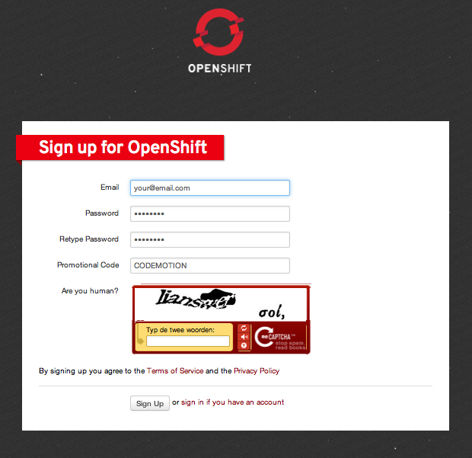
Sign up, it's free!
http://openshift.redhat.com – “Sign up and Try it!”
Example projects you can deploy now!
  https://www.github.com/openshift
Help?
  IRC: freenode #openshift
  Forums: http://www.redhat.com/openshift/community/forums
  Email: openshift at redhat dot com
Promotional Code: RHCT

Slide 3


Slide 4

Immersion...
Shift happens?

Slide 5

Never look back...

Slide 6



PaaS?

Slide 7

Why am i DORKING
with the stack?!

Slide 8
Express
Sign Up
Install Client Tools
Create Domain
Create Application
Deploy Application (GIT)

Slide 9
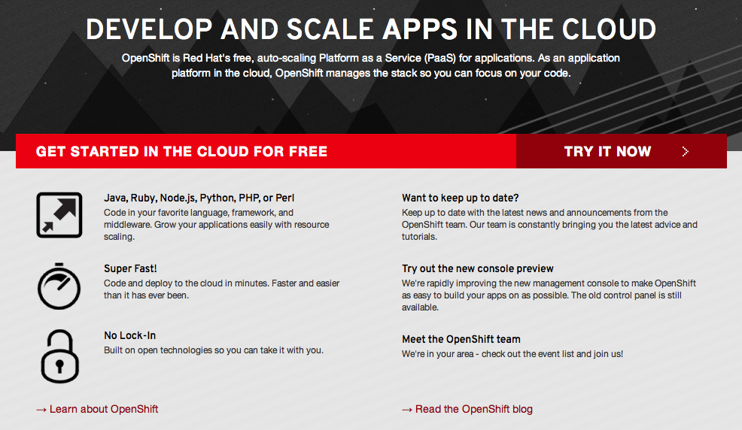
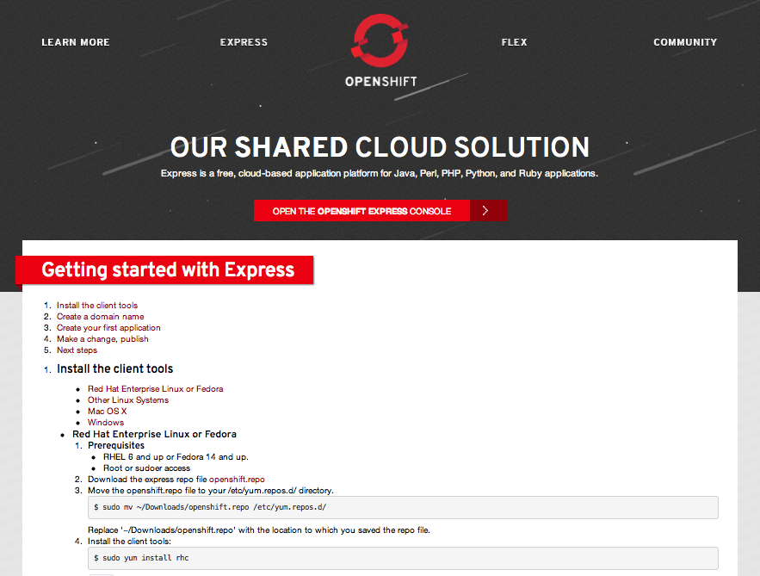
Sign Up
http://openshift.redhat.com

Slide 10
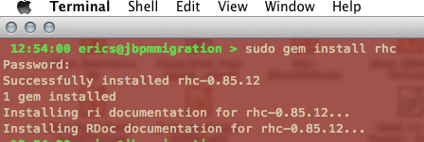
Install Client Tools
The rest (osX, Ubuntu, Cygwin):
  gem install rhc (json_pure)
  see forums, blogs
Fedora / RHEL
  openshift.repo
Move to yum.repos.d
$ sudo mv openshift.repo /etc/yum.repos.d
Install client tools
$ sudo yum install rubygem-rhc

Slide 11
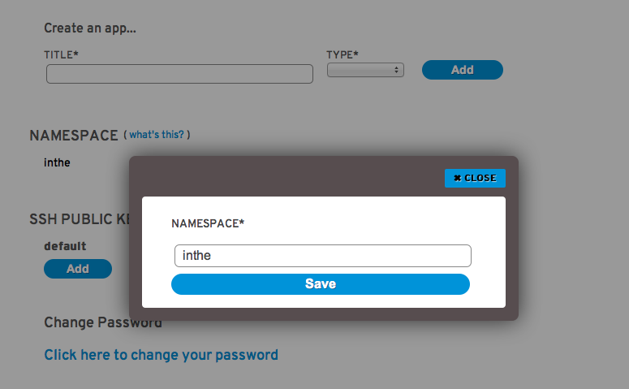
Create Domain
Use rhc command
  $ rhc domain create -n mydomain -l openshiftlogin
use Express console!

Slide 12
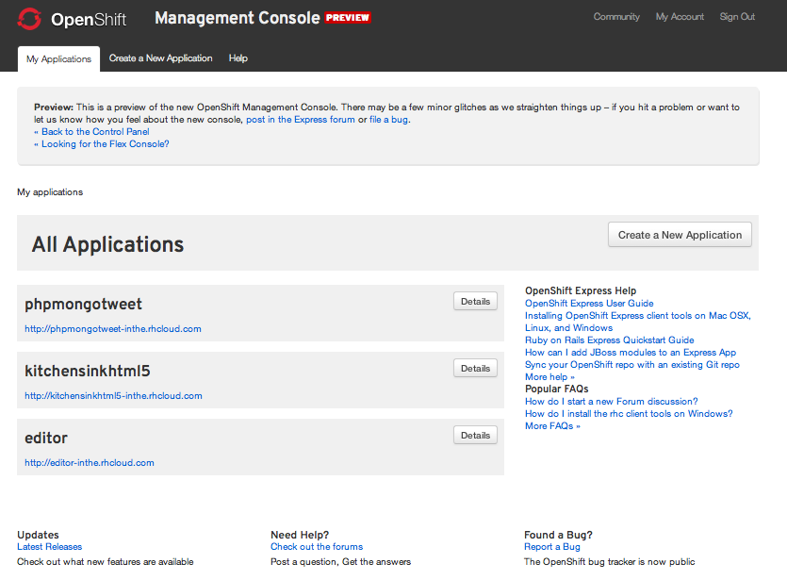
Web Administration

Slide 13
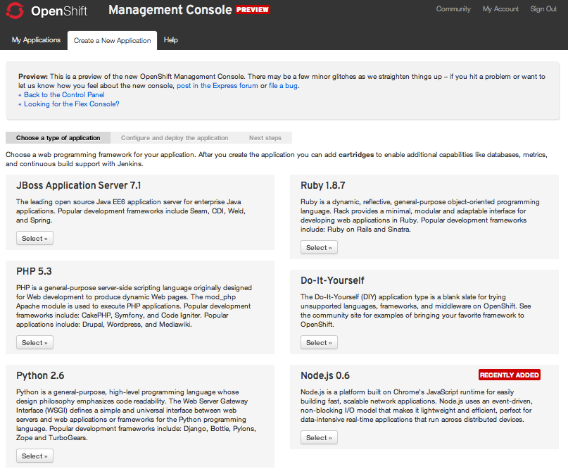
Create Application

Slide 14
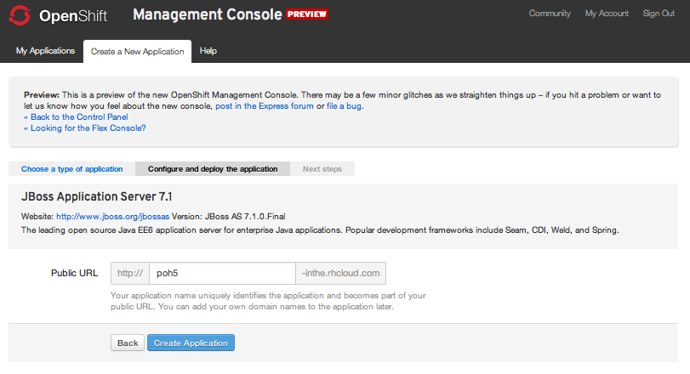
Configure Application

Slide 15
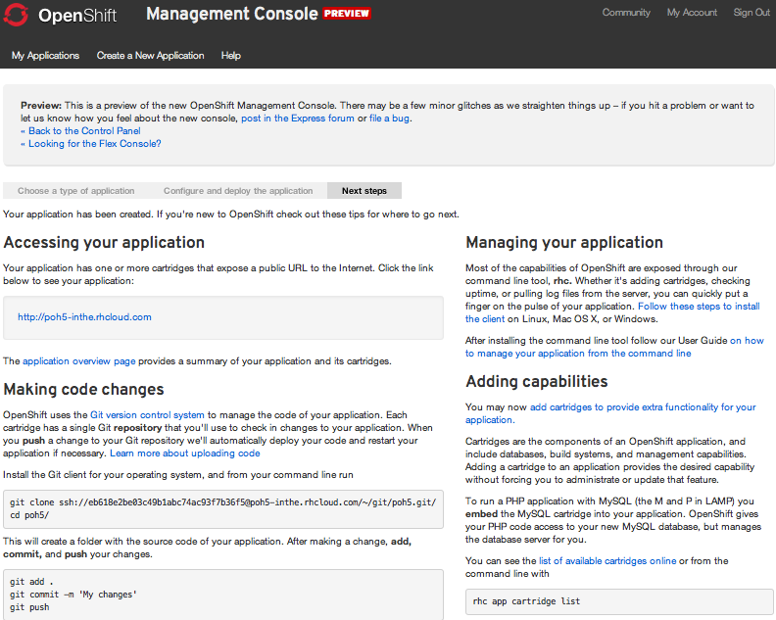
Ready to code!

Slide 16
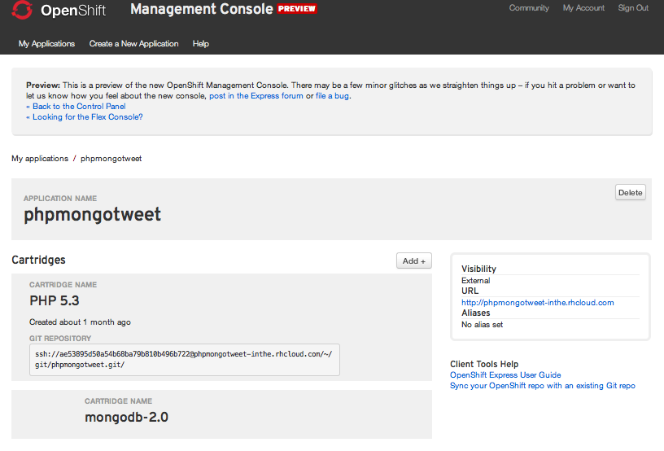
Application Details

Slide 17
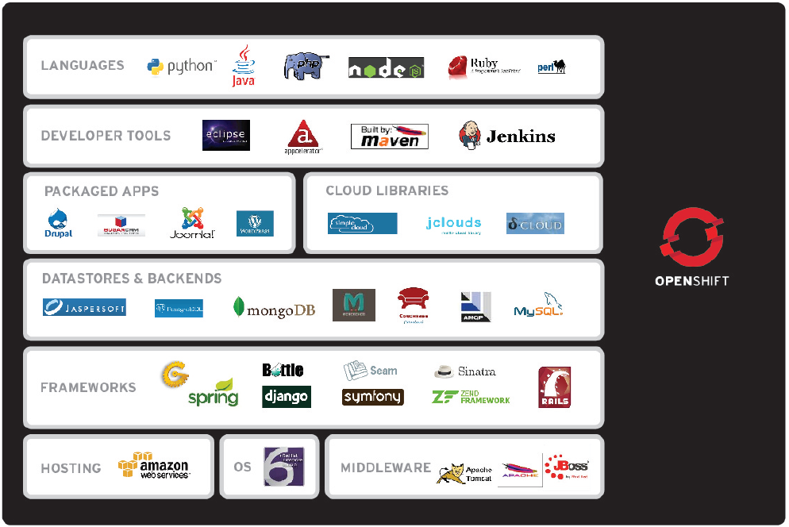
Why OpenShift? It's you.
Notes:
But one of the best things about OpenShift (in addition to being Easy and Solid) is that it is exactly what You need, no matter who you are. This slide shows the wealth of languages, frameworks, tools, applications, vendors, and cloud providers that are part of the OpenShift family.
Whether you are a Ruby coder, or a Java EE programmer, OpenShift will help you be fast and efficient in your application development efforts.

Slide 18

Other Options: create apps
Name app and define type
  $ rhc app create -a appname -t apptype -l openshiftlogin
  (Node.js, DIY, Jenkins, PHP, Ruby, Python, Perl and most important, Java!)
Add application to local repo
  $ git add .
Commit changes
  $ git commit -m “Initial app import.”

Slide 19
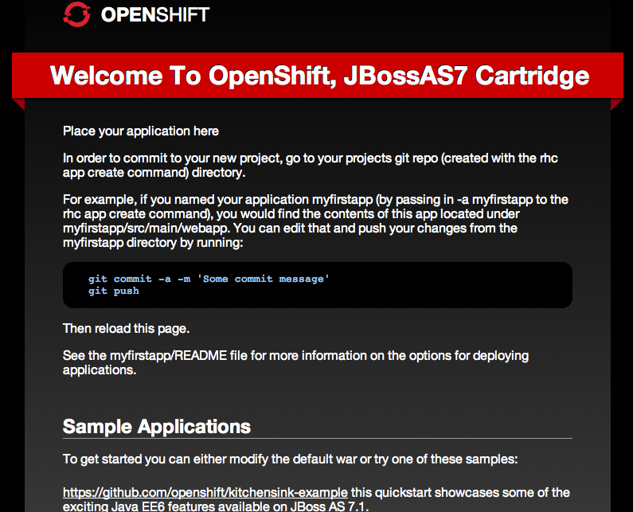
Deploy to Cloud
Push the code to Express
  $ git push
Congratulations, your app is in the cloud!

Slide 20


Slide 21
Demo CloudTour Mobile App
$ rhc app create -a cloudtour -t jbossas-7
$ cd cloudtour
$ git remote add upstream -m master git://github.com/eschabell/openshift-cloudtour.git
$ git pull -s recursive -X theirs upstream master
$ git push
http://cloudtour-$your_domain.rhcloud.com

Slide 22
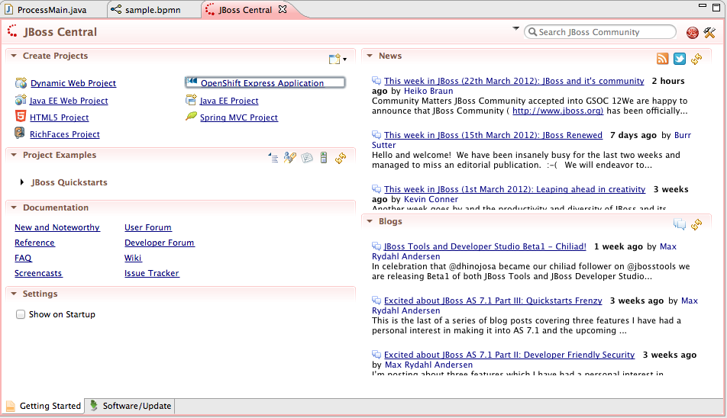
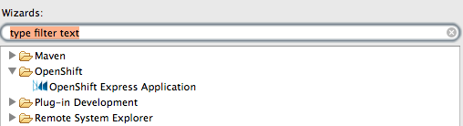
JBoss Developer Studio

Slide 23
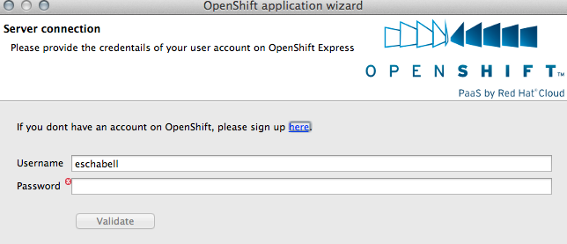
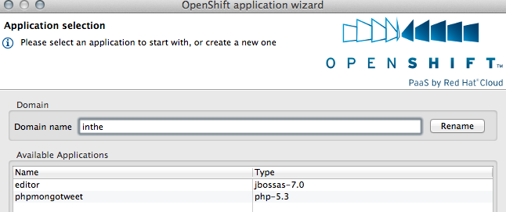
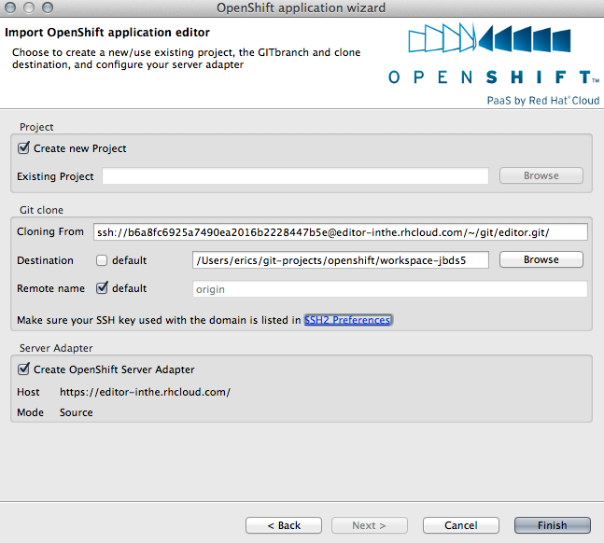
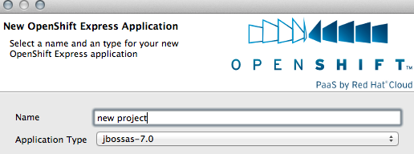

Slide 24
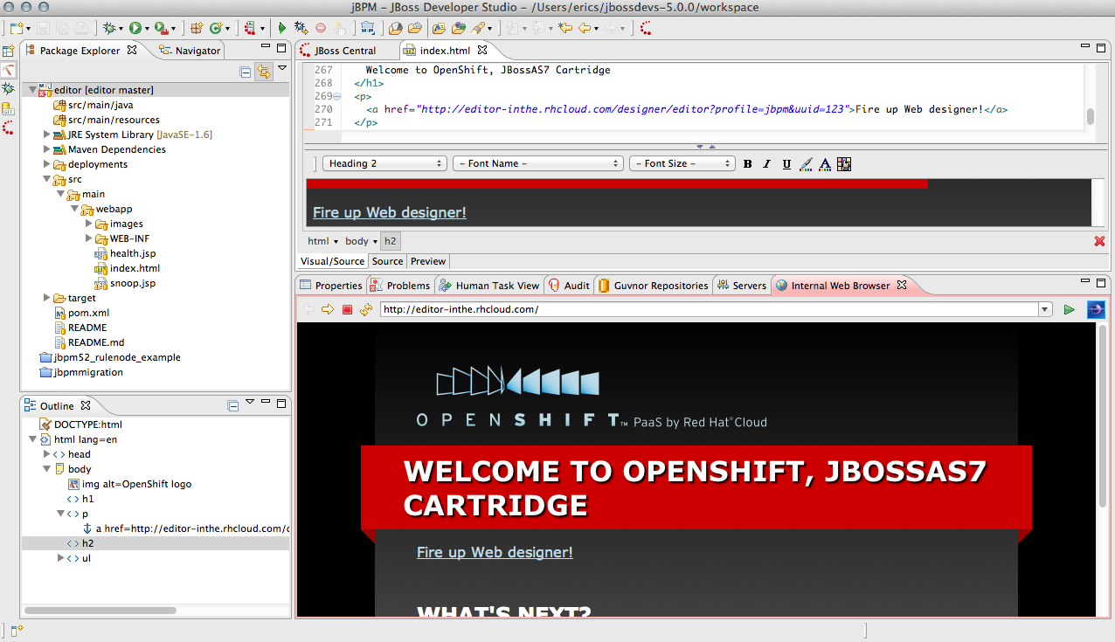
JBDS in action...

Slide 25
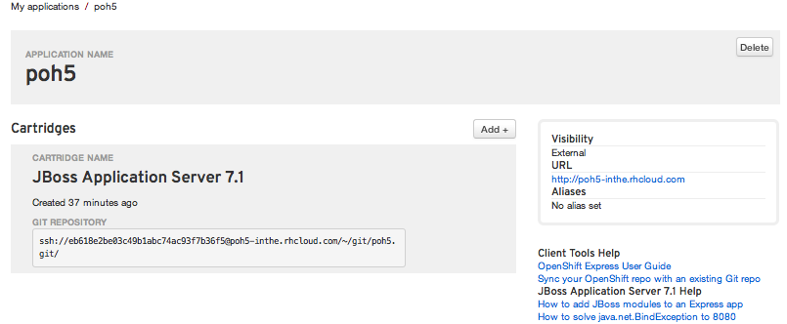
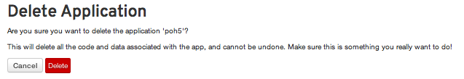
Remove Application

Slide 26
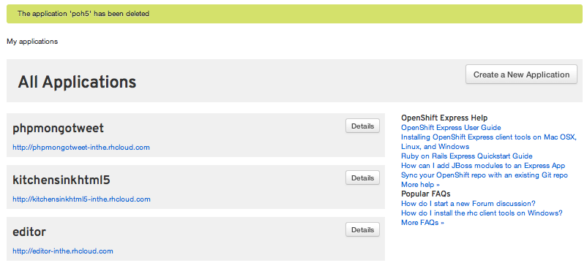
Time for a new project!

Slide 27

What will the future bring?
Express / Flex unification
JBoss++
Commercial Service / Pricing
Mobile
Open Source (SDK + project)
2012

Slide 28




Loving your hammer?

Slide 29

OpenShift: http://openshift.redhat.com
OpenShift Express: https://openshift.redhat.com/app/express
Blogs: https://www.redhat.com/openshift/community/blogs
CloudTour mobile application demo on OpenShift: https://github.com/eschabell/openshift-cloudtour
Deploy an application to OpenShift with JBossTools (video): http://vimeo.com/33988381
Deploying mobile application with JBoss Dev Studio: https://community.jboss.org/wiki/DeployingHTML5ApplicationsToOpenshift
Rise above the Cloud hype with OpenShift: http://www.schabell.org/2012/01/rise-above-cloud-hype-with-openshift.html

