Slide 1
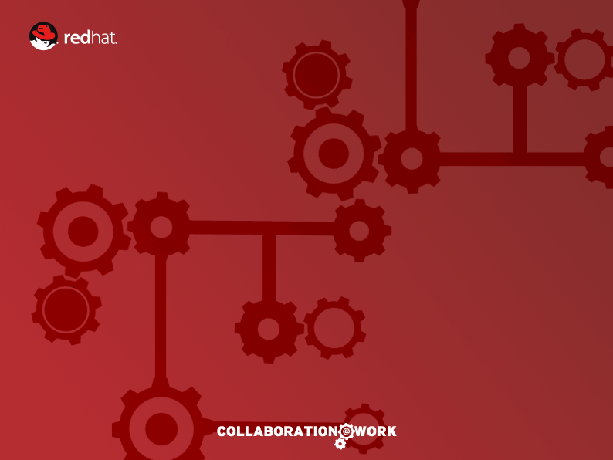
JBoss Enterprise Business Rules
Business Rules Management System (BRMS)
Eric D. Schabell
JBoss Senior Solution Architect Benelux

Slide 2
Agenda
Introduction
JBoss BRMS
    Overview
    Future directions
Demo
Questions

Slide 3
JBoss BRMS v5.2
Declarative Business Rules
  Avoids hard-coding business rules in business logic
  Rules can change without Java code changes or re-compilation
  Expert system allowing solution of complex problems
Multiple Authoring Options: DRL, DSL, CSV and Programmatic Rules Definition
  Application objects (facts) mixed with conditions (rules) – similar to HQL
  POJO and Declarative Fact Model
  Decision Tables in Excel/Open Office
  DSL Natural Language Extensions
Rule Repository
  Versioning of business rule-related artifacts (e.g. Fact models, enumerations, functions, DSL definitions, rules, tests, etc.)
Rule Manager
  RIA for creation & maintenance of business rule artifacts

Slide 4
JBoss BRMS
What is a rule engine?
A rule engine at its core is an environment/shell for capturing knowledge
  Applying that knowledge to specific data (facts)
  Uses production rules
    IF <conditions> THEN <actions>
    rules express logic
Has roots in AI research
  Success of “expert” systems in the past triggered popularity of rule engines

Slide 5
JBoss BRMS
What is it going to do for me?
Externalize business logic
  Logic that is complex
  Logic that changes often
  Logic that just doesn’t fit neatly in code
  Logic that means more to domain experts than it does programmers
Keep application and user interface logic in your application
  Business logic in the rule engine
Use domain objects as interface to rule engine

Slide 6
JBoss BRMS
When should I use a rules engine?
When there is no satisfactory “traditional” solution
The problem becomes to complex to express using traditional methods
No known algorithms for solving the problem traditionally
Too hard
Too “fluid”

Slide 7
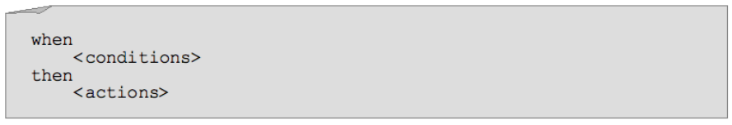
JBoss BRMS
What is a rule?
In short, a rule is an premise and conclusion
  If it is raining, then the ground must be wet
A rule is made of conditions and actions. When all the conditions are met, a rule may “fire”.
The conditions are collectively referred to as the LHS (left hand side) and the actions are referred to as the RHS (right hand side, or consequence).
A rule operates on facts (data). In our case, these facts are instances of objects in our application.

Slide 8

JBoss BRMS
What is inferencing?
We want to take all of our data (facts) and combine it with our knowledge (rules) and come up with some conclusions (inferencing)

Slide 9

JBoss BRMS
What is inferencing?
We want to take all of our data (facts) and combine it with our knowledge (rules) and come up with some conclusions (inferencing)

Slide 10
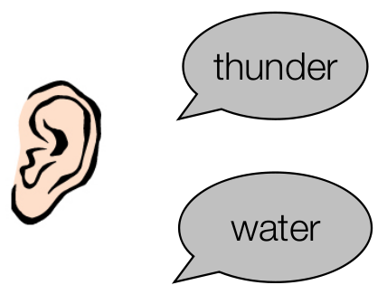
JBoss BRMS
What is inferencing?
We want to take all of our data (facts) and combine it with our knowledge (rules) and come up with some conclusions (inferencing)

Slide 11
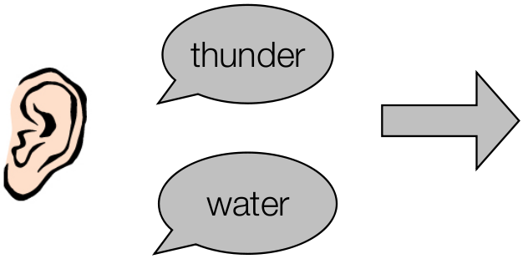
JBoss BRMS
What is inferencing?
We want to take all of our data (facts) and combine it with our knowledge (rules) and come up with some conclusions (inferencing)

Slide 12
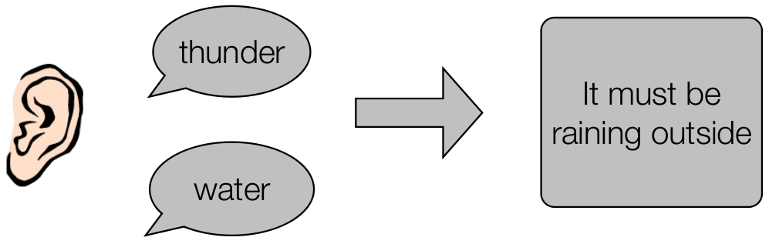
JBoss BRMS
What is inferencing?
We want to take all of our data (facts) and combine it with our knowledge (rules) and come up with some conclusions (inferencing)

Slide 13
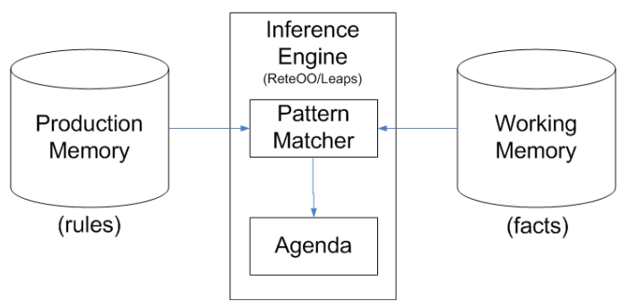
JBoss BRMS
Inference Engine
The brain of a Production Rule System is an Inference Engine which matches facts against Production Rules.
When matches are found, the rules actions are fired.
Actions most often change the state of the facts, or perform some external action on the application.

Slide 14
JBoss BRMS
How it Works
Agenda
Rule
Activation
Rule
1.Parse DRL
Rule
RuleBase
Rule
Fact
Rule
Rule
Activation
Fact
Rule
Fact
2. Create
Fact
Fact
Fact
3. Assert Facts
WorkingMemory
Fact
Fact
Fact
Fact
Fact
Fact
4. Fire All Rules
Fact
Rule
(5) activation
-> consequence
Rule
Rule
Rule
Rule

Slide 15
Conceptual example
Knowledge
Base
Stateful / Stateless
Knowledge
Session
Rule package
(artifacts)
Agenda

Slide 16
Example: real BPM
Knowledge
Base
Stateful
Knowledge
Session
Process
Definition
Process
Instance

Slide 17
Java Example
// (1) Create knowledge base and add process definition
KnowledgeBuilder kbuilder = ...
kbuilder.add( ..., "sample.bpmn", ResourceType.BPMN2);
KnowledgeBase kbase = kbuilder.newKnowledgeBase();
// (2) Create new stateful knowledge session
StatefulKnowledgeSession ksession =
kbase.newStatefulKnowledgeSession();
// (3) Start a new process instance
ksession.startProcess(“com.sample.bpmn.hello”);

Slide 18
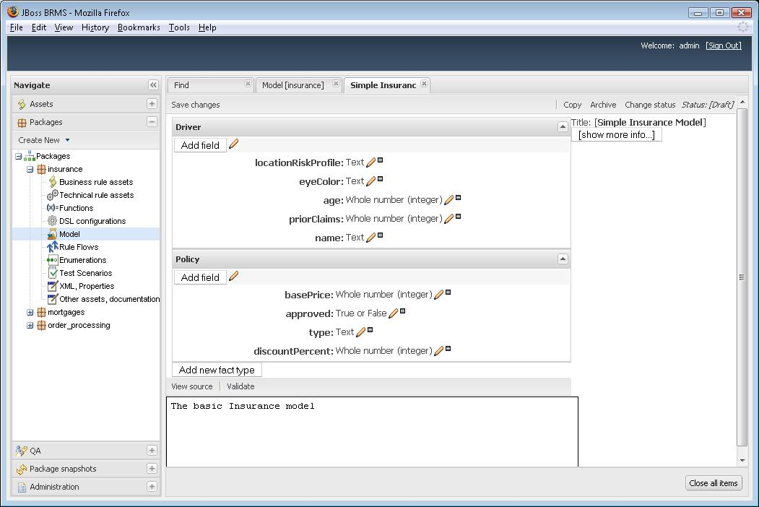
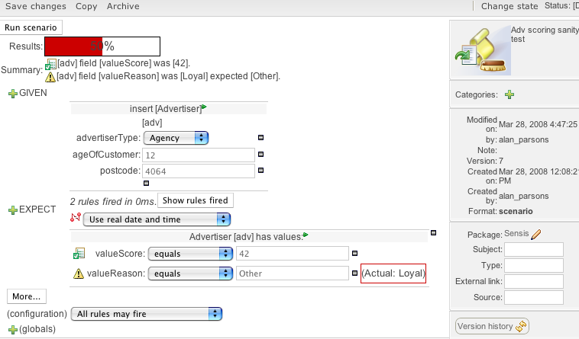
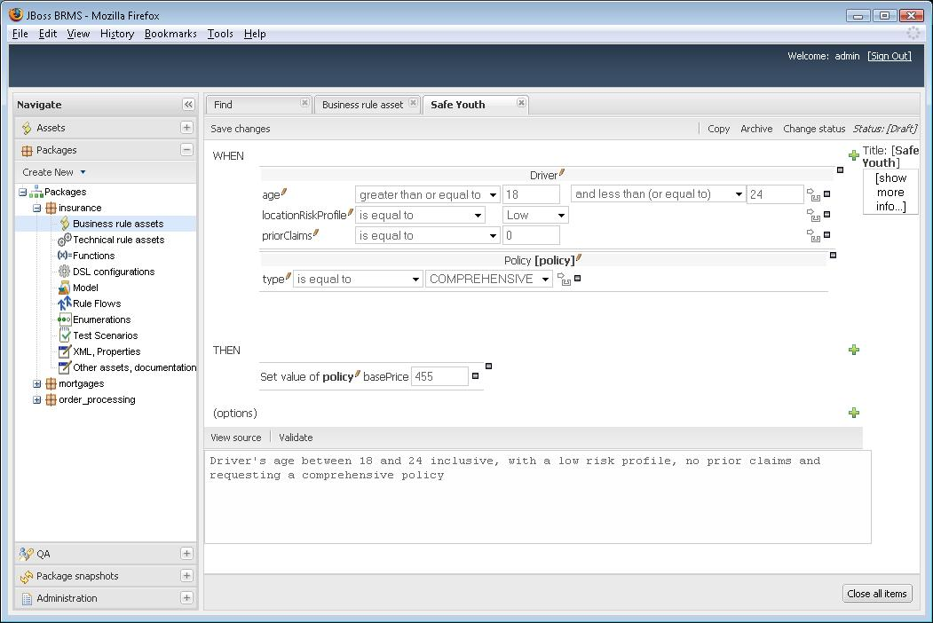
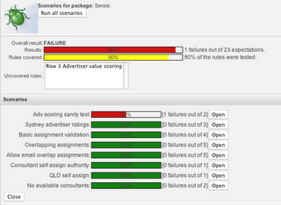
BRMS – Rich UI for Business Rules

Slide 19
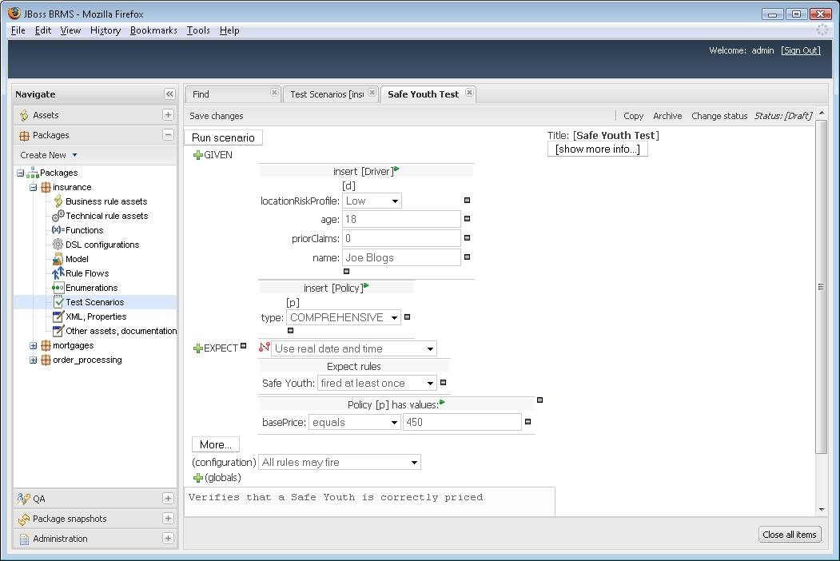

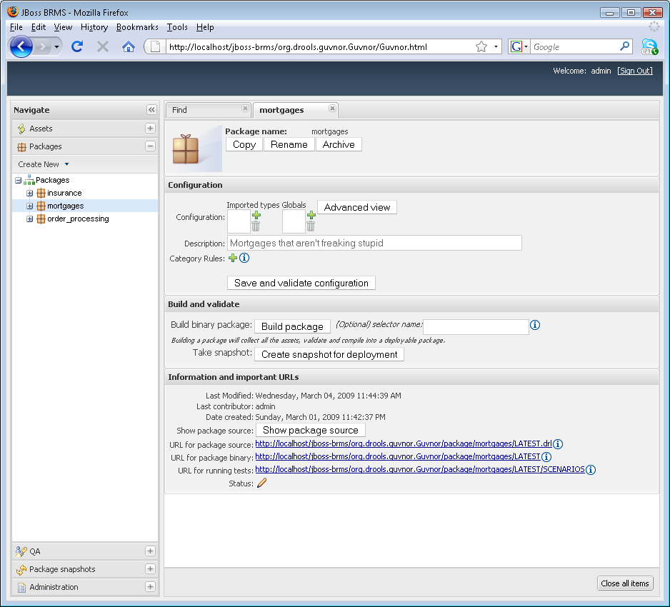
Analysis Perspective
Test the Rules
JBoss BRMS Web Manager
Model the Facts
Prototype the Rules
J2SE
JBoss Developer Studio
Check-Out Artifacts from Repository
Build & Test Application
Check-In changes to Repository
Deployment
EAP-WS,WAR,EAR
SOA-P,
Mediated Services
JBoss BRMS Web Manager
Create Package

Slide 20
Fact Model Editor

Slide 21
Guided Rule Editor (Web)

Slide 22
Guided Rule Editor (Web)

Slide 23
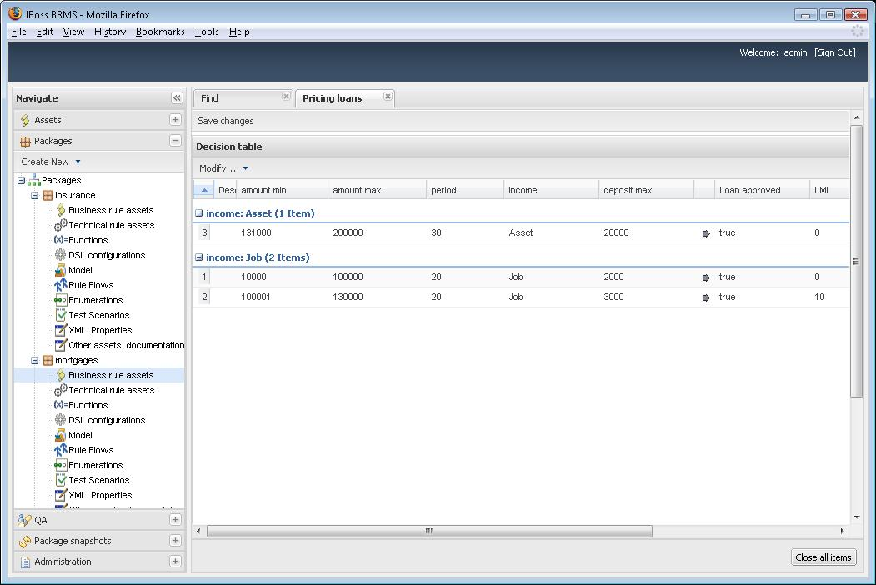
Web Decision Table Editor

Slide 24
Test Scenario Editor

Slide 25
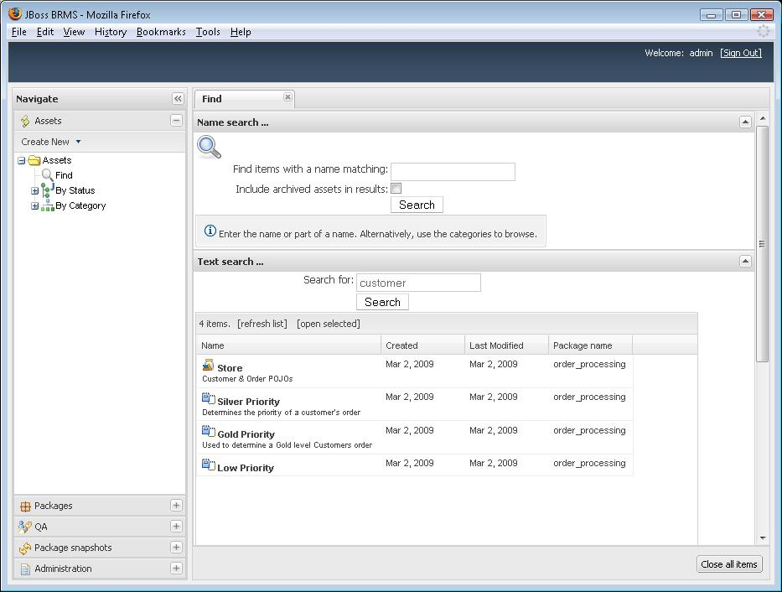
Developer Perspective
JBoss Developer Studio
Fact Model
DSL Template
Check-In Artifacts to Repository
JBoss BRMS Web Manager
Use Facts & DSL
to create Business Rules
J2SE
EAP-WS,WAR,EAR
Deployment
SOA-P,
Mediated Services
JBoss BRMS Web Manager
Create Test Scenarios
JBoss BRMS Web Manager
Create Package

Slide 26
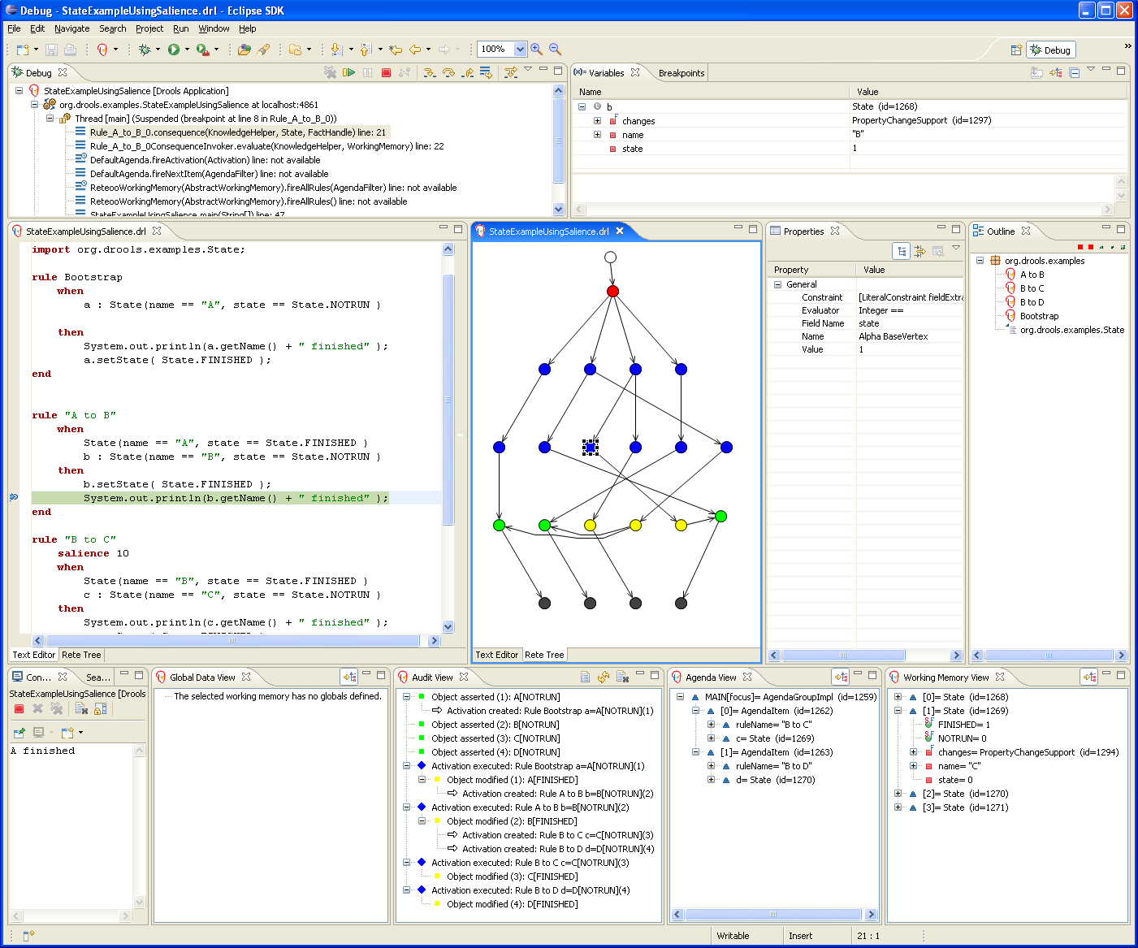
Eclipse – Developer Perspective

Slide 27
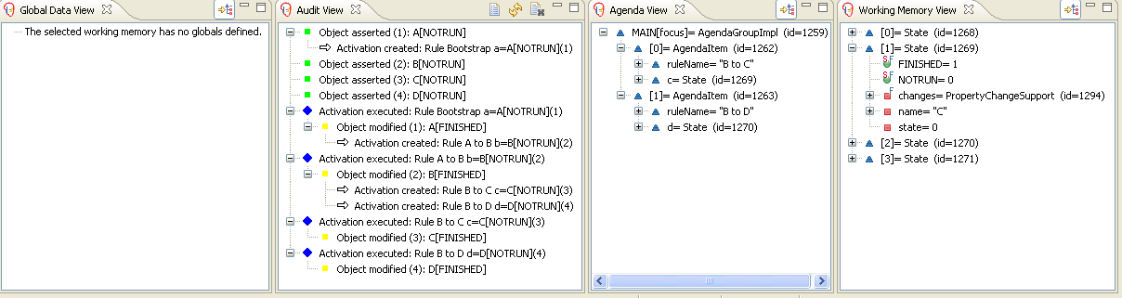
Debugging
Debug Views
  New rule “perspective” to configure IDE for rules as needed

Slide 28
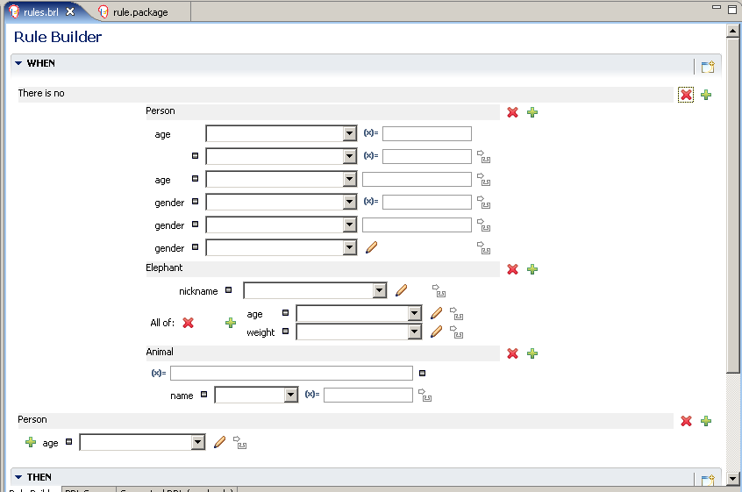
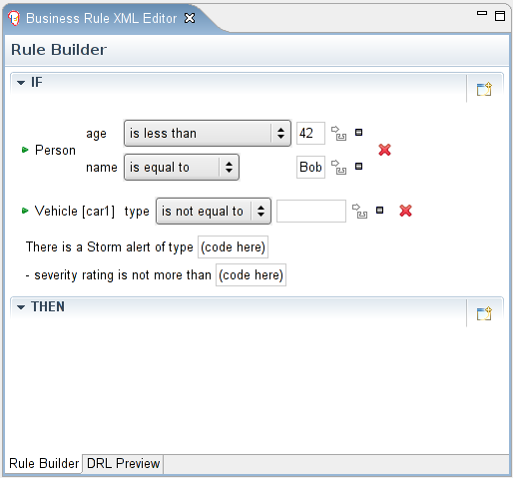
Guided Rule Editor (Eclipse)
Eclipse Guided Editor

Slide 29
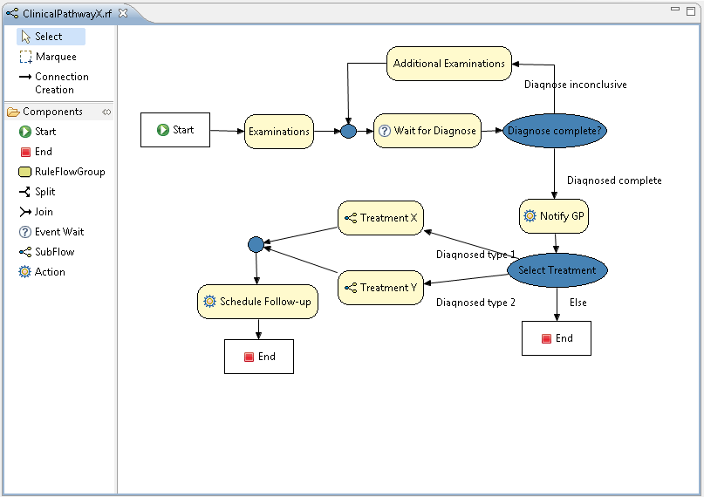
Rule Flow

Slide 30
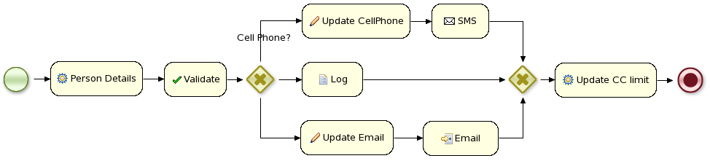
JBoss BPM
Core
Engine
Core engine is a workflow engine in pure Java
  state transitions
  lightweight
  embeddable
  generic, extensible

Slide 31
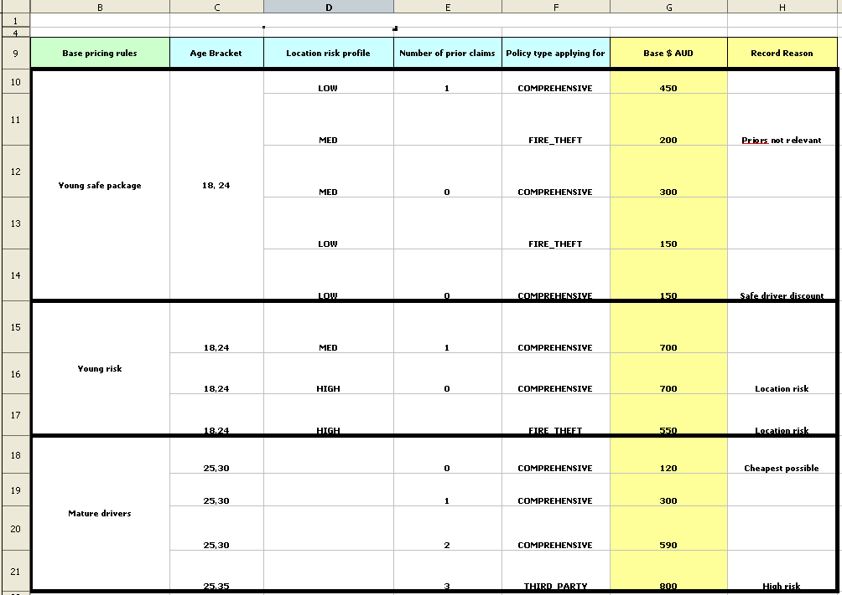
Decision Tables
Decision Tables – Excel/Open Office

Slide 32
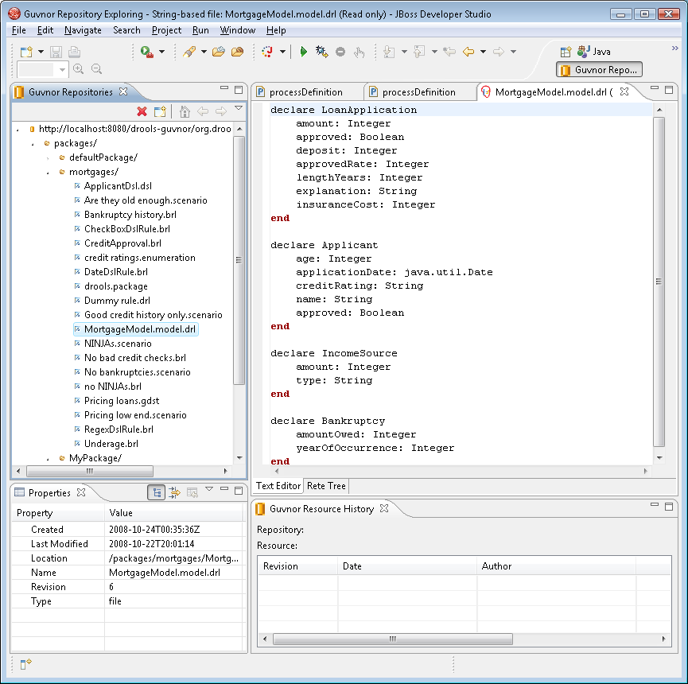
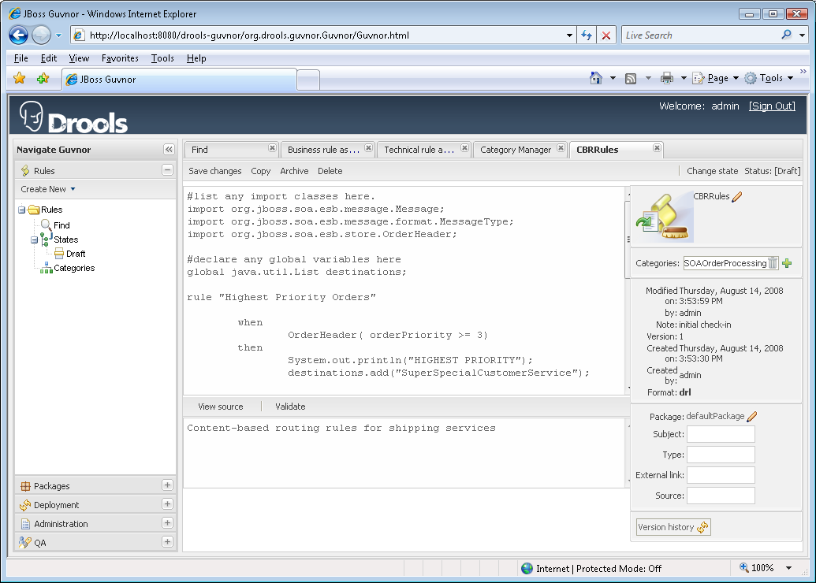

Eclipse to BRMS Synchronization
JBoss Developer Studio
BRMS 5
JCR
Repository

Slide 33

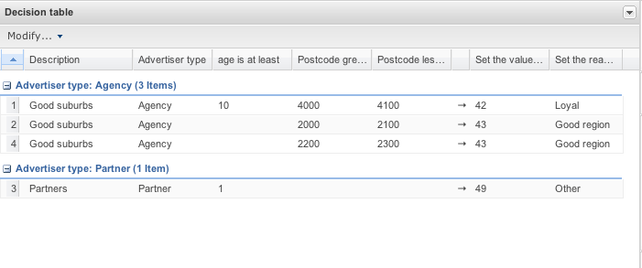
BRMS/Rules Deployment Scenario
J2SE
JBoss Rules Runtime
RuleAgent
BRMS
EAP 4.3
J2EE use cases
Seam use cases
Clustered
RuleAgent
SOA-P 5.0 (future)
Stateless Rule Services
Stateful Rule Services
CBR & CBF
Federated Hot Deployment
RuleAgent
JCR
Repository
Delivery of proper version of a rule package via the ruleagent to any of the above “containers”.
EE and SOA containers allow for hot deployment/reload of the changed rules without component restart and no loss of transactions/messages.

Slide 34
BRMS v5: Summary of Features
Graphical User Interface and repository for Business Rule Editing, Versioning & Deployment management that is usable by the non-Java Programmer and non-System Administrator.
Manages the following artifacts:
  Rule Packages
  Business Rules (via Guided Rule Editor)
  Business Fact Model
  Technical Rules (sync with Eclipse and/or BRMS UI)
  Technical POJO Fact Model
  Domain Specific Languages – DSL
  Web-based Decision Tables
  Spreadsheet-based Decision Tables
  Rule Categories (for searching)
  Users & Roles associated with rule life cycle states
  Rule Promotion (Dev, QA, Production)
  Test Scenarios

Slide 35

JBoss BRMS, the future is now

Slide 36

Future: Event Stream Processing
Some Process: Order Fulfillment, Replenishment, Customer Service, Financial Analysis
Stateless Rules Services identify “interesting ”information
Collect
Suspect
Data
Potentially Significant Event
Stateful Rules Services
hold, analyze & raise events
Other Process also capturing interesting data points and routing them to the “stateful” rules service for keeping and analysis.

Slide 37


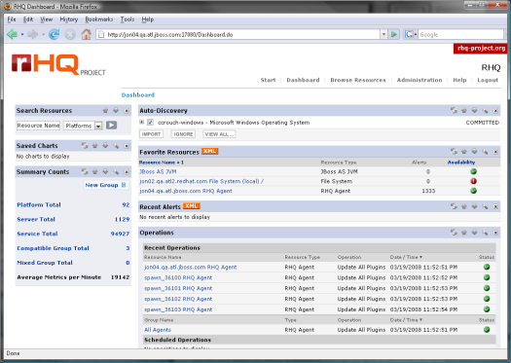
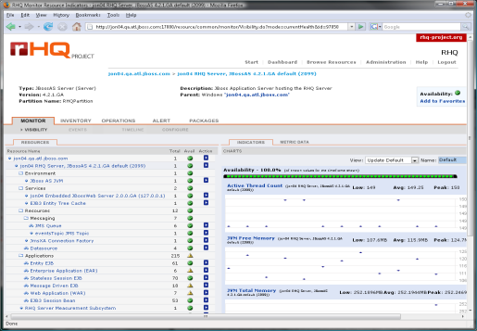
Features: ESP + CEP via ESB, Rules & JON
ESB: consumption, capture, transformation, routing, orchestration
Rules: selection, aggregation, correlation, generation and publication
Governance
Tools
Repository: for editing, versioning, testing
and publishing rules and SOA artifacts
JON: start/stop services, monitor and alert on service and action-level performance, monitor and alert on business metric values

Slide 38
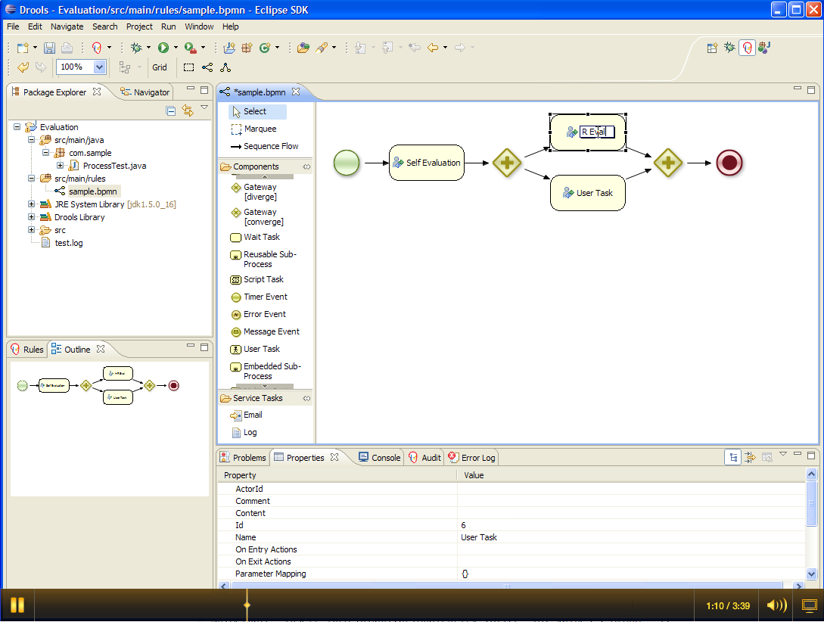
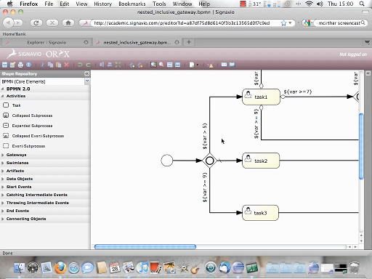
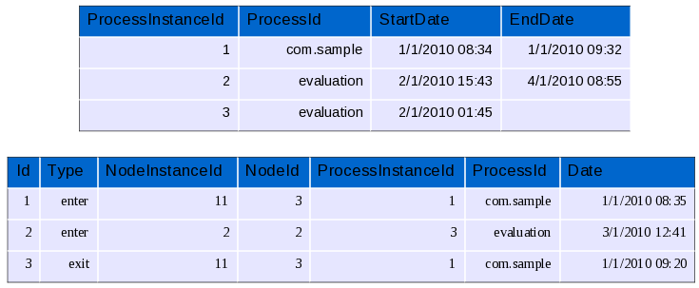
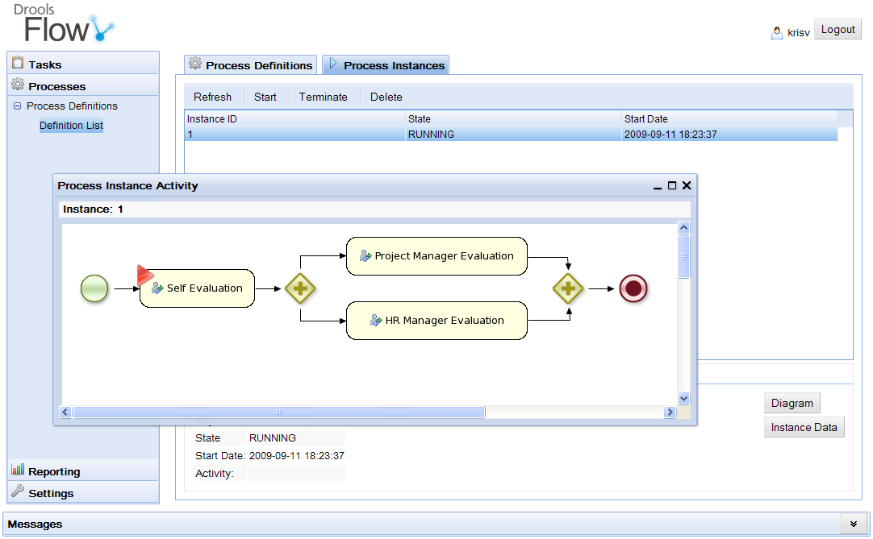
BPMS future at JBoss
Pluggable
&
Standards
Eclipse
BPMN2
Editor
Persistence
XML
Core
Engine
Trans-
actions
Oryx Web-
Based Editor
History
Log
BPMN
2.0
Events
Management
Console
Integration
Domain-specific
Processes
Human Task
Service
BAM
ESB

Slide 39
BPMN2 and Projects
BPMN2
Model
Savara
Drools
jBPM
Rules
Process
Choreography
Event
Collaboration
WS-BPEL
Services
RiftSaw
SOA

Slide 40
Agenda
Introduction
JBoss BRMS
    Overview
    Future directions
Demo
Questions

