Slide 1

JBoss jBPM, the future is now for all your Business Processes
Eric D. Schabell
JBoss Solution Architect

Slide 2


What is BPM?
Overview jBPM5
Flexible Processes
Cool Stuff

Slide 3

Business Process Management
is a
systematic approach
to making an organization's
workflow
more effective, more efficient
and more capable of
adapting
to an ever-changing
environment.

Slide 4
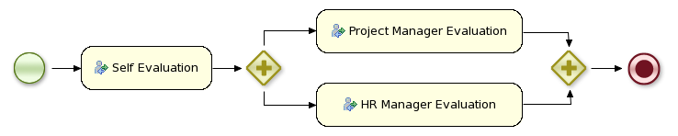
Workflow is?
A business process as an activity or set of activities
that will accomplish a specific organizational goal.

Slide 5
What is BPM?
Overview jBPM5
Flexible Processes
Cool Stuff

Slide 6
From Workflow...
Core engine is a workflow engine in pure Java
  state transitions
  lightweight
  embeddable
  generic, extensible
Core
Engine

Slide 7
Core Engine
Knowledge
Base
Stateful
Knowledge
Session
Process
Definition
Process
Instance

Slide 8

ProcessRuntime interface
startProcess(processId)
startProcess(processId, parameters)
signalEvent(type, event)
signalEvent(type, event, instanceId)
abortProcessInstance(instanceId)
getProcessInstance(instanceId)

Slide 9
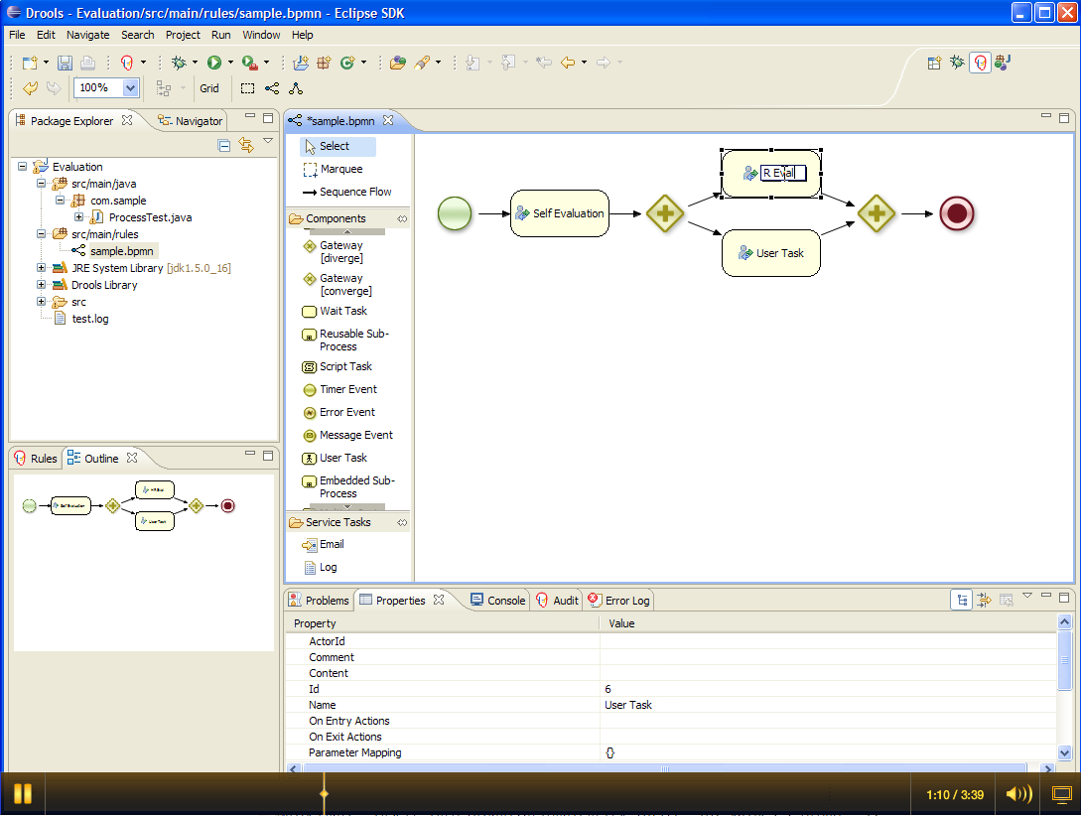
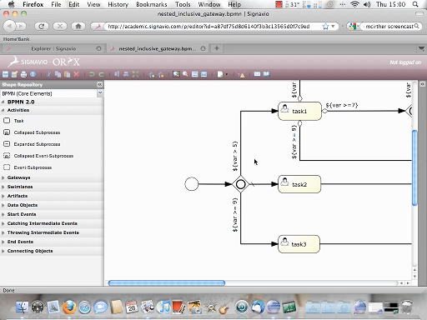
...to BPMS
Eclipse
BPMN2
Editor
XML
Core
Engine
BPMN
2.0
Web Designer
(Oryx)

Slide 10
BPMN 2.0
OMG specification
  Model
  Notation
  Execution semantics
Understandable by all business users
Process, collaboration, choreography
Extensible

Slide 11
jBPM5 and BPMN2
Focus on executable processes
  Java environment
  Native execution
Subset
  Common Executable ++
High-level and domain-specific
Minimal custom extensions

Slide 12

BPMN 2.0 Example
<definitions ... >
<process id="com.sample.bpmn.hello" name="Hello World" >
<startEvent id="_1" name="StartProcess" />
<sequenceFlow sourceRef="_1" targetRef="_2" />
<scriptTask id="_2" name="Hello" >
<script>System.out.println("Hello World");</script>
</scriptTask>
<sequenceFlow sourceRef="_2" targetRef="_3" />
<endEvent id="_3" name="EndProcess" />
</process>
</definitions>

Slide 13
BPEL Vs BPMN
Red Hat does not intend to create 2 BPM solutions
BPMN2 is the strategic direction
BPEL requirements will be fulfilled with implementation.
Project Riftsaw – implementation of BPEL will be included in SOA-P 5.2
Future BPM solutions will be built on BPMN2 standards
JBoss BPM platform is our answer to all process flow / workflow solutions
Notes:
JBoss Enteprise BRMS (new in 2009)
Enables critical business rules to be managed in a more centralized manner (e.g. Insurance = policy risk assess and pricing; Heathcare = claims processing annual regulatory changes)
Avoids need to otherwise re-code business rules redundantly in multiple applications
Leverages JBoss Rules execution engine which has been available for years
Adds new browser-based Rules Mgmt app, enabling business users to participate in the review, editing, and maintenance of business rule changes
Also adds Repository to provide version management of multiple sets of business rules
Supports the deployment of business rules to JBoss middleware platforms and non-JBoss runtime environments

Slide 14
BPMN2 positioning
BPMN2
Model
Savara
BRMS
jBPM
Rules
Process
Choreography
Event
Collaboration
WS-BPEL
Services
RiftSaw
SOA

Slide 15
...to BPMS
JPA
(runtime, history, services)
Persistence
XML
JTA
(command-scoped,
user-defined)
Core
Engine
Trans-
actions
BPMN
2.0

Slide 16

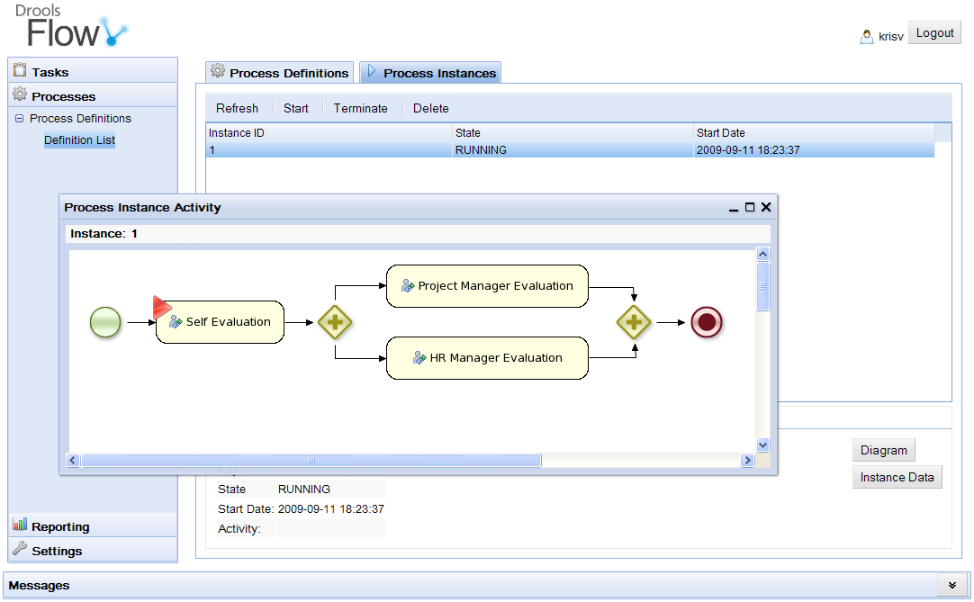
...to BPMS
Persistence
XML
Core
Engine
Trans-
actions
History
Log
BPMN
2.0
Events
Management
Console
BAM

Slide 17
...to BPMS
Persistence
XML
Core
Engine
Trans-
actions
BPMN
2.0
Events
Domain-specific
Processes
Integration
Human Task
Service (WS-HT)
ESB

Slide 18
What is BPM?
Overview jBPM5
Flexible Processes
Cool Stuff

Slide 19

The quality of being adaptable...

Slide 20
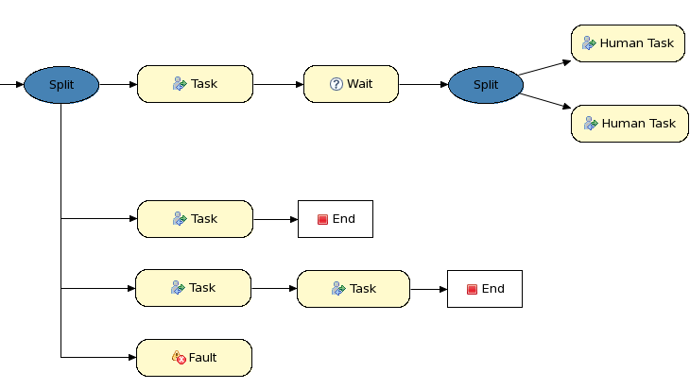
Exceptional Control Flow
90%
5%
3%
2%

Slide 21
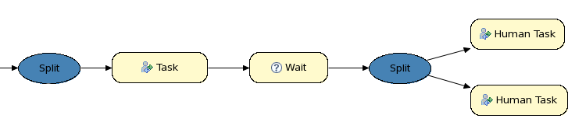
Exceptional Control Flow
90%
Rule1
When
...
Then
...
Rule2
When
...
Then
...
Rule3
When
...
Then
...
5%
3%
2%

Slide 22
Processes + Rules + Events

Slide 23
Combining processes and rules
Integration
  From loose coupling (decision services)
  To advanced integration (process rules)
Unification
  Rules and processes are different types of business knowledge assets
  Tooling (IDE, repository, management)

Slide 24
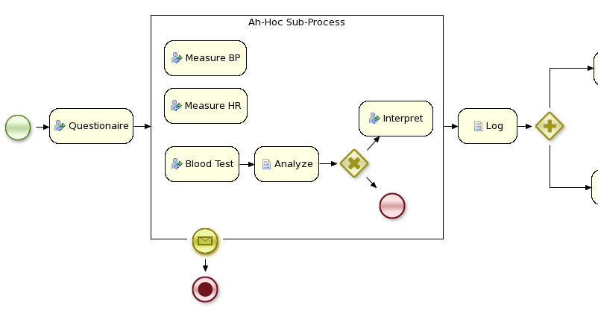
Medical process

Slide 25
What is BPM?
Overview jBPM5
Flexible Processes
Cool Stuff

Slide 26

That's awesome!

Slide 27

Web based artifact management
BRM as knowledge repository
  BPMN2 processes
  Task and process forms
Web designer (Oryx)
Build, deploy, test, manage and collaboration features

Slide 28

Is that possible?

Slide 29

Domain-specific Processes
Extend palette with domain-specific, declarative service nodes
  define input / output parameters
  runtime binding

Slide 30


Service Repository
[
[
"name" : "JavaNode",
"parameters" : [
"class" : new StringDataType(),
"method" : new StringDataType(),
],
"displayName" : "Java Node",
"icon" : "icons/java.gif"
]
]
http://people.redhat.com/kverlaen/repository

Slide 31

jBPM Eclipse Plugin
Import services from repo
Import default handler
Support for local repo (filesystem)
Support for URI repo
At latest update site...

Slide 32

There's
more?

Slide 33

Get your ducks in a row...

Slide 34
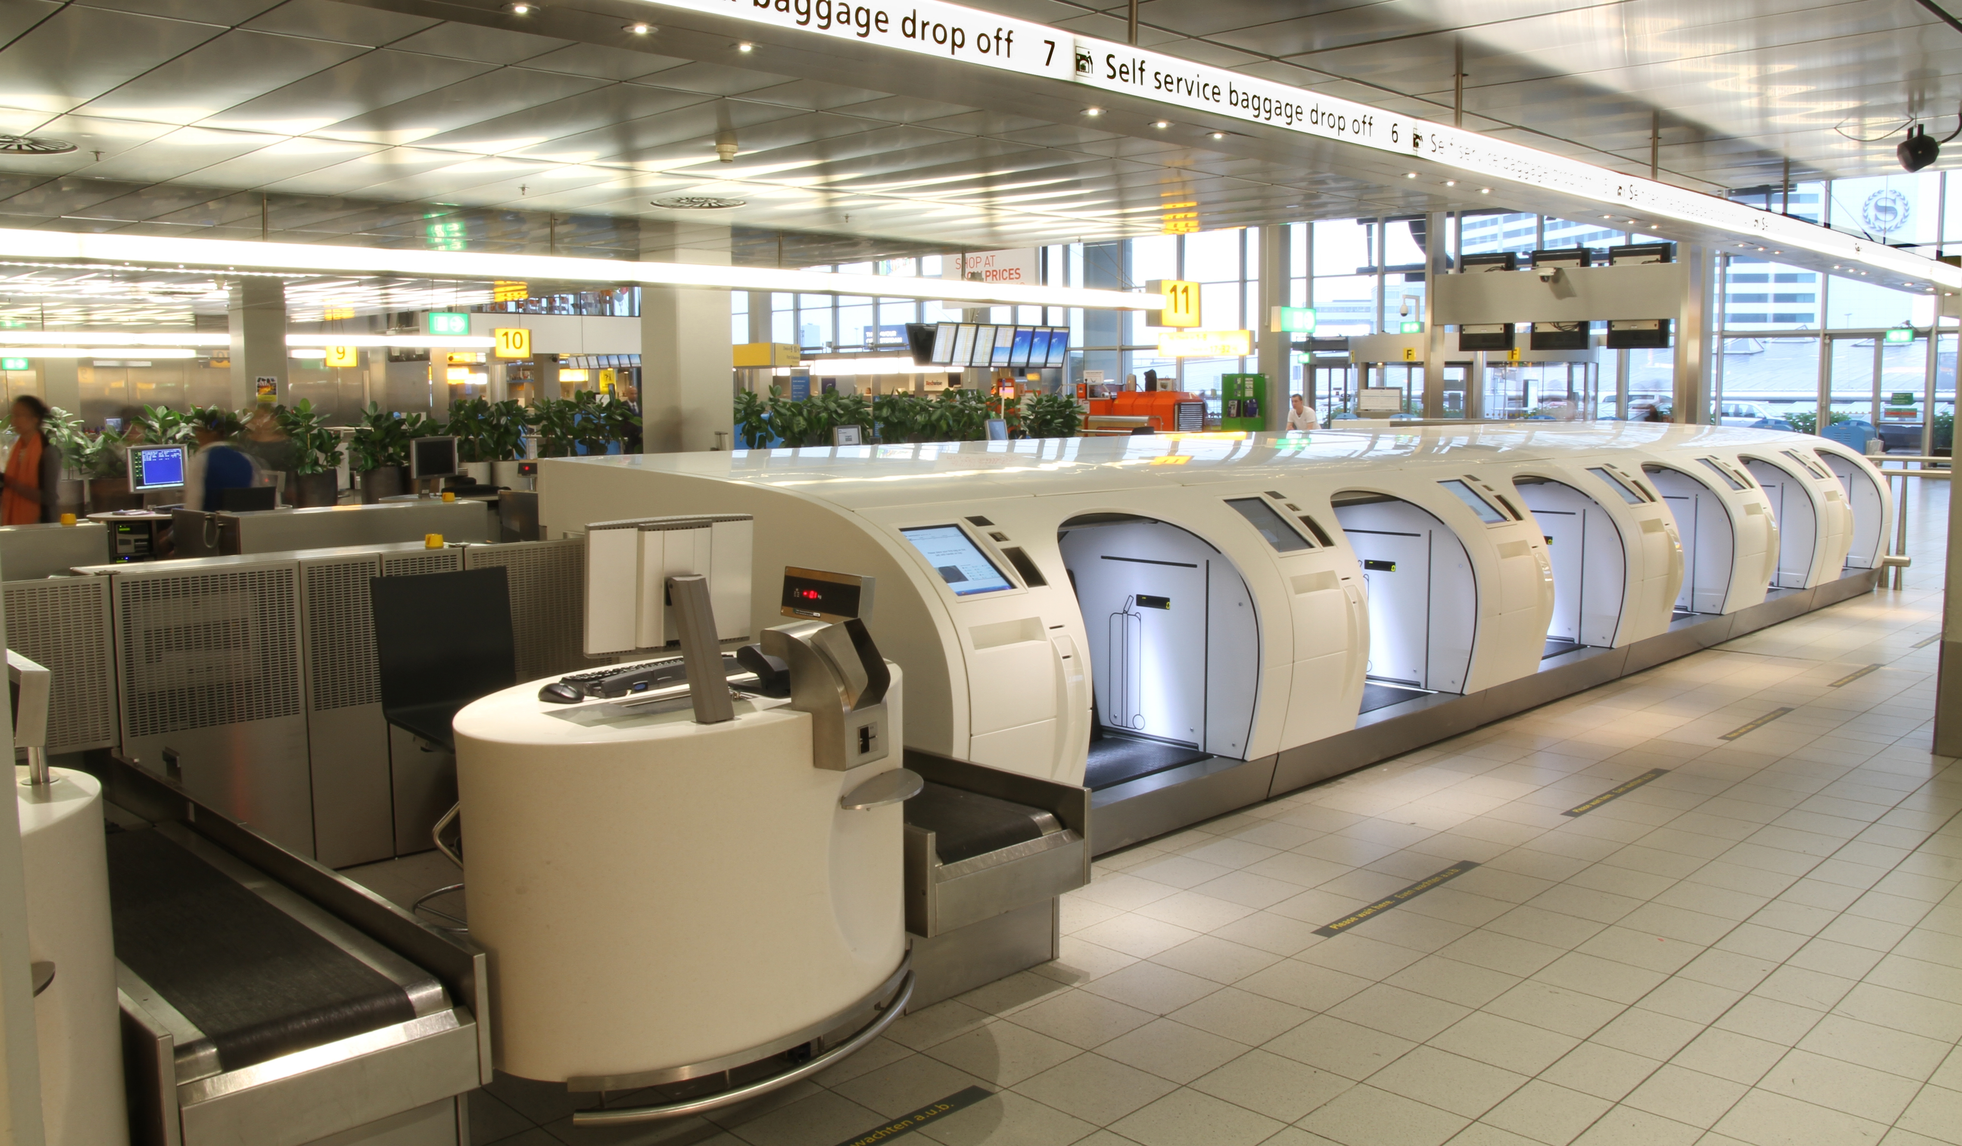
jBPM
everywhere
you can
imagine...

Slide 35

What about us?
jPDL != BPMN

Slide 36


Slide 37


Historical migration...

Slide 38


Slide 39

Full web designer integration!

Slide 40
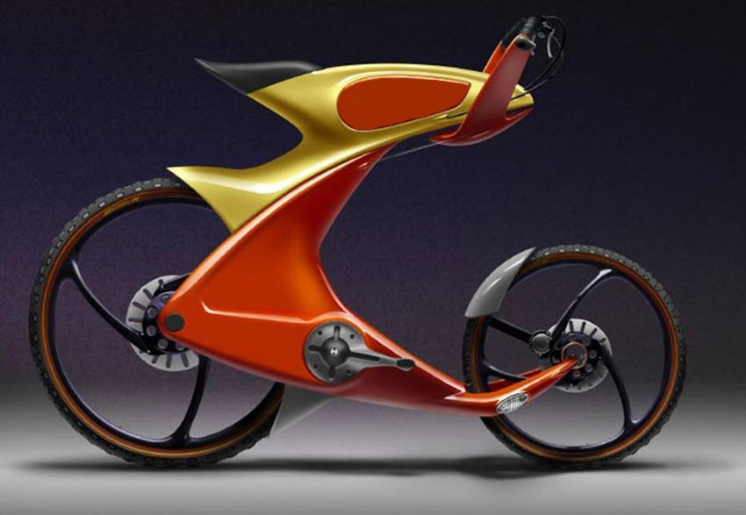
The future is now...
Eric D. Schabell | erics@redhat.com | @ericschabell

Slide 41

jBPM5 community: http://www.jboss.org/jbpm
jBPM5 source: http://github.com/droolsjbpm/jbpm
jBPM5 Hudson: http://hudson.jboss.org/hudson/job/jBPM
Blog: http://kverlaen.blogspot.com
#jbpm on irc.codhaus.org / jbpm-dev@jboss.org
jBPM user forums: http://community.jboss.org/en/jbpm?view=discussions
jBPM migration strategies: http://www.schabell.org/2010/03/jbpm-migration-strategies-introduction.html
Migration tool project: https://github.com/droolsjbpm/jbpmmigration
Migration story JUDCon 2010: http://www.schabell.org/2010/10/judcon-2010-berlin-get-your-bpm-ducks.html
Migration project update JUDCon 2011: http://www.schabell.org/2011/05/judcon-2011-jbpm-migration-tooling-no.html
Eric D. Schabell | erics@redhat.com | @ericschabell

