Slide 1

jBPM in action – past, present and future
Eric D. Schabell
JBoss Solution Architect Benelux
September 2009
TITLE SLIDE: HEADLINE
Presenter name
Title, Red Hat
Date

Slide 2

Agenda
jBPM v3.x in the field (past - present)
  limitations in the field
  results (implementation)
New directions with jBPM v4.x (future)
  API nightmares resolved
  console improvements
  BPMN editor (Signavio)
  BPEL wars
Migrations

Slide 3
Who am I?
American / Dutch (2007)
  NL since 1992
  Studies – Vrije Universiteit (VU) AMS
  Work:
    building sw for 13 yrs
    Pascale, Module2, C/C++, PHP, Ruby, Perl, PL/1, and Java
    teaching: university, freelance, IBM, and GLS
    last job: 2+ years jBPM + financial JEE
    jBPM Tech Lead
      9+ products in NL market
      4 large enterprise projects + GPS project now!

Slide 4
Agenda
jBPM v3.x in the field (past - present)
  limitations in the field
  results (implementation)
New directions with jBPM v4.x (future)
  API nightmares resolved
  console improvements
  BPMN editor (Signavio)
  BPEL wars
Migrations

Slide 5
Limitations
no ESB's
no integrated Rules Engine
most major backend systems fail to support:
  transactionality
  events
  asynchronicity

Slide 6
Real world architecture
Rules
Engine
System
Front
Office
Apps
S
O
A
L
DB
System
.
.
.
.
.
.
Process
Engine
System

Slide 7
Ways of working (I)
Nodes used
  Node
    for all automated tasks
    contained all business logic
  Decision
  Task
Synchronous execution
  single thread for entire process (no persistence until a task)

Slide 8
Ways of working (II)
Synchronous process scheduler
  start list of proc's one after another
Single jBPM process engine
Exception handling
  via one top-level jBPM exception handler
  passing problem proc to Dropout App (jump to node)
Hibernate configured to auto-commit

Slide 9
Exceptions?
public class BackendExceptionHandler implements ActionHandler {
public void execute(ExecutionContext context) throws Exception {
Token token = context.getProcessInstance().getRootToken();
String originatingNode = token.getNode().getName();
if (!BackendExceptionHandler.BACKENDERROR_REDIRECTING_NODE.equals(originatingNode)) {
ExecutionContextHelper.setVariable(context, BACKENDERROR_DROPOUT_NODE,
token.getNode().getName());
}
token.setNode(context.getProcessDefinition().getNode(BACKENDERROR_NODE_NAME));
token.signal();
throw new Exception("Functional error on back end.");
}
}

Slide 10
Hibernate?
public class SaveProcessInstanceHandler implements ActionHandler {
public void execute(ExecutionContext context) throws Exception {
context.getJbpmContext().getConnection().setAutoCommit(false);
context.getJbpmContext().getConnection().commit();
context.getJbpmContext().getConnection().setAutoCommit(true);
// Do something with context and changes will be saved, this call results
// in an empty list Remark: not every call to context will result in a DB update.
// This one does...
context.getJbpmContext().getTaskList();
[further processing...]
}
}

Slide 11
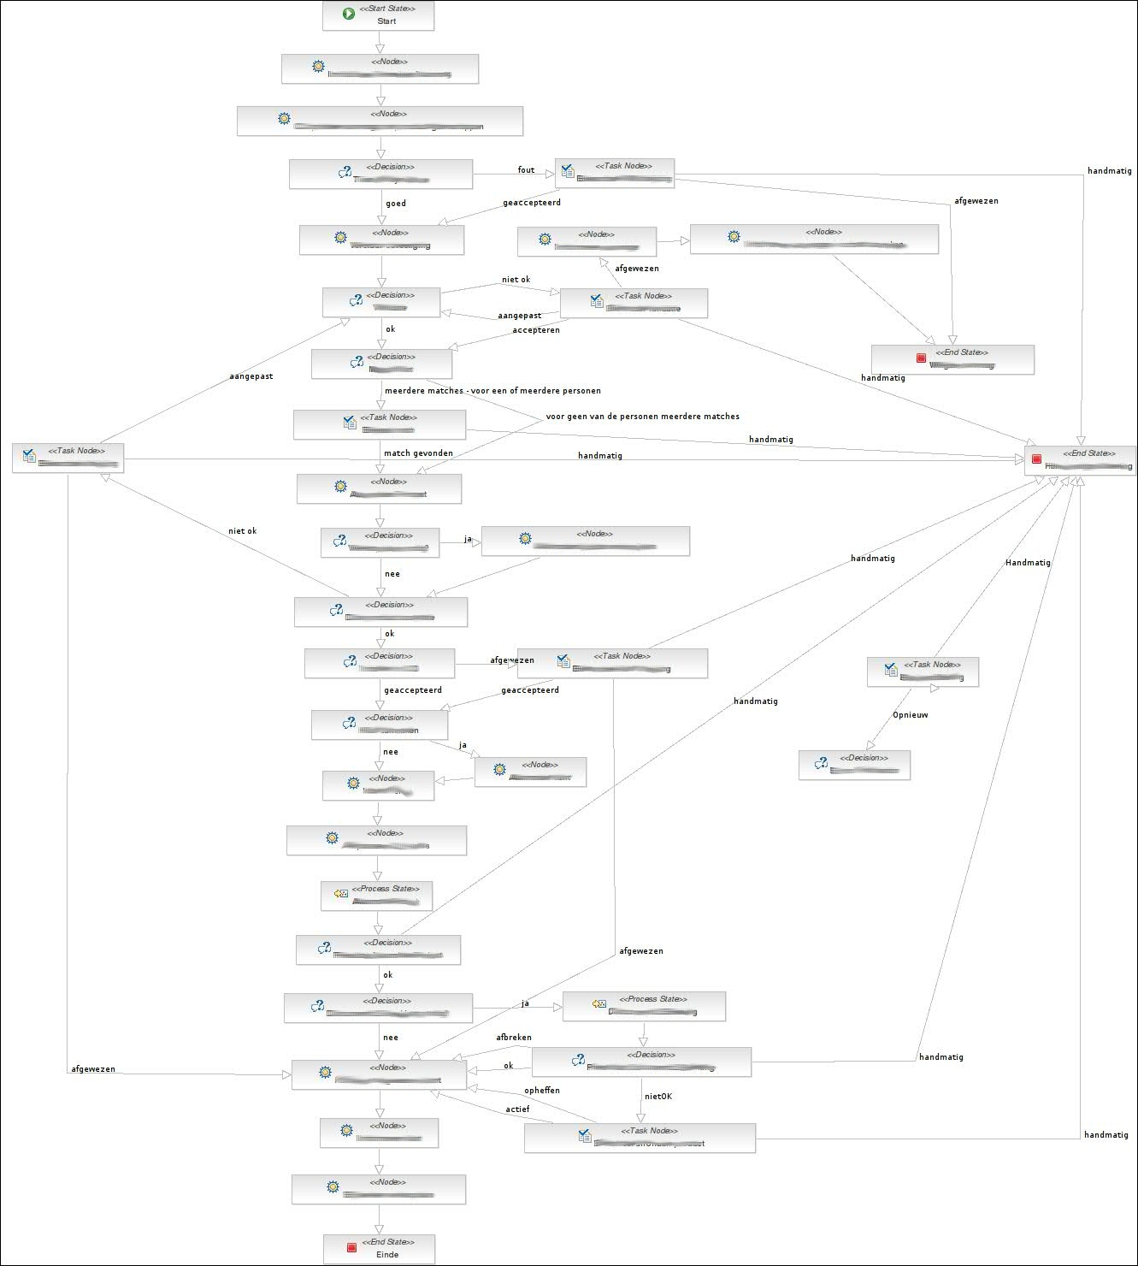

Slide 12
Best practices?
Use State nodes
Use process-states
Create par repository
State-proxy?
Process creation just like good OO programming:
  reuse == par repo
  methods == sub-flows + context
  encapsulate == sub-flows
  unit testing == per node, sub-flow, flow

Slide 13
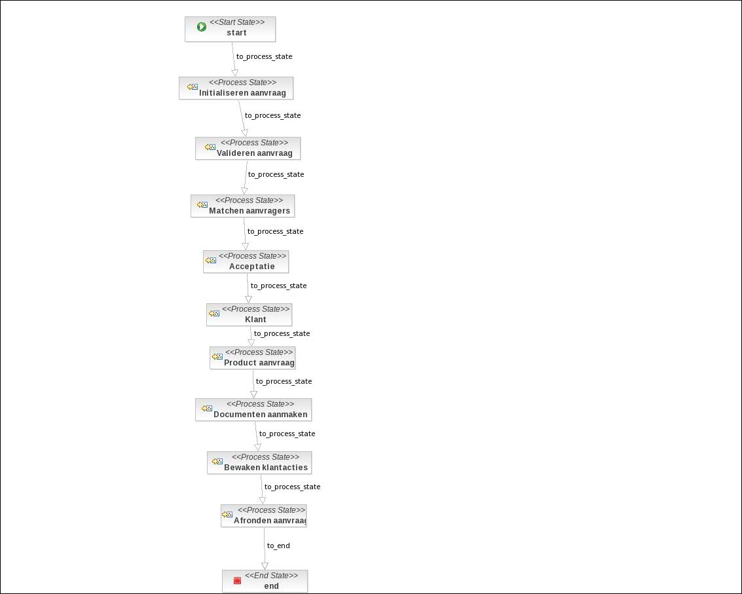

Slide 14
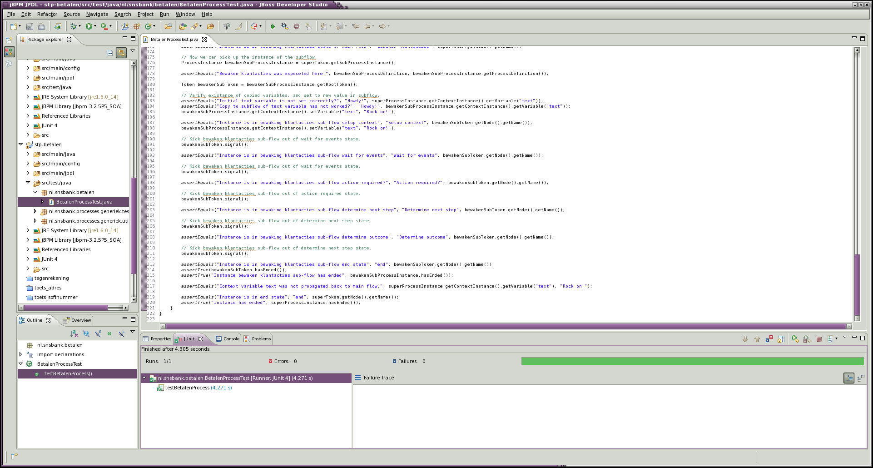

Slide 15
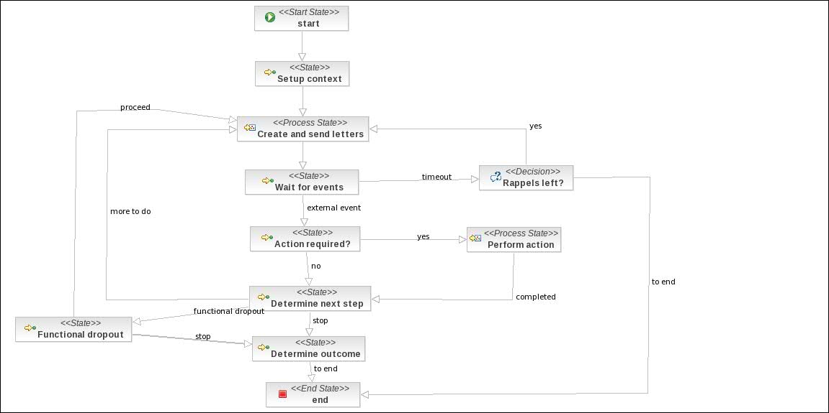

Slide 16
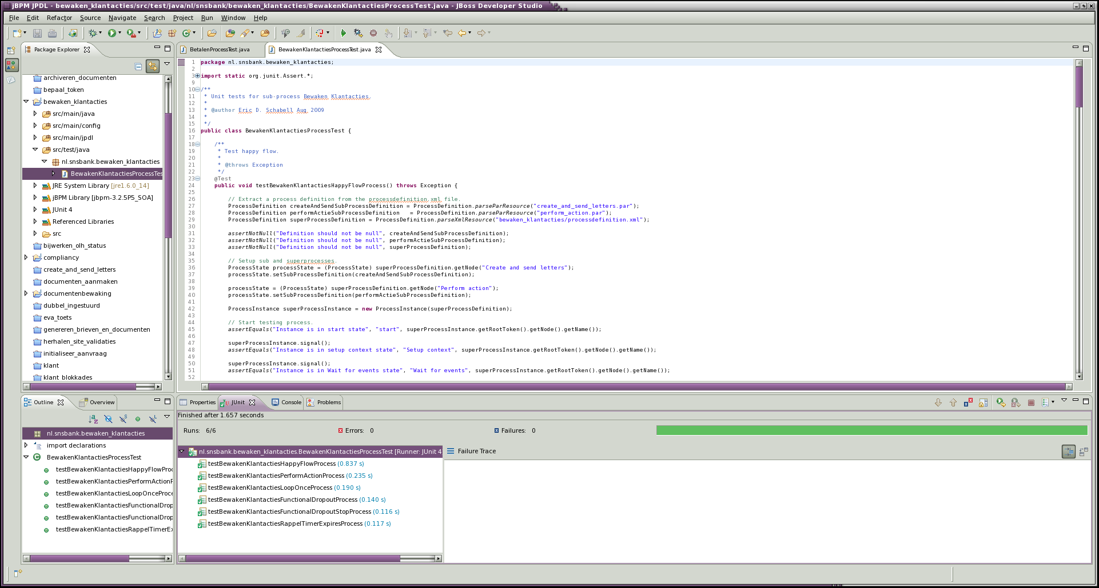

Slide 17
Agenda
Introduction
From the jBPM v3.x Trenches
  limitations in the field
  results (implementation)
New directions with jBPM v4.x
  API nightmares resolved
  console improvements
  BPMN editor (Signavio)
  BPEL wars
Migrations

Slide 18

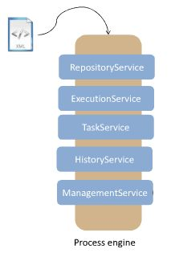
API nightmares resolved
API nightmares resolved
  v3.x has ~63 API's
  massive learning curve
  leads to 'best(intention) practices'
Simplicity
  5 service interfaces
  v4.x has 10 API's

Slide 19
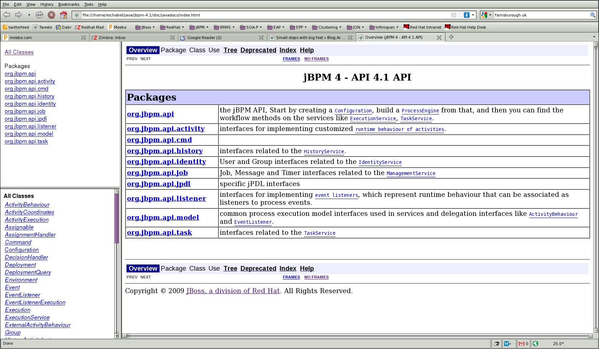
jBPM v4.x API

Slide 20
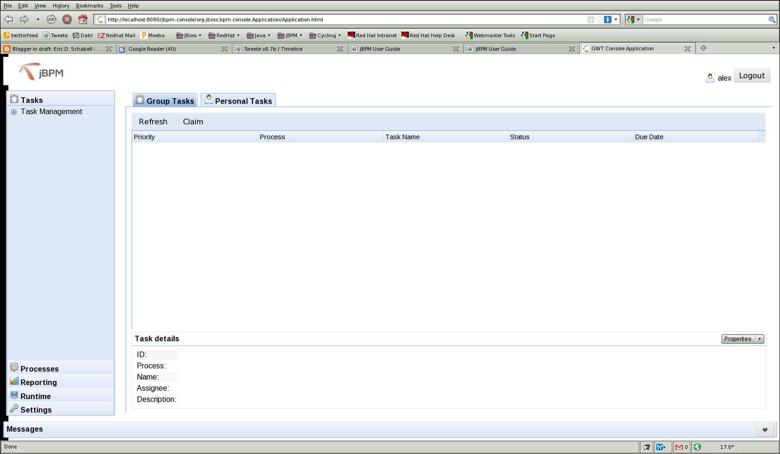
Console improvements

Slide 21
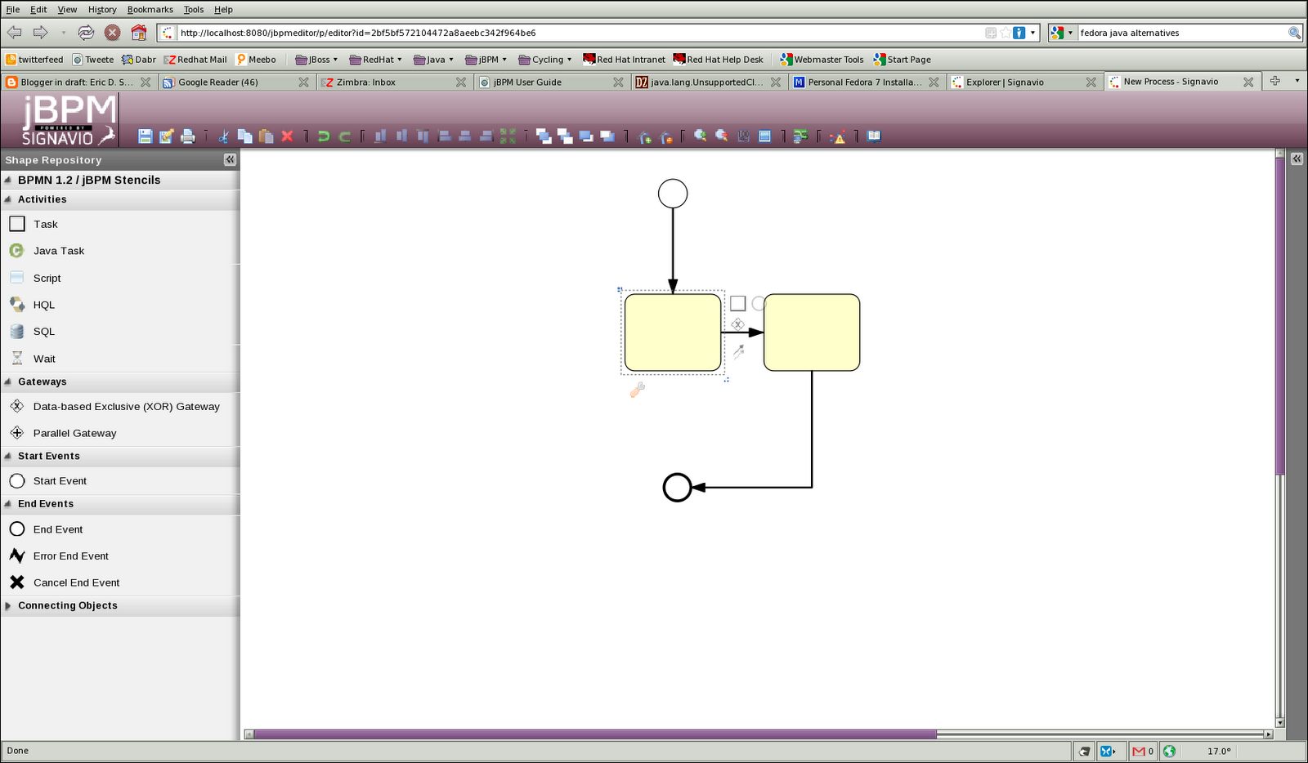
BPMN editor (Signavio)

Slide 22
BPEL wars
Burr Sutter discussions
  RiftSaw (project) ==> ???
  Drools (project) ==> BRMS (product)
  jBPM (project) ==> SOA-P (product)
Furture ~= no stand-alone subscriptions
  BRMS
  jBPM

Slide 23
Agenda
Introduction
From the jBPM v3.x Trenches
  limitations in the field
  results (implementation)
New directions with jBPM v4.x
  API nightmares resolved
  console improvements
  BPMN editor (Signavio)
  BPEL wars
Migrations

Slide 24
Migrations (part I)
jBPM v3.1 ==> jBPM v3.2 == very hard
  db mapping: schemaspy http://schemaspy.sourceforge.net/
  running instances
    migrate? how? leave v3.1 running for live instances?
jBPM v3.2.x ==> jBPM v3.2.x == most likely ok
  db mapping: changlogs or schemaspy http://schemaspy.sourceforge.net/
  running instances (see above strategies)

Slide 25
Migrations (part II)
jBPM v3.x ==> jBPM v4.x == massive problems
  looks like a job for Super Man (GPS)!
  no community support / history (yet).
  no way to migrate running instances from v3.x
  massive schema changes
jBPM v4.x ==> jBPM v4.x
  automated via tooling!

Slide 26


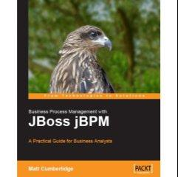
Reading list
“The Process Virtual Machine”, T. Baeyens, M. Valdes Faura, 2008. http://docs.jboss.com/jbpm/pvm/article/
“7 Forms of Business Process Management with JBoss jBPM”, T. Baeyens, 2008. http://java.dzone.com/articles/seven-forms-business-process-m
“Empowering Full Scale Straight Through Processing with BPM”, E. Schabell, S. Hoppenbrouwers, Advances in Enterprise Engineering II, Springer, pp. 18-33.2009. http://www.schabell.org/2009/02/caise09-pret-chapter-submitted.html
“Financial Crisis Front Line: SNS Bank”, E. Schabell, S. Hoppenbrouwers, 2009 BPM & Workflow Handbook, ISBN 0-9777527-9-8, pp. 161-172, 2009. http://www.schabell.org/2009/04/2009-bpm-workflow-handbook-financial.html

