Slide 1
Show Me the Money: Predicting Yearly Airbnb Revenue
Ethan Schein

Slide 2
Background
Airbnb is a popular home-sharing platform enabling people all over the world to share their unique accommodations.
For potential hosts, this could be a profitable option for their empty vacation homes or spare rooms
However, it is difficult for new hosts to know how much they could earn, and particularly, what is the true value of their swanky AdMo penthouse.

Slide 3
Data Used:
InsideAirbnb’s ‘listings’ dataset - Boston
how many nights a dwelling is rented per year
minimum nights stay
whether the host is present
how many rooms are being rented in a building
the number of occupants allowed in a rental
whether the listing is licensed
Rentcafe/Yardi Matrix average household rental cost data
Average rental unit cost per month - neighborhood basis
https://www.rentcafe.com/average-rent-market-trends/us/ma/boston/
http://insideairbnb.com
Notes:
The data utilizes public information compiled from the Airbnb web-site including the availability calendar for 365 days in the future, and the reviews for each listing. Data is verified, cleansed, analyzed and aggregated.

Slide 4
Defining Our Target Variable:
Y = (price + cleaning fee) * average length of stay * (number of reviews/month * review rate) * 12
Average length of stay = 3 nights (https://www.airbnbaction.com)
Review Rate = 0.5 (http://insideairbnb.com/about.html)

Slide 5
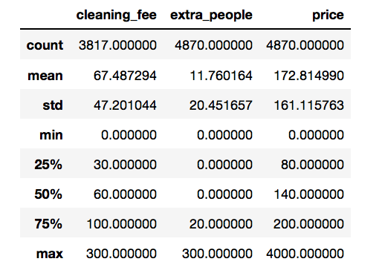
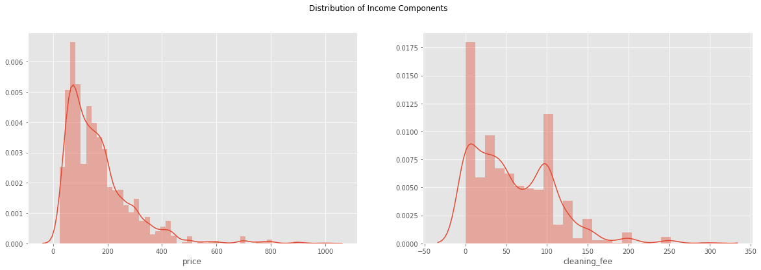
EDA

Slide 6
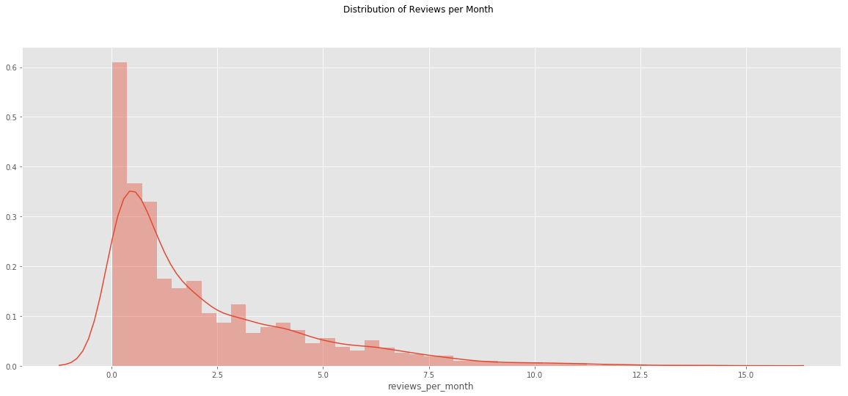

Slide 7
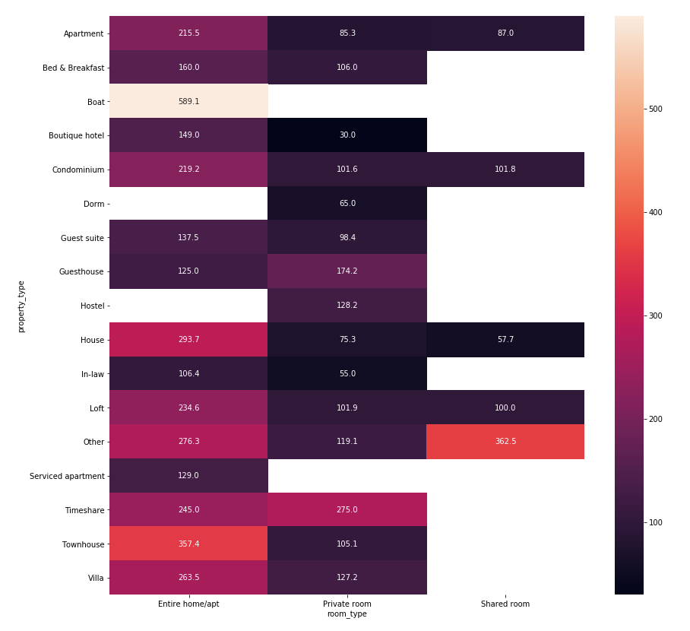
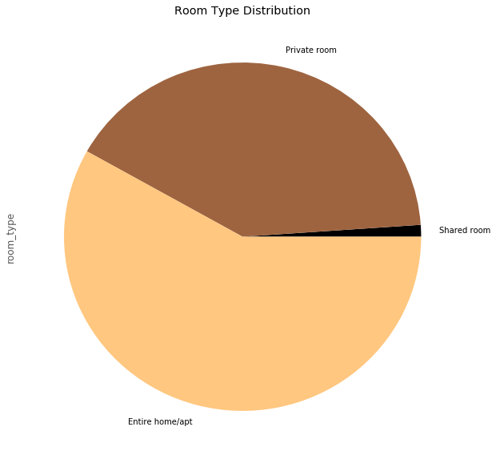

Slide 8
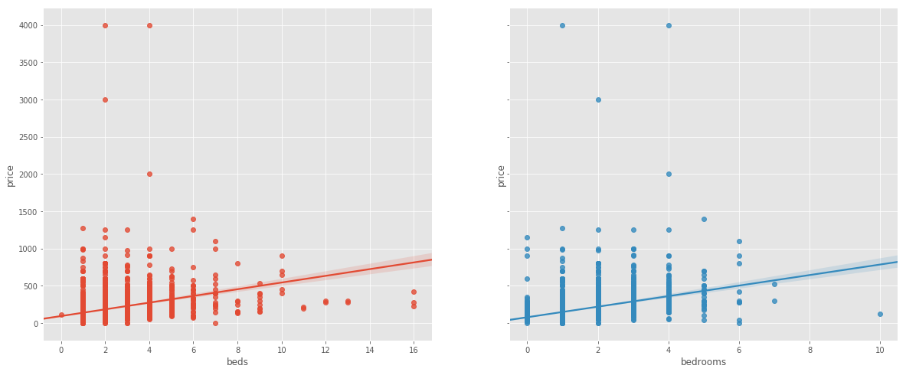

Slide 9
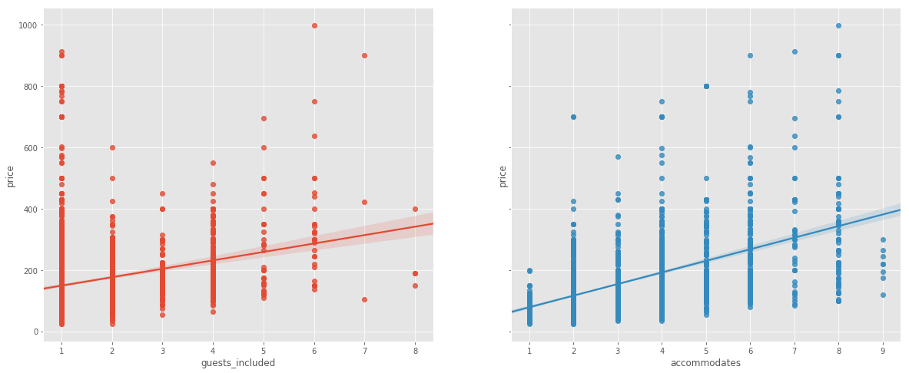

Slide 10
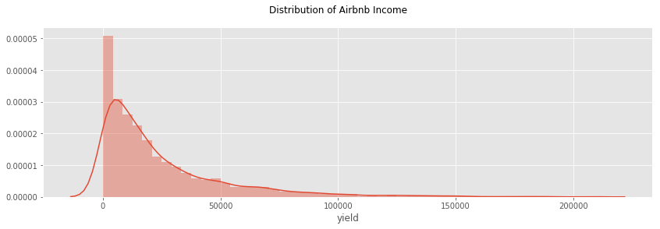
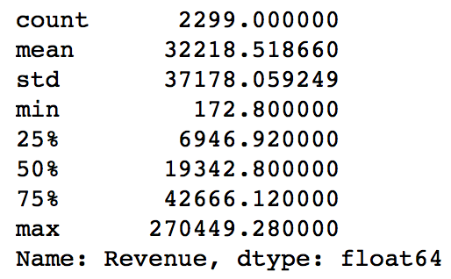

Slide 11
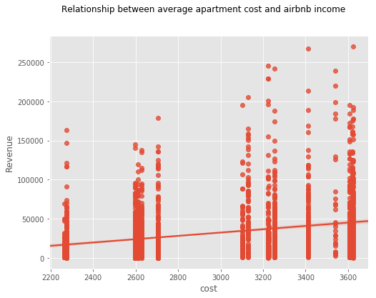

Slide 12
Features:
X= ['Apartment', 'Condominium', 'House', 'accommodates', 'bathrooms', 'bedrooms',
'beds', 'guests_included',
'minimum_nights', 'availability_365',
'Private room',
'Shared room', 't','Allston-Brighton', 'Back Bay', 'Beacon Hill',
'Charlestown', 'Chinatown', 'Downtown Crossing',
'East Boston', 'Fenway/Kenmore', 'Financial District', 'Jamaica Plain',
'Mattapan', 'Mission Hill', 'North End', 'Roslindale', 'Roxbury',
'South Boston', 'South End', 'West End','extra_people', 'cost']

Slide 13
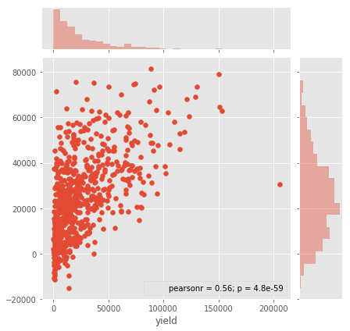
Model 1:
Linear Regression
70/30 test/train split
R2: .34
MSE: 895173520.29
(CV 10 folds:
Mean MSE 928494002
Mean R2: .35)

Slide 14
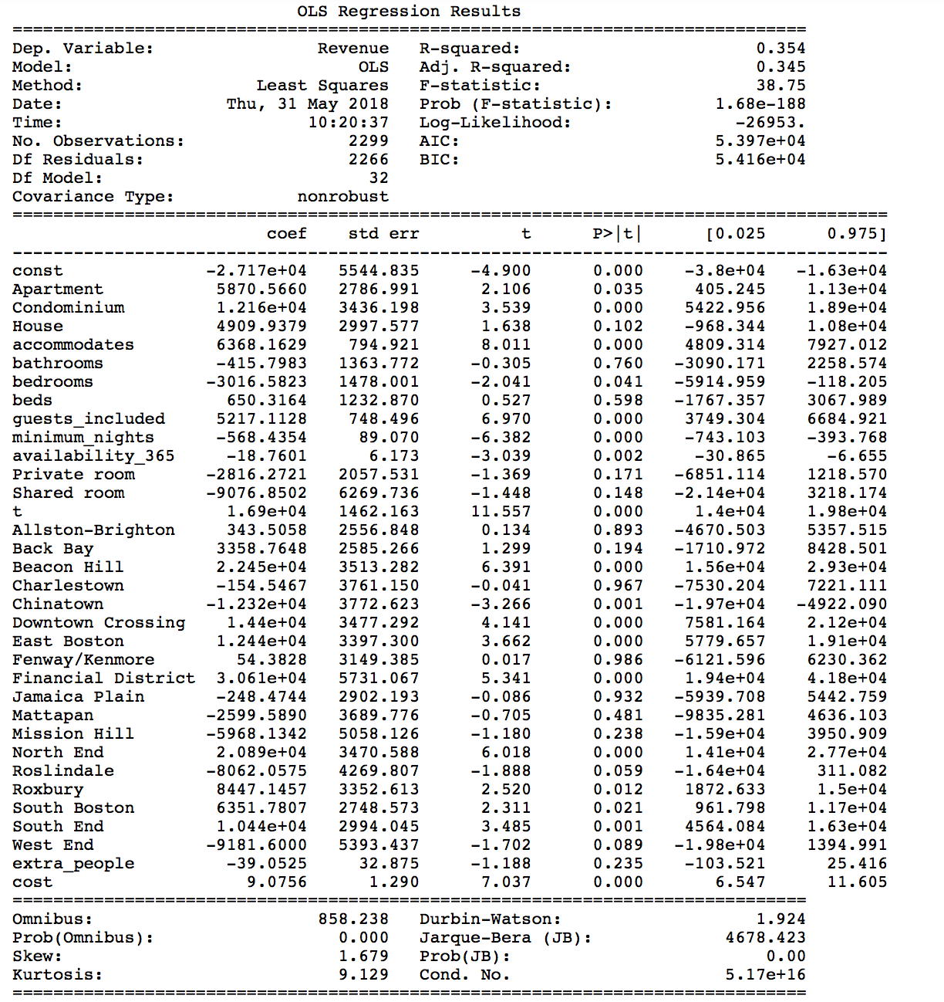

Slide 15
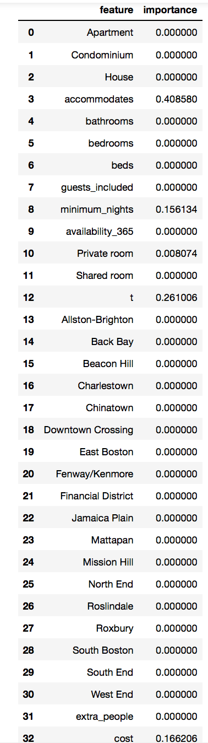
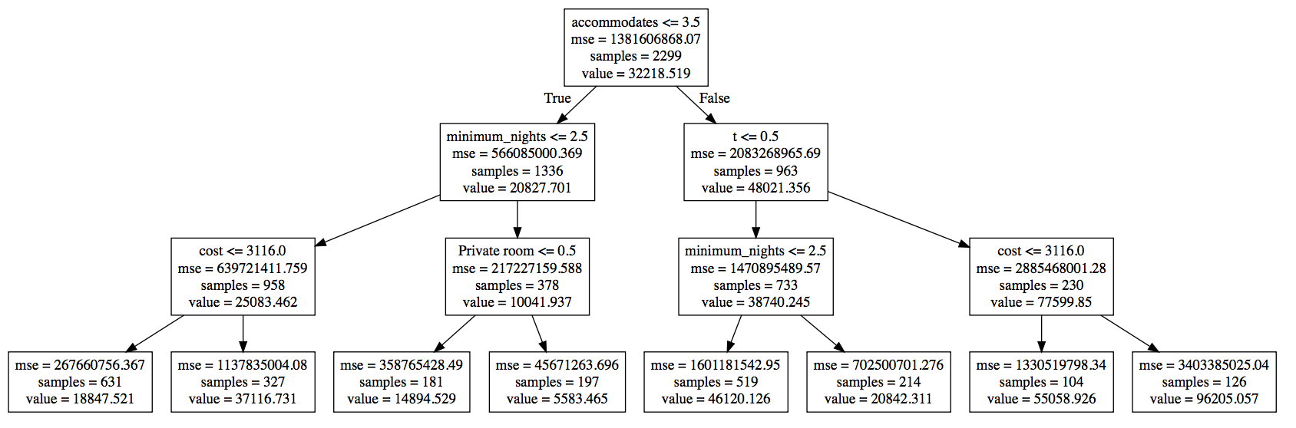
Model 2: Decision Tree
depth = 3
R2: .31; MSE:841864684

Slide 16
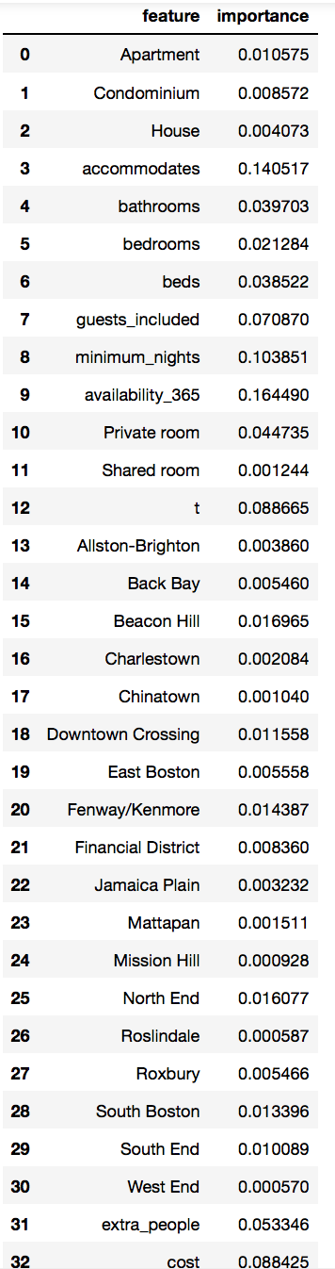
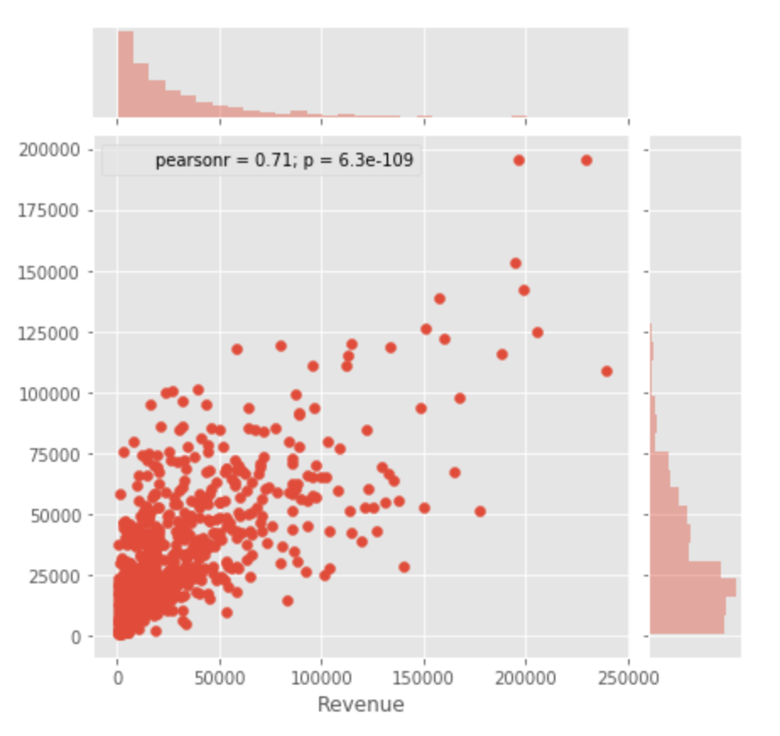
Model 3:
Random Forest
MSE: 674272775
R2: .5

Slide 17
